Slide 1

Power BI Workshop

Slide 2





About Me
Kristy Wedel
Sr Manager, Data Scientist – Abbott

Slide 3
agenda
Loading and transforming data with Power Query
Joining data
Measures vs Calculated Columns
Creating measures in DAX
Designing a report
Customizing visuals
Publishing to a workspace
Bookmarks and exporting to PowerPoint
Dashboards and Alerts
Files: https://github.com/kristywedel/LegoData

Slide 4
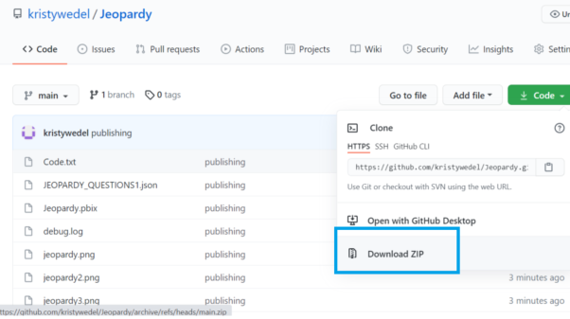
files
Files: https://github.com/kristywedel/LegoData

Slide 5
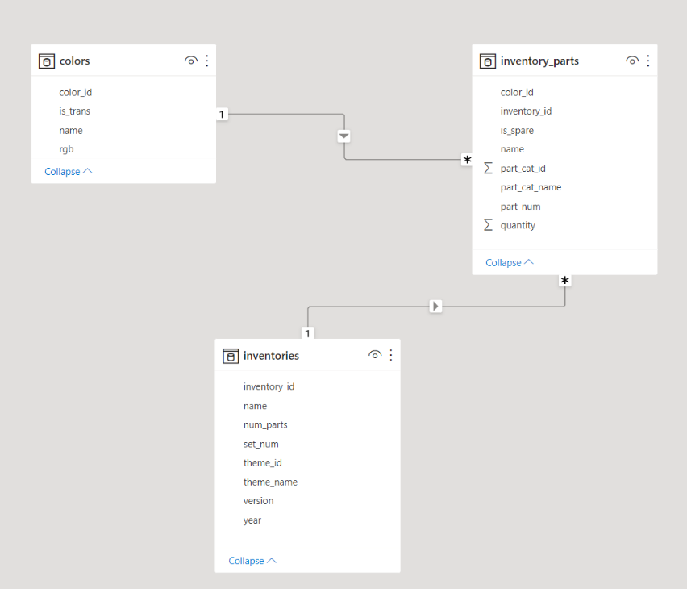
Data

Slide 6
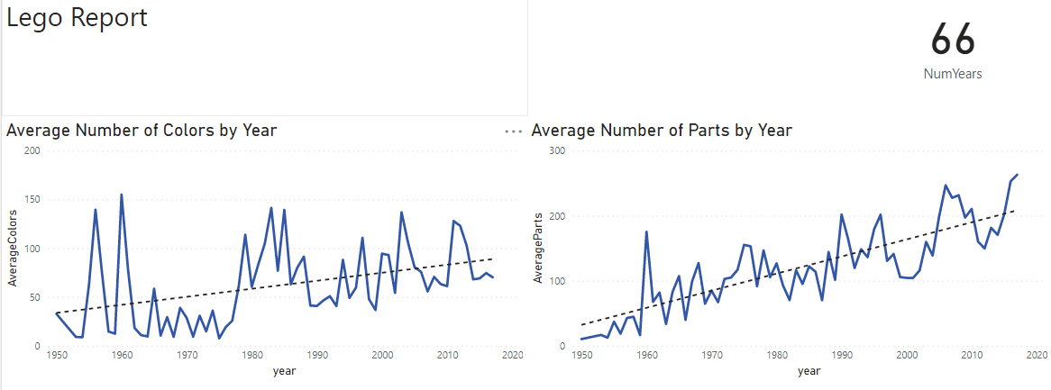
Report

