Slide 1

Power BI Workshop

Slide 2
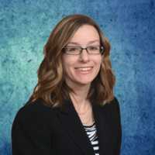




About Me
Kristy Wedel
Sr Manager, Data Scientist – Abbott
Notes:
I am a senior manager data scientist at Abbott Nutrition in columbus. In my current role, my team sits between the sales and marketing teams. I’m also an analyst for the WIA team, and an instructor for cognitir and alignAI. I’m currently helping to build out a data storytelling course.

Slide 3
agenda
Loading and transforming data with Power Query
Joining data
Measures vs Calculated Columns
Creating measures in DAX
Designing a report
Customizing visuals
Publishing to a workspace
Bookmarks and exporting to PowerPoint
Dashboards and Alerts
Files: https://github.com/kristywedel/LegoData
Notes:
Today we’re going to be working with Lego data from Lego sets

Slide 4
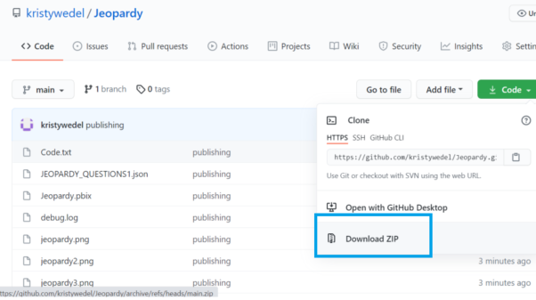
files
Files: https://github.com/kristywedel/LegoData

Slide 5
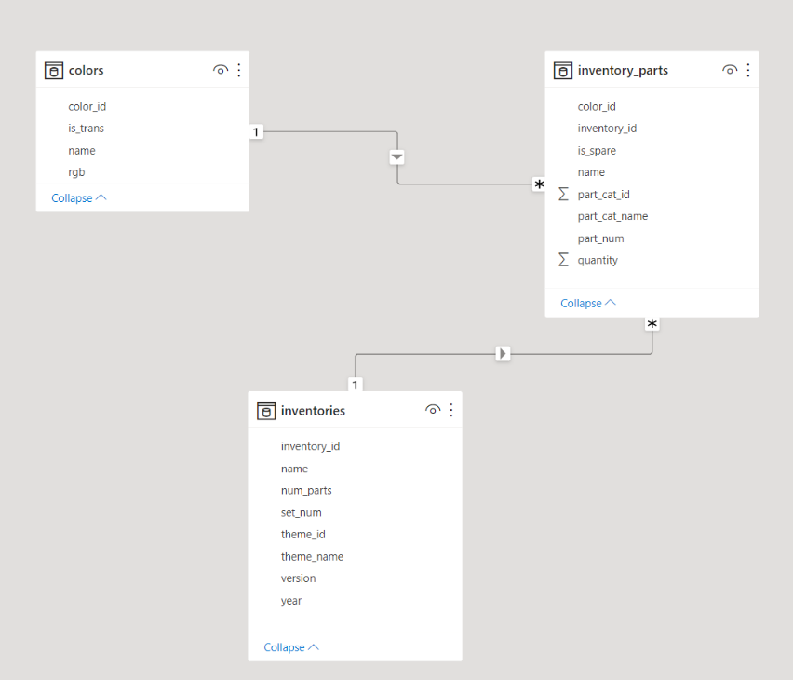
Data
Notes:
The data we’ll be working with in this demo is about Lego sets. includes things like the blocks in the set, the color of these blocks, whether the block is translucent, and the year the set was created.

Slide 6
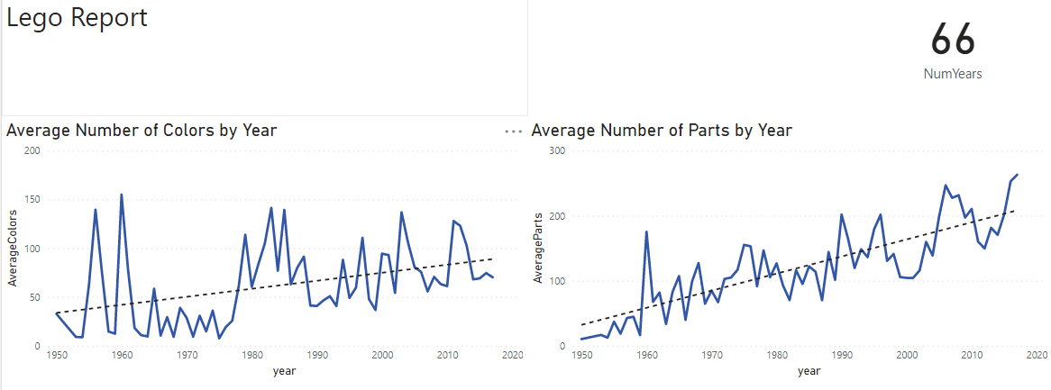
Report
Notes:
This is the completed report.

