Slide 1
News Text Classification
with CNN and LSTM
MDS
217012018 LI ZHAO
218012007 DONG SI
218012045 XU YINGNAN

Slide 2
CONTENTS
PART ONE
MOTIVATION
PART TWO
DATASET
PART THREE
MODELS
PART FOUR
HYPERPARAMETER
TUNING
PART FIVE
RESULTS

Slide 3
PART ONE
MOTIVATION

Slide 4
part one motivation
goal
The main goal is to classify news articles based on multiple news topics. The input to our models are text bodies of articles from various news publishers, applying pre-trained word embeddings(GloVe).
implication
Digital journalism has increased the accessibility to news articles drastically. The sheer amount of information is a critical challenge for readers. Our project will increase the accuracy of text classification task. By automatically identifying the category bias of an article, the recommendation engine for users can be improved.

Slide 5
PART TWO
DATASET

Slide 6
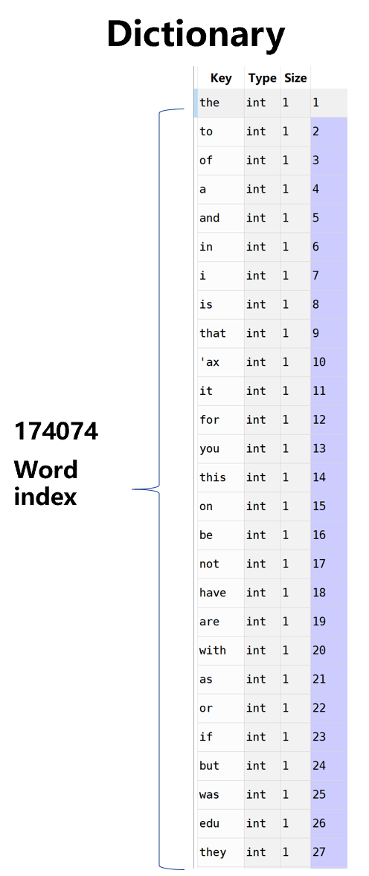
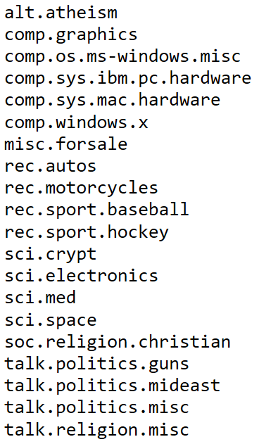
part two dataset
Dataset 20 news group
Label The 20000 news articles are labeled with 20 categories.
Data preprocessing
1. Read 20000 news texts with 20-category labels.
2. Build a dictionary based on the news dataset.
*Token is based on word frequency.

Slide 7
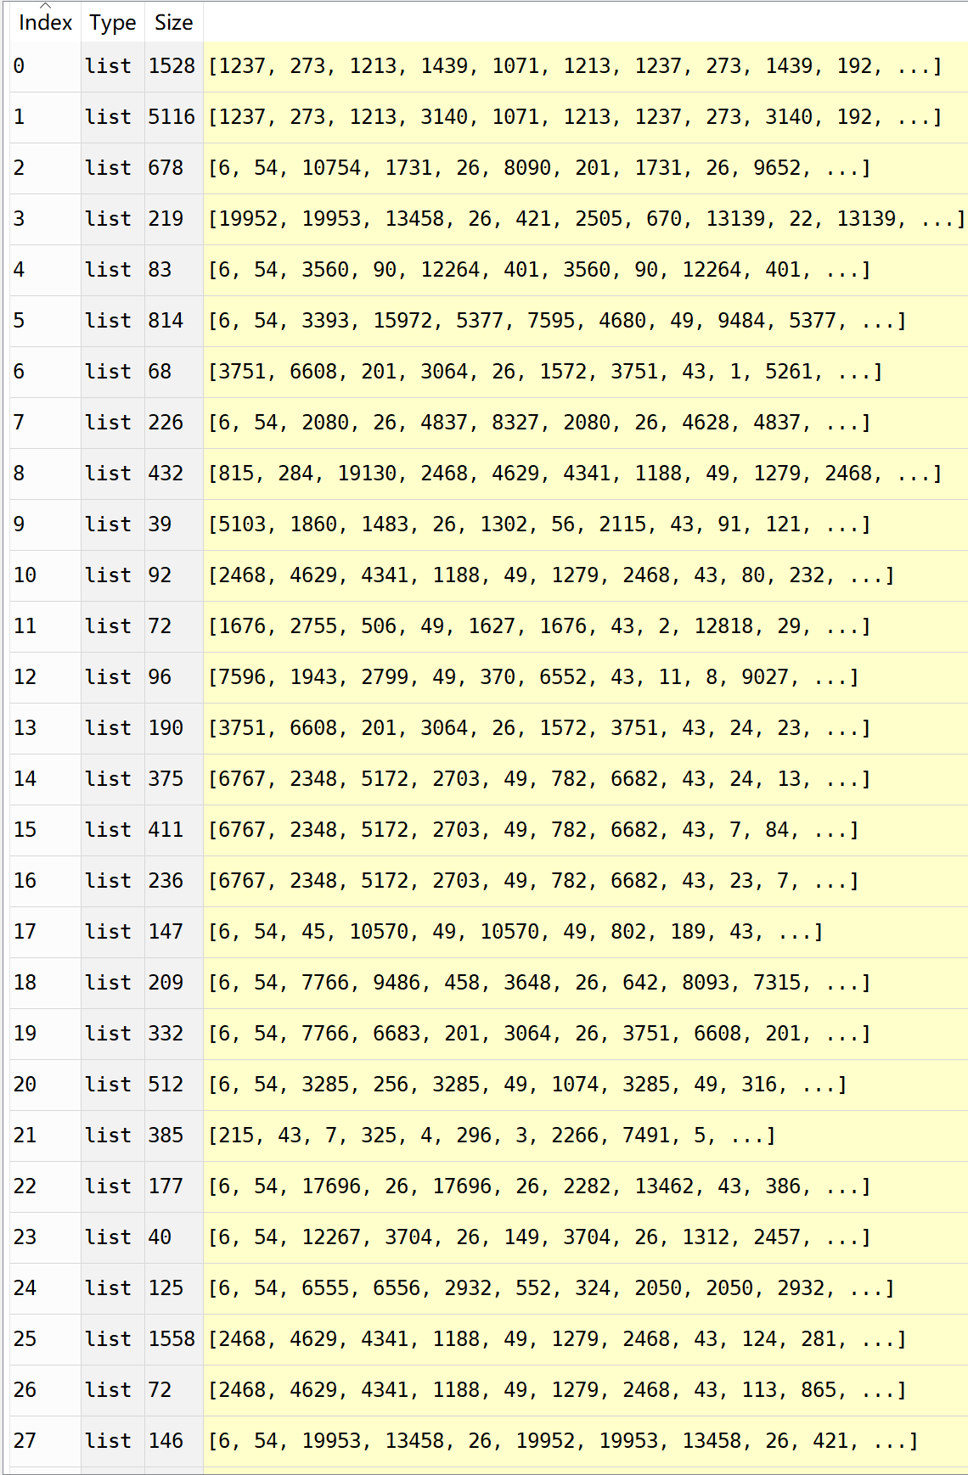
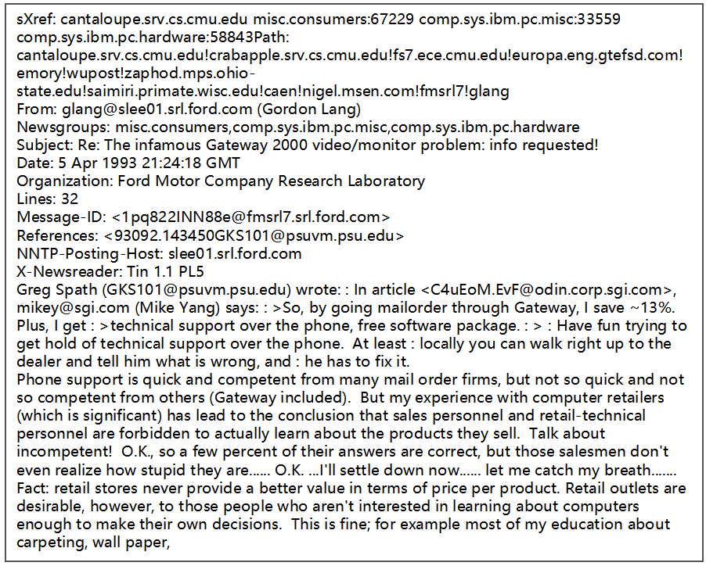
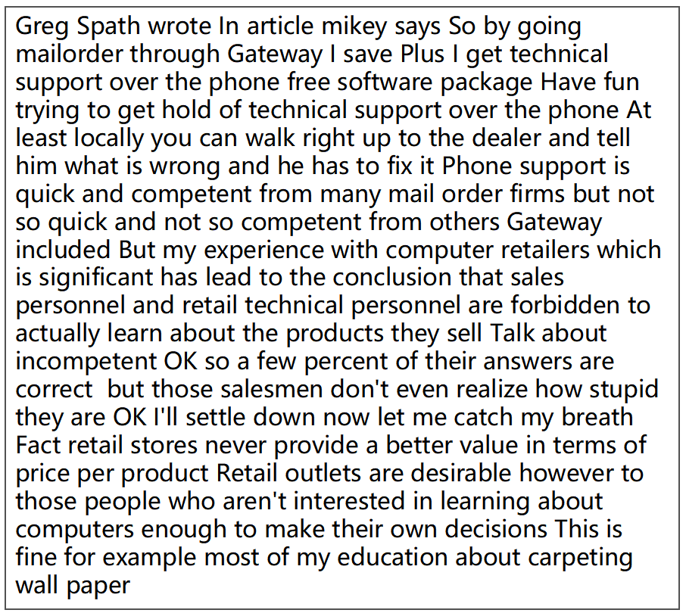
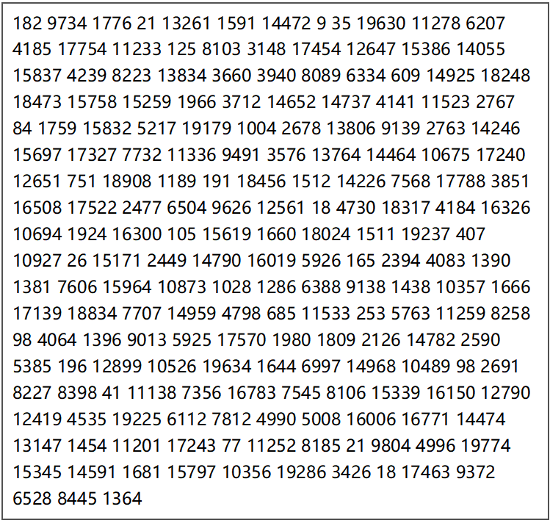
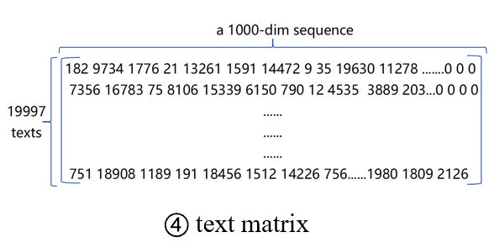
part two dataset
3. Tokenization
① an original news text
② cleaning and tokenizing
③ indexing
① This is an original news text.
② All punctuation,tabs and line breaks is removed,turning the texts into space-separated sequences of words (words maybe include the ' character). Only top 20,000 words based on dictionary are left.
③ These sequences(word) are then split into lists of tokens. They will then be indexed or vectorized.
④This is the texts matrix(called “data” in the code). Pads sequences to 1000-token length.Sequences that are shorter than num_timesteps are padded with value 0 at the end; sequences longer than num_timesteps are truncated.

Slide 8
part two dataset
4. Labels are vectorized by one-hot code. Converts a class integers to binary class matrix (20000*20dim) as follows.
0 0 0 0 0 0 1 0 0 0 0 0 0 0 0 0 0 0 0 0
0 0 1 0 0 0 0 0 0 0 0 0 0 0 0 0 0 0 0 0
...
...
0 0 0 0 0 0 0 0 0 0 0 0 0 0 0 0 1 0 0 0
label_id: 7
(0-19)
0 0 0 0 0 0 1 0 0 0 0 0 0 0 0 0 0 0 0 0
a text : alt.atheism
1*20 dim
20000*20 dim
5. Load pre-trained word embeddings into an Embedding layer.
(1)Search word in GloVe and put it into matched location of embedding matrix. The index is top 20,000 words and tokens in the dictionary.Words not found in embedding index will be all-zero vectors.
(2)We set 'trainable = False' so as to keep the embeddings fixed and turns positive integers (indexes) into dense vectors of fixed size.
GloVe
dictionary
embedding matrix
1
2
3
...
and
firms
tech
...
-0.1529 -0.24279 .... 0.16996
0.53516 0.48784 .... -0.17982
-1.3581 0.42541 .... 0.24215
...
1
2
...
20000
Now
finance
...
tech
0.64846 -0.0932 ... -0.1778
-0.3239 0.51868 ... 0.34381
...
-1.3581 0.42541 .... 0.24215

Slide 9
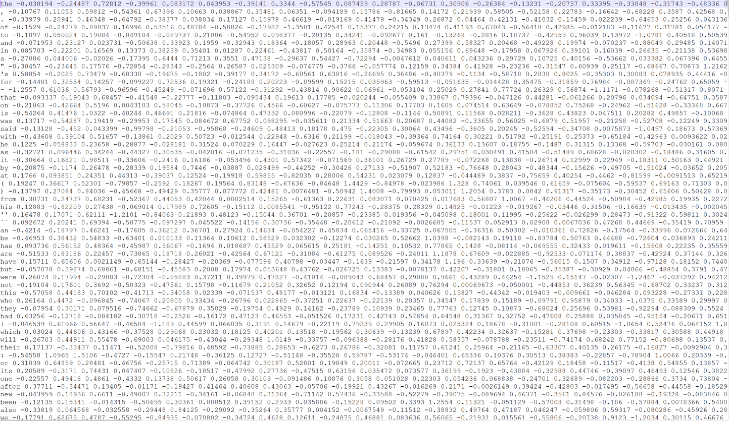
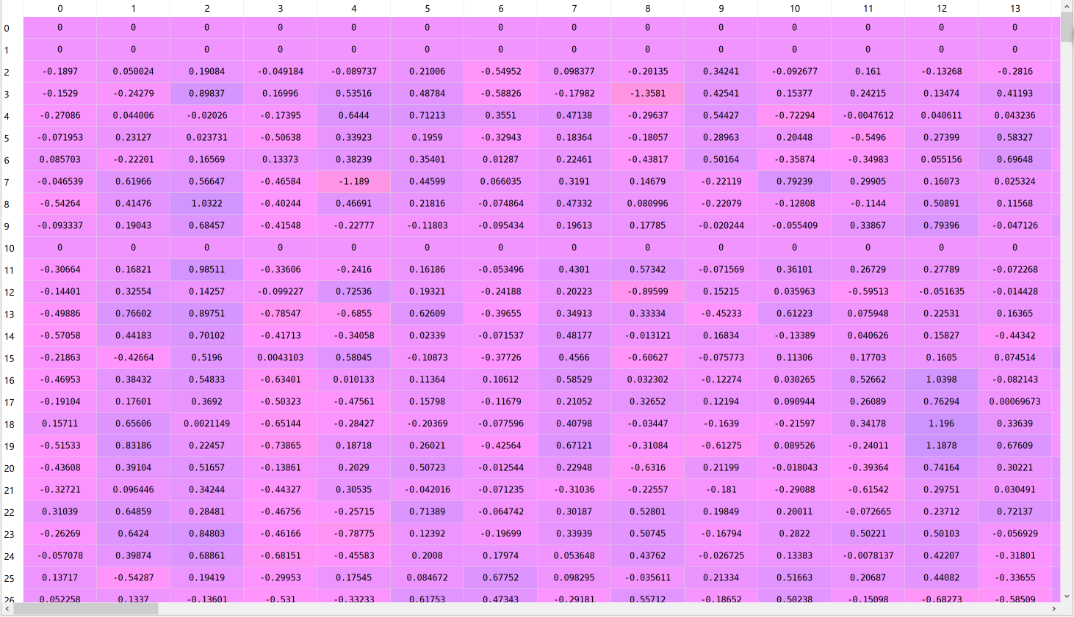
part two dataset
GloVe
dictionary
embedding matrix
1
2
3
...
and
firms
tech
...
-0.1529 -0.24279 .... 0.16996
0.53516 0.48784 .... -0.17982
-1.3581 0.42541 .... 0.24215
...
1
2
...
20000
Now
finance
...
tech
0.64846 -0.0932 ... -0.1778
-0.3239 0.51868 ... 0.34381
...
-1.3581 0.42541 .... 0.24215
6. Modify a sequence in-place by shuffling its contents. Split the data into a training set and a validation set (0.2).

Slide 10
PART THREE
MODELS

Slide 11
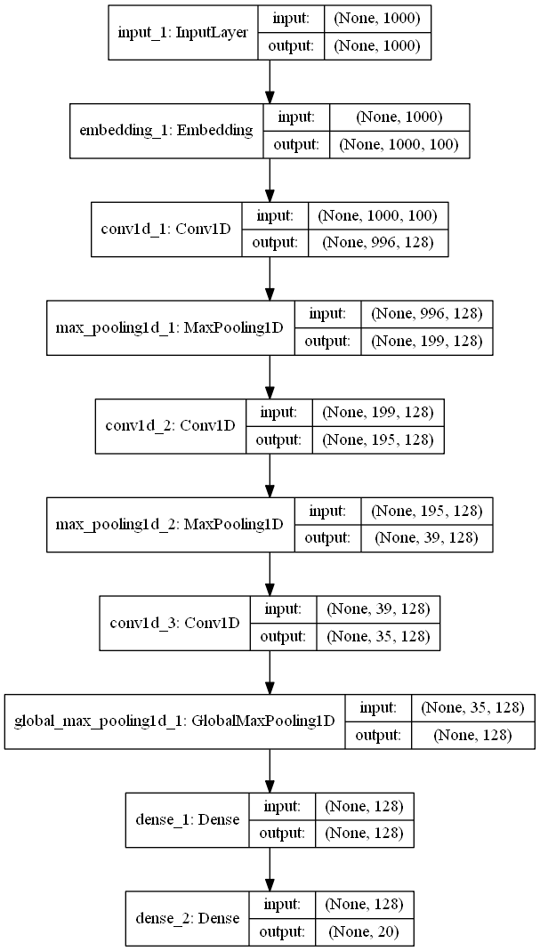
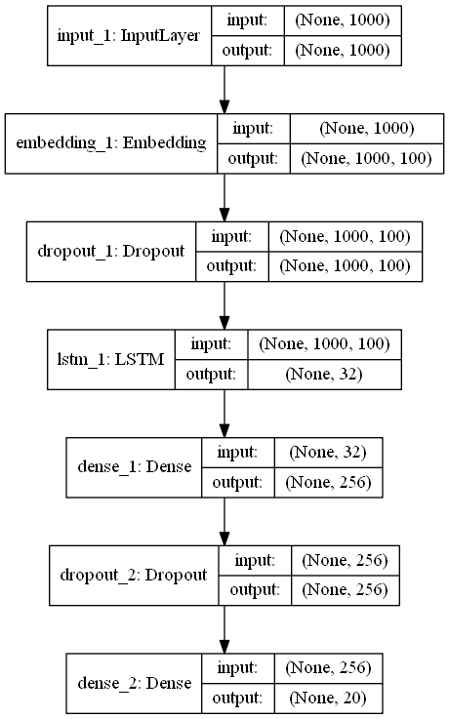
part three models
flow chart
bulid a new dictionary based on news text dataset
Conv1D
LSTM
tokenize news corpus
initialize embg layer with embedding matrix
neural networks
get training results
satisfy
requirments
yes
complete training
no
news texts
feedforward output

Slide 12
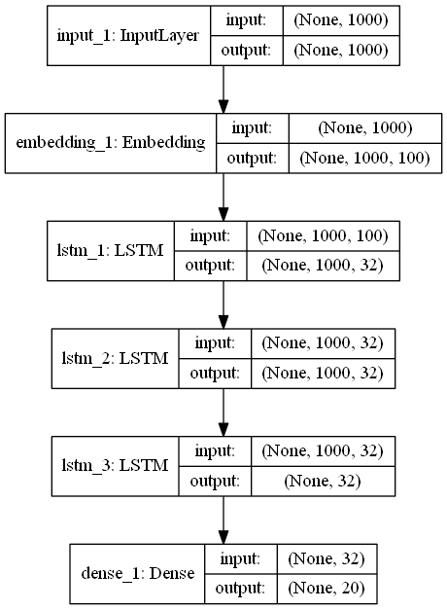
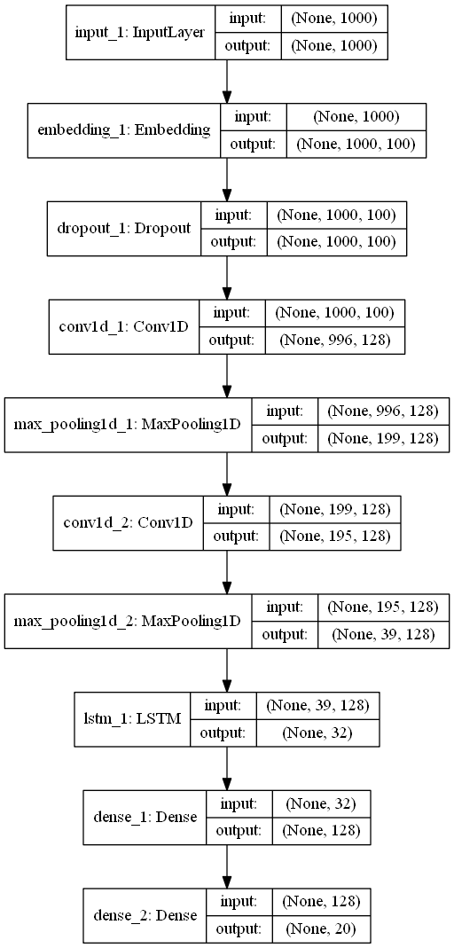
part three models
flow chart
bulid a new dictionary based on news text dataset
Stack LSTM
Conv1D+LSTM
tokenize news corpus
initialize embedding layer with embedding matrix
neural networks
get training results
satisfy
requirments
yes
complete training
no
news texts
feedforward output

Slide 13
PART FOUR
HYPERPARAMETER
TUNING

Slide 14
part four hyperparameter tuning
Because of computational limitations, tuning the models is performed in a sequential manner :
(1) learning rate
(2) sequence length
(4) filters
(5) regulatization / dropout
The most sensitive parameters are learning rate and sequence length.

Slide 15
PART FIVE
RESULTS

Slide 16
part five results
Model | Training set |  | Validation set |  | Epoch | Time
 | Loss | Accuracy | Loss | Accuracy
Baseline | 0.7628 | 0.5406 | 1.7406 | 0.5674 | 100 | 5394.78s
Conv1D | 0.2489 | 0.9160 | 1.7905 | 0.7094 | 100 | 15848.26s
LSTM | 0.4162 | 0.8482 | 0.9692 | 0.7409 | 100 | 20314.72s
Stacked LSTM | 0.3541 | 0.8819 | 1.2440 | 0.6809 | 100 | 40026.06s
Conv1D+LSTM | 0.2735 | 0.9015 | 1.0055 | 0.7972 | 100 | 15497.79s

Slide 17
task partitioning
Idea
Code
Li Zhao
Xu Yingnan
Dong Si
Dong Si
Xu Yingnan
Model Optimization & Evaluation
PPT
Dong Si
Xu Yingnan
Presentation
Report
Li Zhao
Dong si
Xu Yingnan

Slide 18
reference
[1] 20_newsgroup Dataset. http://www.cs.cmu.edu/afs/cs.cmu.edu/project/theo-20/www/data/news20.html
[2] Wikipedia GloVe Dataset. http://dumps.wikimedia.org/enwiki/20140102/
[3] Pennington J, Socher R, Manning C. Glove: Global vectors for word representation[C]. //Proceedings of the 2014 conference on empirical methpre-trained GdoVinembedding as inputs to our models.20-2273.
[4] Lai S, Xu L, Liu K, et al. Recurrent Convolutional Neural Networks for Text Classification[C]. //AAAI. 2015, 333: 2267-2273.
[5] Yin W, Kann K, Yu M, et al. Comparative study of cnn and rnn for natural language processing[J]. arXiv preprint arXiv:1702.01923, 2017.
[6] Vaswani A, Shazeer N, Parmar N, et al. Attention is all you need[C]//Advances in Neural Information Processing Systems. 2017: 5998-6008.
[7] Devlin J, Chang M W, Lee K, et al. Bert: Pre-training of deep bidirectional transformers for language understanding[J]. arXiv preprint arXiv:1810.04805, 2018.
[8] Andrew M. Dai and Quoc V. Le. 2015. Semi-supervised Sequence Learning. In Proceedings of the 28th International Conference on Neural Information Processing Systems - Volume 2 (NIPS’15). MIT Press, Cambridge, MA, USA, 3079–3087.
[9] Richard Socher, Brody Huval, Christopher D. Manning, and Andrew Y. Ng. 2012. Semantic Compositionality through Recursive Matrix-Vector Spaces. In Proceedings of the 2012 Joint Conference on Empirical Methods in Natural Language Processing and Computational Natural Language Learning. Association for Computational Linguistics, Jeju Island, Korea, 120111211.
[10] Yoon Kim. 2014. Convolutional Neural Networks for Sentence Classification. In Proceedings of the 2014 Conference on Empirical Methods in Natural Language Processing (EMNLP). Association for Computational Linguistics, Doha, Qatar, 1746–1751.

Slide 19
thanks!
MDS
217012018 LI ZHAO
218012007 DONG SI
218012045 XU YINGNAN

