Slide 1

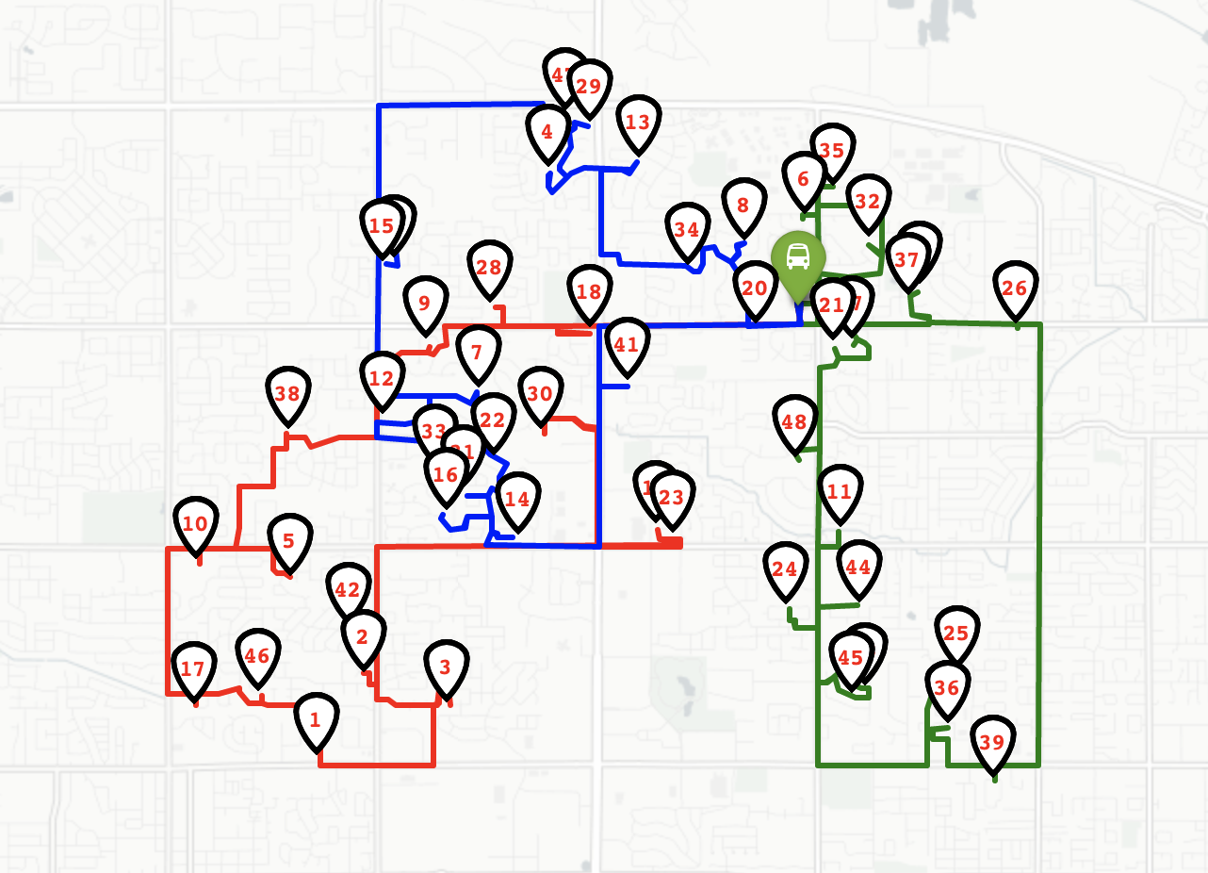

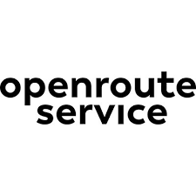




Route Optimization
Matthew Castrigno
Noah Barnes
Kris Veruari
Screen shot here, outline for illustration only
This proof of concept project utilizes the open source service developed by The Heidelberg Institute for Geoinformation Technology. openrouteservice.org provides API services for directions, time-distance matrices, points of interest and isochrones. The objective was to apply these services to school bus routing use case to assess the quality of the results. The school bus routing use case needs to balance the number of buses, total travel time and bus capacity. The free service limits the number of waypoints (pick up locations for this use case). In order to solve a more complex problem set a local instance of the service can be run in a docker container or on a ubuntu machine. The scope of the project also investigated creating and accessing such a container.
Traveling Salesman Problem
This application is an example of the traveling salesman problem. Any computer scientist will tell you proving that you have an optimum solution to this problem is impossible. This technology tests the limits of finding such solutions.
Technology Tools
Bus route planning for School Districts
Routes to optimize resources balancing the number of buses and travel route times.

