Slide 1

Team: NCAA March Madness
By: Brett Thompson, Grant Wooldridge, Kris Wasemiller, and Scott Frazier

Slide 2

Inspiration
Queue “One Shining Moment” music

Slide 3
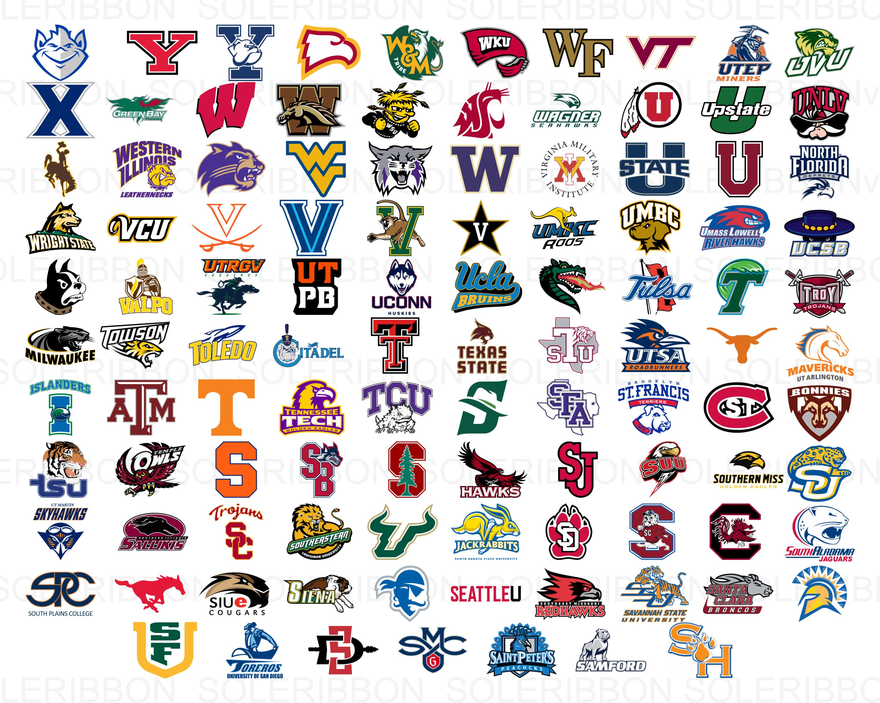
Introduction
Each season there are thousands of NCAA basketball games played between Division I men’s tams, culminating in March Madness®, the 68-team national championship that starts in the middle of March.
The data is provided by Kaggle and includes the following in order to build a simple prediction model:
Team ID’s and Team Names
Tournament seeds since 1984-85 season
Final scores of ALL regular season, conference tournament, and NCAA® tournament games since 1984-85 season.
Season-level details including dates and region names

Slide 4
Questions to be answered
Who will win the 2021 NCAA Tournament?
How many points will they score?
The 2020 NCAA tournament was cancelled due to COVID. Who would have won?
Who is the best historical team? (i.e. 2021 Gonzaga vs. 2019 Gonzaga)

Slide 5
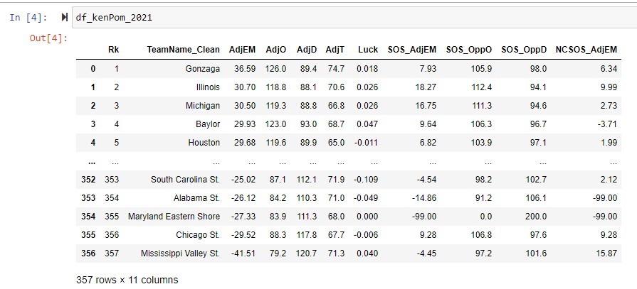
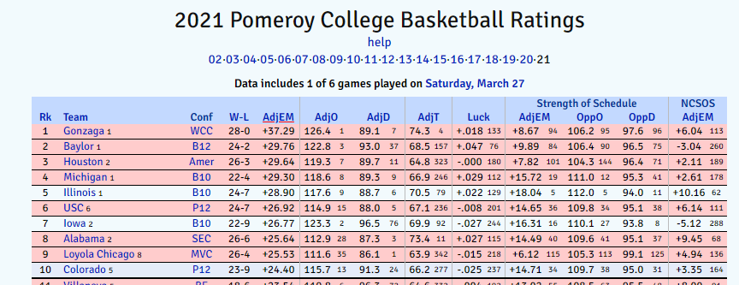
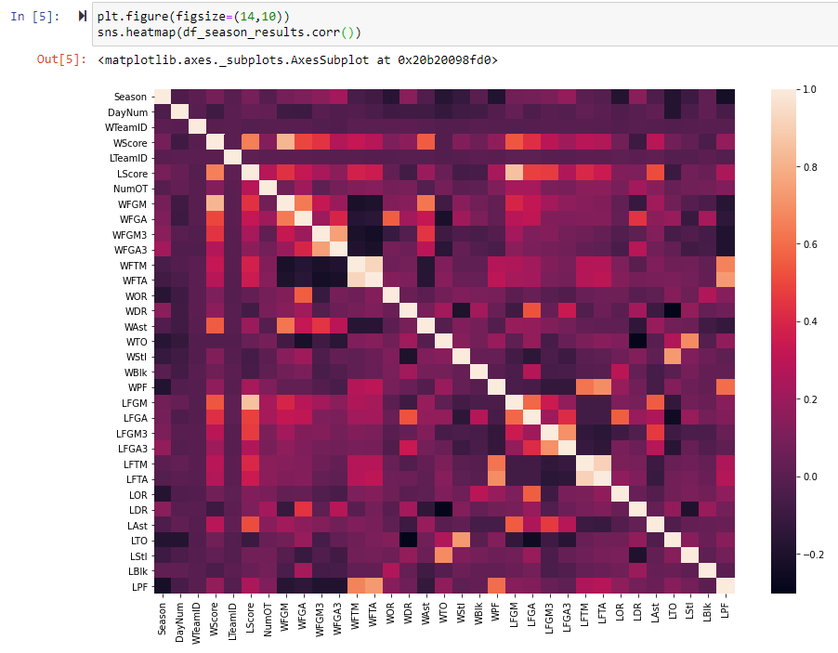
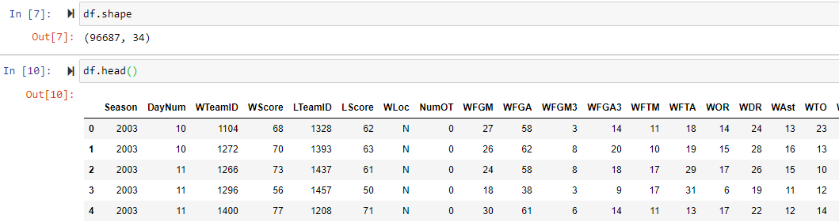
March Madness Dataset

Slide 6
Methodology

Slide 7
Results / Analysis
The model accurately predicted 23 out of 32 (72%) first round games correctly for the 2021 NCAA tournament.

Slide 8
Conclusions

Slide 9
Limitations/Bias
The model uses known KenPom data to make predictions. While historical data is helpful, the model would be limited in predicting 2022 outcomes.
There is a component that regresses to the season averages. While that is expected, the model does not capture “blow out wins” or “blow out losses.”

Slide 10
Future Work

Slide 11
Questions

