Slide 1

Team: NCAA March Madness
By: Brett Thompson, Grant Wooldridge, Kris Wasemiller, and Scott Frazier

Slide 2

Inspiration
Queue “One Shining Moment” Music

Slide 3
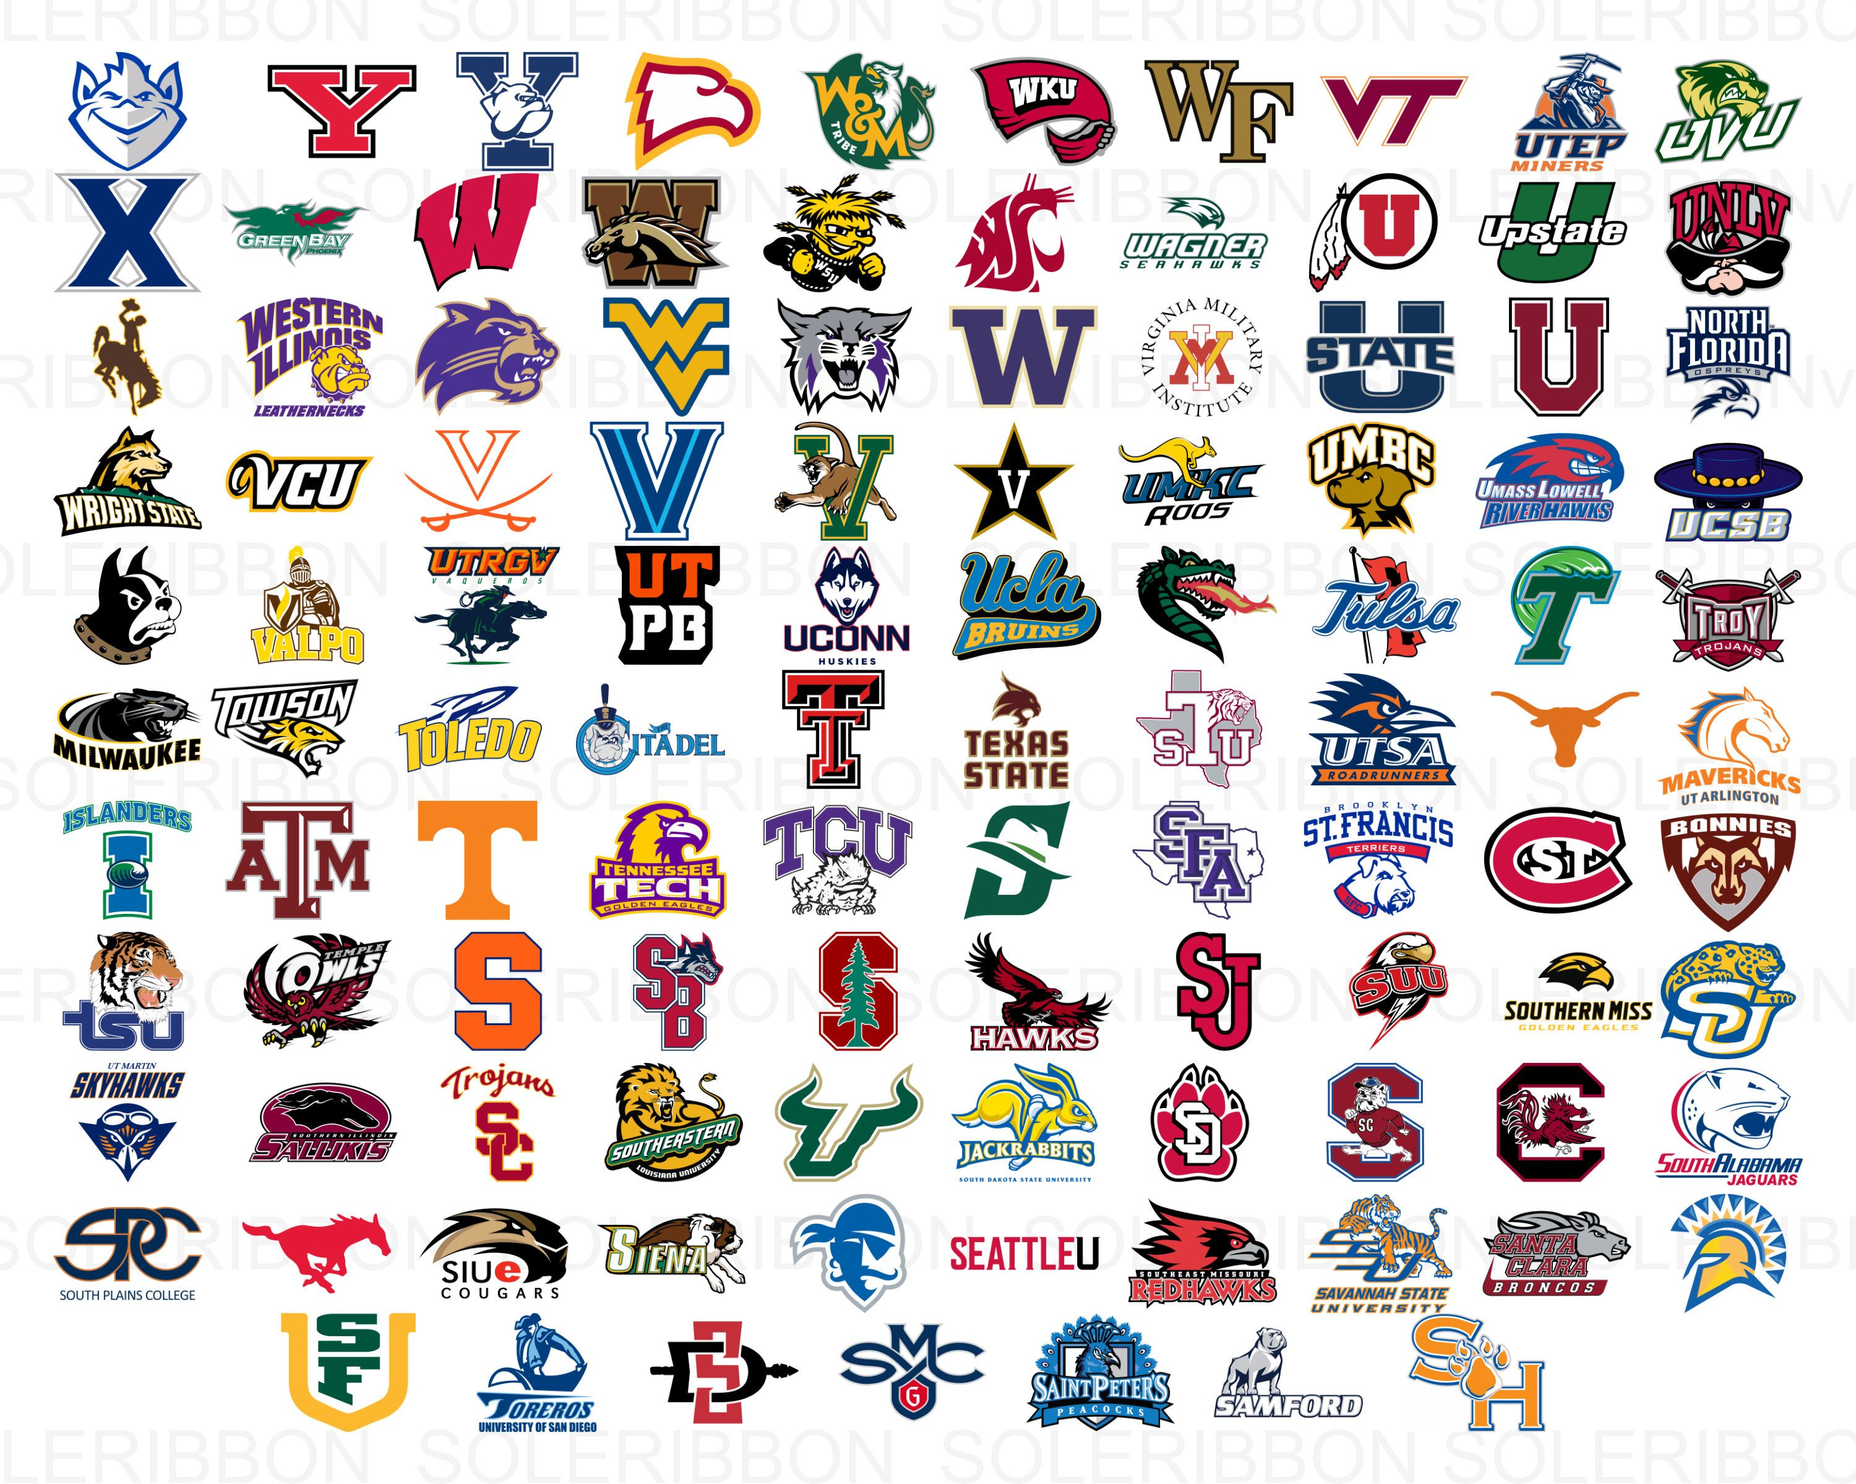
Introduction
Each season there are thousands of NCAA basketball games played between Division I men’s tams, culminating in March Madness®, the 68-team national championship that starts in the middle of March.
The data is provided by Kaggle and includes the following in order to build a simple prediction model:
Team ID’s and Team Names
Tournament seeds since 1984-85 season
Final scores of ALL regular season, conference tournament, and NCAA® tournament games since 1984-85 season.
Season-level details including dates and region names

Slide 4
Questions to be answered
Who will win the 2021 NCAA Tournament?
How many points will they score?
The 2020 NCAA tournament was cancelled due to COVID. Who would have won?
Who is the best historical team? (i.e. 2021 Gonzaga vs. 2019 Gonzaga)

Slide 5
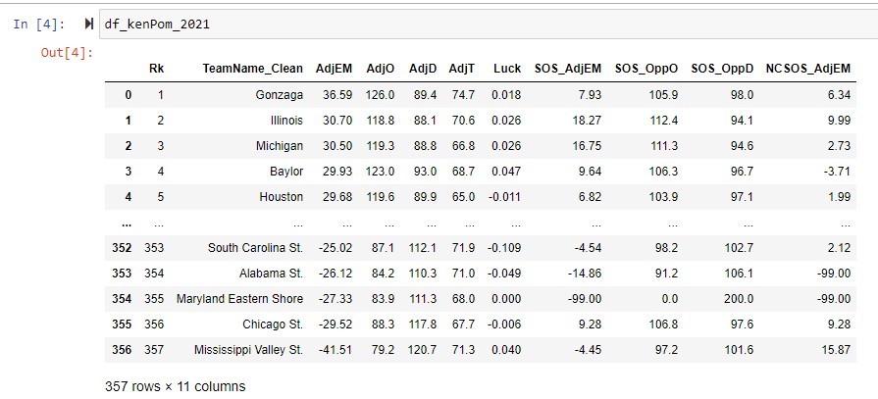
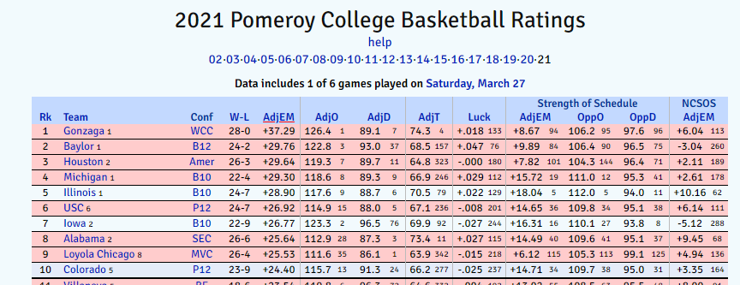
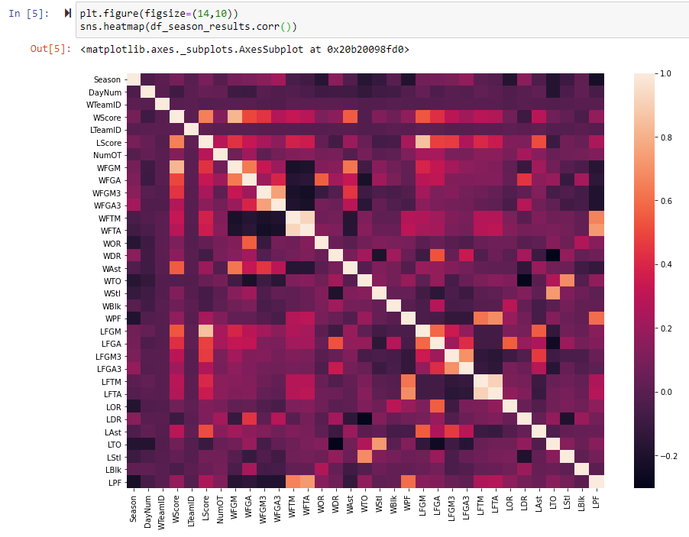
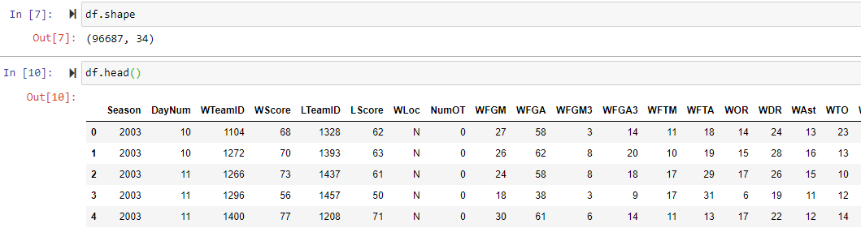
March Madness Dataset

Slide 6
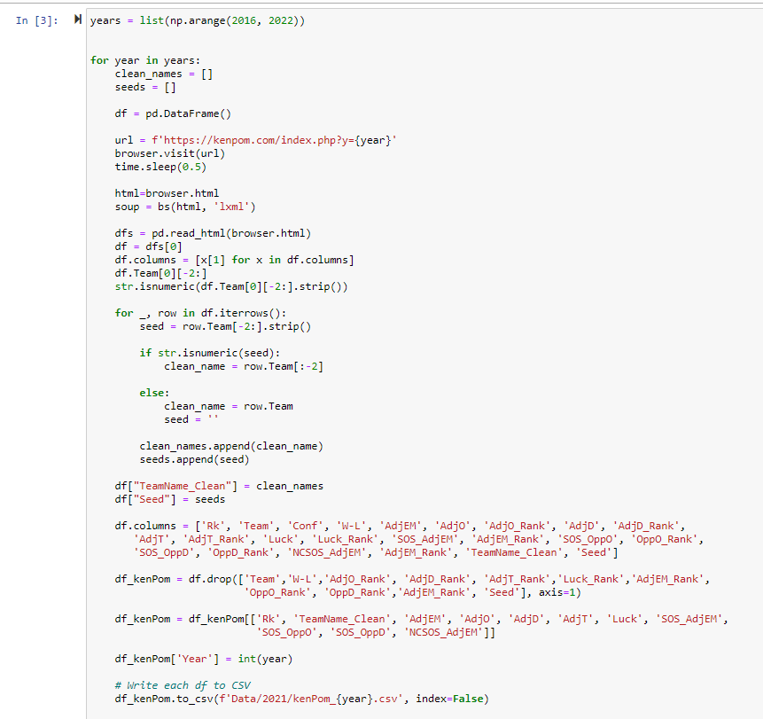
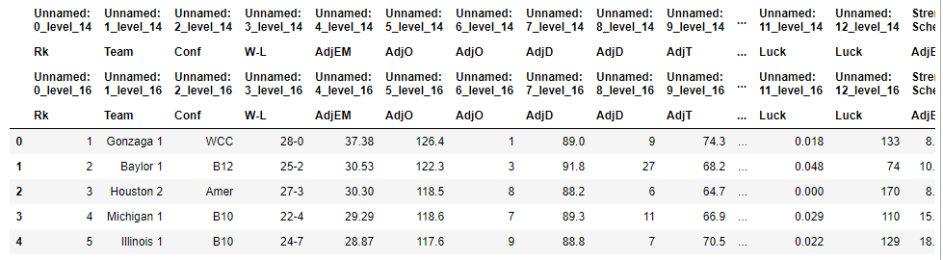
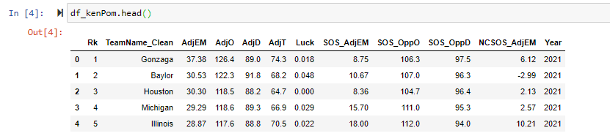
Methodology – Cleaning the Data
KenPom Data
KenPom Data Clean

Slide 7
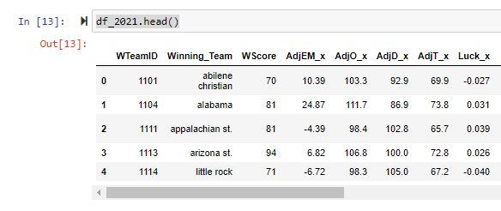
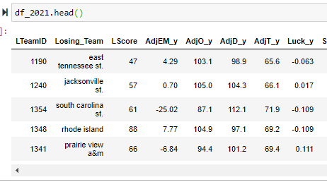
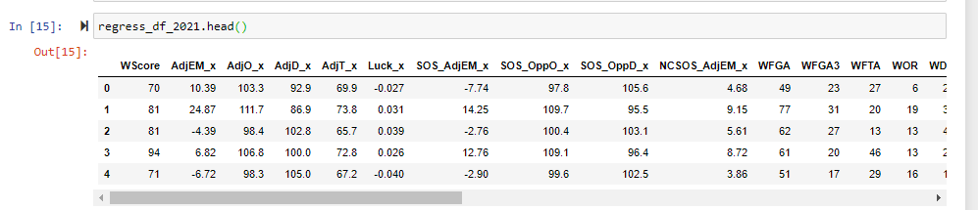
Methodology – Cleaning the Data
Individual Game data merged with KenPom statistics
Gave insight on the “quality” of wins/losses

Slide 8
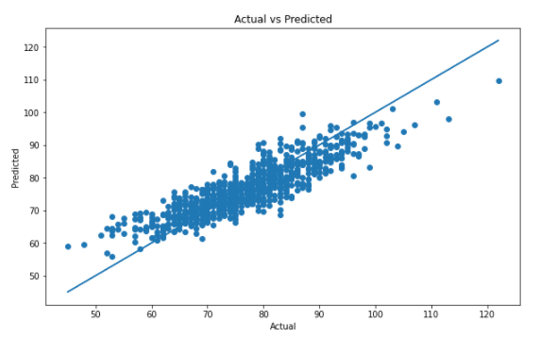
Methodology: Regression
Model Name | In-Sample R² | Out-Sample R²
Linear Regression | 1.000000 | 0.842298
Decision Tree | 1.000000 | 0.216801
Random Forest | 0.947128 | 0.660921
Ada Boost | 0.640881 | 0.611243
Gradient Boost | 0.820716 | 0.825950
XTREME Gradient Boost | 0.992378 | 0.735492
KNN | 0.625536 | 0.448048
Single Game Matchups:
Target = Points Scored
Features = KenPom statistics, season average stats per team

Slide 9
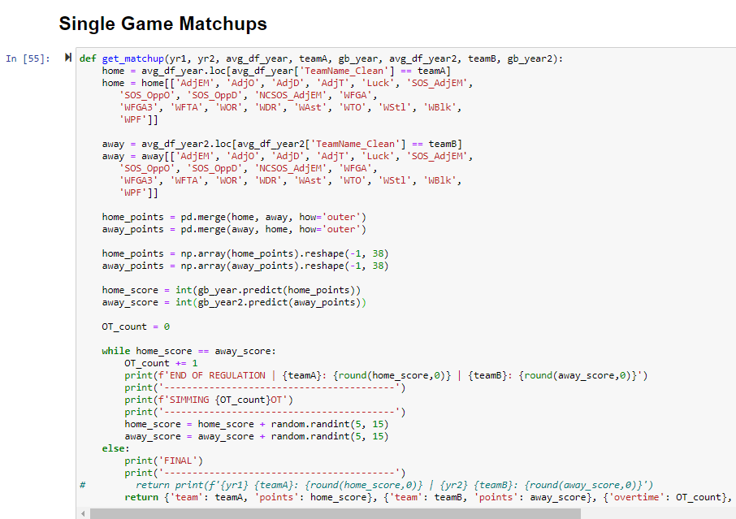
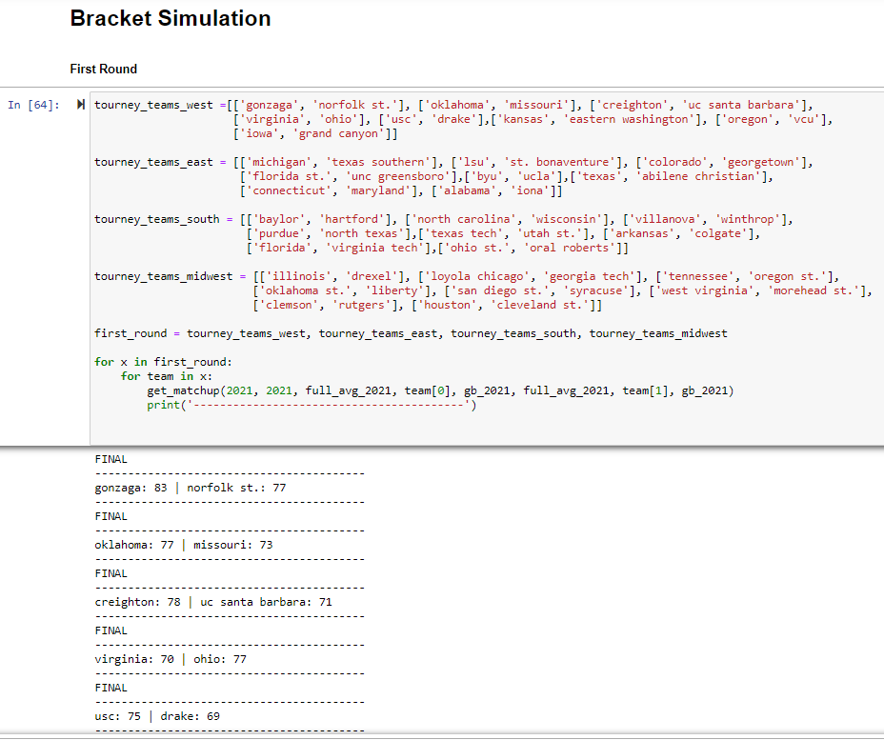
Methodology: Regression

Slide 10
Link to App
<Link goes here>

Slide 11
Results / Analysis
The model accurately predicted 23 out of 32 (72%) first round games correctly for the 2021 NCAA tournament.
The 2020 NCAA tournament was cancelled. The model predicts the #3 seed Michigan State would have won the tournament.
The model accurately predicted 19 out of 32 (59%) first round games correctly for the 2019 NCAA tournament

Slide 12
Limitations/Bias
The model uses known KenPom data to make predictions. While historical data is helpful, the model would be limited in predicting 2022 outcomes.
There are components that regress to the season averages for points scored. While that is expected, the model does not capture “blow out wins” or “blow out losses.”
The model may be biased to teams with a higher than average “Tempo.” i.e. Fast-paced or high scoring teams seem to outperform actual outcomes when run through the model regardless of the caliber defense they play against.

Slide 13
Future Work
Pull in additional years (pre-2016) to refine model.
Optimize/recommend first round matchups to improve tournament quality.
Create a bracket that would auto-complete based on the model.
Add players to game-by-game data to improve the model.
Further refine features to reduce model complexity.

Slide 14


Works Cited
2021 Pomeroy College Basketball Rankings "2021 Pomeroy College Basketball Ratings". Kenpom.Com, 2021, https://kenpom.com/. Accessed 21 Mar 2021.
March Machine Learning Mania 2021 – NCAAM | Kaggle "March Machine Learning Mania 2021 - NCAAM | Kaggle". Kaggle.Com, 2021, https://www.kaggle.com/c/ncaam-march-mania-2021/data. Accessed 28 Mar 2021.

Slide 15

Questions

