Slide 1
What does Unsupervised ML say? Clustering Virtual Reality Behavior for Typical and Physically Disabled Persons
Soos Kriszta, Frîncu Marc
West University of Timișoara
The Fifth Serbian International Conference on Applied Artificial Intelligence (AAI2026)

Slide 2
Introduction
VR Usage
VR uses 3D head-mounted displays and pose tracking to create immersive experiences across entertainment, education, and medicine
Studies show VR elicits neural responses comparable to real-world interactions
Higher immersion levels correlate with better patient recovery outcomes
VR serves as a non-intrusive and enjoyable tool for motor rehabilitation and psychotherapy
Study Aim
Investigate behavioral patterns in VR and correlate them with motor disability
Analyze data from 19 participants across three distinct locomotion scenarios: controller-based, eye movement-based, and static
Apply dimensionality reduction via PCA followed by unsupervised K-means clustering
Classify participants as typical or atypical based purely on their movement data, without clinical labels

Slide 3
Related Work
Afdideh & Shamsollahi(2025)
Raya et al. (2020)
Vlasiu et al. (2024)
ASD vs. Typical Children
ASD & Mental Disorders
Neurological Waves via BCI
Used multimodal CAVE-VR + Intel RealSense camera. Applied PCA + Euclidean distance for feature reduction. Classified behavior with SVM. Compared against traditional diagnostic testing.
72 participants: typical, ASD, other disorders. Compared SVM, Decision Trees, and Random Forest. RF excelled at binary classification; DT at multi-class tasks. Same data-gathering technique as our study.
Focused on brain-computer interface signals. Applied FFT and Autoregressive Coefficients. Classification via Linear Discriminant Analysis. Results validated through cross-validation.

Slide 4
Dataset & Methodology
Dataset
19 participants (5 with motor impairments)
3 VR scenarios per participant (randomized order)
5 minutes per scenario
Data: head position (x,y,z), rotation, forward direction, timestamps
42 behavioral features extracted
Stored as anonymized JSON files
Ethics approved, informed consent obtained
Three VR Scenarios
Scenario A – Static
Head & gaze only, no locomotion. Simulates immobility; tests attention & frustration.
Scenario B – Gaze Navigation
Move by focusing gaze on blocks. Difficult for non-disabled; mirrors motor limits.
Scenario C – Controller
Standard VR controller. Free natural movement; baseline for healthy behavior.
ML Pipeline
① Collect & clean raw VR data
② Extract 42 behavioral features
③ Standardize (Z-score)
④ PCA — reduce to 95% variance
⑤ K-means clustering
⑥ Euclidean + Mahalanobis distance
⑦ Composite atypicality score
⑧ Threshold → None/Low/Med/High
⑨ Report and plot generation

Slide 5
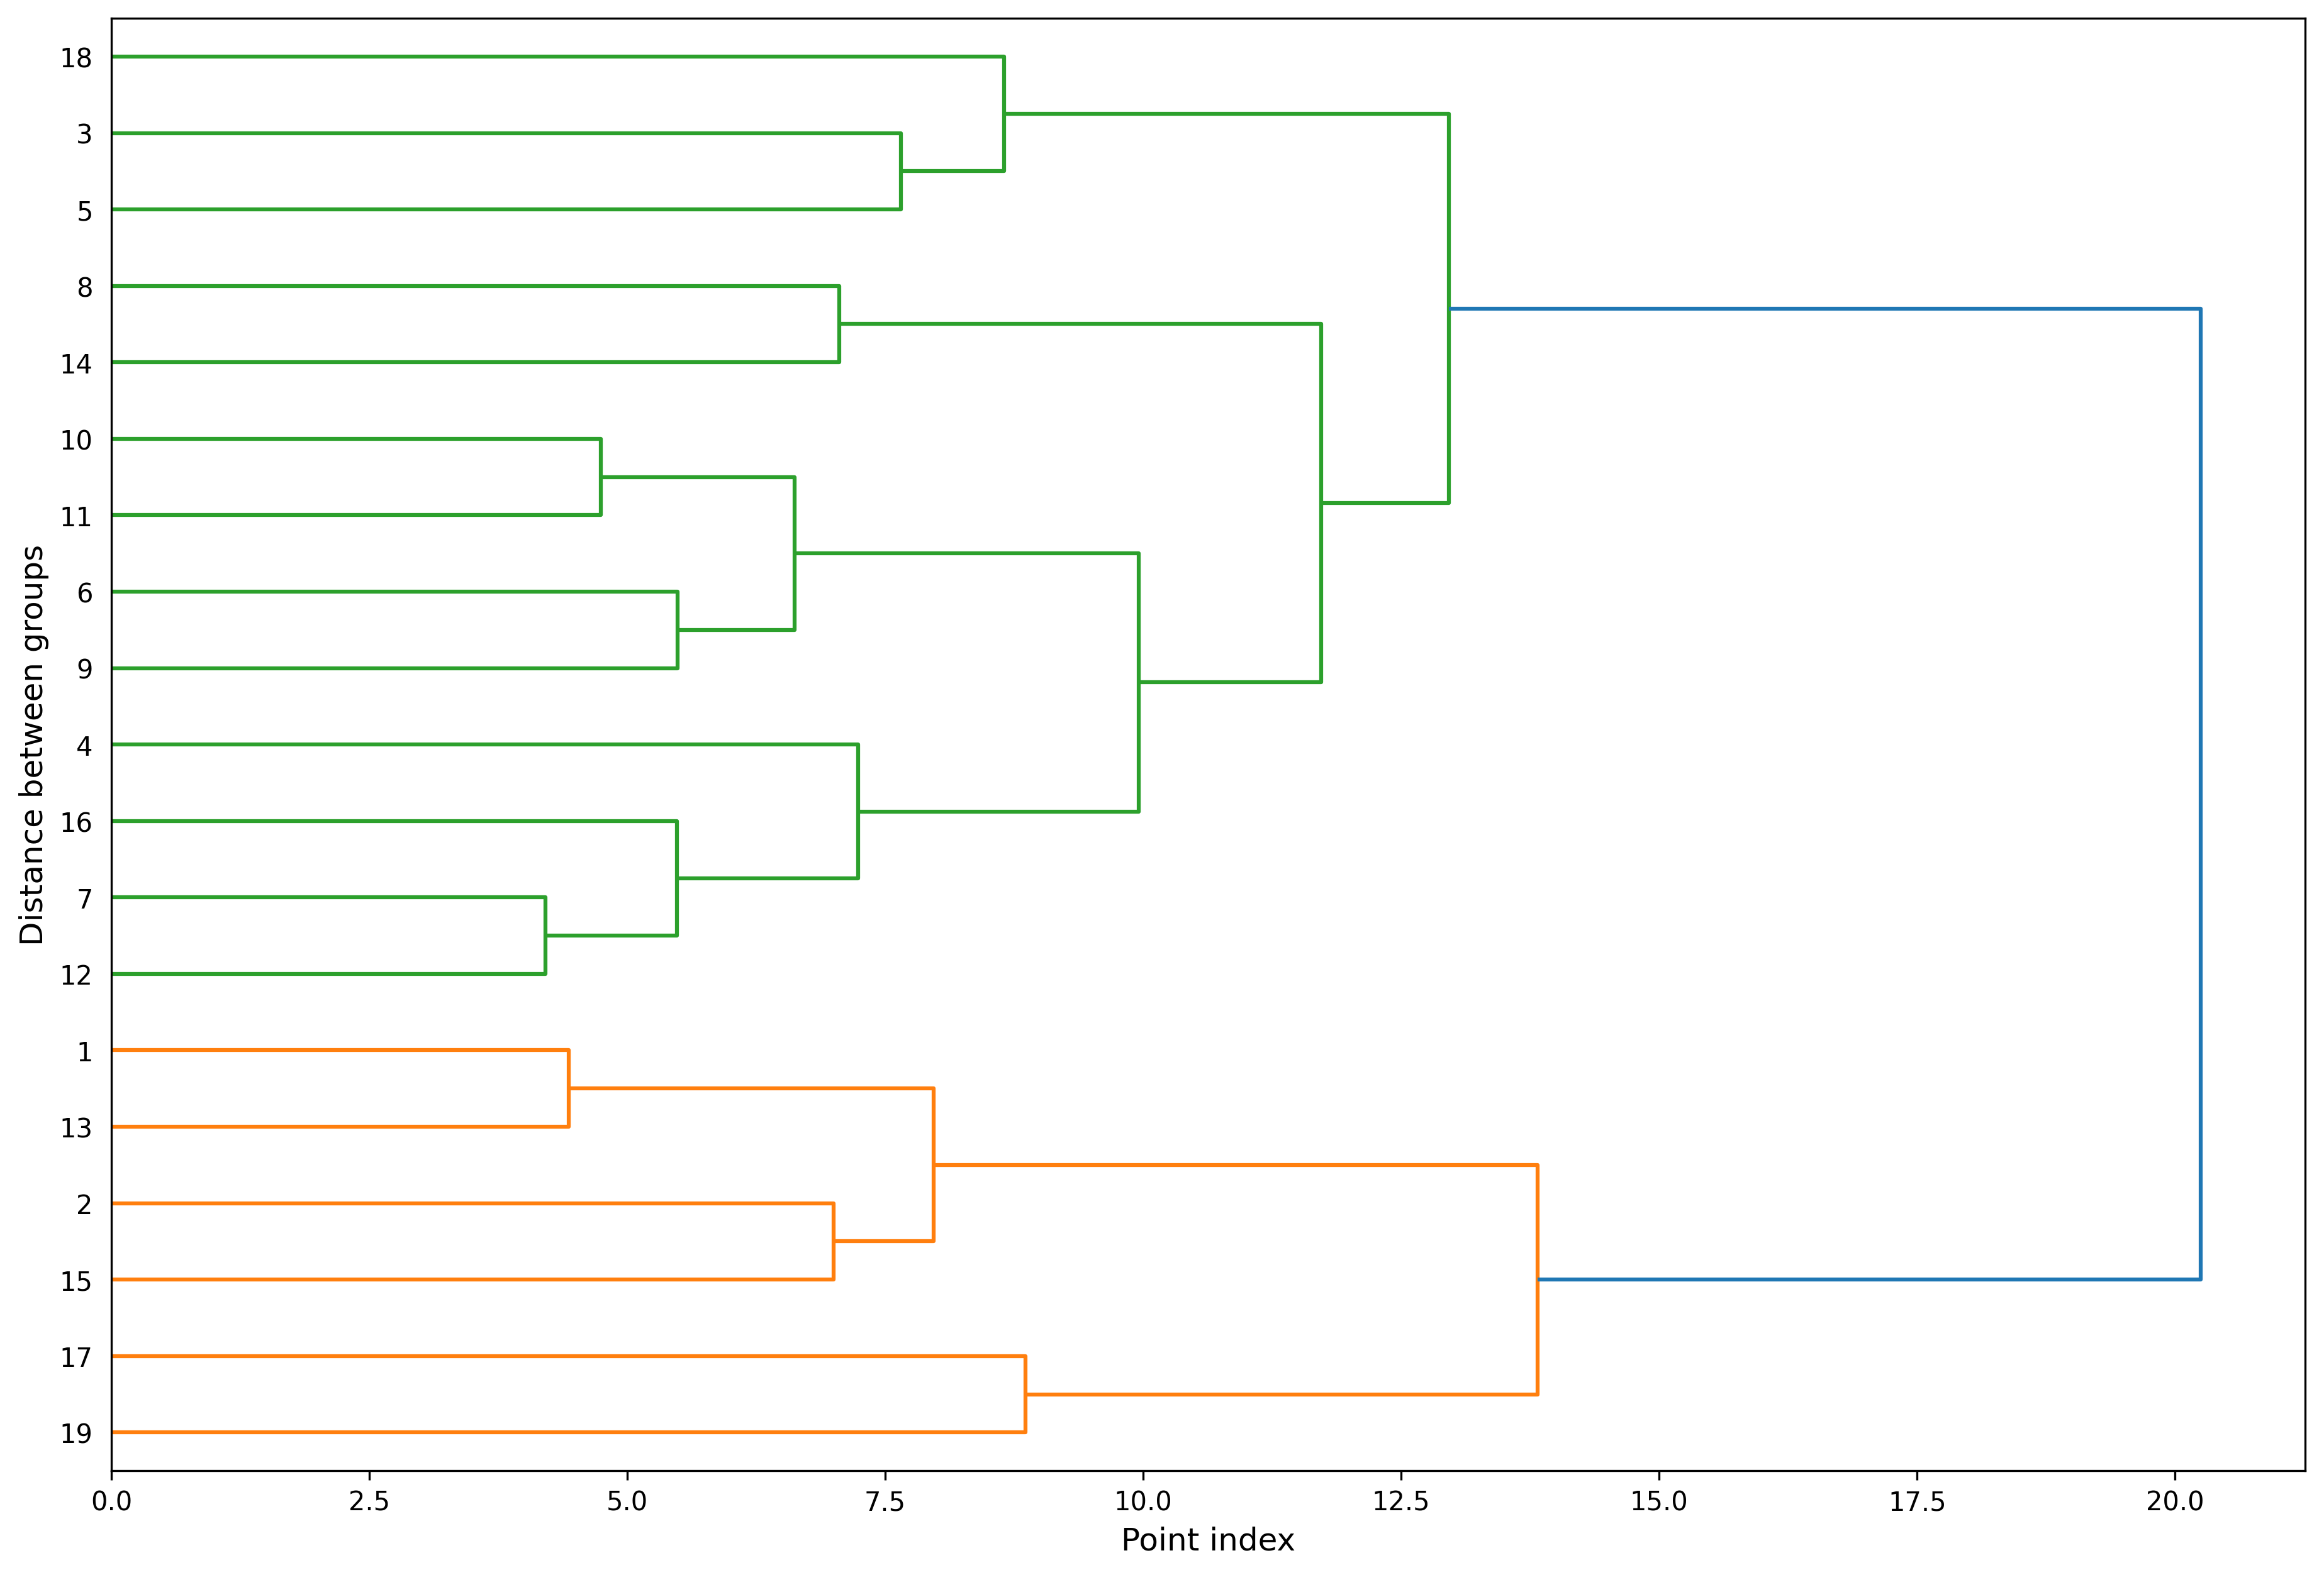
State of the Art – Our Approach
Approach 1 – Hierarchical Clustering
Why This Approach
Transparent visualization of natural behavioral groupings
Ideal exploratory first-pass before the more complex pipeline
How It Works
Bottom-up agglomerative clustering
Participants progressively merged based on behavioral similarity
Dendrogram maps hierarchical distances between participants
What It Found
Two primary clusters separated by a distance of ~20
Majority group: 13 participants, typical behavioral profiles
Minority group: 6 participants, distinct behavioral patterns
Disabled participants concentrated within the minority group

Slide 6
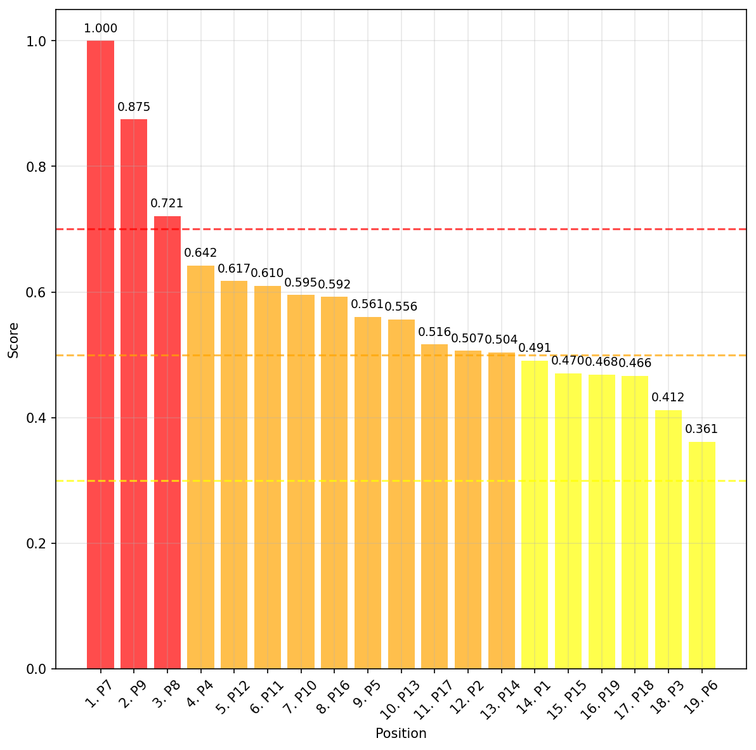
State of the Art – Our Approach
Approach2 – PCA & K-means clustering & Scoring
Why This Approach
Addresses limitations of hierarchical clustering
Designed for high-dimensional classification with precision
Combines exploratory grouping with quantifiable anomaly detection
How It Works
PCA reduces 42 features retaining 95% of variance
K-means clustering with 3 predefined clusters applied in reduced space
Composite atypicality score computed per participant: 0.5 · ‖d_Euclidean‖ + 0.3 · Δ_Mahalanobis + 0.2 · α_consistency
Mahalanobis accounts for correlations between features
Consistency separates rare-but-normal from genuinely atypical
What It Found
Scores mapped to four levels: None (≤0.3) / Low (≤0.5) / Medium (≤0.7) / High (>0.7)
Person 7 and Person 9 clearly separated at 1.000 and 0.875
All 5 disabled participants successfully detected
5 false positives identified, high engagement misread as restriction

Slide 7
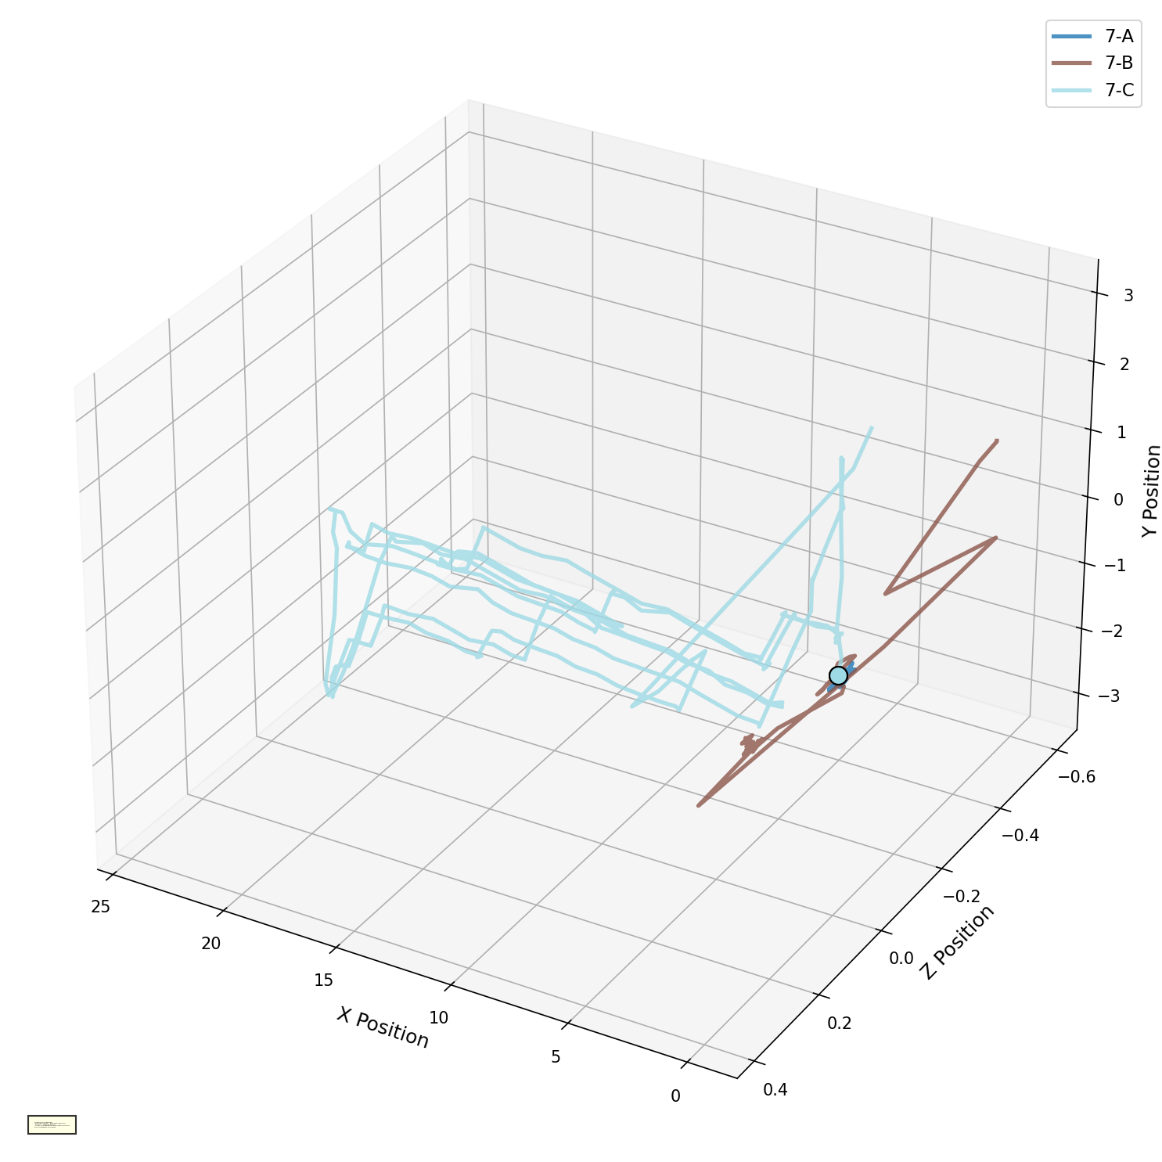
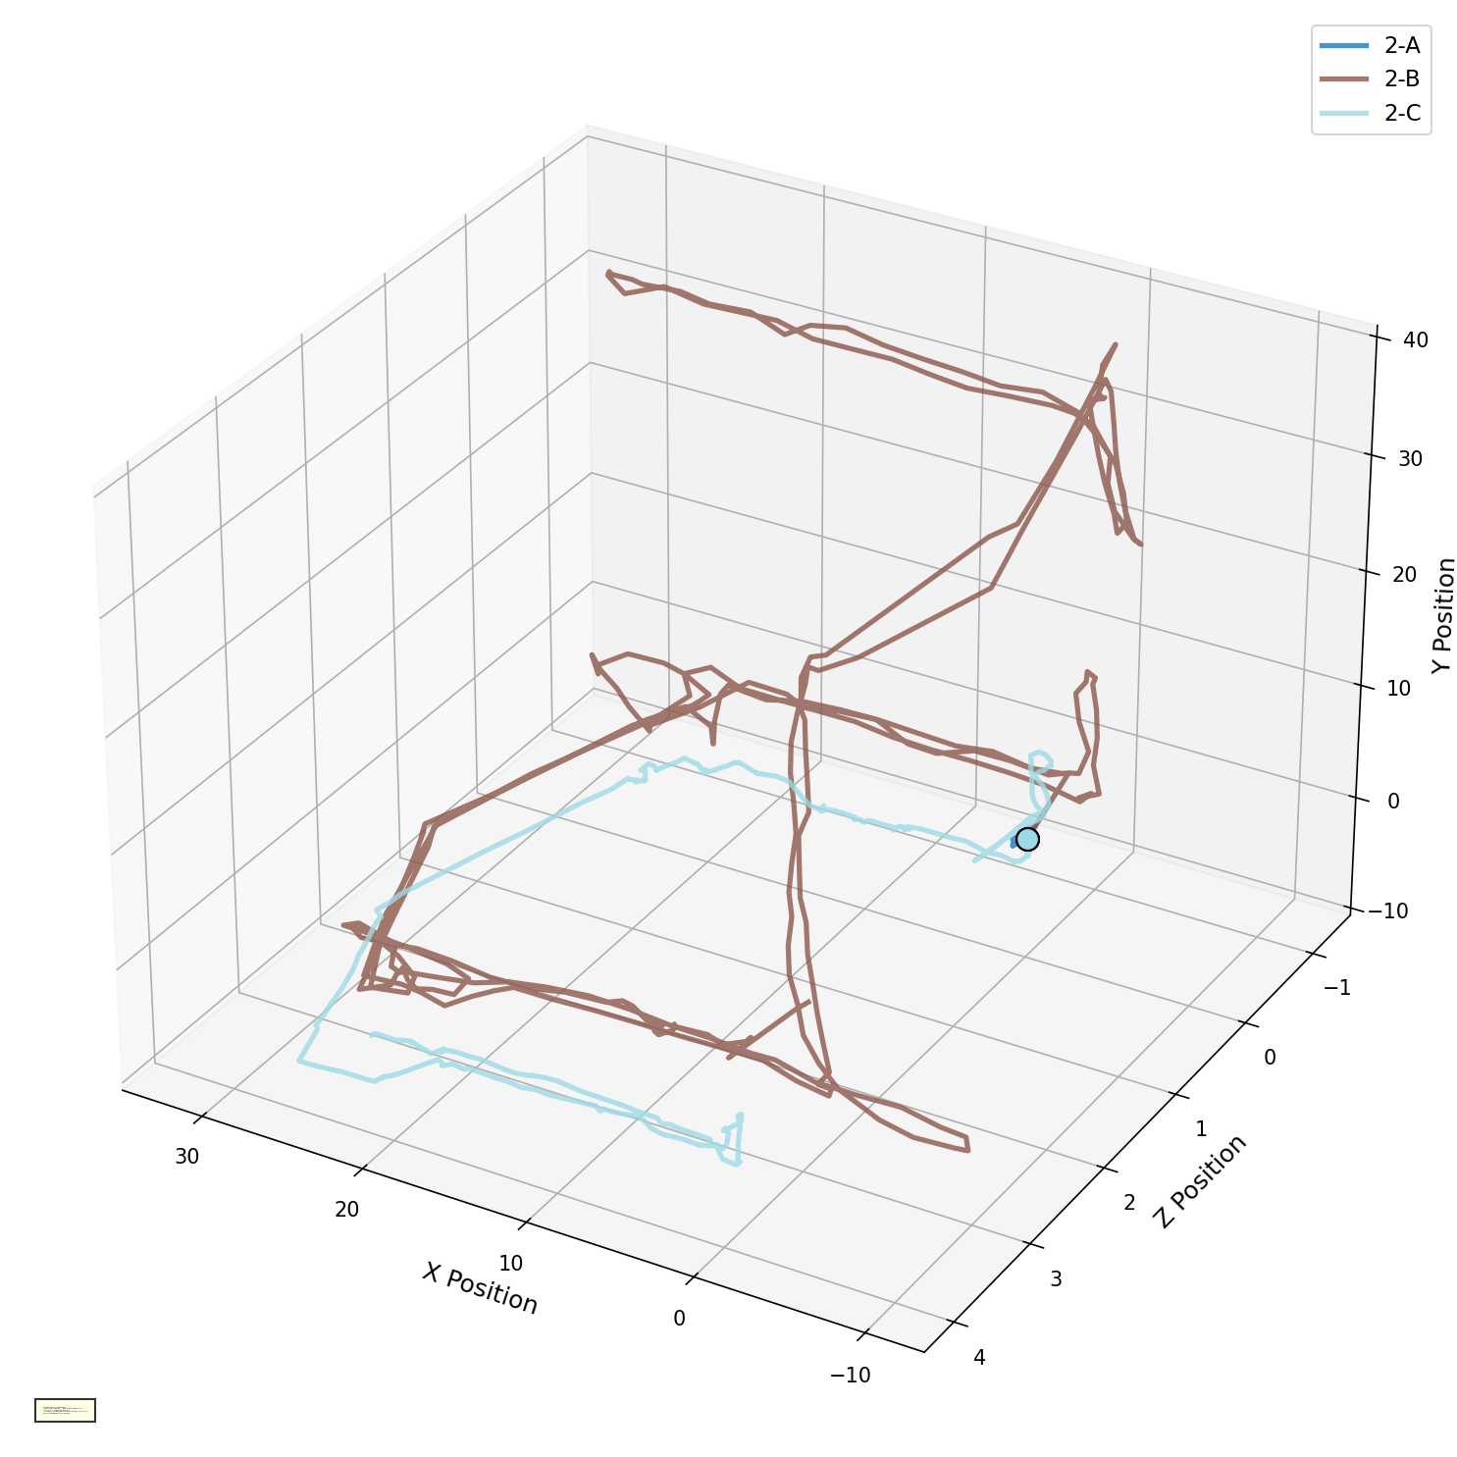
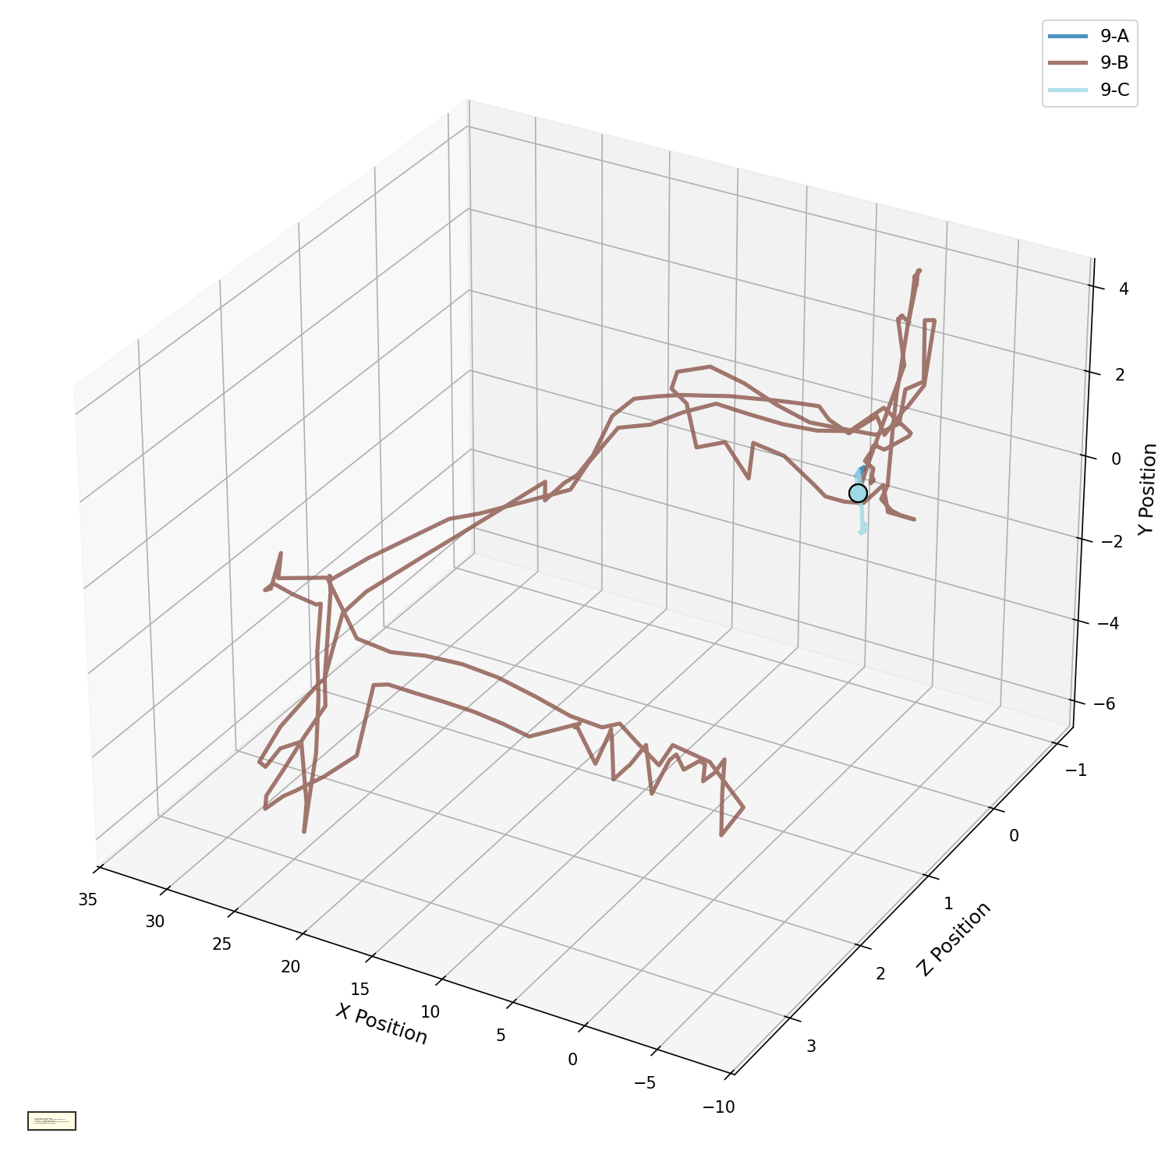
Visual Analysis - Approach 2
Person_7
Person_2
Person_9

Slide 8
Results
19
5
5 / 5
1.000
Total Participants
False Positives
Disabled Correctly Detected
Top Atypicality Score (Person_7)
Key Participant Profiles
Person
Score
Status
Key Finding
Person_7
1.000
Atypical (Motor disabled)
Restricted to single horizontal plane; unable to perform vertical gaze, strongest atypicality signal
Person_9
0.875
Atypical (motor disabled)
Persistent downward head posture; near-static in Scenario C, second strongest signal
Person_2
0.50
Typical (benchmark)
Normative reference: balanced, systematic exploration across all scenarios
Person_8
0.72
Typical (FALSE+)
Exceptional movement energy misread as impairment; high engagement, not restriction
Person_16
0.59
Typical (FALSE+)
Maximum behavioral range across scenarios creates unusually wide kinematic variance

Slide 9
Future Work & Conclusions
What We Demonstrated
PCA + K-means pipeline detects all disabled participants
Composite atypicality score separates impaired vs. typical cohort
Scenario C (controller) is most sensitive for detecting limitations
VR-based screening is non-intrusive, engaging, and scalable
Future Directions
Secondary interpretive layer to distinguish engagement-driven vs. restriction-driven atypicality
Expand dataset, more participants, broader disability types
Incorporate supervised learning for higher specificity
Extend to cognitive and sensory disabilities
Longitudinal tracking: monitor patient progress over time

Slide 10
THANK YOU!

