Slide 1



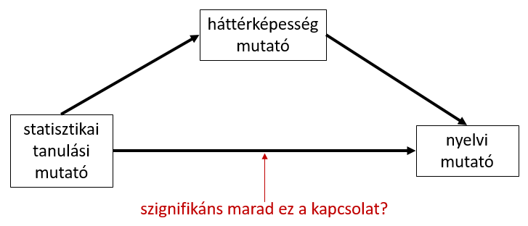

The effect of statistical learning and general cognitive skills on language processing: a structural equation modeling study
Krisztina Sára Lukics^{1,2}; Dorottya Dobó^{1,2}; Bálint József Ugrin^{3,4}; Ágnes Lukács^{1,2}
Department of Cognitive Science, Budapest University of Technology and Economics, Budapest, Hungary
MTA-BME Momentum Language Acquisition Research Group, Eötvös Loránd Research Network, ELKH, Budapest, Hungary
Department of Cognitive Psychology, Institute of Psychology, Eötvös Loránd University, Budapest, Hungary
Psycholinguistics and Neurolinguistics Research Group, Institute for General and Hungarian Linguistics, ELKH Hungarian Research Centre for Linguistics, Budapest, Hungary
Background and aims
Results
bullet points
bullet points
bullet points
bullet points
bullet points
bullet points
statistical learning
short term memory
cognitive control
working memory
Task and index selection
statistical learning tasks
nonlinguistic cognitive tasks
language processing tasks
word segmentation
visual segmentation
artificial grammar learning
NAD learning
word segmentation
visual segmentation
artificial grammar learning
NAD learning
word segmentation
visual segmentation
artificial grammar learning
NAD learning
1
reliability analysis of task indices
2
exploratory factor analysis
References, ackn., & contact…
3
structural equation modeling based on indices
bullet points
bullet points
bullet points

