Slide 1

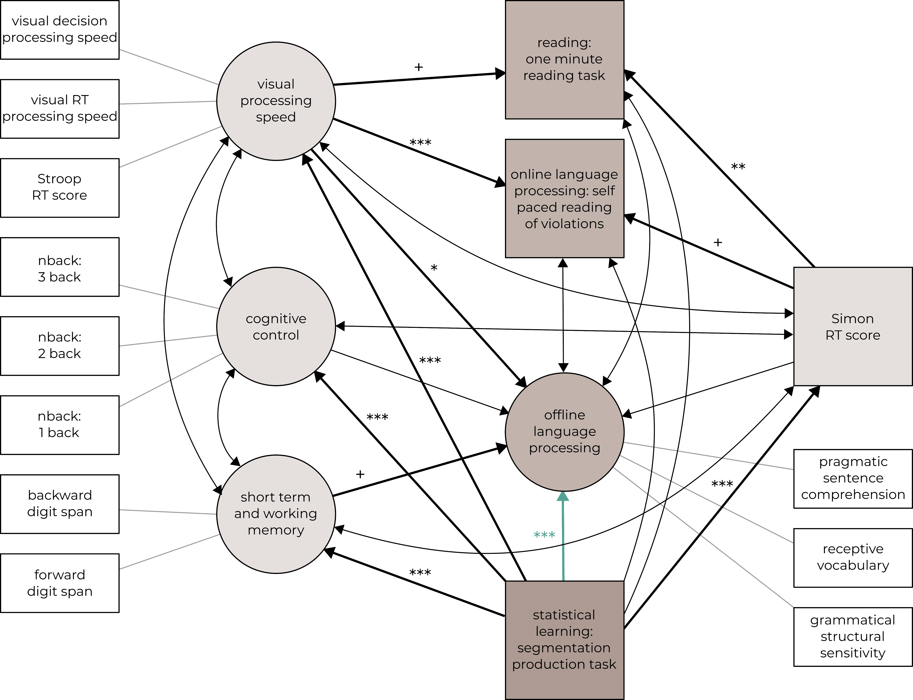


The effect of statistical learning and general cognitive skills on language processing: a structural equation modeling study
¹Department of Cognitive Science, Budapest University of Technology and Economics, Budapest, Hungary
²MTA-BME Momentum Language Acquisition Research Group, Eötvös Loránd Research Network, ELKH, Budapest, Hungary
³Department of Cognitive Psychology, Institute of Psychology, Eötvös Loránd University, Budapest, Hungary
⁴Psycholinguistics and Neurolinguistics Research Group, Institute for General and Hungarian Linguistics, ELKH Hungarian Research Centre for Linguistics, Budapest, Hungary
Krisztina Sára Lukics^{1,2}; Dorottya Dobó^{1,2}; Bálint József Ugrin^{3,4}; Ágnes Lukács^{1,2}
This work was supported by the Momentum Research Grant of the Hungarian Academy of Sciences (Momentum 96233 'Profiling learning mechanisms and learners: individual differences from impairments to excellence in statistical learning and in language acquisition', PI: Ágnes Lukács
Background and aims
The study
Statistical learning is related to language, e.g.:
Speech perception in noise (Conway et al, 2010)
Syntactic priming (Kidd, 2012)
Syntax comprehension (Kidd & Arciuli, 2012; Misyak & Christiansen, 2012)
No systematic examination of this relationship
No investigation of potential mediator cognitive abilities
This study:
Uses multiple language tasks
Controls for background cognitive skills
1
reliability analysis of indices
Participants
502 participants
mean age: 26 years, range: 18-79 years
2
exploratory factor analysis
Test administration
3
structural equation modeling
online and in-person through the Pavlovia platform
Factor selection
Factors behind language processing
1
All indices in the three skill sets tested for internal consistency, reliable indices are printed in black
3
Structural equation modeling
statistical learning tasks
nonlinguistic cognitive tasks
language processing tasks
language processing factors
statistical learning
nonlinguistic cognitive factors related to both statistical learning and language
word segmentation
visual segmentation
artificial grammar learning
NAD learning
processing speed
forward and backward digit span
nback (1, 2, 3 back)
Simon
Stroop
dichotic listening
receptive vocabulary
sentence comprehension: grammar
sentence comprehension: pragmatics
grammatical structure sensitivity
self paced reading
predictive
one minute reading
2
Reliable indices entered into exploratory factor analysis Emerging factors are shown in bold for each skill set
Statistical learning
segmentation – production task
csa gye jü
cé vi gá
lo ha ri
sö pe tu
cé vi gá
production task:
?
xx__x
1) a
2) b
3) c
(Siegelman, et al., 2017)
Nonlinguistic cognitive tasks
visual processing speed
visual RT p. s.
visual decision p. s.
Stroop RT score
acoustic processing speed
cognitive control
nback: 1, 2 and 3 back
short-term and working memory
forward DS
backward DS
dichotic listening
Language
Statistical learning → offline language processing
Even beyond the effect of shared nonlinguistic cognitive abilities
Online language processing and reading skills are not related to statistical learning
Lack of relationship due to the nature of the statistical learning and language tasks?
Future directions:
Using theoretically more motivated tasks of statistical learning and language
Using psychometrically more sound tasks
offline language processing
Grammatical structure sensitivity
Pragmatic sentence comprehension (KOBAK, Lukács & Kas, in prep.)
Receptive vocabulary task (KOBAK)
online processing of syntactic and semantic violations
predictive language processing (Hintz et al., 2020)
one minute reading task (Lukács, Kas, Takács, & Vidnyánszky, 2021)
References
Lukács, Á., & Kas, B. (in preparation). Development and standardization of a comprehensive developmental speech and language screening test (Komplex Beszélt Anyanyelvi Képességteszt, KOBAK)
Lukacs, Kas, Takacs, & Vidnyánszky (in preparation). Olvasási képességeket mérő feladatcsomag középiskolások és felnőttek számára [Test battery for examining reading abilities in adolescents and adults].
Misyak, J. B., & Christiansen, M. H. (2012). Statistical learning and language: An individual differences study. Language Learning, 62(1), 302-331.
Siegelman, N., Bogaerts, L., & Frost, R. (2017). Measuring individual differences in statistical learning: Current pitfalls and possible solutions. Behavior research methods, 49(2), 418-432.
Contact
Conway, C. M., Bauernschmidt, A., Huang, S. S., & Pisoni, D. B. (2010). Implicit statistical learning in language processing: Word predictability is the key. Cognition, 114(3), 356-371.
Hintz, F., Dijkhuis, M., van‘t Hoff, V., McQueen, J. M., & Meyer, A. S. (2020). A behavioural dataset for studying individual differences in language skills. Scientific data, 7(1), 1-18.
Kidd, E. (2012). Implicit statistical learning is directly associated with the acquisition of syntax. Developmental psychology, 48(1), 171.
Kidd, E., & Arciuli, J. (2016). Individual differences in statistical learning predict children's comprehension of syntax. Child development, 87(1), 184-193.
lukics.krisztina.sara@ttk.bme.hu
balintugrin@yahoo.de
Download the PDF!

