Slide 1

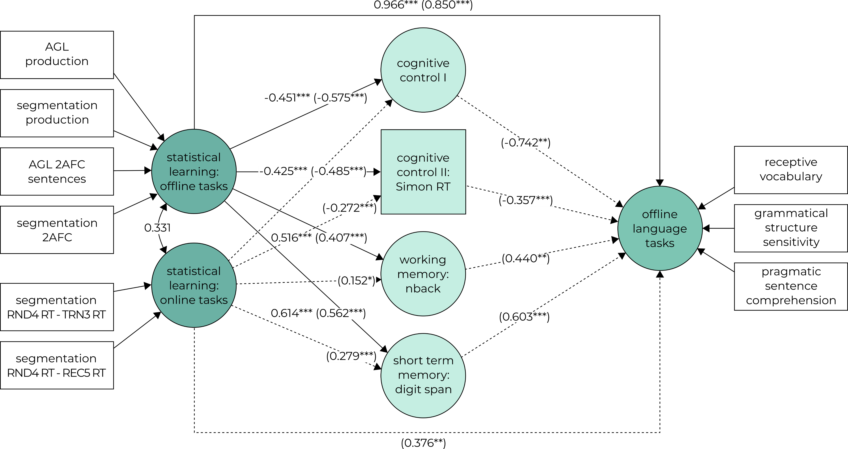
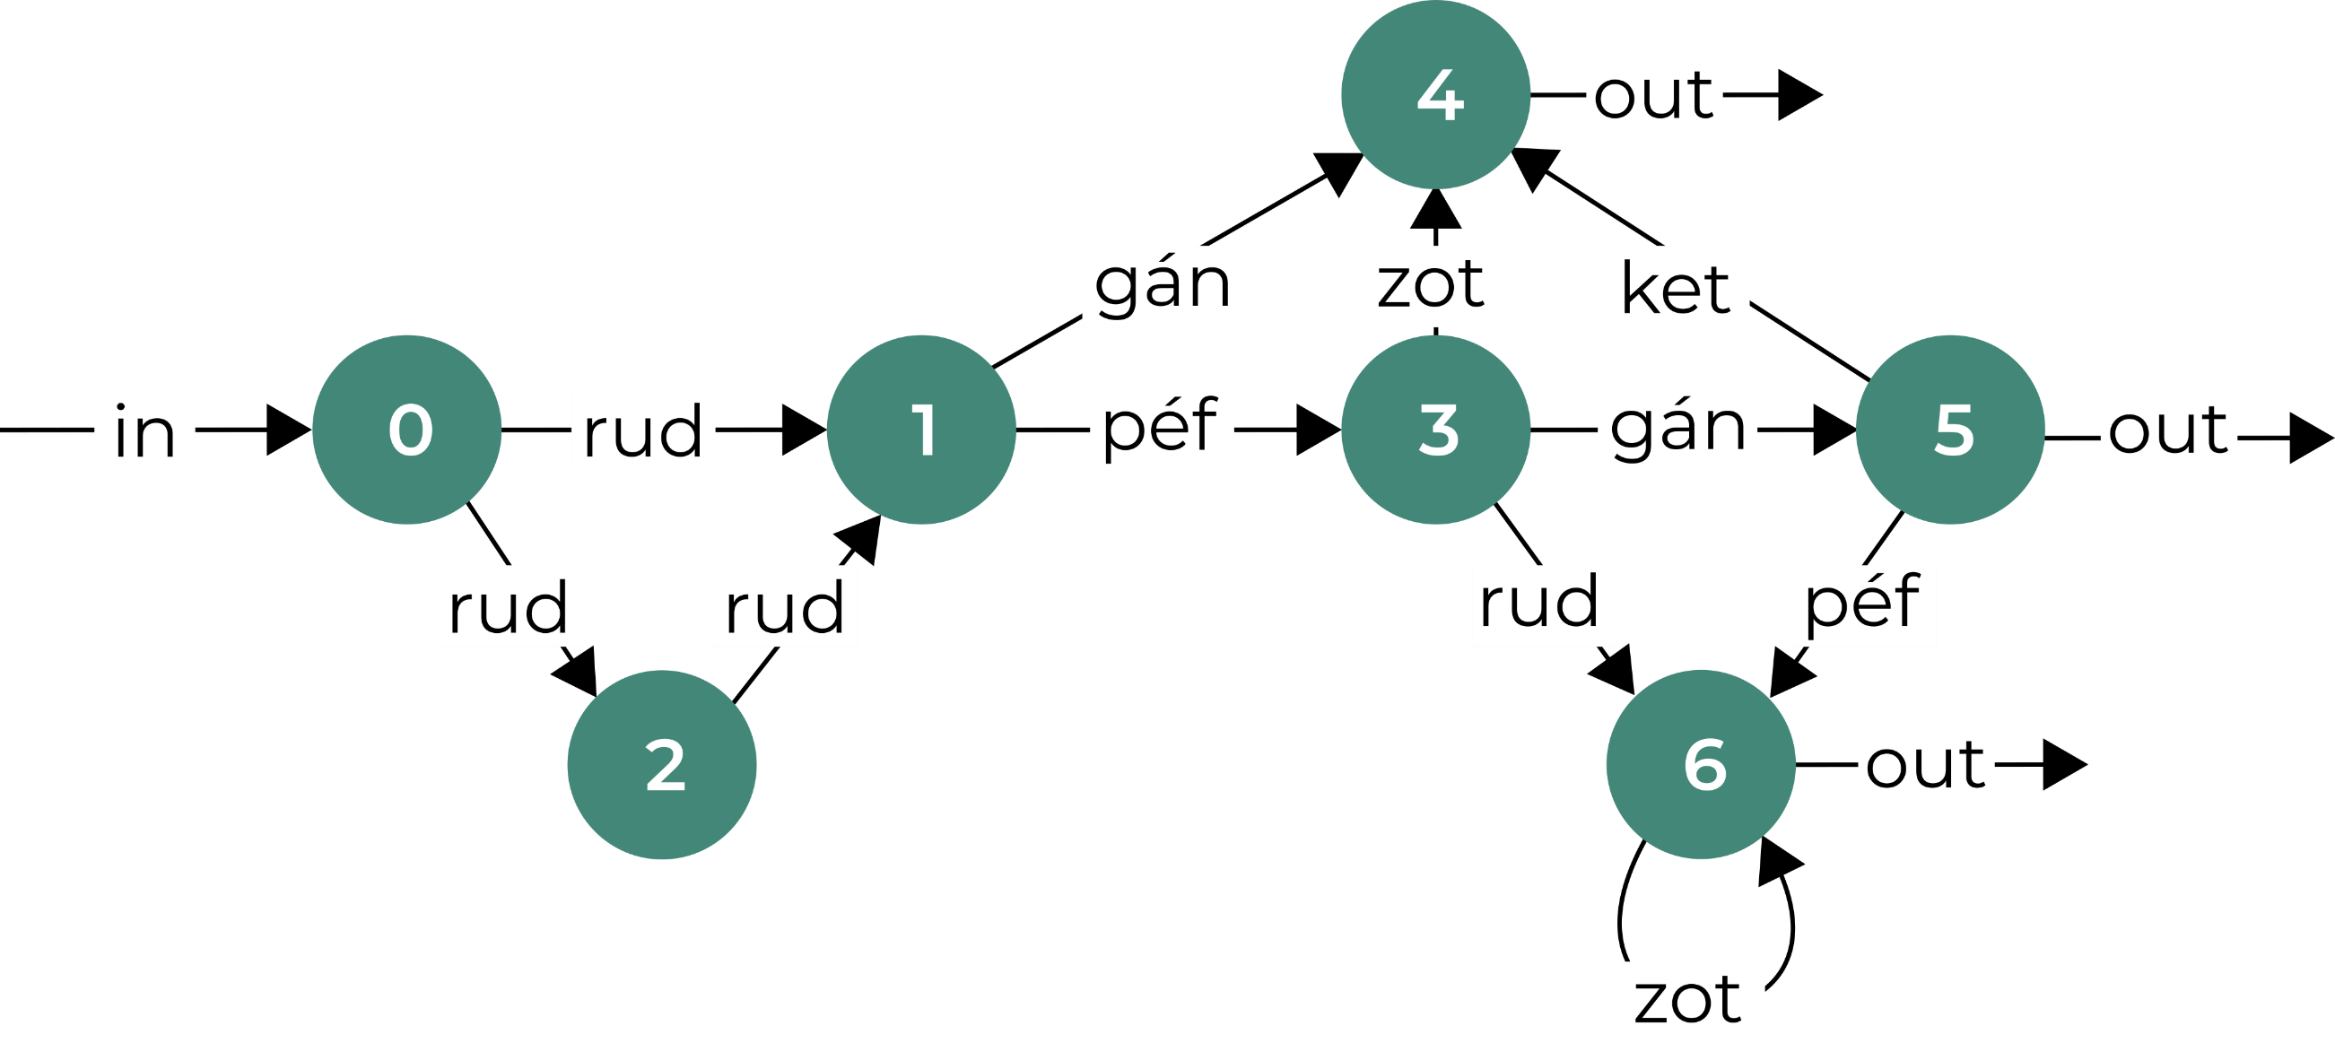




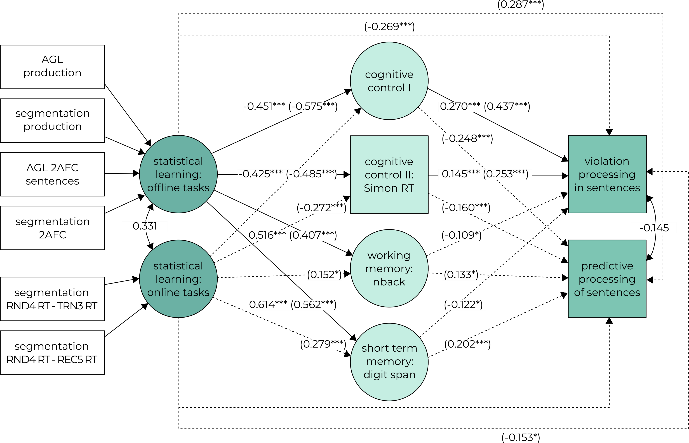

The effect of statistical learning and general cognitive skills on language processing: a structural equation modeling study
¹Department of Cognitive Science, Budapest University of Technology and Economics, Budapest, Hungary
²MTA-BME Momentum Language Acquisition Research Group, Eötvös Loránd Research Network, ELKH, Budapest, Hungary
³Department of Cognitive Psychology, Institute of Psychology, Eötvös Loránd University, Budapest, Hungary
⁴Psycholinguistics and Neurolinguistics Research Group, Institute for General and Hungarian Linguistics, ELKH Hungarian Research Centre for Linguistics, Budapest, Hungary
Krisztina Sára Lukics^{1,2}; Dorottya Dobó^{1,2}; Bálint József Ugrin^{3,4}; Ágnes Lukács^{1,2}
This work was supported by the Momentum Research Grant of the Hungarian Academy of Sciences (Momentum 96233 'Profiling learning mechanisms and learners: individual differences from impairments to excellence in statistical learning and in language acquisition', PI: Ágnes Lukács
Background and aims
this study:
includes multiple statistical learning and language tasks
controls for background cognitive skills
uses statistical learning and language tasks suitable for assessing predictive processing
does the efficiency of statistical learning relate to the efficiency of language mechanisms including predictive mechanisms?
statistical learning is related to language, e.g.:
speech perception in noise (Conway et al, 2010)
syntactic priming (Kidd, 2012)
syntax comprehension (Kidd & Arciuli, 2012; Misyak & Christiansen, 2012)
no systematic examination of this relationship, and no systematic investigation of potential mediator cognitive abilities yet
The study
Factors behind language processing
502 participants (mean age: 26, SD = 12.5, range = 18-79, 367 F)
online and in-person test administration via Pavlovia
offline language measures
Tasks
1
statistical learning
1) word segmentation
csa gye jü
cé vi gá
lo ha ri
sö pe tu
cé vi gá
csa gye jü
lo ha ri
2) artificial grammar learning (AGL)
procedure and measures of SL tasks
target detection task
2AFC
production
xxxx
?
xxxxxxxxxxxxxx
?
xx__x
predictive language measures
*xxxx
1) a
2) b
3) c
offline tasks based on Siegelman, Bogaerts & Frost (2017)
online measures |  | offline measures
RT difference | ACC difference | 2AFC | production
2
nonlinguistic cognitive skills
visual processing speed: RT and decision RT
auditory processing speed: RT and decision RT
forward and backward digit span
nback: 1, 2 and 3 back
Stroop task: RT and ACC
Simon task: RT and ACC
3
language
grammatical structure sensitivity
pragmatic sentence comprehension (KOBAK, Lukács & Kas, in prep.)
receptive vocabulary task (KOBAK)
online processing of syntactic and semantic violations
predictive processing of sentences (Hintz et al., 2023)
The cognitive control I factor consists of the Stroop RT and the visual processing speed decision RT indices. The cognitive control II is a single-index factor and consists of the Simon RT index. The working memory index contains the 1, 2 and 3 back indices. The short term memory factor consists of the forward and backward digit span indices. The cognitive control factors were positively correlated with each other, while the cognitive control and short term and working memory factors were negatively correlated with each other.
Discussion
both statistical learning and language tasks strongly rely on a shared set of general cognitive abilities
the shared variance between statistical learning and language tasks are mostly explained by these general cognitive abilities
offline statistical learning measures contribute to variance in offline (but not online, predictive) linguistic measures even beyond cognitive abilities
questions:
why is the relationship between offline measures of statistical learning and language abilities stronger than the relationship with offline statistical learning measures ?
can statistical learning measures be improved to be less confounded by other cognitive abilities?
what are the aspects of language where the relationship with statistical learning is well motivated?
References
Contact
Conway, C. M., Bauernschmidt, A., Huang, S. S., & Pisoni, D. B. (2010). Implicit statistical learning in language processing: Word predictability is the key. Cognition, 114(3), 356-371.
Hintz, F., Voeten, C. C., Dobó, D., Lukics, K. S., & Lukács, Á. (2023). The role of general cognitive skills in integrating visual and linguistic information during sentence comprehension: Individual differences across the lifespan [Manuscript submitted for publication].
Kidd, E. (2012). Implicit statistical learning is directly associated with the acquisition of syntax. Developmental psychology, 48(1), 171.
Kidd, E., & Arciuli, J. (2016). Individual differences in statistical learning predict children's comprehension of syntax. Child development, 87(1), 184-193.
Lukács, Á., & Kas, B. (in preparation). Development and standardization of a comprehensive developmental speech and language screening test (Komplex Beszélt Anyanyelvi Képességteszt, KOBAK)
Lukacs, Kas, Takacs, & Vidnyánszky (in preparation). Test battery for examining reading abilities in adolescents and adults.
Misyak, J. B., & Christiansen, M. H. (2012). Statistical learning and language: An individual differences study. Language Learning, 62(1), 302-331.
Siegelman, N., Bogaerts, L., & Frost, R. (2017). Measuring individual differences in statistical learning: Current pitfalls and possible solutions. Behavior research methods, 49(2), 418-432.
lukics.krisztina.sara@ttk.bme.hu
balintugrin@yahoo.de
Download the PDF!

