Slide 1


CAPSTONE PROJECT
PROJECT TITLE
Presented By
Student Name: KRIT GIRI
College Name: NARULA INSTITUTE OF TECHNOLOGY
Department: CSE (AI & ML)
Email ID: kritgiri2006@gmail.com

Slide 2
OUTLINE:
Problem Statement (Should not include solution)
Proposed System/Solution
System Development Approach (Technology Used)
Algorithm & Deployment
Result (Output Image)
Conclusion
Future Scope
References

Slide 3
Problem Statement:
Electric vehicle adoption is increasing rapidly across many cities as governments and organizations promote sustainable transportation. However, understanding EV demand trends, infrastructure growth, and environmental impact remains a challenge. Cities need data-driven insights to understand how EV registrations are changing over time, how charging infrastructure is developing, and how electric vehicles contribute to reducing carbon emissions.
Analyzing historical EV data from 2015 to 2025 can help identify demand patterns across cities, evaluate infrastructure readiness, and understand the environmental benefits of EV adoption.

Slide 4
Proposed Solution:
The proposed system aims to analyze the demand and impact of electric vehicles using data analytics and visualization techniques. The project focuses on understanding EV adoption trends, infrastructure development, and environmental benefits from 2015 to 2025. The solution consists of the following components:
Data Collection
Historical EV data from 2015–2025 including registrations, vehicle types, charging stations, charging sessions, and CO₂ reduction was collected.
Data from major Indian cities was organized to analyze regional EV adoption trends.
Data Preprocessing
The dataset was cleaned and structured using Microsoft Excel to remove inconsistencies and prepare it for analysis.
Relevant fields such as date, city, vehicle type, and infrastructure data were organized for visualization.
Visualization
An interactive Power BI dashboard was developed to visualize EV adoption trends and infrastructure growth.
Charts such as line charts, bar charts, donut charts, and KPI cards were used to present insights clearly.
Deployment
The dashboard was designed to allow interactive filtering and exploration of EV demand trends.
The solution can be deployed using Power BI for data-driven decision-making and reporting

Slide 5
System Approach:
System Requirements
A computer system capable of running Microsoft Power BI and Microsoft Excel for data processing and visualization.
A structured dataset containing EV registrations, charging stations, charging sessions, vehicle types, and CO₂ reduction data from 2015–2025.
Libraries / Tools Required
Microsoft Excel for data cleaning, preprocessing, and organizing the dataset.
Microsoft Power BI for building interactive dashboards, charts, KPI cards, and data analysis.

Slide 6
Algorithm & Deployment:
Algorithm Selection
The project uses data analytics and visualization techniques instead of a machine learning model to analyze EV demand trends.
Aggregation and filtering methods in Power BI were used to summarize EV registrations by year, city, and vehicle type.
Data Input
The dataset includes EV registrations, vehicle type, charging stations, charging sessions, and CO₂ reduction data from 2015–2025.
The data also contains city-wise information to analyze regional EV adoption patterns.
Training Process
The dataset was cleaned and preprocessed in Microsoft Excel to ensure accurate analysis.
Data was then imported into Power BI, where relationships and measures were created to calculate totals and trends.
Prediction / Analysis Process
Power BI visualizations such as line charts, bar charts, donut charts, and KPI cards were used to analyze EV demand patterns.
Interactive filters and slicers allow users to explore EV growth trends and infrastructure development across cities and years.

Slide 7
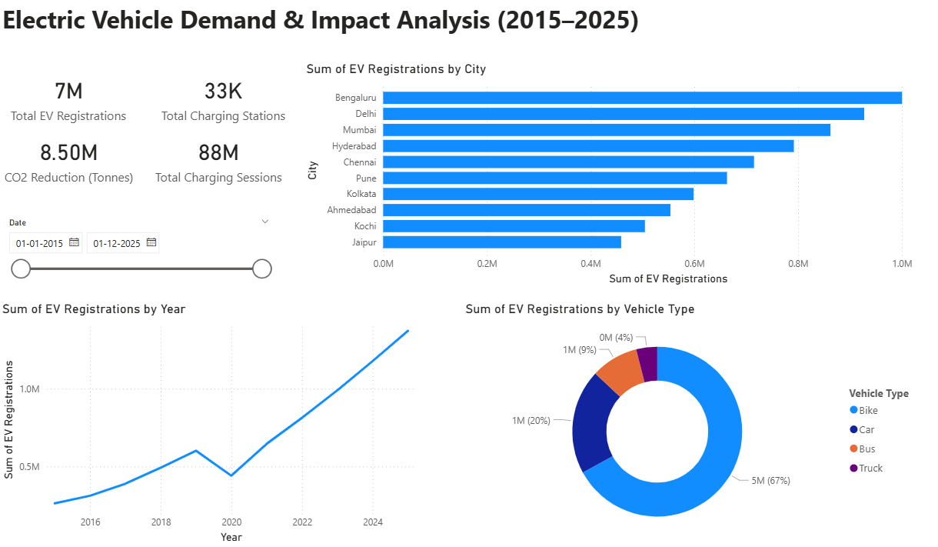
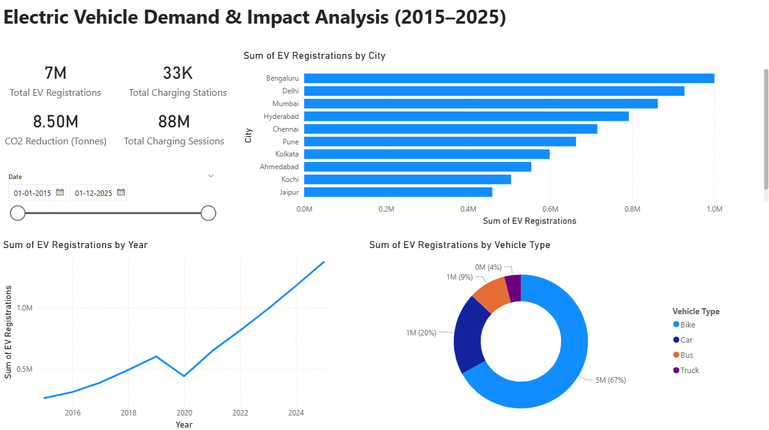
Result:
Key Insights:
EV adoption has increased significantly from 2015 to 2025, showing strong growth in electric mobility.
Bengaluru, Delhi, and Mumbai lead EV registrations among major cities.
Two-wheelers (bikes) account for the majority of EV registrations in India.
A noticeable drop in EV registrations occurred in 2020 due to the COVID-19 lockdown.
Growth in charging stations and charging sessions indicates improving EV infrastructure and usage.

Slide 8
Conclusion:
Electric vehicle adoption has shown significant growth from 2015 to 2025, highlighting the increasing shift toward sustainable transportation. The developed Power BI dashboard effectively analyzes EV registrations, charging infrastructure development, and environmental impact across major cities. The analysis reveals that metropolitan cities such as Bengaluru, Delhi, and Mumbai lead EV adoption, while two-wheelers dominate the EV market. The insights obtained from this dashboard can help policymakers and organizations understand EV demand patterns and support better planning for future electric mobility infrastructure.

Slide 9
Future scope:
Future improvements can enhance the EV demand analysis system by integrating additional real-time data sources such as government EV policies, charging station availability, and regional economic indicators.
Advanced analytics and machine learning models can be incorporated to forecast future EV adoption trends more accurately.
The system can also be expanded to include more cities and states across India, enabling large-scale monitoring of electric mobility growth.
Additionally, integrating geographic mapping and predictive infrastructure planning could help policymakers and organizations optimize charging station deployment and support sustainable transportation development.

Slide 10
References:
• Government of India EV Data: Ministry of Road Transport and Highways (VAHAN Database) – https://vahan.parivahan.gov.in
• NITI Aayog Reports on Electric Mobility in India – https://www.niti.gov.in
• International Energy Agency (IEA) Global EV Outlook Reports – https://www.iea.org
• Microsoft Power BI Documentation – https://learn.microsoft.com/power-bi
• Electric Vehicle Market Research Articles and Reports
GitHub Link: https://github.com/krit-k7/EV-Demand-Impact-Analysis

Slide 11
Thank You

