Slide 1


CAPSTONE PROJECT
Electric Vehicle Demand & Impact Analysis (2015–2025)
Presented By
Student Name: Krit Giri
College Name: NARULA INSTITUTE OF TECHNOLOGY
Department: Cse (ai & ml)
Email ID: kritgiri2006@gmail.com

Slide 2
OUTLINE:
Problem Statement
Proposed System/Solution
System Development Approach
Algorithm & Deployment
Result (Output Image)
Conclusion
Future Scope
References

Slide 3
Problem Statement:
India's rapid shift towards electric mobility has led to growing EV registrations across major urban cities. However, city planners and policymakers lack a centralized, data-driven view of EV adoption trends, charging infrastructure utilization, and environmental impact across different regions and vehicle categories. Without clear visibility into these metrics, it becomes difficult to allocate resources efficiently and formulate effective EV promotion policies. This project develops an interactive Power BI dashboard analyzing EV data across 10 major Indian cities from 2015 to 2025 to enable informed, data-driven decisions.

Slide 4
Proposed Solution:
The proposed system aims to address the lack of centralized visibility into India's EV adoption by developing an interactive Power BI dashboard analyzing data across 10 major cities from 2015 to 2025. The solution consists of the following components:
Data Collection:
Gathered synthetic EV dataset including registrations, charging stations, charging sessions, and CO2 reduction across 10 Indian cities.
Data covers multiple vehicle categories — Bikes, Cars, Buses, and Trucks — over a 10-year period.
Data Preprocessing:
Cleaned and structured the dataset to ensure consistency across city, year, and vehicle type fields.
Formatted date fields and validated numeric columns for accurate aggregation.
Dashboard Development:
Built an interactive Power BI dashboard with KPI cards, bar charts, line charts, and donut charts.
Implemented a date slicer to enable dynamic filtering across the full 2015–2025 timeline.
Key Metrics Visualized:
Total EV Registrations (7M), Charging Stations (33K), CO2 Reduction (8.50M Tonnes), and Charging Sessions (88M).
EV registrations broken down by city, year, and vehicle type.
Evaluation:
Verified dashboard accuracy by cross-checking KPI totals against city and vehicle type breakdowns.
Validated that all visuals reflect consistent values and the date slicer filters all charts correctly.

Slide 5
System Approach:
The System Approach outlines the overall strategy and methodology for developing and implementing the EV Demand & Impact Analysis dashboard using Microsoft Power BI.
System Requirements:
Microsoft Power BI Desktop
Microsoft Excel (for dataset preparation)
Windows 10 or above
Tools & Technologies Used:
Power BI Desktop — for dashboard creation and data visualization
Excel/CSV — for storing and managing the EV dataset
DAX (Data Analysis Expressions) — for creating calculated measures and KPI values
Power Query — for data cleaning and transformation
Dataset Details:
10 Indian cities: Bengaluru, Delhi, Mumbai, Hyderabad, Chennai, Pune, Kolkata, Ahmedabad, Kochi, Jaipur
Time period: 2015–2025
Vehicle types: Bike, Car, Bus, Truck
Key fields: City, Year, Vehicle Type, EV Registrations, Charging Stations, Charging Sessions, CO2 Reduction

Slide 6
Algorithm & Deployment:
The following outlines the data processing approach and deployment methodology used to develop the EV Demand & Impact Analysis dashboard.
Algorithm Selection:
Power BI's built-in DAX (Data Analysis Expressions) engine was used for data aggregation and KPI calculations instead of a traditional ML algorithm.
DAX measures were created to calculate Total EV Registrations, Total CO2 Reduction, Total Charging Stations, and Total Charging Sessions dynamically.
Data Input:
Input dataset contains fields: City, Year, Vehicle Type, EV Registrations, Charging Stations, Charging Sessions, and CO2 Reduction (Tonnes).
Data covers 10 Indian cities across 2015–2025.
Processing Approach:
Data was cleaned and transformed using Power Query in Power BI.
Relationships were established between tables to enable cross-filtering across all visuals.
Deployment:
Dashboard was developed and published using Microsoft Power BI Desktop.
Interactive slicers allow stakeholders to filter data dynamically by date range across all visuals simultaneously.

Slide 7
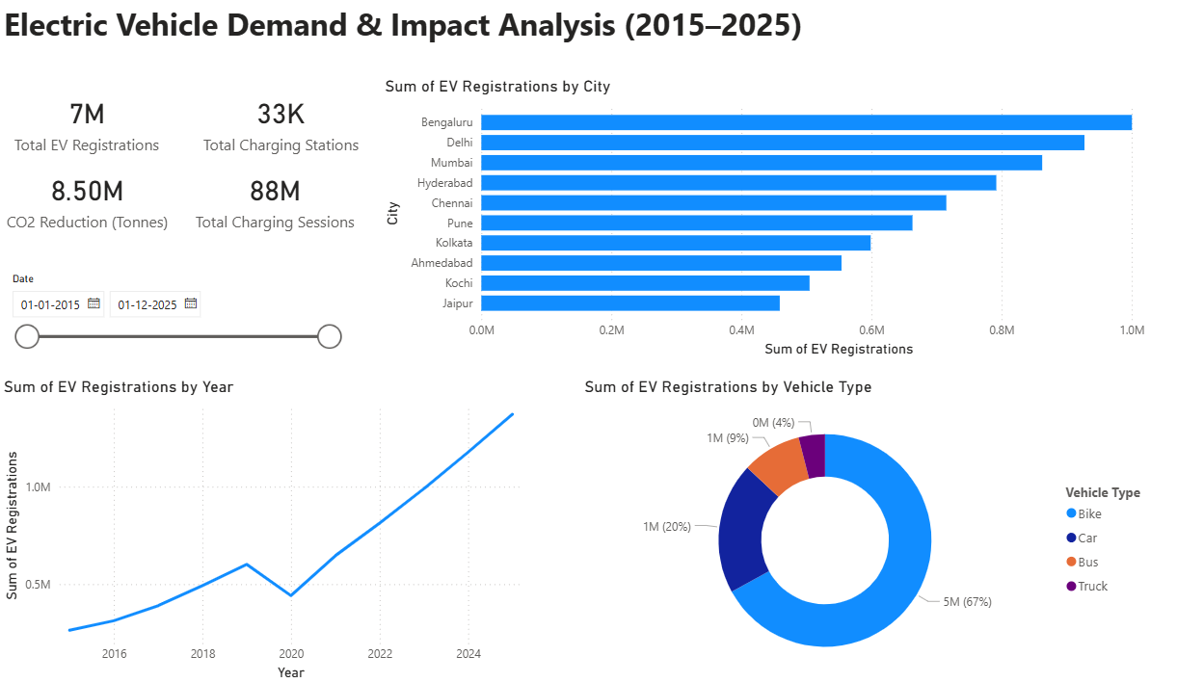
Result:
Key Insights:
EV adoption has increased significantly from 2015 to 2025, showing strong growth in electric mobility.
Bengaluru, Delhi, and Mumbai lead EV registrations among major cities.
Two-wheelers (bikes) account for the majority of EV registrations in India.
A noticeable drop in EV registrations occurred in 2020 due to the COVID-19 lockdown.
Growth in charging stations and charging sessions indicates improving EV infrastructure and usage.

Slide 8
Conclusion:
The EV Demand & Impact Analysis dashboard successfully provides a centralized, data-driven view of electric vehicle adoption across 10 major Indian cities from 2015 to 2025.
The analysis reveals that Bengaluru, Delhi, and Mumbai lead in EV registrations, reflecting stronger EV infrastructure and policy support in these cities.
Bikes dominate the EV market at 67%, consistent with India's two-wheeler culture and affordability factor.
EV registrations show a steady growth trend from 2015 to 2025, with a minor dip around 2020 likely due to the COVID-19 pandemic impact on vehicle sales.
A total CO2 reduction of 8.50M Tonnes highlights the significant environmental benefit of EV adoption across these cities.
The interactive date slicer enables dynamic analysis, making the dashboard a practical tool for policymakers and urban planners.
Overall, the project demonstrates how data visualization using Power BI can transform raw data into actionable insights for India's clean energy transition.

Slide 9
Future scope:
The current dashboard provides a strong foundation for EV analysis, and can be further enhanced in the following ways:
Real-Time Data Integration:
Connect the dashboard to live government EV registration APIs to display real-time adoption data instead of static historical data.
Predictive Analytics:
Incorporate machine learning models to forecast future EV demand, charging station requirements, and CO2 reduction targets for upcoming years.
Geographic Expansion:
Extend the analysis beyond 10 cities to cover all Indian states and tier-2/tier-3 cities to get a more comprehensive national picture.
Charging Infrastructure Optimization:
Add analysis to identify areas with high EV density but low charging station coverage to guide infrastructure investment decisions.
Economic Impact Analysis:
Include metrics such as fuel cost savings, government subsidy impact, and employment generated by the EV industry.
Mobile Accessibility:
Deploy the dashboard on Power BI Service to make it accessible on mobile devices for on-the-go decision making by stakeholders.

Slide 10
References:
Government of India EV Data: Ministry of Road Transport and Highways (VAHAN Database) – https://vahan.parivahan.gov.in
• NITI Aayog Reports on Electric Mobility in India – https://www.niti.gov.in
• International Energy Agency (IEA) Global EV Outlook Reports – https://www.iea.org
• Microsoft Power BI Documentation – https://learn.microsoft.com/power-bi
• Electric Vehicle Market Research Articles and Reports
GitHub Link: https://github.com/krit-k7/EV-Demand-Impact-Analysis

Slide 11
Thank You

