Slide 1


SMART INDIA HACKATHON 2025
TITLE PAGE
Problem Statement ID – SIH 25092
Problem Statement Title-Development of a Digital Mental
Health and Psychological Support System for Students in
Higher Education
Theme- MedTech/BioTech/HealthTech
PS Category- Software
Team ID-
Team Name (Registered on portal) - ByteX

Slide 2

IDEA TITLE
ByteX
IDEA / SOLUTION :
Problem Resolution:
AI Chatbot: Instant first-aid mental health support.
Mood Check-In: Tracks stress, anxiety, and emotions with AI analytics.
Anonymous Journal: AI-driven sentiment analysis and personalized feedback.
Self-Assessment Tests: Quick AI-generated reports on stress, anxiety, personality.
Therapy Modules: AI-curated meditation, colour, and sound therapy.
Peer Connection: Safe, AI-moderated student support platform.
Confidential Booking: Secure appointments with counsellors/helplines.
Admin Dashboard: Anonymized AI insights for data-driven interventions.
Anonymous Student-to-Student Chat – Students can connect and talk to each other anonymously for peer support.
AI-Powered Support: Instant, stigma-free guidance with early stress detection and personalized coping strategies.
Institutional Insights: Anonymized analytics enable colleges to monitor well-being and act effectively.
Unique Value Propositions (UVP):
AI Personalization: Tailors mental health support to each student.
Stigma-Free Expression: Anonymous journaling and peer forums.
Early Detection: Tracks moods and assessments to spot risks.
All-in-One Platform: Chatbot, therapy, meditation, and dashboards.
Institutional Insights: Gives anonymized data for targeted interventions.

Slide 3
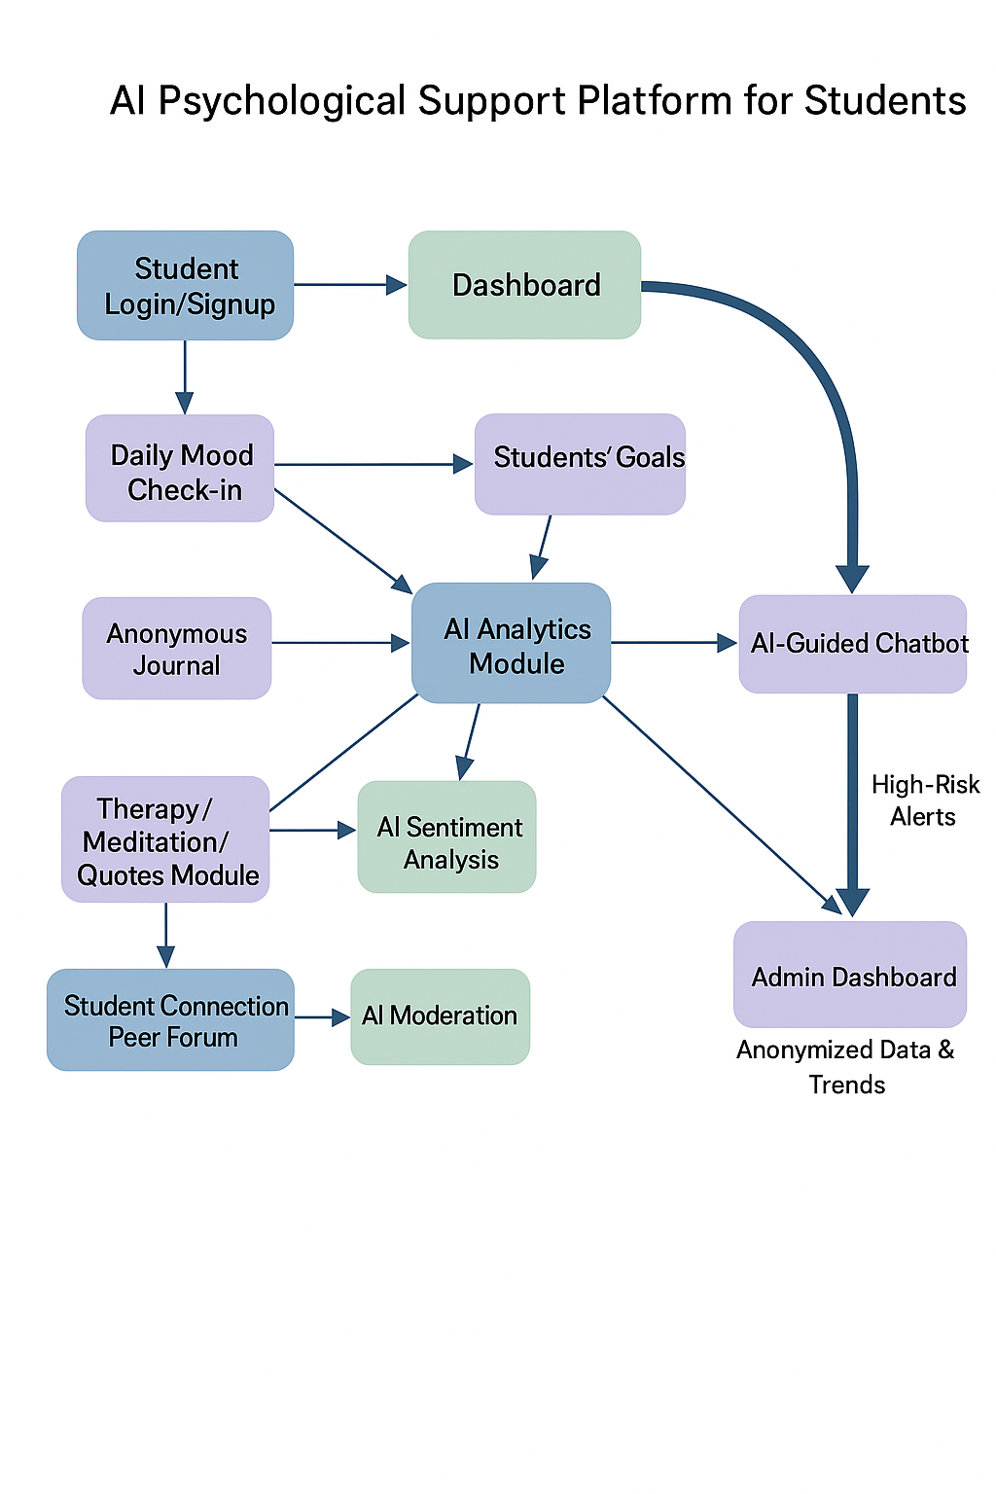
TECHNICAL APPROACH
ByteX
PROCESS FLOW ARCHITECTURE
Frontend: Responsive student dashboard (React/Vue) with mood check-ins, chatbot, journaling, and therapy modules.
Backend & Database: Django/Flask or Node.js with MongoDB/PostgreSQL for secure storage of profiles, logs, and assessments.
AI/ML: NLP for chatbot & journal analysis, predictive mood analytics, and therapy recommendation engine.
Deployment & Analytics: Frontend on Vercel/Netlify, backend on Render/Railway, CI/CD enabled, admin dashboard with anonymized insights.

Slide 4
FEASIBILITY AND VIABILITY
ByteX
Feasibility:
Technical: Built with React/Vue frontend, Flask/Django or Node backend, free cloud hosting; AI uses pre-trained models.
Operational: Easy for students and institutions; privacy maintained; no special hardware needed.
Financial: Minimal cost using open-source tools and free cloud tiers.
Viability:
Adoption: Anonymity and AI personalization encourage student usage.
Scalability: Can expand to multiple colleges, regional languages, and integrate with existing counsellors.
Impact: Early detection, timely support, and data-driven institutional insights.

Slide 5
IMPACT AND BENEFITS
ByteX
Impact:
Early detection of stress, anxiety, and burnout in students.
Reduces stigma around seeking mental health support.
Provides data-driven insights for institutions to plan interventions.
Benefits:
Personalized, AI-powered guidance for students’ well-being.
Safe, anonymous platform for journaling and peer support.
Easy integration with college counselling and support systems.

Slide 6
RESEARCH AND REFERENCES
ByteX
Research:
Rising stress, anxiety, and burnout among college students.
AI and digital tools improve early detection and personalized support.
Anonymous and peer platforms boost engagement.
References:
WHO, “Mental Health of Students,” 2023.
Liu et al., Frontiers in Psychiatry, 2021.

