Slide 1

Movie Review Sentiment Analyser
Made by:-
Kritank Singh
Lakshay Saini
Avinash Sitaram

Slide 2
INDEX
Introduction
Where can it be used?
How to classify Sentiment?
Machine Learning Approach
Lexicon-Based Approach
Hybrid Approach
Problem Scenario
Road Map
Data Preprocessing
Bag of Words Representation
Sentiment Analysis Model
Implementation and Result
Bibliography

Slide 3
Introduction
Sentiment Analysis also known as “Opinion Mining”, Sentiment Analysis refers to the use of Natural Language Processing to determine the attitude, opinions and emotions of a speaker, writer, or other subject within an online mention.
Essentially, it is the process of determining whether a piece of writing is positive or negative. This is also called the Polarity of the content.
As humans, we are able to classify text into positive/negative subconsciously. For example, the sentence “The kid had a gorgeous smile on his face”, will most likely give us a positive sentiment. In layman’s terms, we kind of arrive at such a conclusion by examining the words and averaging out the positives and the negatives. For instance, the words “gorgeous” and “smile” are more likely to be positive, while words like “the”, “kid” and “face” are really neutral. Therefore, the overall sentiment of the sentence is likely to be positive.
Where can it be used?
A common use for this technology comes from its deployment in the social media space to discover how people feel about certain topics.
It also finds its use in analyzing the sentiment of the general public towards a particular product, person or thing, In our case it is a movie.

Slide 4
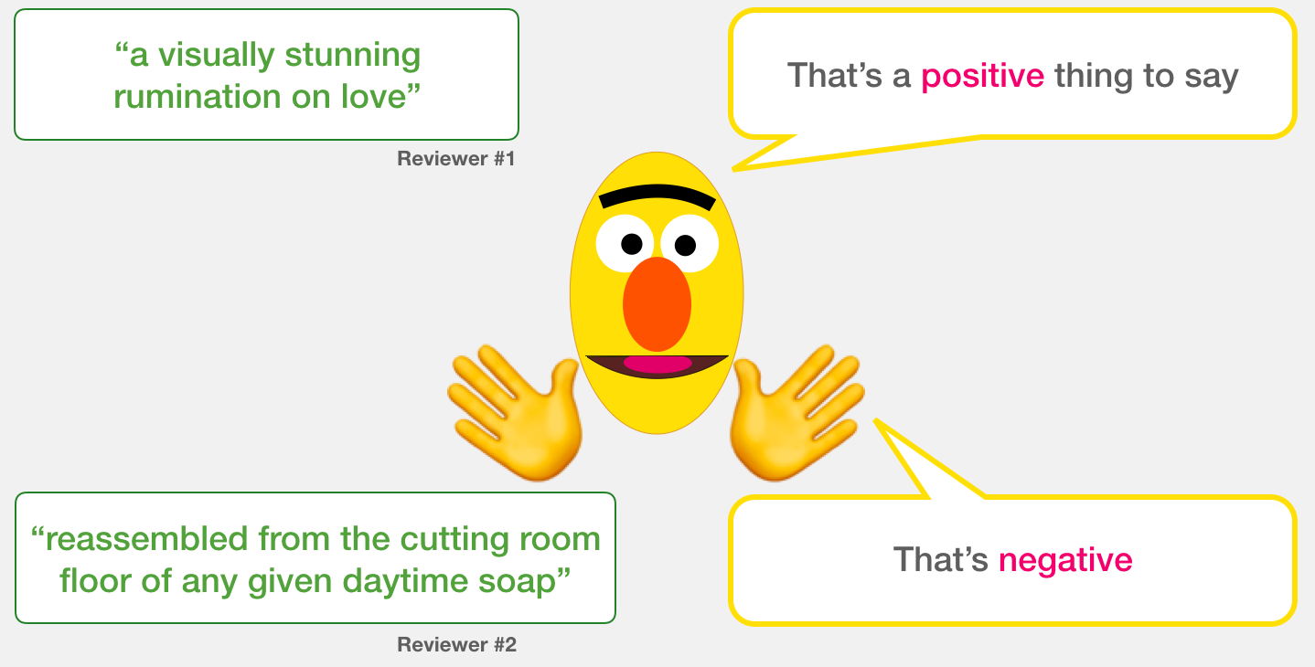

Slide 5
How to classify Sentiment?
Machine Learning Approach
This approach employs a machine-learning technique and diverse features to construct a classifier that can identify text that expresses sentiment. Nowadays, deep-learning methods are popular because they fit on data learning representations.
Lexicon-Based Approach
This method uses a variety of words annotated by polarity score, to decide the general assessment score of a given content. The strongest asset of this technique is that it does not require any training data, while its weakest point is that a large number of words and expressions are not included in sentiment lexicons.
Hybrid Approach
The combination of machine learning and lexicon-based approaches to address Sentiment Analysis is called Hybrid. Though not commonly used, this method usually produces more promising results than above approaches.

Slide 6
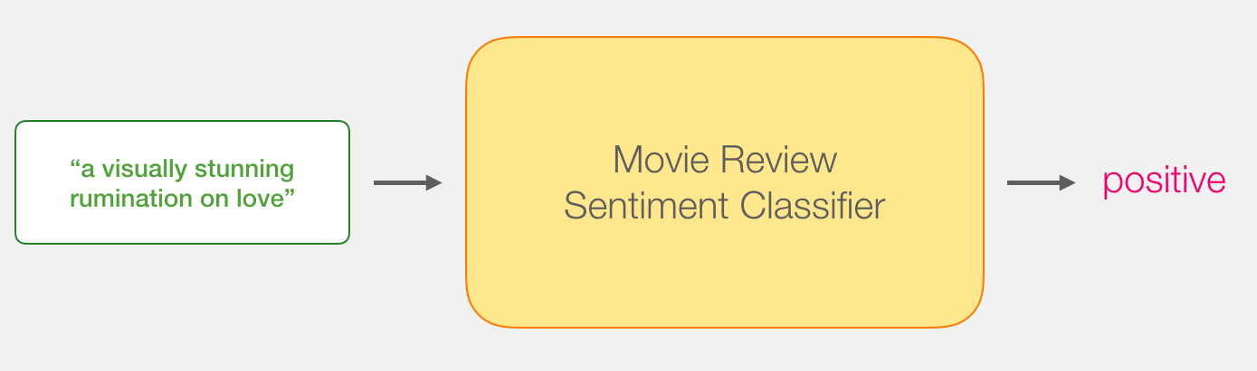

Slide 7
Problem Scenario
We need to train a model to recognize the emotion of the movie review as positive or negative. It is a binary classification problem.
The dataset used here is known as 'Polarity Dataset'. The dataset used in our project has been taken from Stanford .
This is a dataset for binary sentiment classification containing substantially more data than previous benchmark datasets.
This dataset has following properties:
They provide a set of 25,000 highly polar movie reviews for training, and 25,000 for testing.
It only comprises of English reviews.
There is whitespace around punctuations like periods, commas, and brackets.
There is additional unlabeled data for use as well.

Slide 8
This problem is approached in three stages:
A. Data Pre-processing
This stage involves the following steps:
Loading the data
Analysis of data
Cleaning the data.
Defining a vocabulary
Creating the feature list (words that would be considered in the sentiment analysis)
B. Bag Of Words Representation
This stage focuses on preparing the data for the training model. It involves following steps:
Converting reviews to lines of tokens.
Encoding reviews with a bag-of-words model representation.
C. Sentiment Analysis Model
In this project we develop a Naive Bayes Model to predict the sentiment/emotion of the reviews.

Slide 9
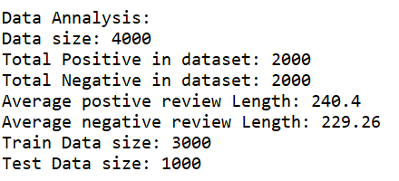
Road Map
A. Data Preprocessing
A.1. Training and Testing set
The dataset contains positive and negative reviews. Among them, some positive and negative reviews are used as training sets and the remaining positive and negative reviews are used as test data.
A.2. Load the data
The load method helps to load the dataset into the memory.
A.3. Analysis of the data
In the analysis of the data we generate a report on:
Size of the dataset
Total Positive Sentiment in the dataset
Total Negatives Sentiment in the dataset
Average Positive review length
Average Negative review length
Train Data size
Test Data size

Slide 10
B. BAG OF WORDS REPRESENTATION
B.1. Define a Vocabulary
Cleaning the data:
This step helps to turn data into clean tokens. The following methods are employed in this project to generate clean tokens.
Remove all the punctuations.
Remove all stop words.
Remove all words with small length (length <= 1 character).
What are Stopwords?
Stop words are words which are filtered out before or after processing of natural language data. Though "stop words" usually refers to the most common words in a language, there is no single universal list of stop words used by all natural language processing tools, and indeed not all tools even use such a list. Here we use stopwords.
Stopwords Example:
'a', 'about', 'above', 'across', 'after', 'afterwards', 'again', 'against', 'all', 'almost', 'alone','along', 'already', 'also', 'although', 'always', 'am', 'among', 'amongst', 'amongst', 'amount', 'an', 'and', 'another', 'any', 'anyhow', 'anyone', 'anything', 'anyway', 'anywhere', 'are', 'around','as', 'at', 'back', 'be', 'became', 'because', 'become', 'becomes', 'becoming', 'been', 'before', 'beforehand', 'behind', 'being', 'below', 'beside', 'besides', 'between', 'beyond', 'bill', 'both', 'bottom', 'but', 'by', 'call', 'can', 'cannot', 'cant', 'co', 'con', 'could…..(and many more)

Slide 11
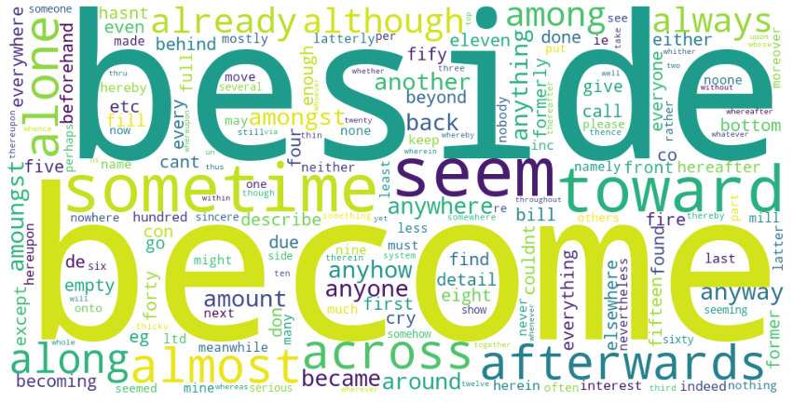

Slide 12
2. Build Vocabulary
It is necessary to define a vocabulary of words to vectorise the document of reviews. The below method defines a vocabulary of words and maintains the count of the occurrence of each word in the vocabulary.
The cleanbuildVocabulary function of the Features class performs cleaning and building the vocabulary
3. Build Features
From the vocabulary created above features are created. And on the basis
of these features our reviews are classified as Positive or Negative.
The buildFeatures function of the Features class performs this task.

Slide 13
B.2. Reviews to lines of tokens (Reviews -> Tokens)
Here, each review is loaded to memory and cleaned for tokens. The obtained tokens are further cleaned by retaining only those tokens that are also in features we defined previously.
B.3. Reviews to Bag-Of-Words Vectors (Reviews -> Tokens -> Vectors)
The data that is fed to the training model should be encoded into numerical values and all the training examples should be of uniform length. So far what we have is the training and test data in the textual form and of non-uniform length. We use the Bag-Of-Words model to encode the data in order to make it suitable for training/learning.
In this model each review is transformed to an encoded vector where each word is assigned a score. The length of the vector corresponds to the length of the vocabulary. There are different methods for scoring the words. In this project we use 'count' for scoring the words. Let's understand how it works.
Example:
Let’s assume that
Features = {this, that, is, mine, not, cat, dog}
text = "This this is mine".
Then encoded text using the 'count' scoring method is [2, 0, 1, 1, 0, 0, 0]

Slide 14
Explanation:
The number of words in the text is 4.
The length of the vector = length of the features = 7
score of 'this' = (total occurrence of 'this' in the text) = 2
the score of 'this' is stored in the index corresponding to 'this' in the vector( for now, we can assume it to be in the same index as in vocabulary).
the words 'that', 'not', 'cat', 'dog' do not occur in the text so their corresponding indexes in the vector are assigned a score of zero
The process of getWordVectorCount of the NaiveBayes class performs the complete task of review -> token -> count vector.
This count vector is fed into the model to train/predict the class to which the review belongs.

Slide 15
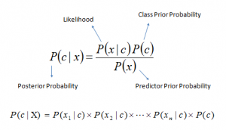
C. SENTIMENT ANALYSIS MODEL
C.1. Building a Classifier Model
There are different types of models that we can use. Here we have used Naive Bayes Classifier.
It is a classification technique based on Bayes’ Theorem with an assumption of independence among predictors. In simple terms, a Naive Bayes classifier assumes that the presence of a particular feature in a class is unrelated to the presence of any other features.
Bayes theorem provides a way of calculating posterior probability P(c|x) from P(c), P(x) and P(x|c). Look at the equation below:
Above,
P(c|x) is the posterior probability of class (c, target) given predictor (x, attributes).
P(c) is the prior probability of class.
P(x|c) is the likelihood which is the probability of a predictor given class.
P(x) is the prior probability of the predictor.
How does Naive Bayes algorithm work?
Let’s understand it using an example. Below we have a training data set of weather and corresponding target variable ‘Play’ (suggesting possibilities of playing). Now, we need to classify whether players will play or not based on weather conditions. Let’s follow the below steps to perform it.

Slide 16
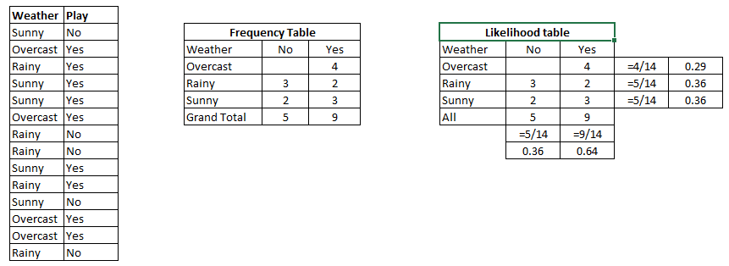
Step 1: Convert the data set into a frequency table
Step 2: Create a Likelihood table by finding the probabilities like Overcast probability = 0.29 and probability of playing is 0.64.
Step 3: Now, use the Naive Bayesian equation to calculate the posterior probability for each class. The class with the highest posterior probability is the outcome of prediction.
Problem: Players will play if the weather is sunny. Is this statement correct?
We can solve it using the above discussed method of posterior probability.
P(Yes | Sunny) = P( Sunny | Yes) * P(Yes) / P (Sunny)
Here we have P (Sunny |Yes) = 3/9 = 0.33, P(Sunny) = 5/14 = 0.36, P( Yes)= 9/14 = 0.64
Now, P (Yes | Sunny) = 0.33 * 0.64 / 0.36 = 0.60, which has higher probability.
Naive Bayes uses a similar method to predict the probability of different classes based on various attributes. This algorithm is mostly used in text classification and with problems having multiple classes.

Slide 17


Slide 18
P^{ˆ}(c) = ^{Nc}
 | Doc | Words | Class
Training | 1 | Chinese Beijing Chinese | c
 | 2 | Chinese Chinese Shanghai | c
 | 3 | Chinese Macao | c
 | 4 | Tokyo Japan Chinese | j
Test | 5 | Chinese Chinese Chinese Tokyo Japan | ?
N
_{Pˆ(w | c) =} count(w, c) +1
count(c)+ | V |
Priors:
P(c)=
P(j)=
3
1
4
4
Choosing a class:
P(c|d5)
3/4 * (3/7) * 1/14 * 1/14
≈ 0.0003
∝
3
Conditional Probabilities:
 | P(Chinese|c) = | (5+1) / (8+6) = 6/14 = 3/7
 | P(Tokyo|c) P(Japan|c) P(Chinese|j) P(Tokyo|j) | (0+1) / (8+6) = 1/14 (0+1) / (8+6) = 1/14 (1+1) / (3+6) = 2/9 | P(j|d5) | ∝ | 1/4 * (2/9)³ * 2/9 * 2/9 ≈ 0.0001
 | P(Japan|j) | (1+1) / (3+6) = 2/9
(1+1) / (3+6) = 2/9

Slide 19
What are the Pros and Cons of Naive Bayes?
Pros:
It is easy and fast to predict the class of test data sets. It also perform well in multi class prediction
When assumption of independence holds, a Naive Bayes classifier performs better compared to other models like logistic regression and you need less training data.
It performs well in case of categorical input variables compared to numerical variable(s). For numerical variables, normal distribution is assumed (bell curve, which is a strong assumption).
Cons:
If a categorical variable has a category (in test data set), which was not observed in training data set, then the model will assign a 0 (zero) probability and will be unable to make a prediction. This is often known as “Zero Frequency”.
On the other side naive Bayes is also known as a bad estimator, so the probability outputs from __probability are not to be taken too seriously.
Another limitation of Naive Bayes is the assumption of independent predictors. In real life, it is almost impossible that we get a set of predictors which are completely independent.

Slide 20
Various Applications of Naive Bayes Algorithms
Real time Prediction: Naive Bayes is an eager learning classifier and it is sure fast. Thus, it could be used for making predictions in real time.
Multi class Prediction: This algorithm is also well known for multi class prediction features. Here we can predict the probability of multiple classes of target variables.
Text classification/ Spam Filtering/ Sentiment Analysis: Naive Bayes classifiers mostly used in text classification (due to better result in multi class problems and independence rule) have higher success rate as compared to other algorithms. As a result, it is widely used in Spam filtering (identify spam email) and Sentiment Analysis (in social media analysis, to identify positive and negative customer sentiments)
Recommendation System: Naive Bayes Classifier and Collaborative Filtering together builds a Recommendation System that uses machine learning and data mining techniques to filter unseen information and predict whether a user would like a given resource or not

Slide 21
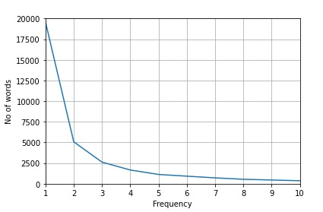
IMPLEMENTATION AND RESULT
Graph showing no of words with frequency in dataset:

Slide 22
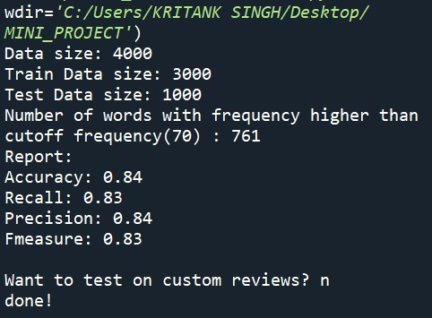
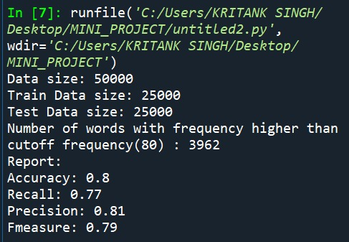
Results using different Cutoff frequencies are given below:

Slide 23
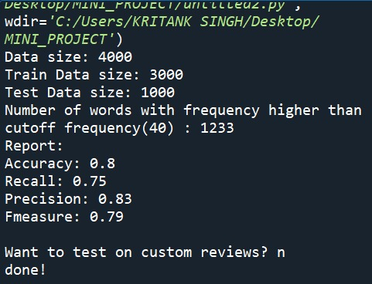
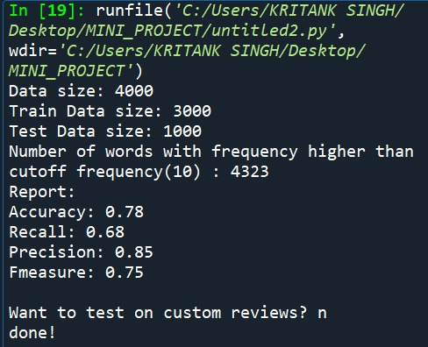

Slide 24
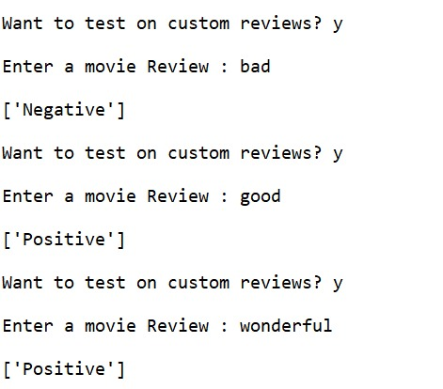
We can supply custom reviews to be classified by our model

Slide 25
Bibliography
Dataset taken from http://ai.stanford.edu/~amaas//data/sentiment/
https://en.wikipedia.org/wiki/Sentiment_analysis
https://en.wikipedia.org/wiki/Naive_Bayes_classifier

