Slide 1




WINNING THE POOH
presents
with
Kritanu
Shivendra

Slide 2
PROBLEM STATEMENT
As a consumer, everyone of us have purchased goods/items which
are in some part of their lifetime, stored in a warehouse.
Warehouses require a lot of maintenance and control so that the
stored products do not degrade or get damaged.
Lot of news reports have proved that the damage due to lack of
infrastructure has led to enormous loss of capital, directly affecting
the low-payed workers.

Slide 3
SOLUTION
Our hack comes under the theme of Activity Analysis. This cost
effective idea is well suited for Honeywell as it provides technology
solutions for the industry.
We propose a monitoring system that can keep track of the
environment using sensors and has the feature of motion tracking
and movement detection using a surveillance camera.
Every time a product changes hands, the transaction could be
documented, creating a permanent history of a product, from
manufacture to sale. This could dramatically reduce time delays,
added costs, and human error that plague transactions today. The
inclusion of blockchains make this successful.
The main “aim” of our work is to adopt safety using monitory sensors,
security by malicious action detection with a camera and efficient use
of electricity using automation.

Slide 4
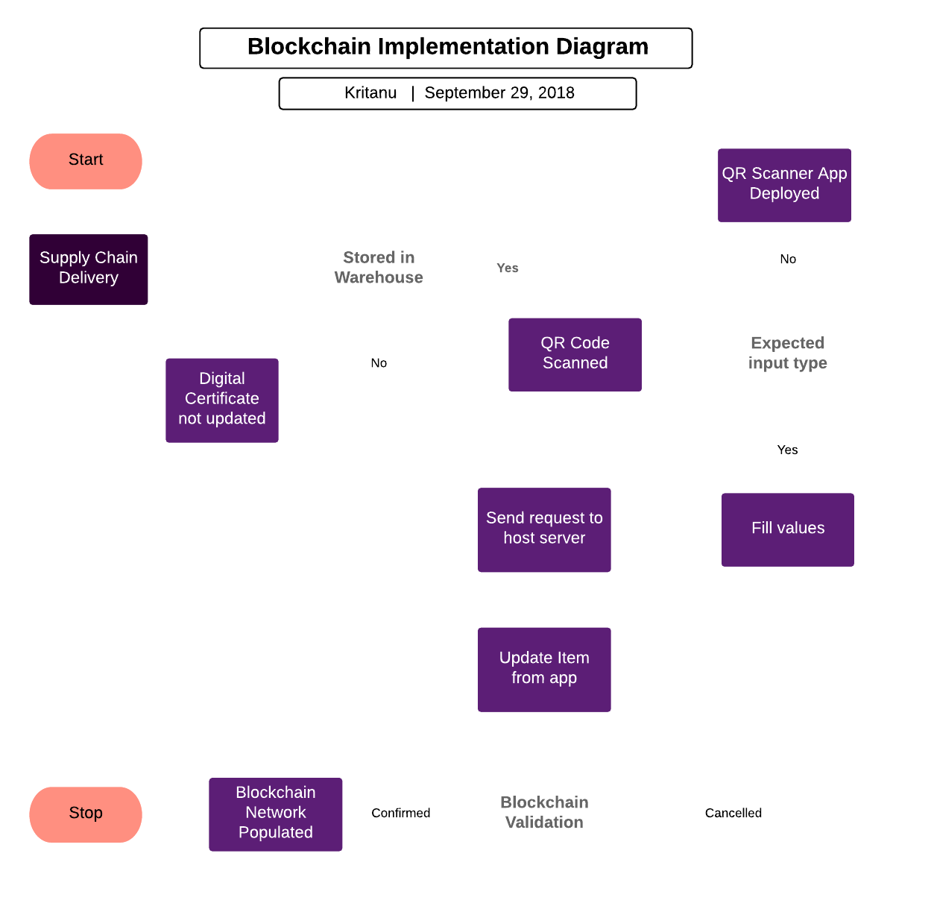
FEATURES
Tools & Frameworks used:
Solidity
Ropsten Test Network
HTML/CSS (Web)
Android Studio (App)
jQuery

Slide 5
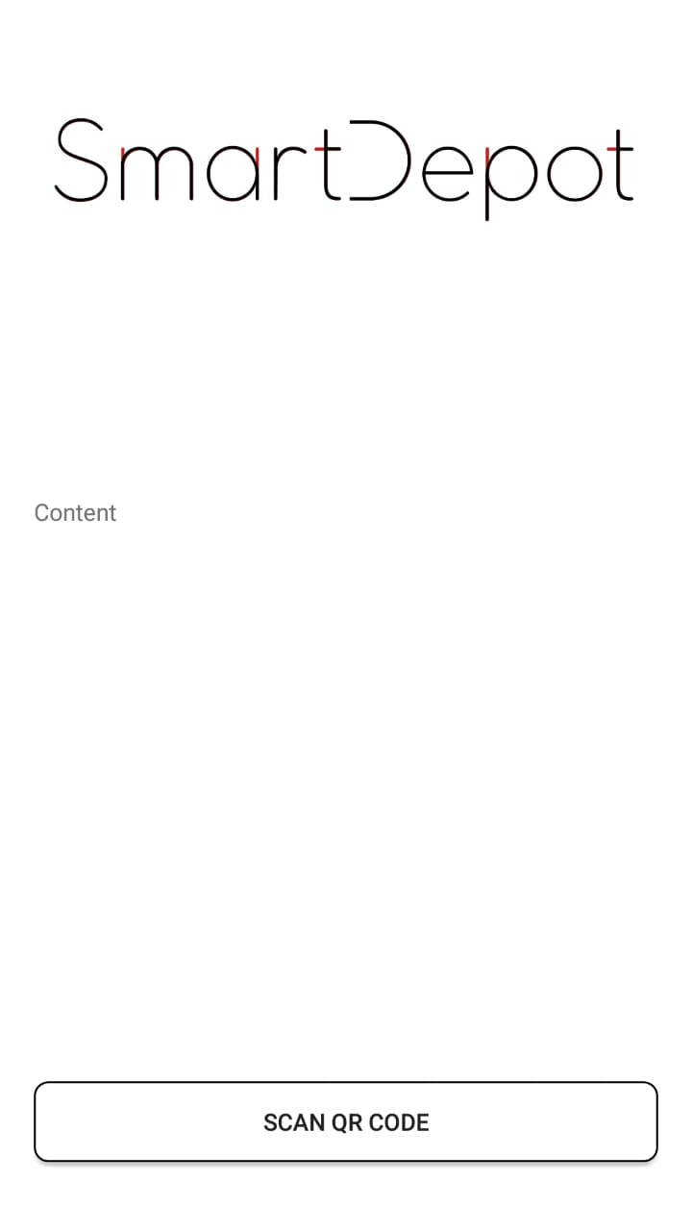
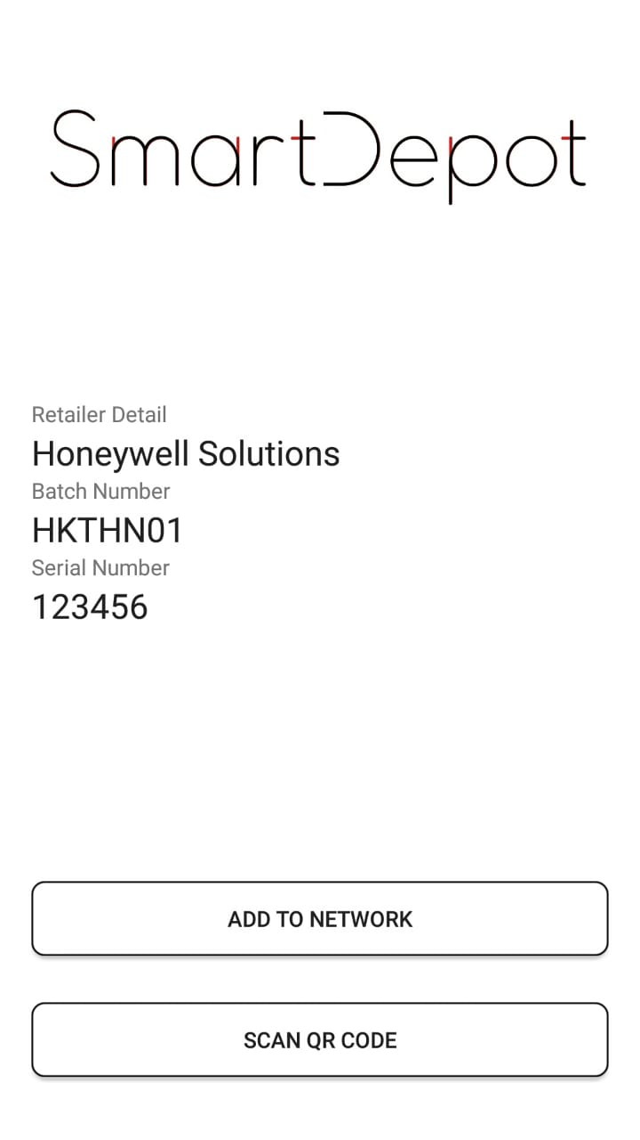
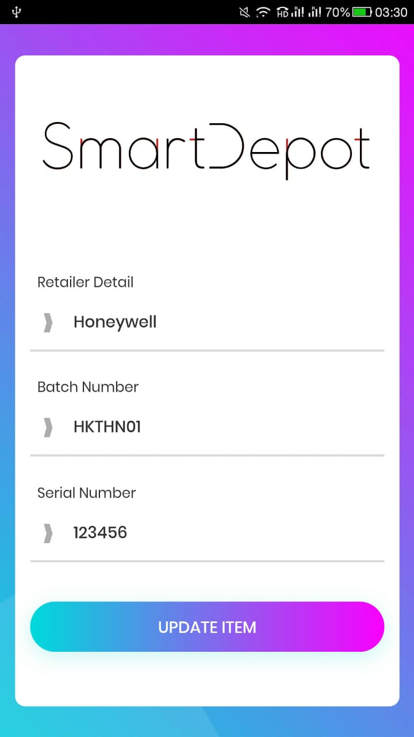
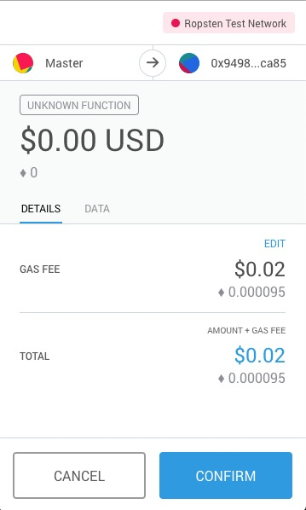
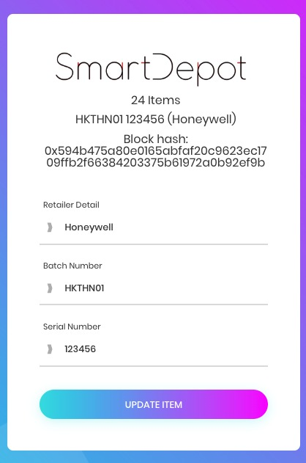

APP
WEB

