Slide 1
Mini Project-II Presentation (2020-21) “IndiaZon”
Submitted by –
Priyanka Nigam (181500509)
Kritarth sharma (181500335)
Supervised by –
Mr.Aakash Kumar Chaudhary
Technical Trainer
Department of Computer Engineering & Application

Slide 2
Introduction
Ecommerce, also known as electronic commerce or internet commerce, refers to the buying and selling of goods or services using the internet, and the transfer of money and data to execute these transactions.
We have build an Ecommerce website entitled as “INDIAZON” using MERN
Stack.

Slide 3
Technoligies Used
React js
React is a JavaScript library created for building fast and interactive user interfaces for web and mobile applications. It is an open-source, component-based, front-end library responsible only for the application’s view layer. In Model View Controller (MVC) architecture, the view layer is responsible for how the app looks and feels. React was created by Jordan Walke, a software engineer at Facebook.

Slide 4
Use of the project
The online marketplace is a good platform for you to expand your business. We are going to explain what kind of advantages there are by sharing what we know about online selling. In brief, these are the plus points we will talk about.
1.Faster buying process 2. Store and product listing creation 3. Cost reduction 4. Affordable advertising and marketing 5. Flexibility for customers 6. No reach limitations 7. Product and price comparison 8. Faster response to buyer/market demands 9. Several payment modes

Slide 5
Data flow Diagram
A data flow diagram (DFD) illustrates how data is processed by a system in terms of inputs and outputs. As its name indicates its focus is on the flow of information, where data comes from, where it goes and how it gets stored.
0 Level DFD: -DFD Level 0 is also called a Context Diagram. It’s a basic overview of the whole system or process being analyzed or modeled. It’s designed to be an at-a-glance view, showing the system as a single high-level process, with its relationship to external entities. It should be easily understood by a wide audience, including stakeholders, business analysts, data analysts and developers.
1 level DFD: - DFD Level 1 provides a more detailed breakout of pieces of the Context Level Diagram. You will highlight the main functions carried out by the system, as you break down the high-level process of the Context Diagram into its sub processes.
2 level DFD: - DFD Level 2 provides a deatails of the process presented in the level-1 DFD in expanded form.

Slide 6
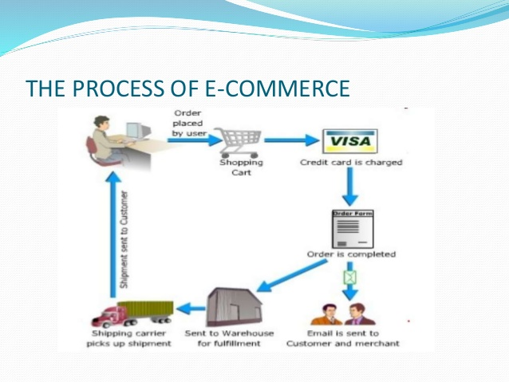
Overview

Slide 7
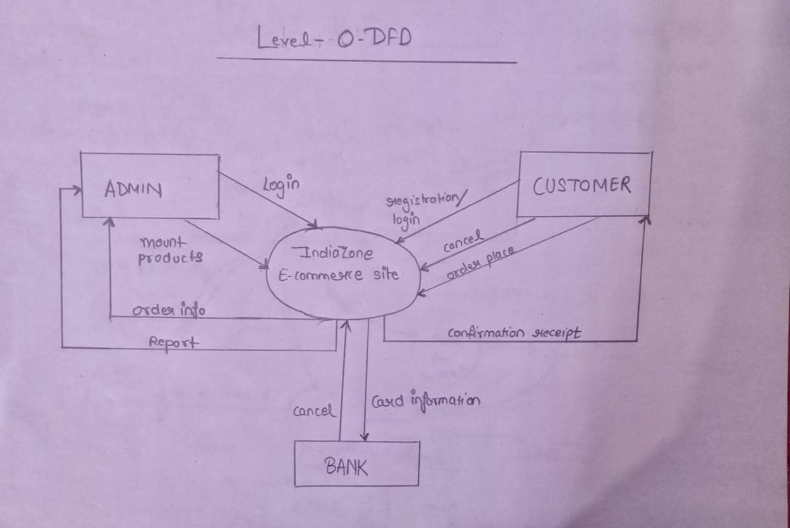
Level - 0 - dfd

Slide 8
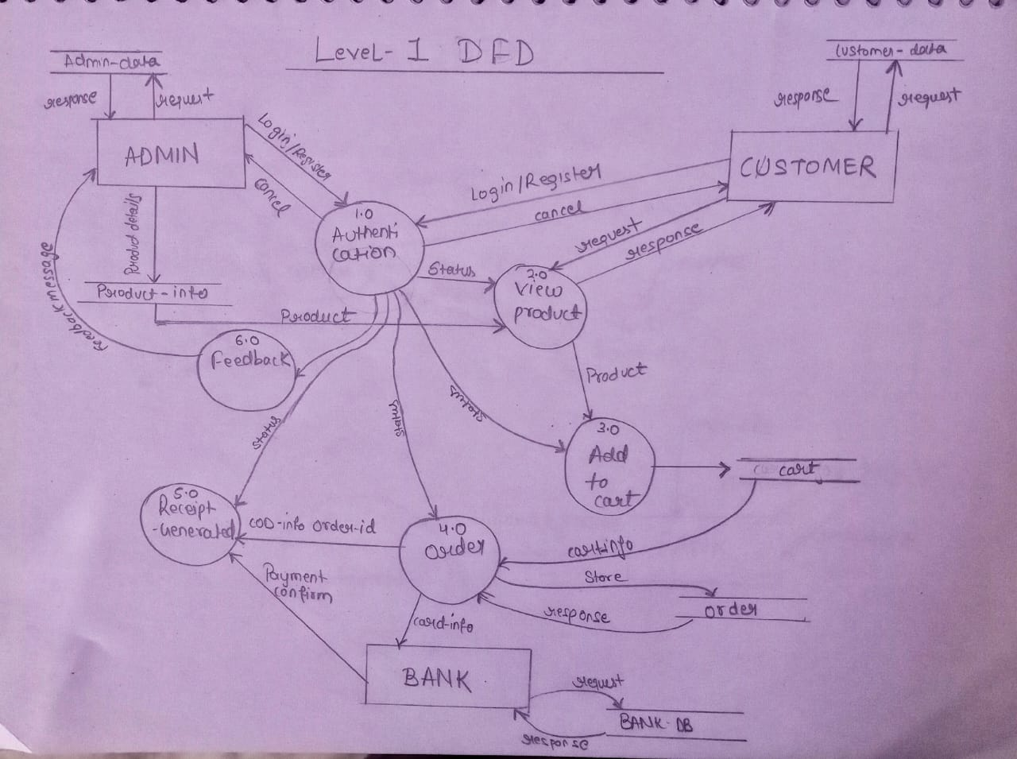
Level - 1 - dfd

Slide 9
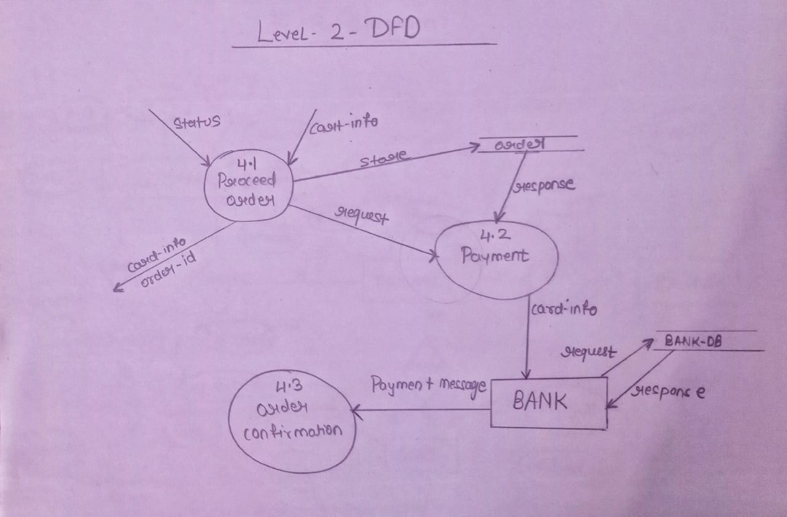
Level -2- dfd
.

Slide 10
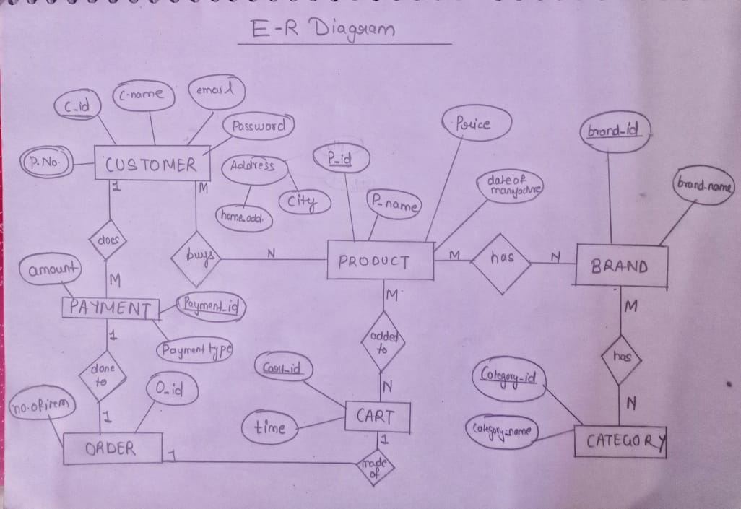
E-R Diagram

Slide 11
Admin Rights
Designing and developing the website.
Creating and updating the database
Inserting, viewing, updating, deleting the data in the database

Slide 12
The main theme of the project
Register if new user
Login
View various items
Add to cart
Purchase items

Slide 13
Modules of the Project
npm (Node Package Manager)-npm is also called a software Package Manager and Installer. The command $create-react-app is the name of the remote script ,this script is used to make a React project.
Setting up the React Router -A very important thing to consider in a React app is the navigation (moving from one page to another) of the users. Since React is a single page application, it doesn’t support multiple routes by default. There’s a package named react-router-dom which allows us to create routes for our React project.
Creating the Navbar –In this we have used Material Icons. Material UI is a very popular UI library for React which has a lot of prebuilt components just as icons which makes life easier.

Slide 14
Cont…..
Creating the Amazon Homepage-We have worked with two components in this section i.e Navbar and products. Product component is used to display products.
Setting up React Context API – The Context API is a very important part of React. It helps us to make application level states and we can get the data from those states through any component.
Setting up Firebase –We have used Firebase for Authentication, Database, Functions and Hosting. Firebase is a great tool to get started with projects quickly.

Slide 15
Conclusion
Online shopping for retail sales direct to consumers via Web sites and mobile apps reduce so many extra charges of transportation. ECommerce allows you to reach customers all over the country and around the world. Your customers can make a purchase anywhere and anytime, especially more people are getting used to shopping on their mobile devices.
Merchants can only provide a limited amount of information on a product in a physical store. On the other hand, eCommerce websites allow the space to include more information such as demo videos, reviews, and customer testimonials to help increase conversion.

Slide 16
REFERENCES
Online Git Repository:
https://github.com/kritarth2121/Ecommerce-website
https://www.google.co.in/
https://reactjs.org/docs/getting-started.html
https://www.w3schools.com/
https://www.youtube.com/

Slide 17


