Slide 1
Quora For college
Efforts By
                Kritarth Sharma

Slide 2
MOTIVATION
Questions are the best way to gain deeper insights and develop more innovative solutions. Children learn by asking questions. Students learn by asking questions. New recruits learn by asking questions. Innovators understand client needs by asking questions. It is the simplest and most effective way of learning
Quora for College is a question and answer site with a fully integrated social network connecting its users.

Slide 3
OBJECTIVE
The purpose of Quora for College is to ask and answer questions. It is NOT simply a social media platform, and don't use it that way. You can benefit by answering and asking lots of questions. The difference between Google and Quora for College is that an actual person can explain things to you.

Slide 4
TECHNOLOGY USED
MERN STACK
MONGODB
EXPRESS
NODE JS
REACT JS

Slide 5
HARDWARE & SOFTWARE REQUIREMENT
Hardware requirement]
    Processor : intel i5
    RAM : 4GB
Software Requirement
    Visual Studio Code
    Operating System : Any (Windows, Mac , Linux)
    Git
    Github

Slide 6
Modules
Login and Sign-Up page
Add Question
Reply to Pre-existing question
Feed up

Slide 7
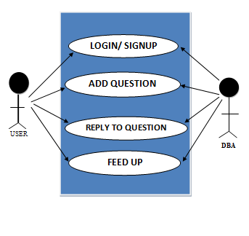
USE CASE DIAGRAM

Slide 8
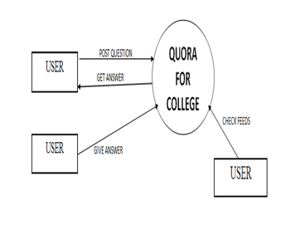
LEVEL – 0 DFD

Slide 9
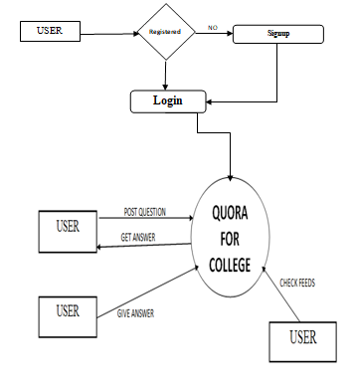
LEVEL -1 DFD

Slide 10
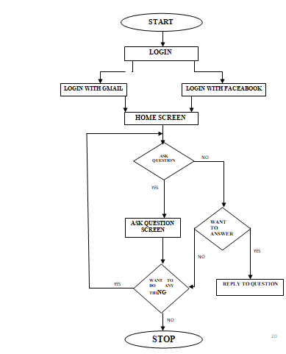
FLOW CHART

Slide 11
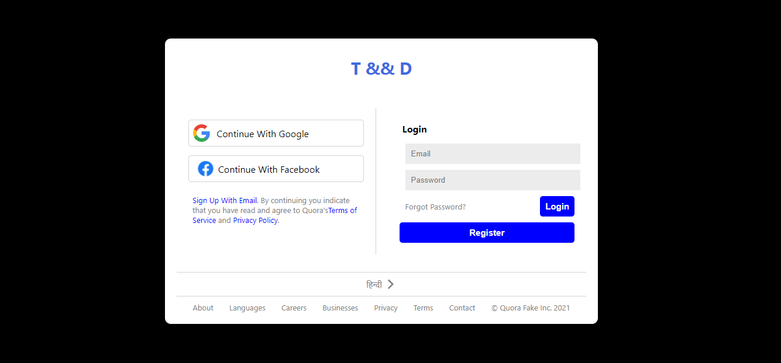
LOGIN PAGE

Slide 12
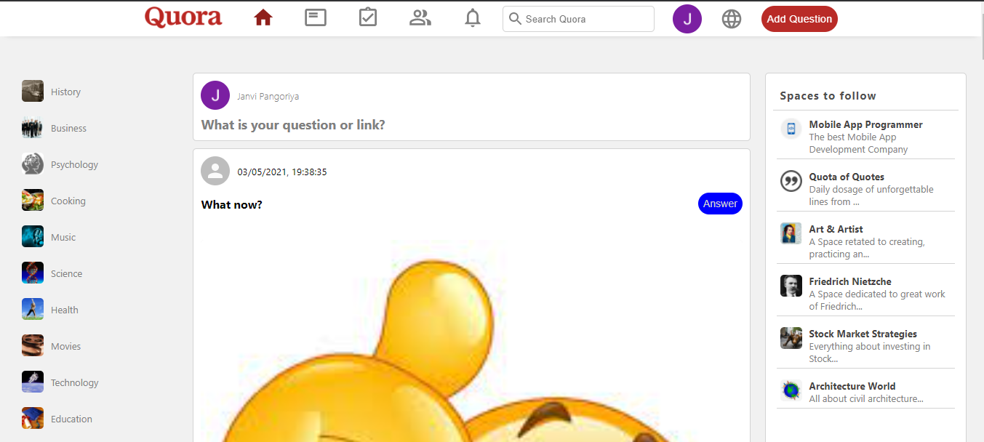
HOME PAGE

Slide 13
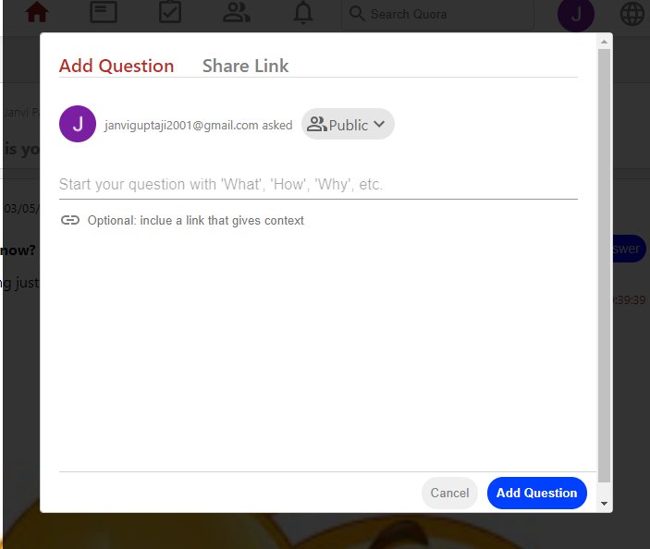
ASK QUESTION

Slide 14
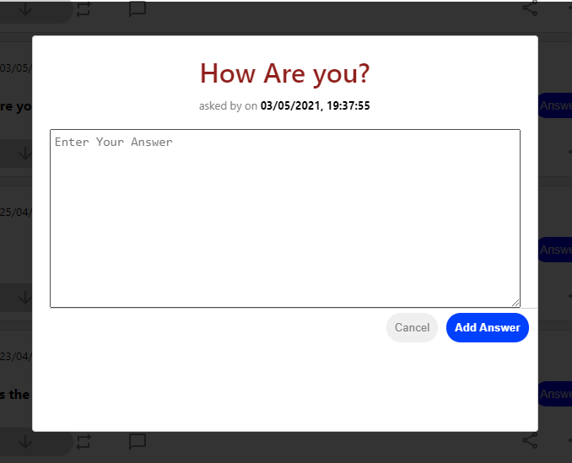
REPLY TO QUESTION

Slide 15
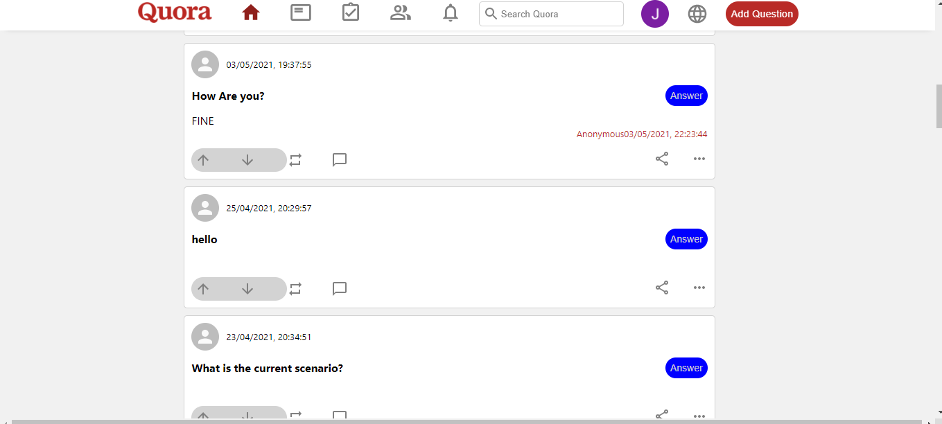
FEEDS

Slide 16
CONCLUSION
In Today’s world, gaining information has become necessity. There are various sources through which you can collect your Information. Since last decade, one new approach i.e. e-Learning is developing very swiftly. People search their questions online through web and they get their answer accordingly. Quora for college is one such example of the same.
With the help of Quora for college, you can serve people with a question and answer community where they can post unlimited questions and get it answered by others.

Slide 17
Thank You

