Slide 1
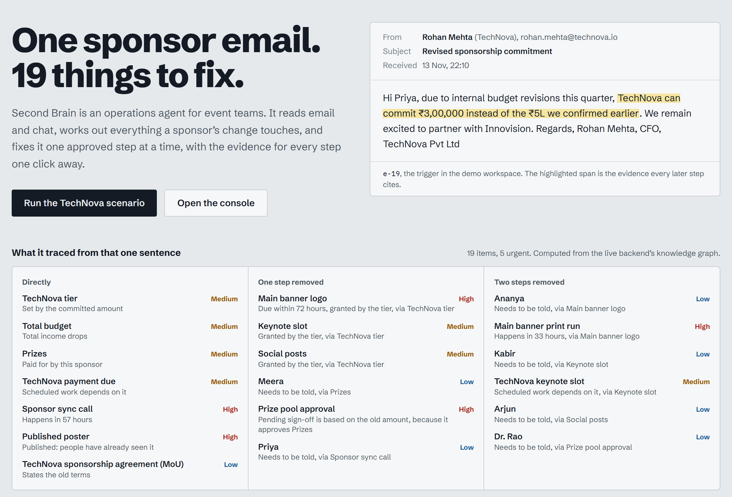
HACKINNOVISION'26 · TRACK B: AGENTIC WORKFLOW AUTOMATION & CONTEXT ENGINEERING
Second Brain
One sponsor email. 19 things to fix.
Six AI agents catch a sponsor's change in email or chat, trace every knock-on effect, fix it with a person's sign-off on anything risky, and prove the result.
Team Big O
Kritesh Mantry
Rachit Biswal
Vabyajeet Das
Srujal Kumar Dutta
Live: the landing page, with the email and everything it traced
Notes:
Second Brain, by Team Big O. One email from a sponsor quietly breaks nineteen things across seven apps. Our six agents find all of them, fix them with a person's approval on anything risky, and verify the result. Everything you will see is the live website.

Slide 2
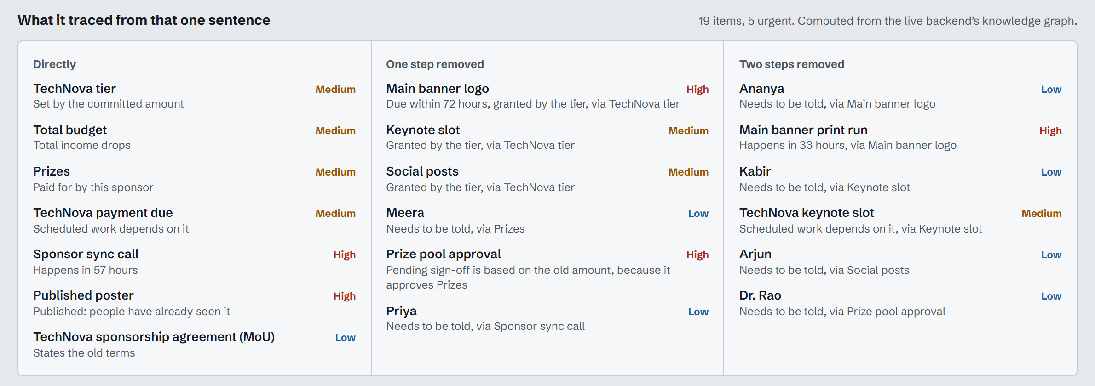
One sponsor email silently breaks 19 things
19
items affected across 7 apps
5
urgent: within 72 hours or already public
7
apps: budget, tiers, deliverables, calendar, approvals, docs, posters
Live: “What it traced from that one sentence”, computed from the backend's knowledge graph
TechNova cuts ₹5,00,000 to ₹3,00,000
A ₹2,00,000 shortfall, Gold drops to Silver, the banner prints in 33 hours, the poster is already public, and the prize-pool sign-off quotes the old amount.
Notes:
The trigger is one polite email from TechNova's CFO. Nobody on a student team will remember that the banner prints tomorrow, the poster is already public and the prize pool approval quotes the old amount. Second Brain traces all nineteen items, five of them urgent.

Slide 3
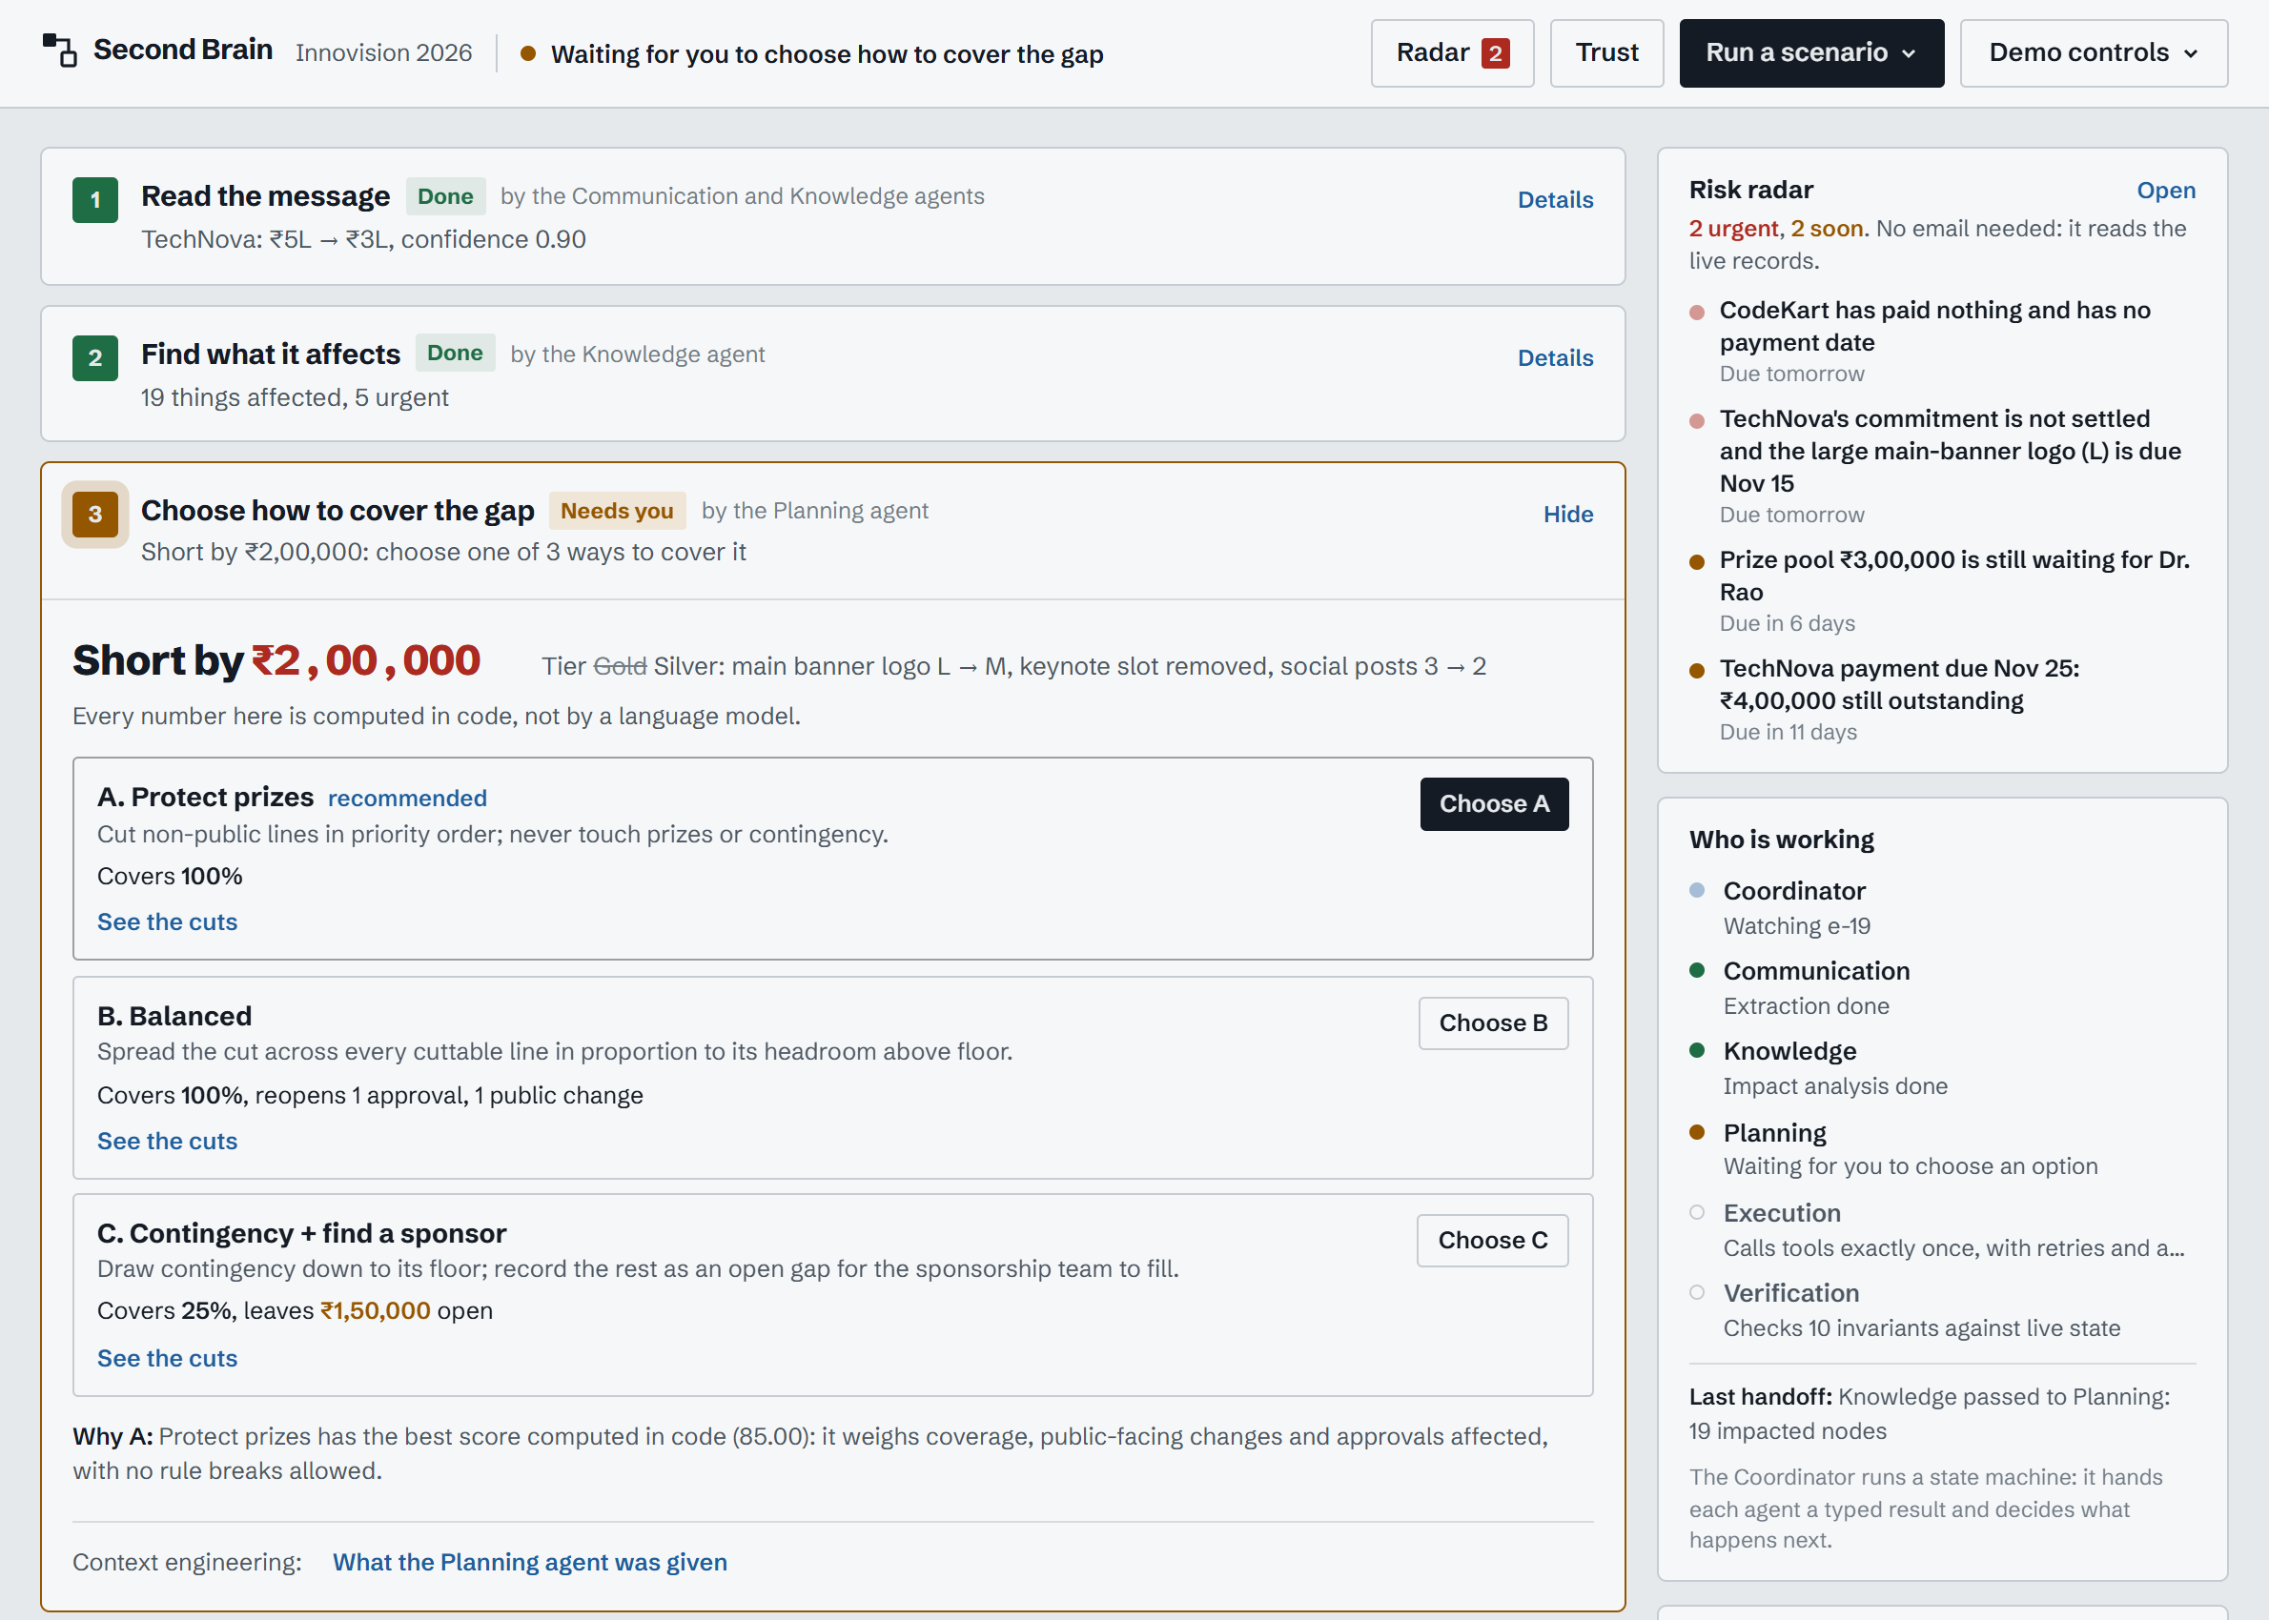
Six specialized AI agents, one coordinator
1
Coordinator
Persisted state machine: hands each agent a typed result, decides what happens next
2
Communication
Triage, prompt-injection quarantine, the LLM reads the email
3
Knowledge
Resolves “TN” = TechNova, checks memory, scores trust, walks the graph
4
Planning
Options A/B/C computed in code; plan = target state minus current state
5
Execution
Calls each tool exactly once, with retries and approval gates
6
Verification
Ten invariant checks against the live records
The LLM reads. Code decides every number, risk and check.
Live: the console mid-run. Each stage names its agent; “Who is working” shows them hand off
Notes:
Six agents, each with a narrow job. The Coordinator is a state machine that saves after every step, so a run can be replayed and audited. Only the Communication agent uses an LLM, to read the message; everything that touches money, risk or verification is deterministic code.

Slide 4
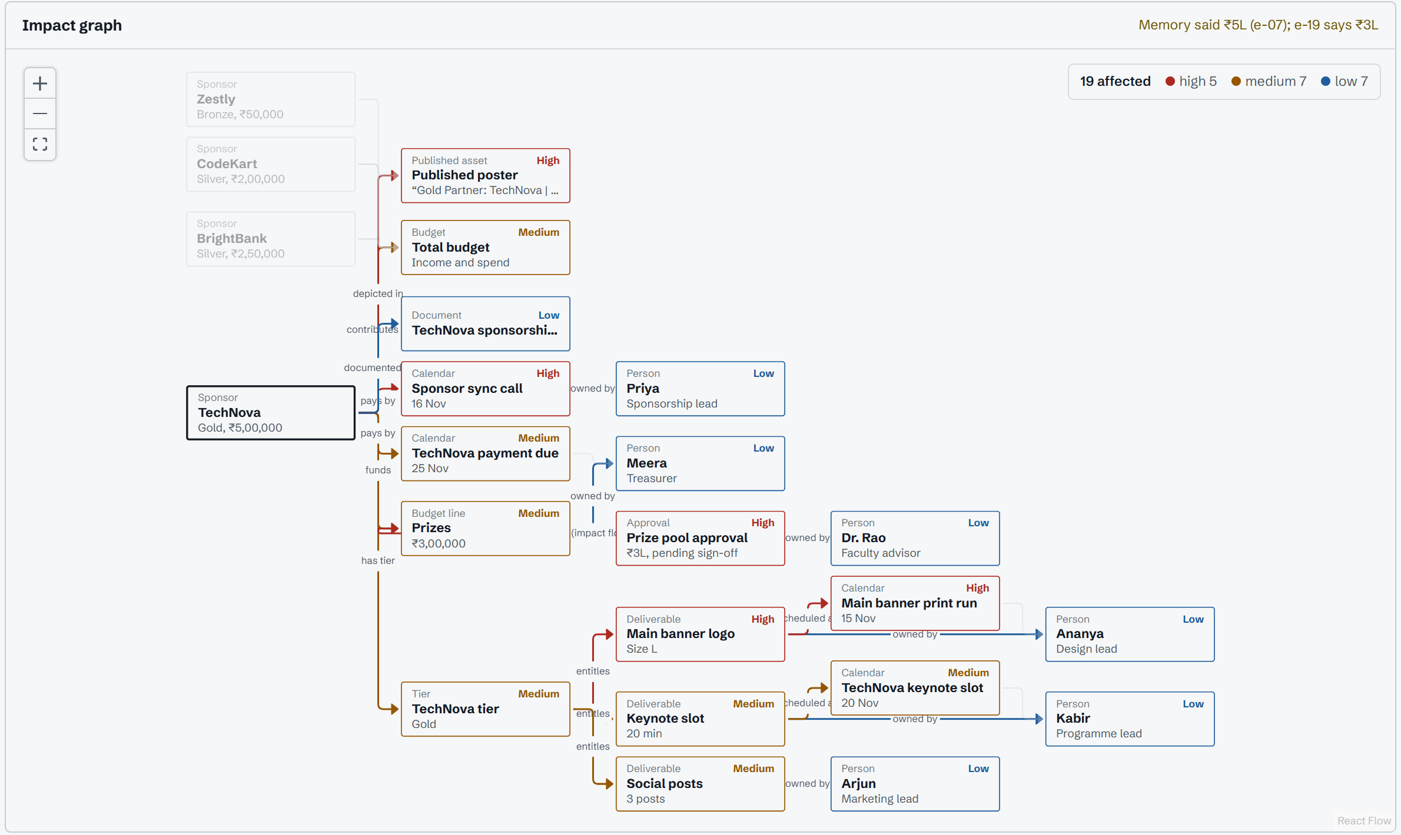
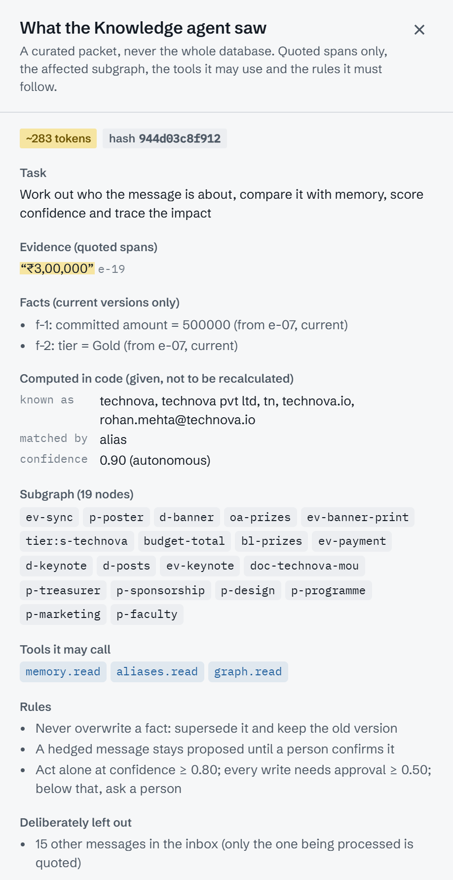
Context engineering and a knowledge graph
Live: the impact map. A typed walk from TechNova reaches 19 items, each with the path that explains why
Live: exactly what the Knowledge agent was given
Notes:
Context engineering: no agent sees the whole database. Each gets a curated packet, about 283 tokens here: the quoted evidence, current facts only, the affected subgraph, the tools it may call and the rules it must follow. The knowledge graph does the investigation: severity comes from publication status, pending sign-offs and deadlines within 72 hours.

Slide 5
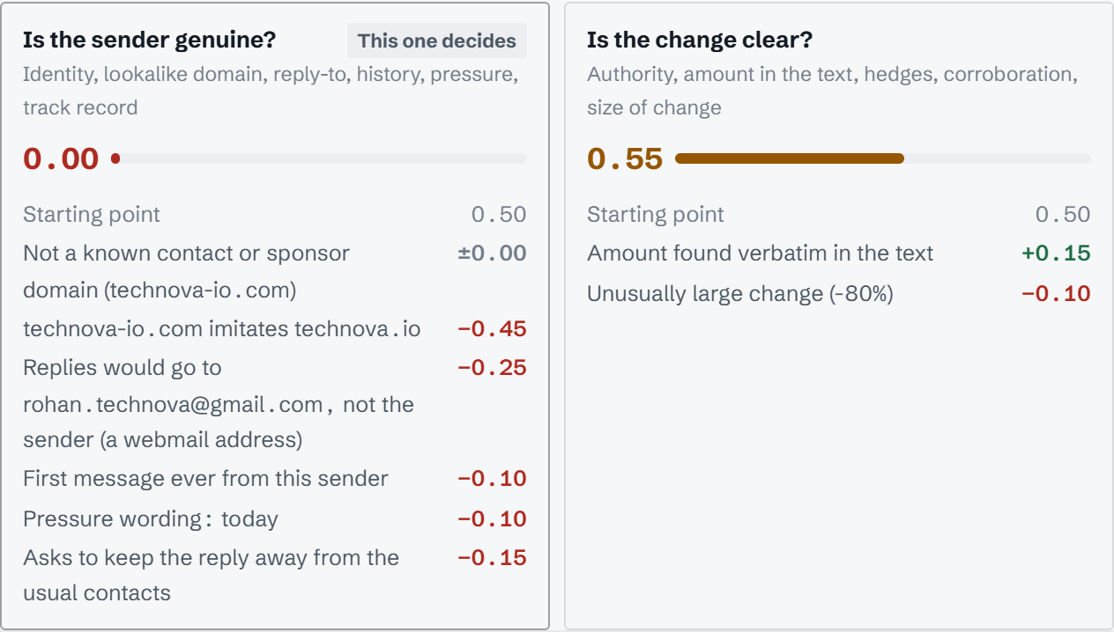
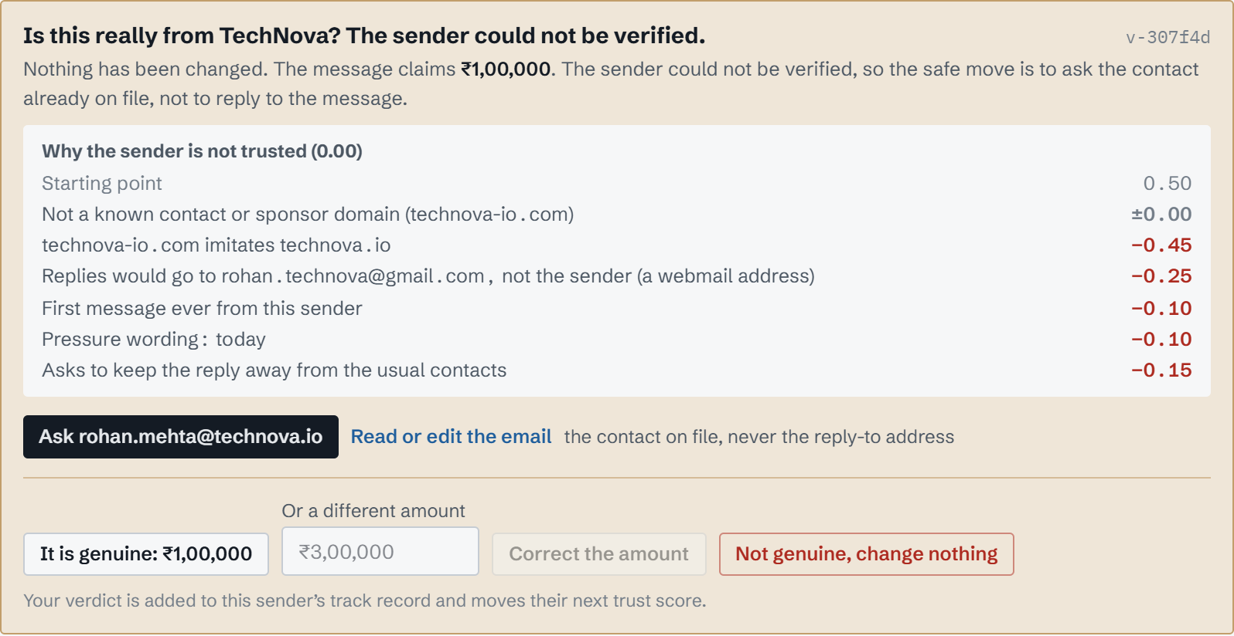
Email Trust Score stops impostors before they act
Live, scenario S5: a ₹1L cut from technova-io.com, replies routed to Gmail. Trust 0.00, nothing written
Two questions, scored apart
Is the sender genuine? Is the change clear? It acts on the weaker, so impostors and vague emails both stop.
Signals you can read
Lookalike domain, reply-to mismatch, first contact, pressure and secrecy wording, learned track record.
The call-back rule
Verify with the contact already on file, never the reply-to address: the rule banks use against fraud.
Notes:
This is the impostor scenario. The email is precise, so a single confidence score would happily act on it. We score the sender separately: the lookalike domain, the Gmail reply-to and the secrecy wording take trust to zero. The system asks the real CFO at the address on file, and every human verdict updates that sender's track record.

Slide 6
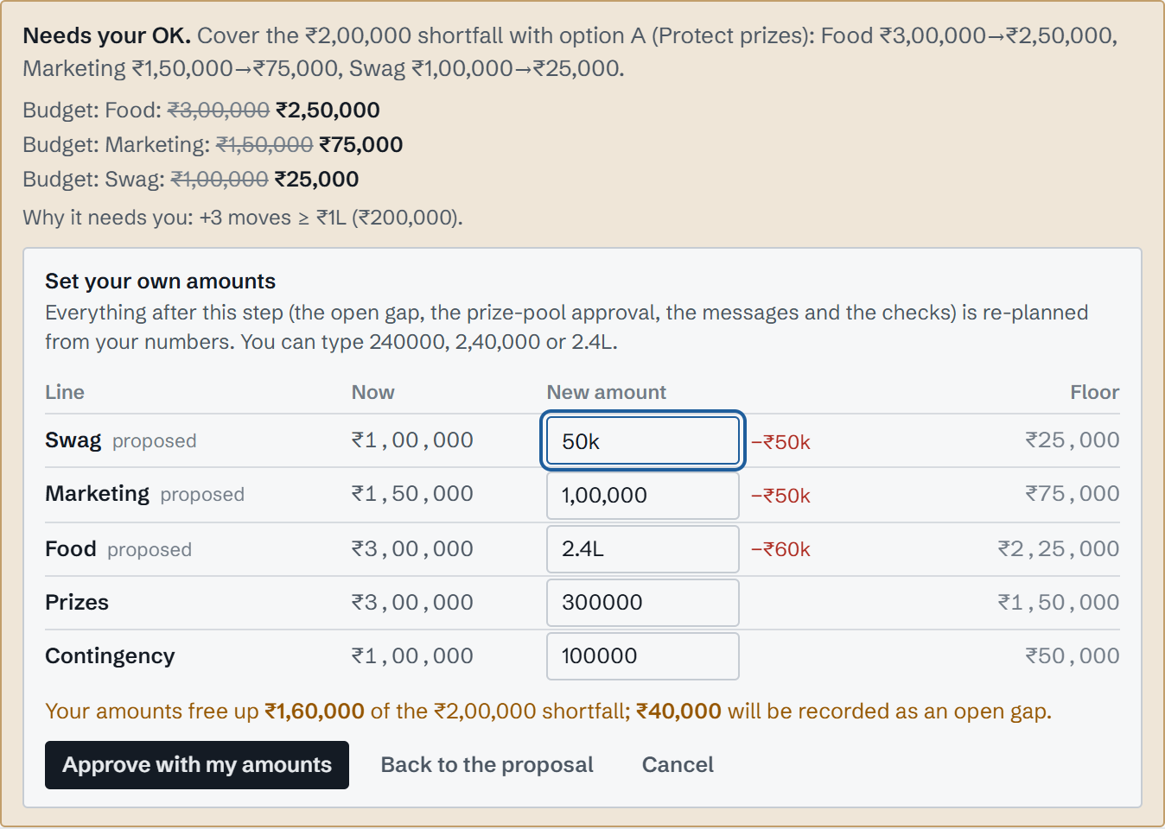
Humans approve high-risk actions, with their own numbers
Risk is scored in code
+3 leaves the organisation · +3 irreversible · +3 moves ≥ ₹1L · +2 blast radius ≥ 3 nodes
Risk ≥ 3 waits for a person
Every external message and every large budget move shows a before/after preview first
Edit the amounts, not just approve
Your numbers become option H; the gap, the prize-pool approval, messages and all 10 checks are re-planned from them
Never asked twice
The edited approval is reused by the new plan; rejecting a step re-plans around it
Live: approving the budget step with my own amounts. ₹1,60,000 covered, ₹40,000 recorded as an open gap
Notes:
High-risk actions never run unattended. The risk score is arithmetic you can read, not a model's opinion. And the human is not a rubber stamp: here I typed my own budget amounts, and everything downstream was recomputed from them and still passed all ten checks.

Slide 7
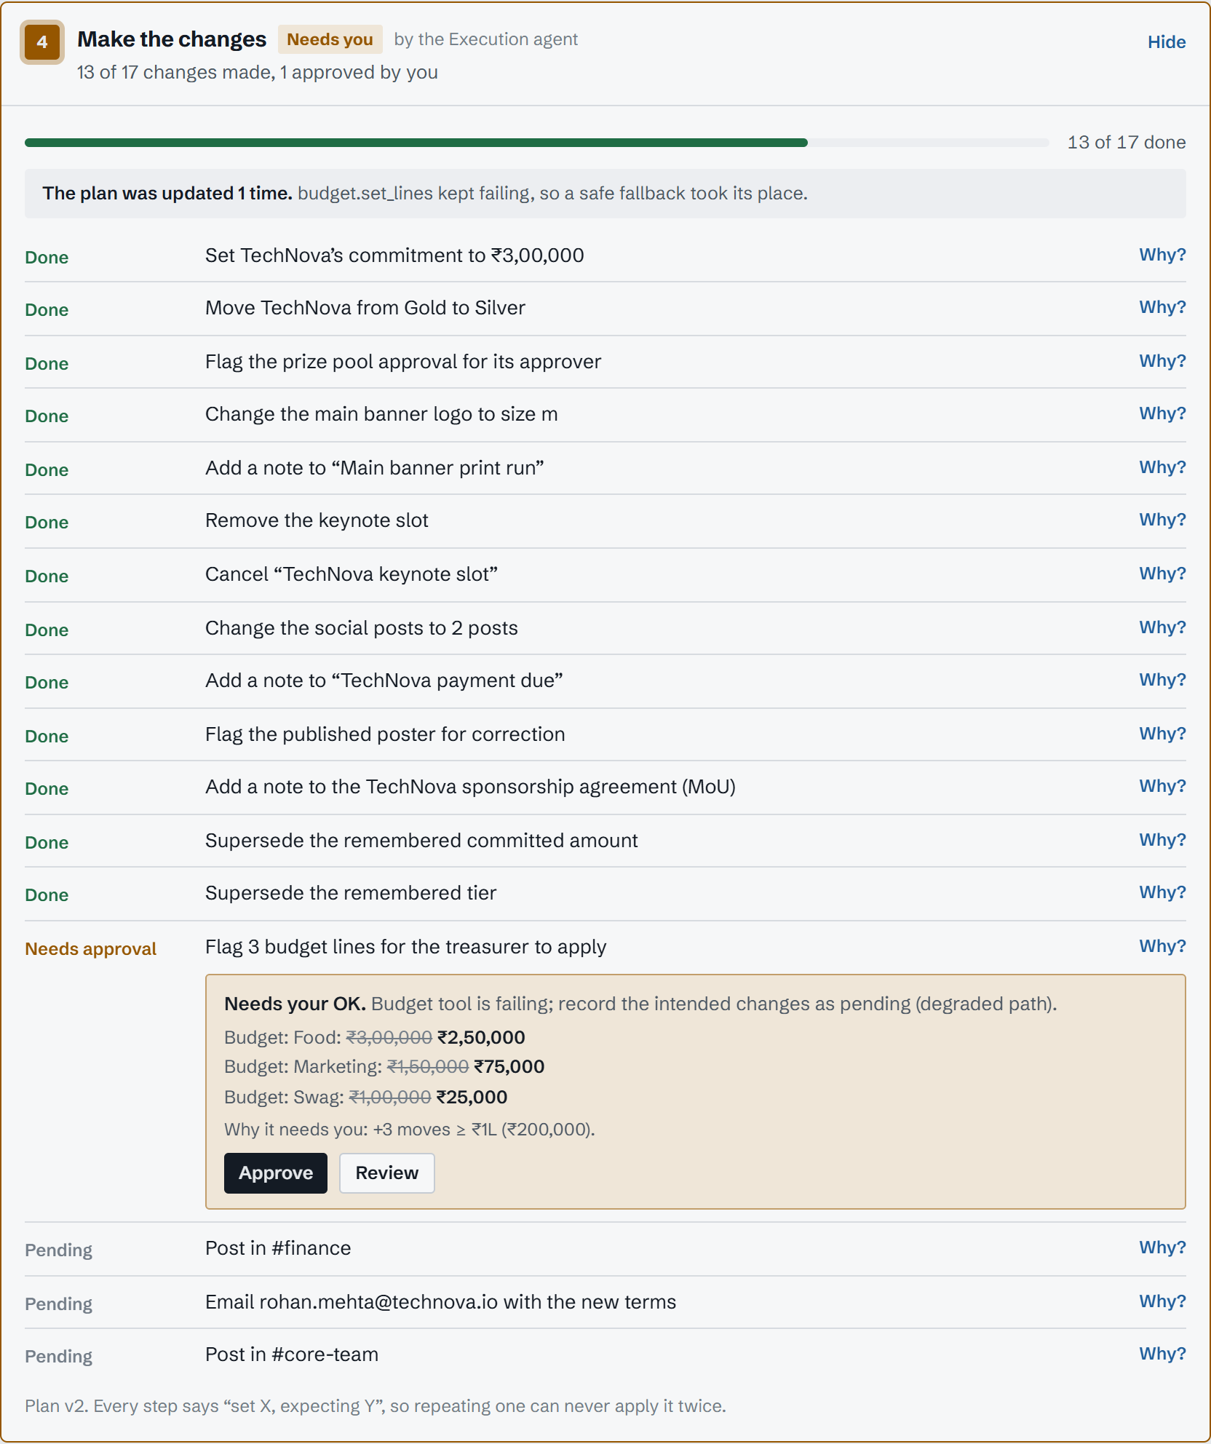
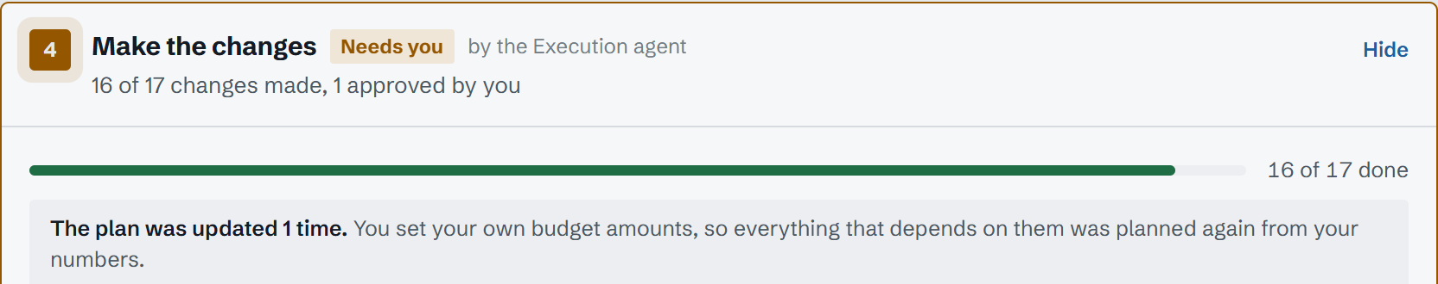
Idempotency + adaptive replanning: never twice, never stuck
Idempotent by design
Every write says “set X, expecting Y” and records its key in the same database transaction. A retry, a slow timeout or a duplicate email changes nothing.
Adaptive replanning
3 retries with backoff, then a circuit breaker. The plan is redone for only what still differs: a safe fallback, a rejected step, an outside edit, or your edited numbers.
Live: the plan redone from a person's edited budget amounts
Live: budget tool forced to fail. Plan v2 takes the safe path
Notes:
Reliability is where agent demos usually fall over. Every tool call is idempotent, so retries are safe. When the budget tool keeps failing, the circuit breaker opens and the plan is rebuilt with a safe fallback: flag the cuts for the treasurer and tell her. The run still finishes with ten of ten checks.

Slide 8
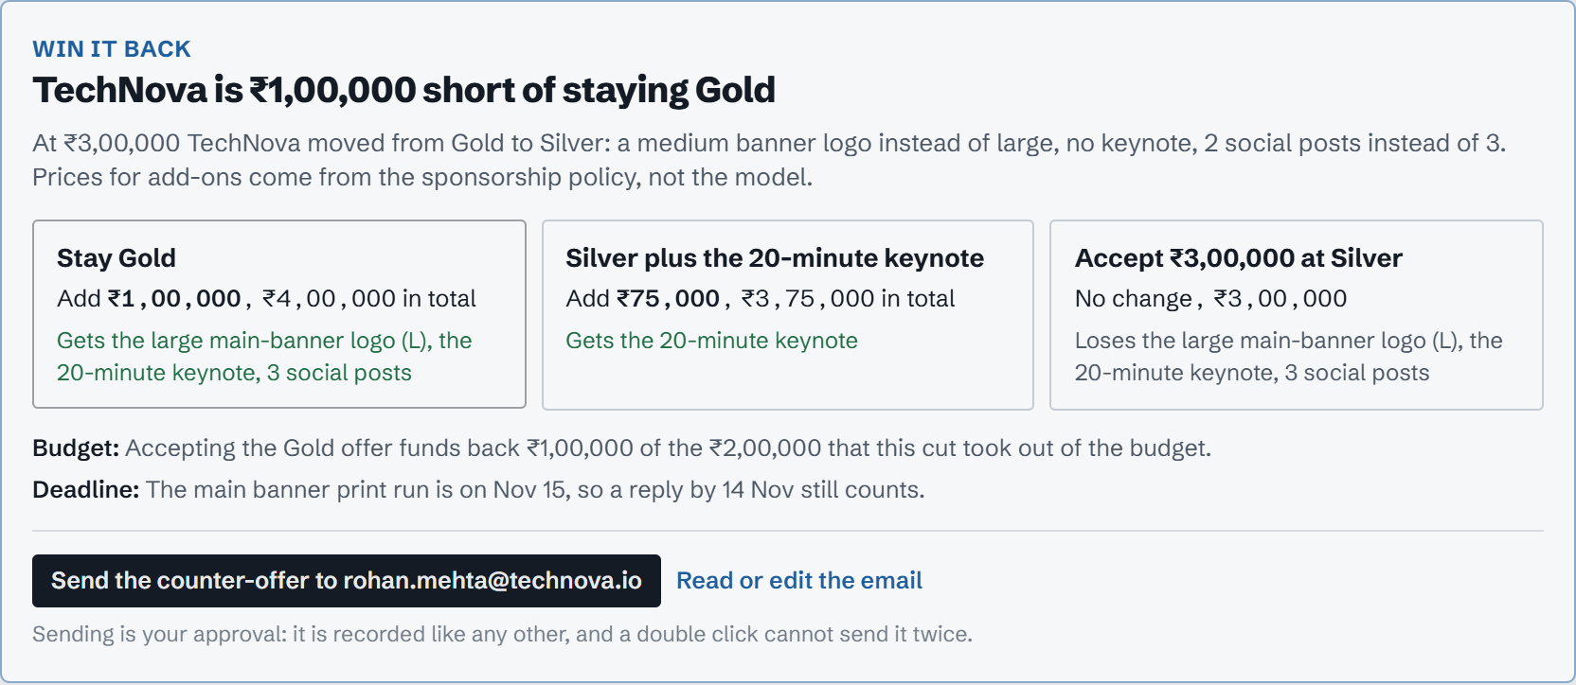
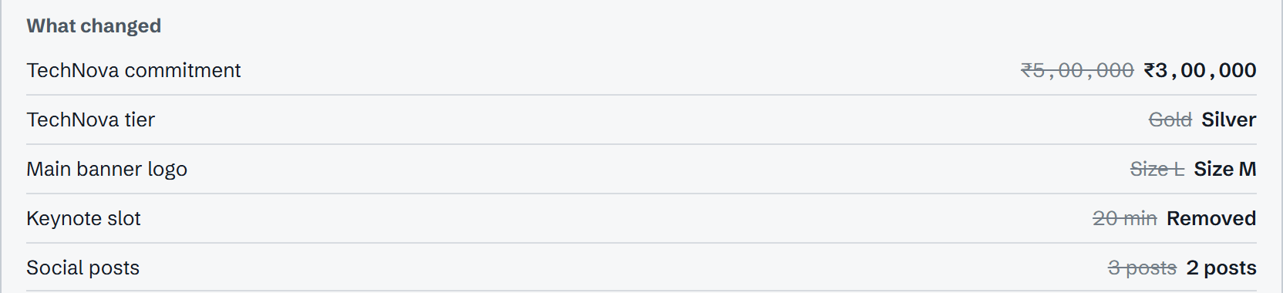
Sponsor tiers for our best sponsors, and a win-back
Tier | Commitment | What the sponsor gets
Gold | ≥ ₹4,00,000 | Large main-banner logo, 20-minute keynote, 3 social posts
Silver | ≥ ₹2,00,000 | Medium main-banner logo, 2 social posts
Bronze | ≥ ₹50,000 | Listing and thanks
When a sponsor's amount crosses a tier line, every entitlement follows automatically: banner size, keynote slot and calendar, social posts, the published poster, the agreement and memory.
Live: TechNova is ₹1,00,000 short of staying Gold, so a counter-offer is drafted
Win-back, not just damage control
Prices come from the sponsorship policy, the print deadline is the leverage, and a person sends the drafted email in one click.
Live: after the run, every entitlement followed the new tier
Notes:
Our sponsors are tiered, and each tier carries concrete benefits. When TechNova drops to Silver, the banner, keynote, posts and poster all follow. Then Second Brain turns it around: TechNova is only one lakh short of Gold, so it drafts a counter-offer. If they accept, a normal run restores Gold.

Slide 9
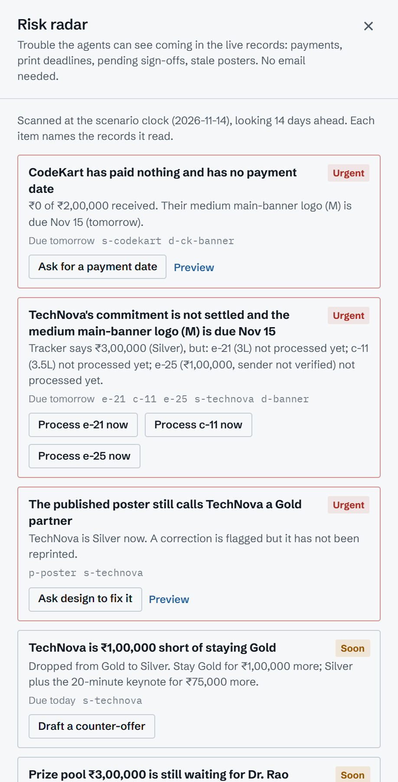
Risk radar: trouble spotted before any email arrives
Money at risk
CodeKart has paid ₹0 of ₹2,00,000 and its logo prints tomorrow; TechNova still owes ₹3,00,000.
Unsettled commitments
Three unread messages disagree about TechNova's amount, one from an unverified sender.
Stale public assets
The published poster still calls TechNova a Gold partner; entitlement drift is caught too.
Pending sign-offs and gaps
Prize pool approval waiting for Dr. Rao, budget cuts waiting for the treasurer, open gaps.
One click to act: send a payment reminder, process a message, or draft a counter-offer. Every send is recorded as an approval and can never go out twice.
8
rules over the live records
14 days
looked ahead on the event clock
0
emails needed to raise an alert
Live: the radar drawer
Notes:
Everything so far reacts to a message. The radar is proactive: plain rules over the live records and the scenario clock. It reads the records, not the inbox, so it spots an unpaid sponsor whose logo prints tomorrow before anyone writes to us.

Slide 10
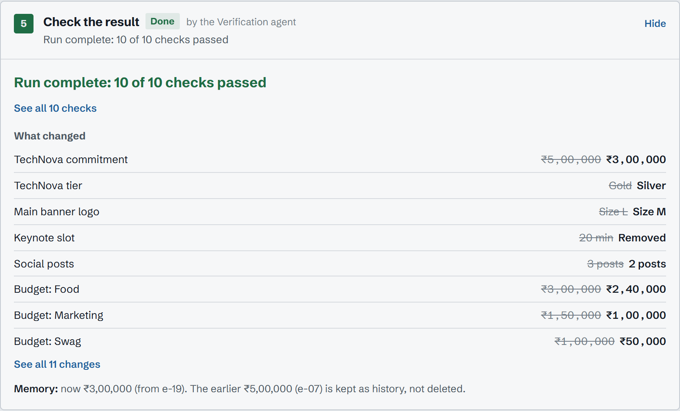
Verified. Explainable. Ready to run.
10/10
invariant checks pass on every scenario run
70
automated tests, end to end
5
live scenarios: clear, vague, relay, injection, impostor
1
LLM step; every number is code, every action traceable
Team Big O
Kritesh Mantry
Rachit Biswal
Vabyajeet Das
Srujal Kumar Dutta
Thank you
Notes:
To close: every run ends with ten live checks, seventy automated tests back it up, and every change traces back to a quoted sentence. Second Brain, by Team Big O. Thank you.

