Slide 1

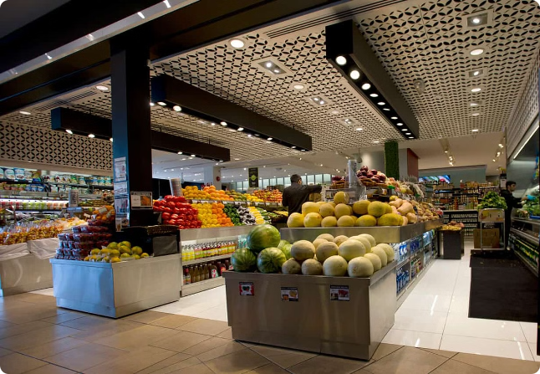
Supermart Grocery Sales - Retail Analytics Dataset
BY KRITHEESHWAR S

Slide 2

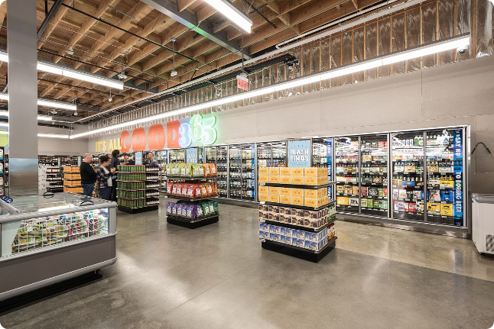
INTRODUCTION
The goal of this project is to analyze the Supermart Grocery Sales dataset to gain insights into sales performance, customer behavior, and management in Tamil Nadu. By leveraging data analytics techniques, the project aims to provide actionable recommendations to enhance business strategies and improve overall operational efficiency. The data was collected from a surveyed sample of people who bought groceries.

Slide 3
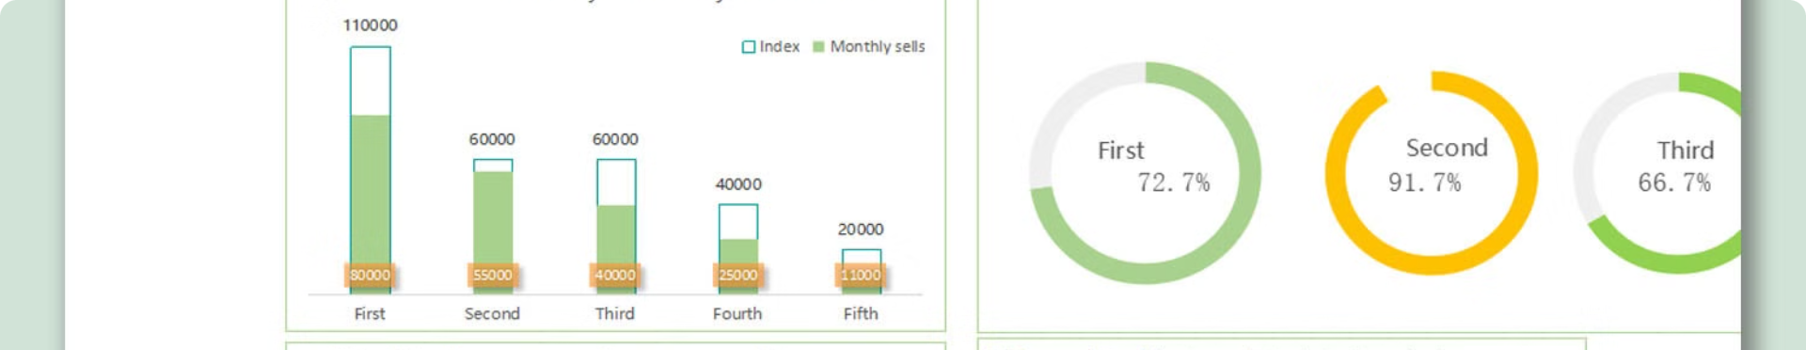
Key Features of the Dataset
Product Data
Customer Data
Transaction Data
Product IDs, descriptions, categories, prices, and sales volumes.
Customer IDs, Names
Date, time, store location, payment method, and total basket value.

Slide 4

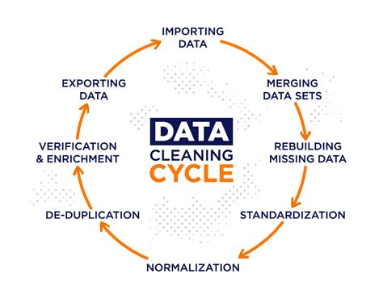
Data Preprocessing and Cleaning
1
Data Extraction
Gather raw data from various sources and consolidate into a unified dataset.
2
Data Cleaning
Identify and address missing values, outliers, and inconsistencies in the data.
3
Feature Engineering
Create new derived variables that enhance the analytical capabilities of the dataset.

Slide 5

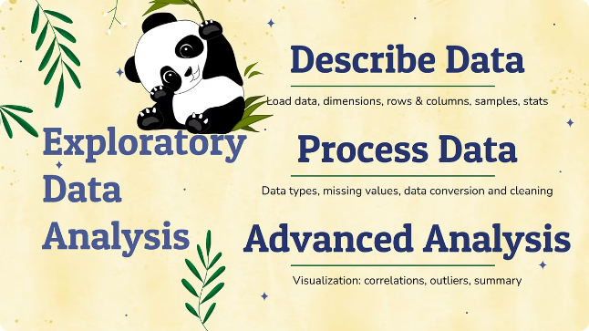
Exploratory Data Analysis
1
Sales by Product Category
2
Customer Behavior Patterns
Identify best-selling and underperforming product categories.
Analyze purchase frequency and size
3
Seasonal and Trend Analysis
4
Market Basket Analysis
Uncover sales fluctuations across different cities.
Discover popular product combinations and min and maximum selling opportunities.

Slide 6


PLOTS
Notes:
· The height of the bars in this plot represents the frequency of values within each bin, revealing the underlying distribution. · We can see a sudden rise in profit when the count reaches 600 and above, indicating a significant increase in profitability at that point. · After crossing the 1000 count mark, the profit appears to gradually decrease, suggesting a potential plateau or decline in performance beyond that threshold.

Slide 7
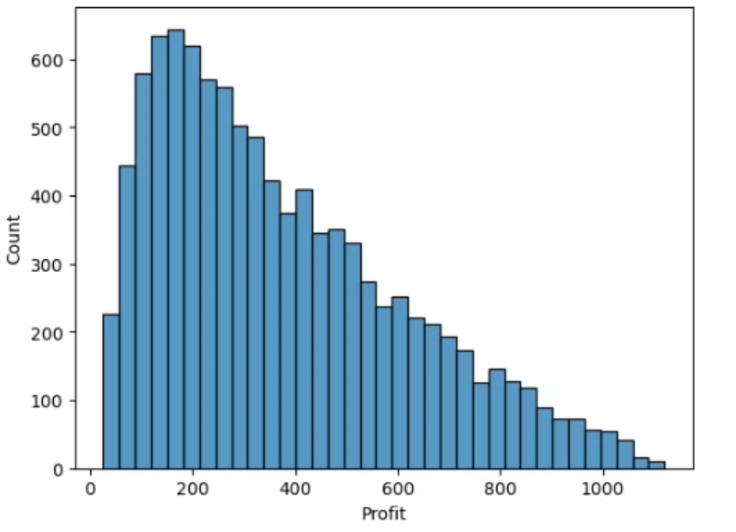
Histogram
· The height of the bars indicates how frequently values within each bin occurs,showing the distribution's
· In this sudden rise of profit when it reaches to the count of 600 and above
· gradual decrease of profit after it crosses 1000

Slide 8
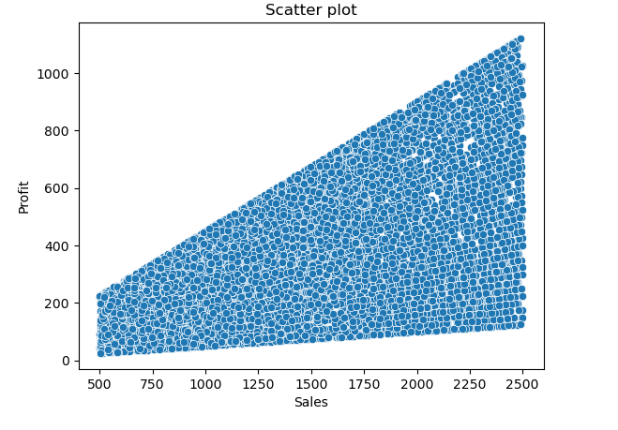
Scatter plot
This plot represents that when the sales are high profit increases

Slide 9
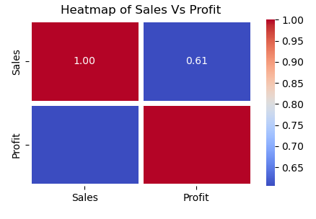
Heat map
There is a strong relation between sale and profit

Slide 10
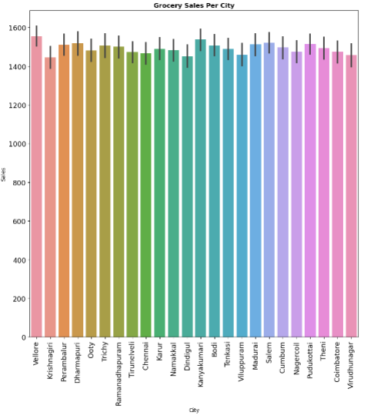
Bar plot
In this type of bar plot based on different cities and their sales
plot shows that every city has a their sales margin above 1400

Slide 11

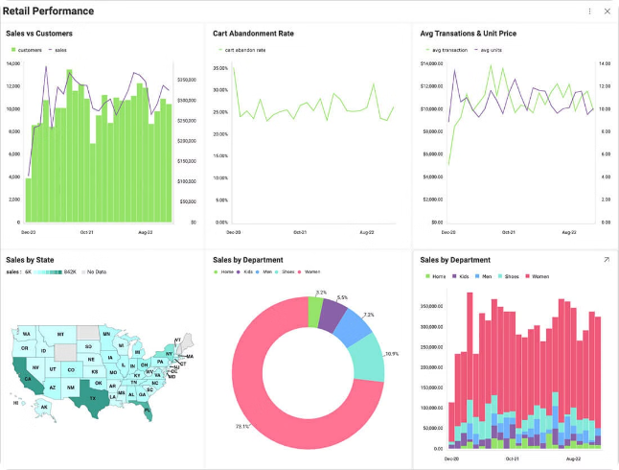
conclusion
This retail analytics project has successfully leveraged the Supermart Grocery Sales dataset to deliver actionable insights that can drive strategic decisions and operational improvements. By focusing on sales performance, customer behavior, inventory management, and promotional effectiveness, we have provided a robust foundation for enhancing Supermart Grocery's business performance and achieving sustainable growth in a competitive retail market.This projects have the following outcomes
Data cleaning,Remove outliers,Describe plots, Handle Hypothesis tests

Slide 12

Thank you

