Slide 1
5G Impact Analysis – Wavecon Telecom
Performance Insights & Revenue Analysis
Presented by: Krithesh
Date: 09-03-2025

Slide 2
Introduction
Purpose: Evaluate the impact of the 5G launch on revenue and KPIs.
Identify performance trends and key insights.
Provide recommendations for improvement.

Slide 3
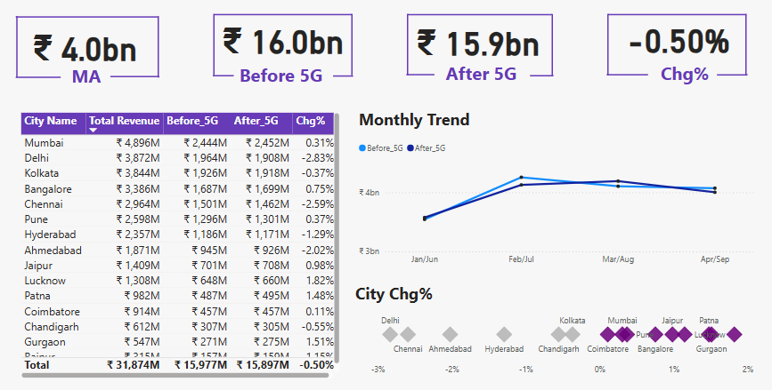
Revenue Impact – Before vs. After 5G
Total revenue before 5G: ₹16.0bn
Total revenue after 5G: ₹15.9bn
Change: -0.50% (slight decline)
Some cities experienced revenue drops: Delhi (-2.38%), Bangalore (-0.73%), Chennai (-2.59%).
Mumbai and Kolkata showed positive trends.

Slide 4
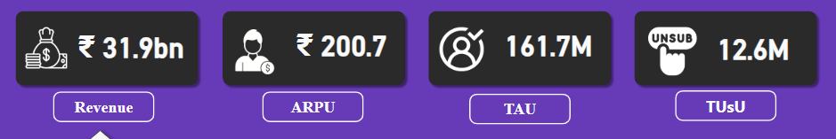
Underperforming KPIs Post-5G Launch
TUsU (Total Unsubscribed Users): 12.6M
ARPU (Average Revenue Per User): ₹200.7
Some cities show inconsistent monthly trends.
Key Insight: ARPU and customer retention need improvement.

Slide 5
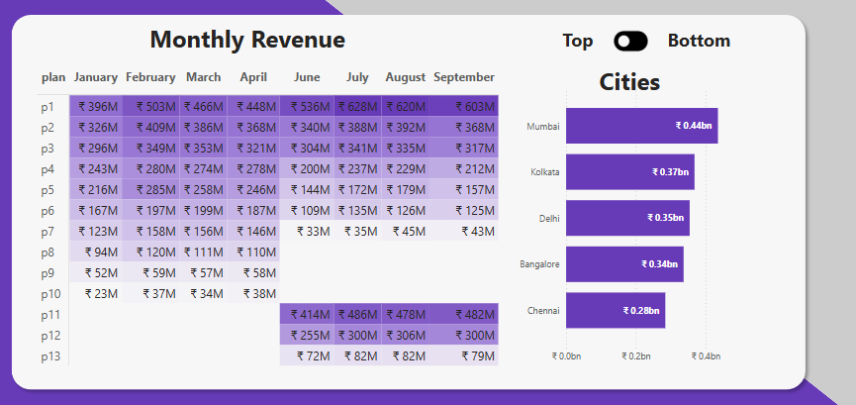
Best and Worst Performing Plans
Top Performing Plans: P1 (₹620M), P11 (₹478M), P2 (₹3.0bn total revenue).
Underperforming Plans: P6-P10 (revenue below ₹200M).
Some plans saw declining revenue after the 5G launch.

Slide 6
Impact on Specific Plans
Super Saviour Pack (P2): No revenue growth (₹1.5bn before and after 5G).
Some plans underperformed significantly after 5G.
Requires analysis for marketing and pricing strategies.

Slide 7
Discontinued or Affected Plans
Some lower-tier plans (P9-P13) show revenue drops.
Certain cities saw larger revenue losses post-5G.
Possible reasons: Pricing strategy, customer preferences, or network performance.

Slide 8
Recommendations & Conclusion
Improve user retention strategies (reduce TUsU).
Adjust pricing for underperforming plans.
Market high-performing plans more effectively.
Enhance 5G service perception to drive ARPU growth.

Slide 9
Thank You! 🚀

