Slide 1
EZ-Admin
Software application for
Linux Server Administration
Team Members
Krithick Kalyan
Vishwa K
Arvind M Bharadwaj
Sai Ram R
Pradeep V
Surya K
Aravind R
Chitturi Hemant
Kavya Keerthana
Ruthirakumar
Dinesh Venkat Sai Karthik

Slide 2
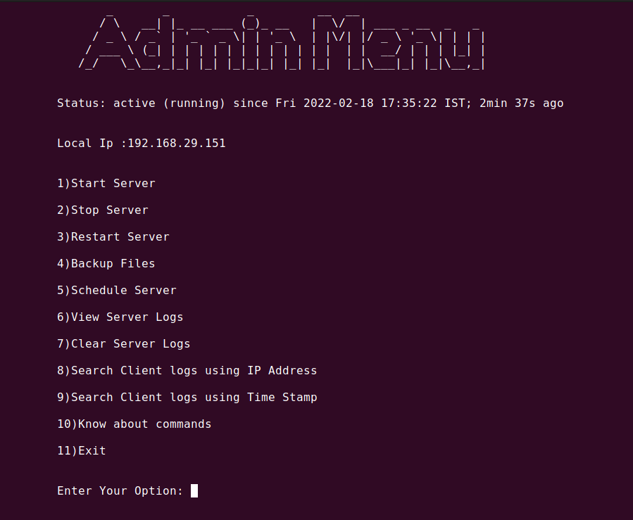
Introduction to EZ-Admin
On starting the application, the terminal window prompts for a password to authenticate the user’s access to the server.
Once the password is entered, the status of the server is displayed followed by the local IP Address.
The menu illustrates the various functionalities or capabilities of the program to perform various server operations

Slide 3
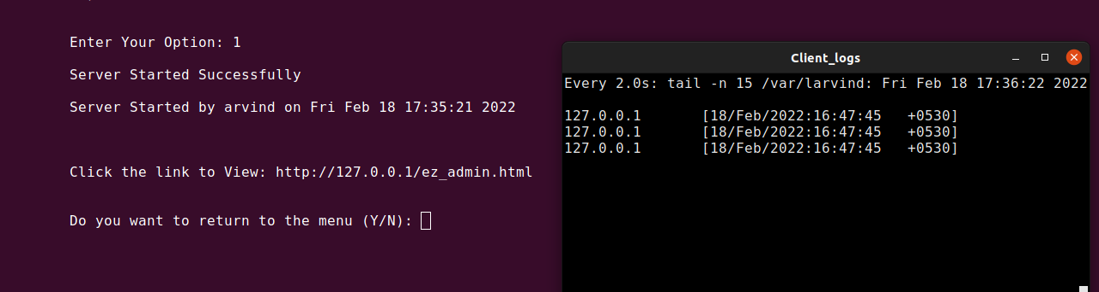
Starting the server
The application prompts the user once the server is switched on
An xterm window pops up showing the details of connections established with the server in real time
The link provided will redirect the user to the server webpage
The activity is logged into the server log file

Slide 4
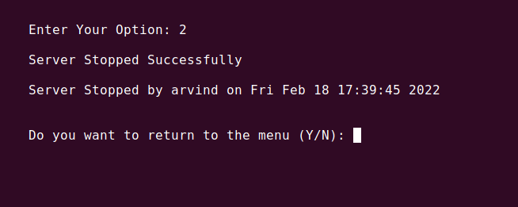
Stopping the server
The application prompts the user once the server is switched off
The xterm window showing real time connections established with the server is closed
The activity is logged into the server log file

Slide 5
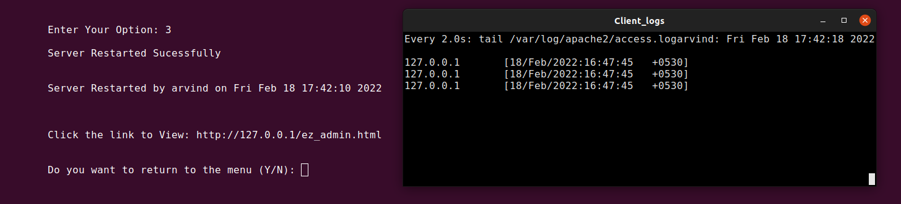
Restarting the server
The application prompts the user once the server is restarted successfully
A fresh xterm window that lists real time connections established with the server pops up on restart
The link provided will redirect the user to the server webpage
The activity is logged into the server log file

Slide 6
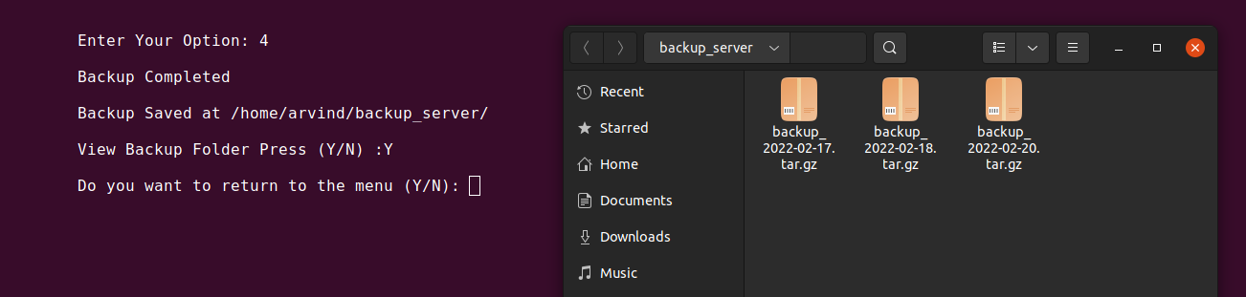
Backing up server files
The server backs up all the files in a compressed format (.tar.gz) with a date stamp for future reference
The backup is stored in the user’s home directory in backup_server folder (Folder will be created if it doesn’t exist beforehand)
Additionally, the application provides the option to view the folder in the file manager

Slide 7
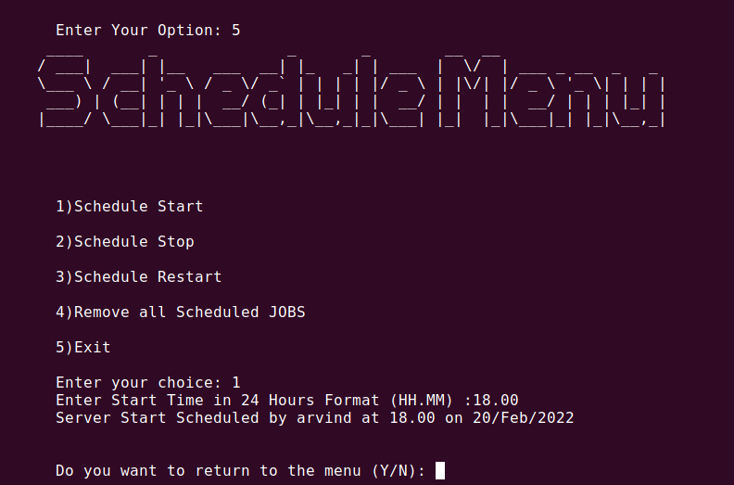
Scheduling server
The Schedule Menu provides functionality to schedule different tasks to be executed at a given time
The tasks that can be scheduled include start, stop and restart
The scheduled tasks are logged into the server log file
Additionally, the previously scheduled tasks can be deleted using the option provided in the Schedule Menu

Slide 8
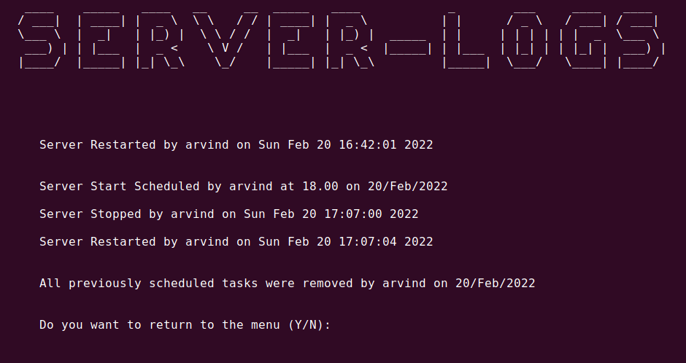
Viewing Server Logs
The server log file lists the various operations performed on the server. It is mainly implemented to monitor server activity
The log file contains the username, date & time at which the operation was performed along with the operation itself
The scheduled operation are listed in the log file as well
Additionally if a scheduled operation is cancelled, the log file records that as well.

Slide 9
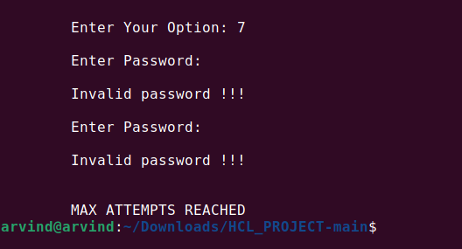
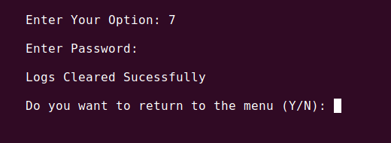
Clearing Server Logs
The server logs file can be cleared with proper authentication. To clear it, a password must be provided to ensure the user is authorized to clear the file.
If an incorrect password is entered twice, the program will be closed.
If the password input is valid, the log file will be cleared successfully.

Slide 10
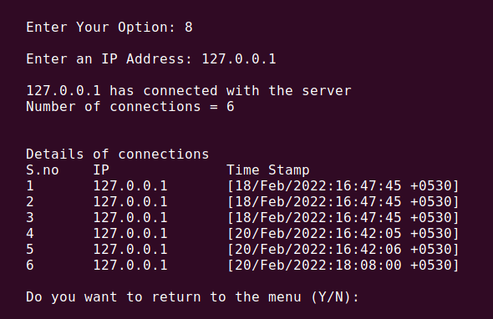
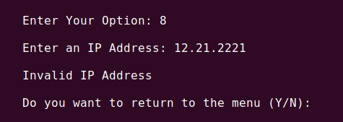
Filtering Client Logs
Using IP Address
The input IP Address will be scanned in the access.log file of the server
If the input is invalid, the application prompts the user stating the IP Address is invalid
Once the IP Address is validated, the matching logs are listed in a tabular format with the IP Address and the time stamp, for reference

Slide 11
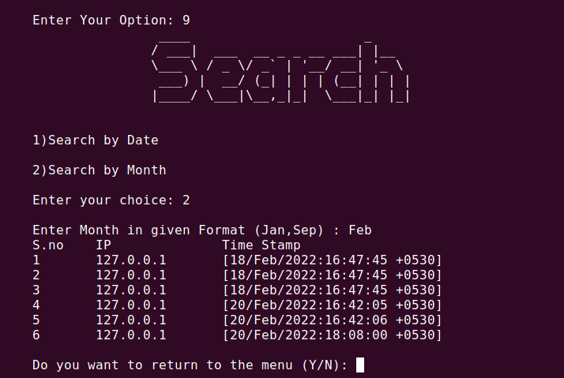
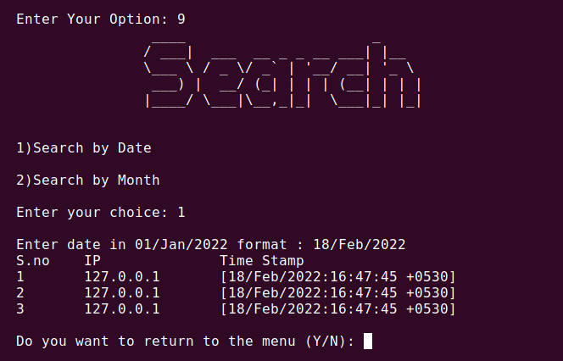
Filtering Client logs
Using Date / Month
The search menu can filter access.log file according to date or month
The input date/month must be in specified format, else the application will prompt the user stating the input is invalid
Once the input is validated, the matching logs are listed in a tabular format with IP Address and time stamp, for reference.

Slide 12
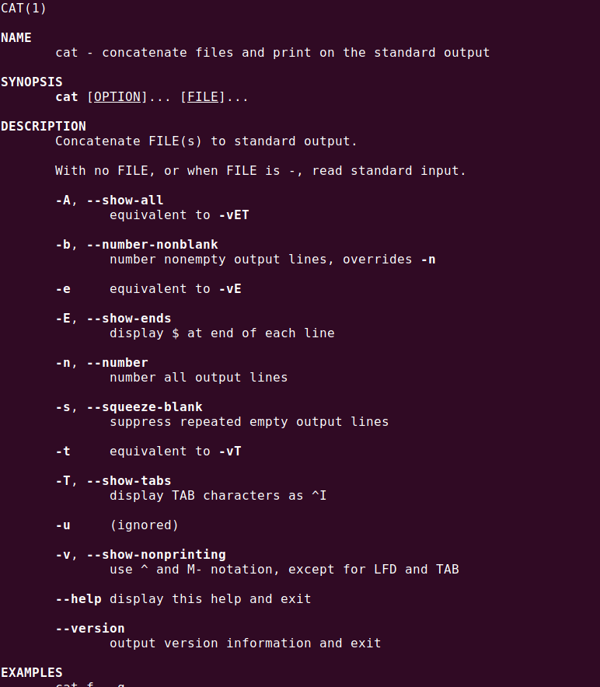
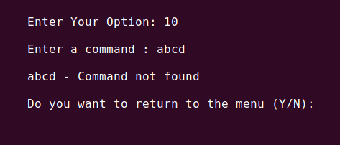
Help menu
The help menu is implemented using the man database, which is in-built in Linux
The input command should be valid, else the application will prompt the user stating the command is not found
If the input command is valid, the user will be redirected to the man page of the same

Slide 13


