Slide 1
KRITHIKA RAVI (2021503517)
Department of Computer Technology
Madras Institute of Technology
Anna University, Zone - IV
Final Project
3/21/2024 Annual Review

Slide 2
PROJECT TITLE
CURRICULUM VITAE GENERATOR
3/21/2024 Annual Review

Slide 3


AGENDA
This project aims to create a Python script for generating professional resumes in Microsoft Word (.docx) format. The script utilizes the python-docx library to programmatically construct CVs based on structured input data. The input data includes personal information, educational background, work experience, and skills. Each section is formatted appropriately and organized within the document. The script follows a modular approach, with separate functions handling different sections of the CV generation process. Example data is provided to demonstrate the functionality of the script, which can be customized or extended to suit individual preferences. The project encompasses research, planning, implementation, testing, documentation, and iteration phases to ensure a robust and user-friendly solution. Ultimately, the generated CVs serve as professional representations of individuals' qualifications, facilitating their job application processes.
3/21/2024 Annual Review

Slide 4

PROBLEM STATEMENT
In the competitive landscape of job applications and professional networking, crafting an impactful Curriculum Vitae (CV) or Resume is essential. This project presents a CV/Resume Generator, a versatile tool designed to assist individuals in creating professional and tailored CVs with ease. The generator utilizes Python programming language and the python-docx library to automate the creation of CV documents.
The CV/Resume Generator aims to cater to users across various industries and professions, offering a customizable template that can be adapted to different career paths. Users can effortlessly generate multiple versions of their CVs tailored to specific job applications or career opportunities.
3/21/2024 Annual Review

Slide 5

PROJECT OVERVIEW
In this project, Python is utilized as a powerful tool for automating the creation of resumes, streamlining the otherwise time-consuming and error-prone process. By leveraging the python-docx library, the script dynamically constructs CVs with consistent formatting and structure, enhancing readability and professionalism. The project caters to diverse user needs, offering flexibility in input data and customization options. Through careful planning and iterative development, the script is designed to be user-friendly, efficient, and adaptable to future enhancements or modifications. With its ability to handle various sections of a resume seamlessly, including education, work experience, and skills, the project empowers individuals to effortlessly generate polished CVs tailored to their unique backgrounds and career aspirations.
3/21/2024 Annual Review

Slide 6

WHO ARE THE END USERS?
1. Job Seekers: Individuals actively seeking new employment opportunities who need to create tailored resumes for different job applications.
2. Students and Graduates: Students or recent graduates entering the workforce who need to showcase their educational background, skills, and any relevant experience.
3. Professionals: Experienced professionals looking to update their resumes for career advancement, job transitions, or networking purposes.
4. Freelancers and Contractors: Freelancers or independent contractors who need to present their skills and expertise to potential clients or employers.
5. Career Changers: Individuals transitioning to a new field or industry who need to highlight transferable skills and relevant experiences.
6. HR Professionals: Human resources professionals or recruiters who may use the tool to generate standardized resumes for applicants or to review and format candidate resumes.
3/21/2024 Annual Review

Slide 7

YOUR SOLUTION AND ITS VALUE PROPOSITION
This project's value proposition lies in its capacity to revolutionize the traditional process of resume creation, offering individuals a seamless and efficient tool to craft compelling professional resumes. By harnessing the power of Python and the python-docx library, users can swiftly generate resumes that reflect their qualifications, experiences, and skills in a polished format. The project eliminates the tedious manual labor typically associated with formatting resumes, allowing users to focus their energy on showcasing their unique strengths and suitability for desired roles. With its intuitive interface and customizable features, the tool empowers users to create resumes that stand out in today's competitive job market.
3/21/2024 Annual Review

Slide 8
YOUR SOLUTION AND ITS VALUE PROPOSITION
Furthermore, the project enhances users' ability to maintain consistency and professionalism across their job applications, reinforcing their brand identity and credibility. By automating the formatting process and adhering to industry standards, the tool ensures that each resume is well-structured, visually appealing, and easy to read. This not only saves users valuable time but also enables them to present themselves in the best possible light to potential employers. Whether individuals are seasoned professionals, recent graduates, or career changers, this project offers a valuable solution that streamlines the resume creation process and maximizes their chances of success in securing their desired employment opportunities.
3/21/2024 Annual Review

Slide 9

THE WOW IN YOUR SOLUTION
What sets this project apart is its fusion of simplicity, automation, and professional presentation in the realm of resume creation. Unlike traditional methods that often involve manual formatting and layout adjustments, this project leverages Python's capabilities along with the python-docx library to automate the entire process. It uniquely offers users the ability to generate polished resumes quickly and efficiently, freeing them from the burden of tedious formatting tasks. Moreover, the project's flexibility allows users to customize their resumes according to their specific needs and preferences, catering to a diverse range of individuals from various backgrounds and industries.
3/21/2024 Annual Review

Slide 10
MODELLING
This project utilizes several libraries to achieve its functionality:
1. python-docx: This library is the core component of the project, allowing Python to interact with Microsoft Word (.docx) files. It provides functionality to create, read, and modify Word documents programmatically. In this project, python-docx is used to generate the resume content, including text, headings, paragraphs, and lists, and to format the document according to predefined styles.
2. docx.shared: This submodule of python-docx provides access to shared properties and objects used throughout a document, such as font styles, colors, and units of measurement. In the project, it's used to set properties like font size for the entire document.
3. docx.enum.text: Another submodule of python-docx, this library provides enumerated constants for specifying text-related properties, such as alignment, indentation, and line spacing. In the project, it's used to specify paragraph alignment for headings and other text elements.
3/21/2024 Annual Review

Slide 11
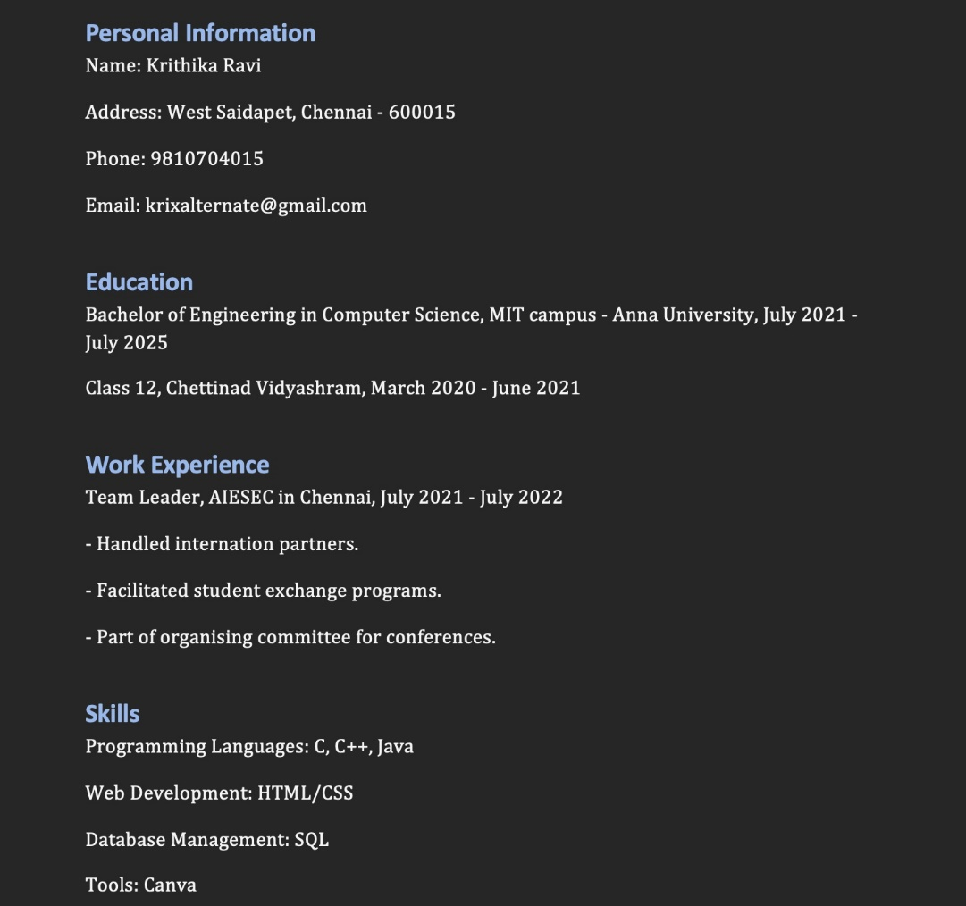
RESULTS
3/21/2024 Annual Review

Slide 12
Thank you!

