Slide 1

Deep Learning in Waste segregation

Slide 2

Purpose
Identify and classify waste materials

Slide 3
Problem
Waste management is a huge problem in any country
Disposal of waste into appropriate bin for recycling
Classifying recyclable wastes into cardboards, glass, metals to be sent to appropriate processing

Slide 4
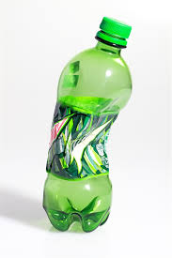
Method
Image recognition using Neural Network (CNN)
Library: Keras
Model: VGG 16 (pre-trained Keras model)
Classification: pop bottle
Accuracy: 18%

Slide 5

Method
Image Recognition using Google Cloud AutoML Vision

Slide 6
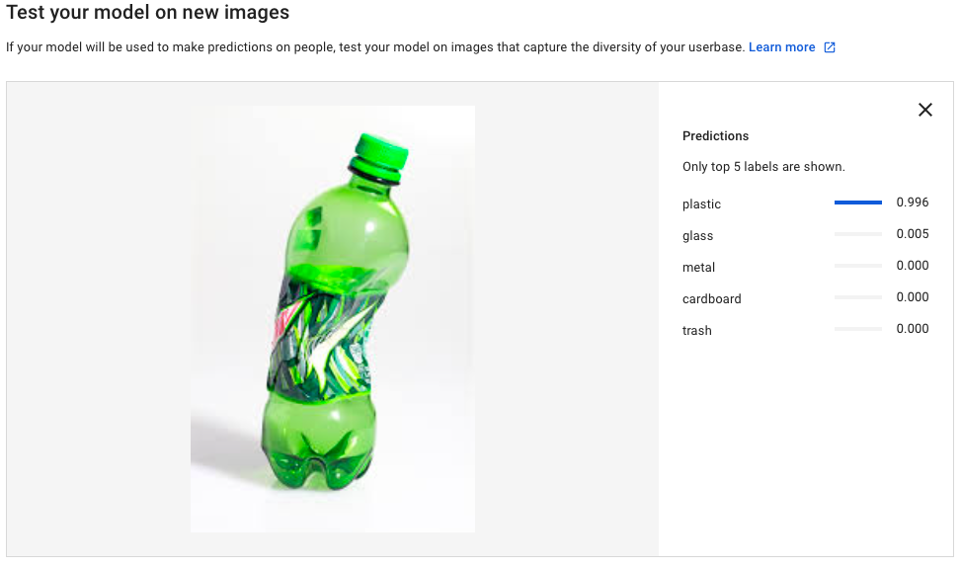
Result
Classify waste materials with 99% accuracy
Using Google Cloud AutoML Vision

Slide 7
Challenges
“Not all plastics are recyclable.”
Differentiate plastic bottles that are recyclable and non-recyclable.
Improve the efficiency to segregate materials at a large scale with an improved speed.

Slide 8
Conclusion
Waste management facilities can segregate waste materials effectively with the help of machine learning.

Slide 9


Thank You!
github.com/krithikaceg
@Krithika_ceg

