Slide 1

Data Science Job Market in the US

Slide 2
Team
Lauren Coder/Project Manager
Kyle Coder/Researcher
Krystal Coder/Data Wrangler
Krithika Coder/Data Wrangler

Slide 3
Objectives
Who are the top employers looking to hire?
What are the educational requirements?
Where are the jobs located?
What are the technical skills employers are looking for?
Notes:
How job market changed over time- Was not able to access Indeed to get a comparable dataset from another date
Population of the cities where jobs are located (urban, rural, suburban) we struggled finding zip codes for specific cities from the Census API

Slide 4
Data Approach
Data Collection
Wanted to use Indeed, LinkedIn, or Monster API
Ended up using a data set from Kaggle
Data was scraped from Indeed as of 8/3/2018
Data Cleaning
Used job title to filter out non data science related jobs
Standardized job titles
Cleaned the location data by removing zip code
Removed unnecessary columns
Tools Used
Excel Jupyter Notebook Python
Matplotlib Google API Pandas

Slide 5
Who are the top employers?
…and what are they looking for?

Slide 6
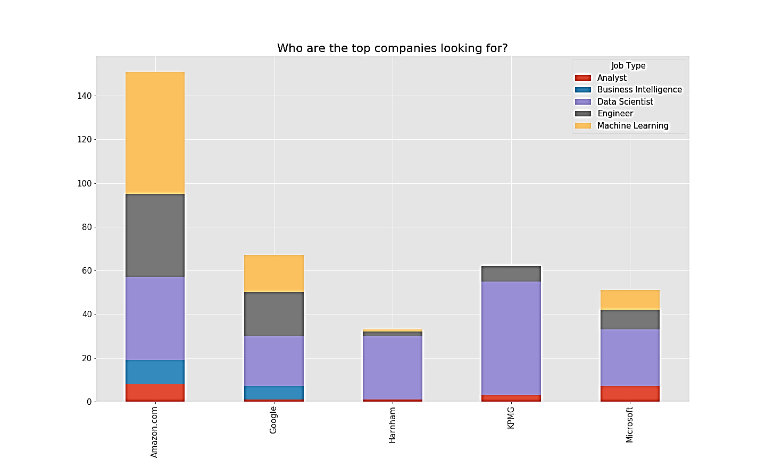
Data Scientist
Amazon: Machine Learning
Google: Data Scientist
Harnom: Data Scientist
Kpmg: Data Scientist
Microsoft: Data Scientist

Slide 7

What are the educational requirements for data science jobs?

Slide 8
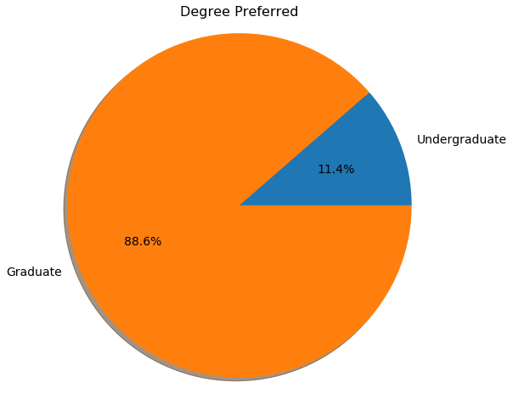
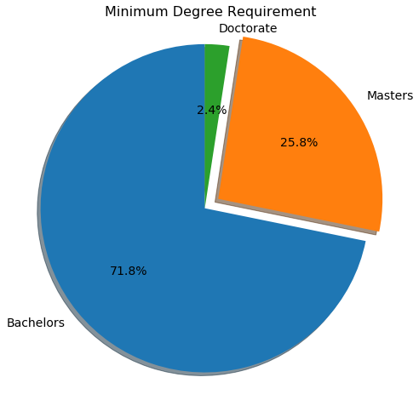
Degree Preferred vs. Degree Required
Having a Masters degree is important

Slide 9

What are the technical skills employers are looking for?

Slide 10
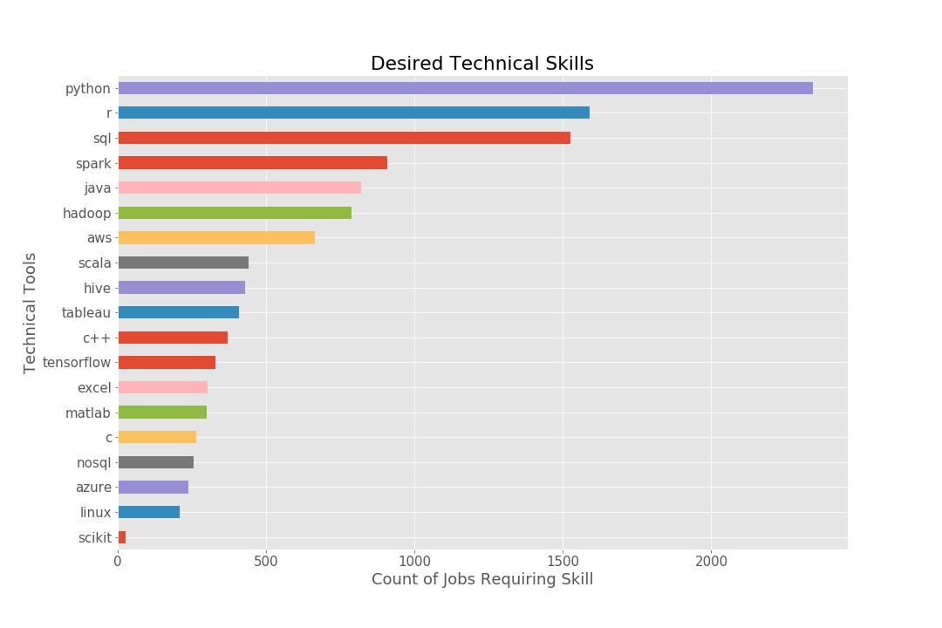

Python skills desired
Python snakes its way to 1st

Slide 11


Where are they hiring?

Slide 12
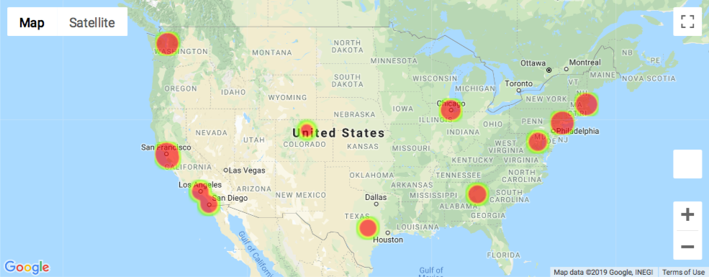
Heatmap

Slide 13
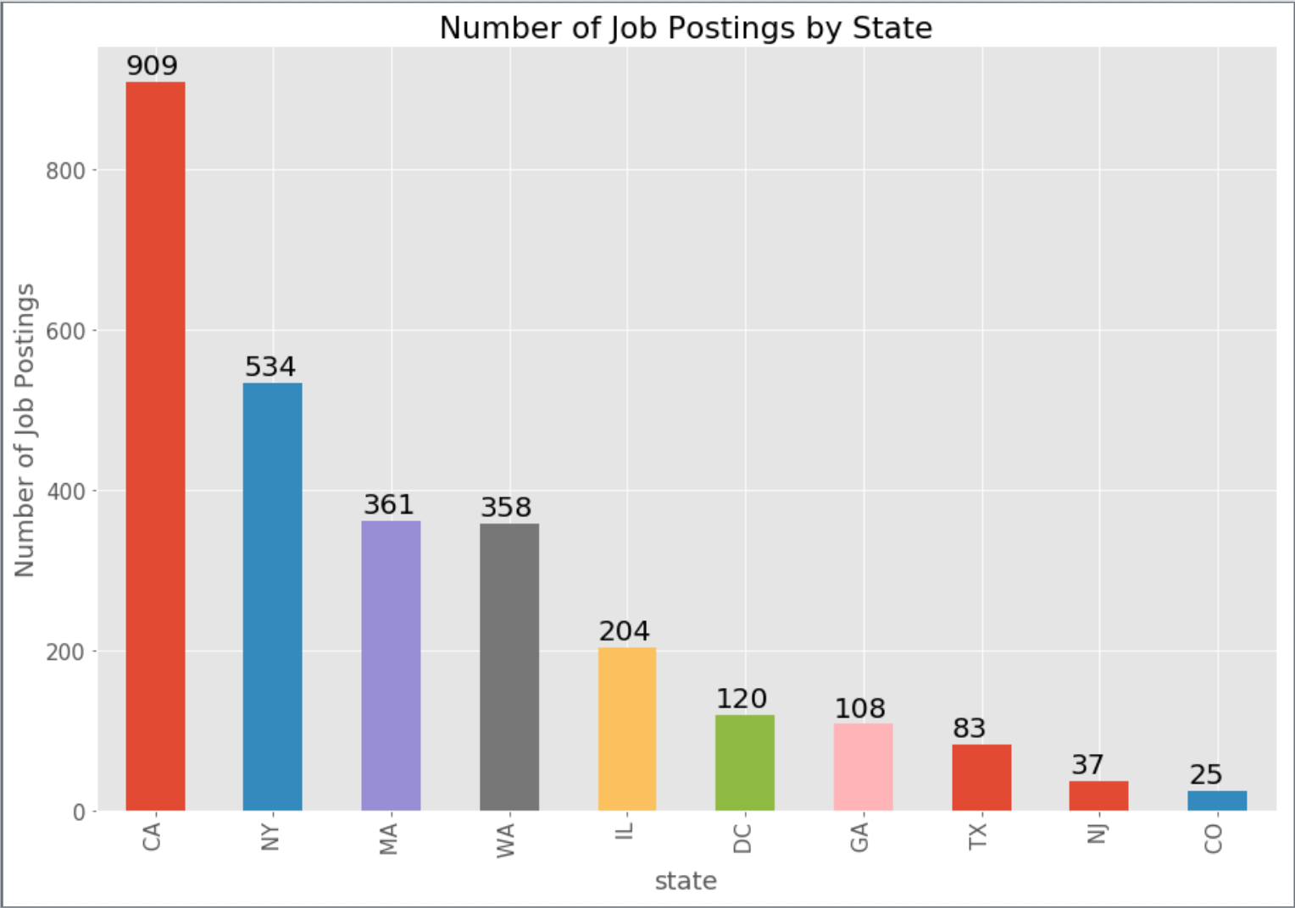
California
California dominates with NY coming in second.

Slide 14
DEMO

Slide 15
Considerations and Roadblocks
Considered Questions
How has the job market changed over time?
What industry are the employers from?
What is the population of the cities where jobs are located?
Challenges
Unable to access API for Indeed jobs to retrieve dataset from different time period.
Unable to determine industry of employers hiring
Struggled to find population size by city in census API

Slide 16

Q&A

