Slide 1

LSB Embedding Steganography: A Comparative Analysis of 2-Bits and 3-Bits Techniques in Different Resolutions of Images
Team Members: Guided by :-
Deepak DM - 125160086 Dr. Lakshmi C
Krithik Naveen AR- 125160029 ECE/SEEE
Jawahar N - 125160021

Slide 2
Overview:
The objective of this presentation is to evaluate and compare the performance of LSB (Least Significant Bit) embedding techniques with 2 and 3 bits for masking in 128x128, 256x256, and 512x512 images. The aim is to determine the optimal technique based on three key metrics: transparency rate, PSNR (Peak Signal-to-Noise Ratio), and SSIM (Structural Similarity Index). By analyzing the impact of different embedding techniques on these metrics, the presentation aims to provide insights into the trade-offs between transparency, image quality, and embedding capacity. Ultimately, the goal is to guide the selection of the most suitable LSB embedding technique for various image sizes and applications.

Slide 3
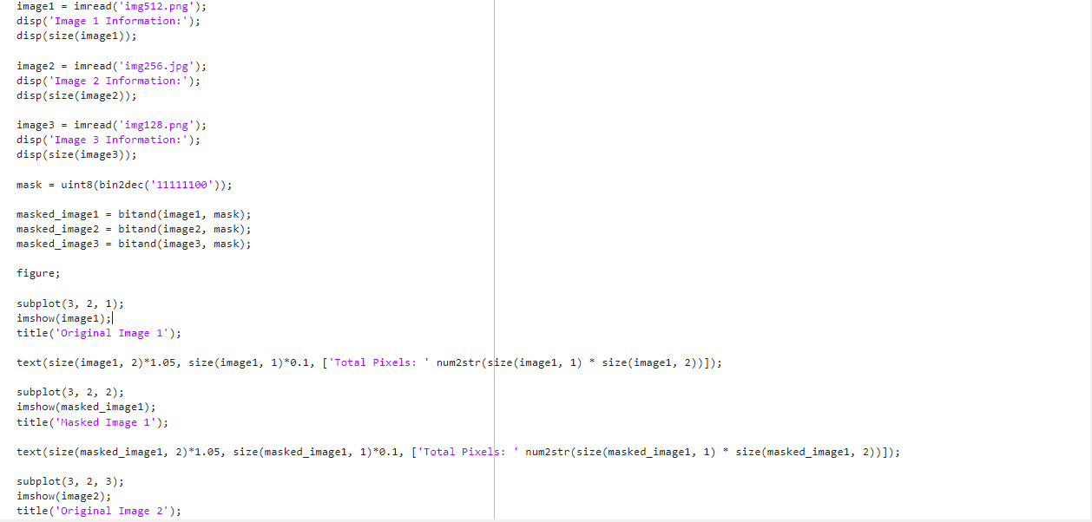
Work Done: 2-Bits LSB Masking:

Slide 4
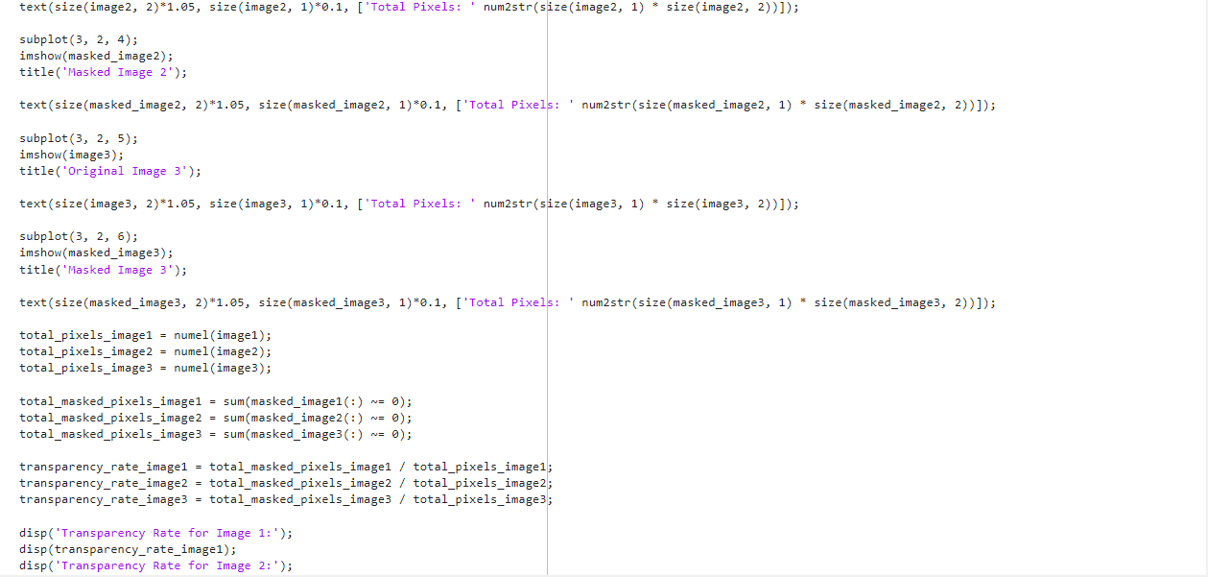

Slide 5
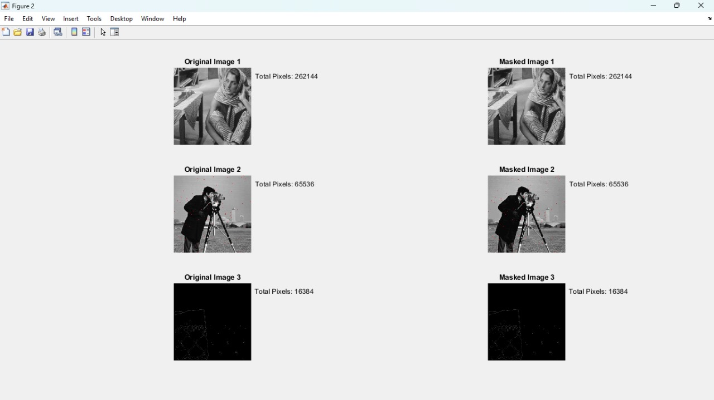

Slide 6
The images of resolutions 128x128,256x256 and 512x512 are taken and their pixels are obtained in which 2 LSB bits are masked and displayed.
The total pixels in each image are displayed.
Similarly, the same is done by masking the 3 LSB bits and also 2 LSB bits in only odd-numbered rows for analysing which technique is optimal by comparing their transparency rates.

Slide 7
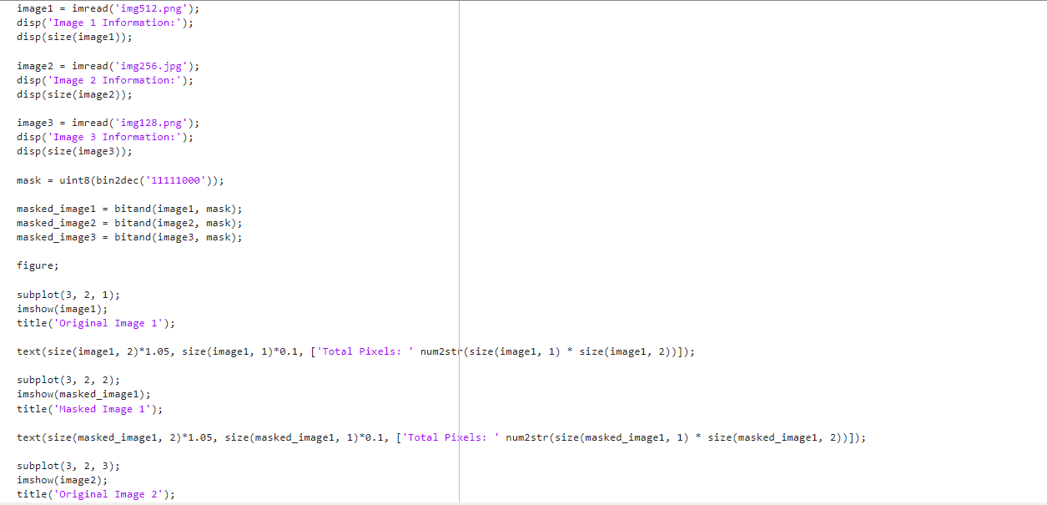
3 LSB bits masking:

Slide 8
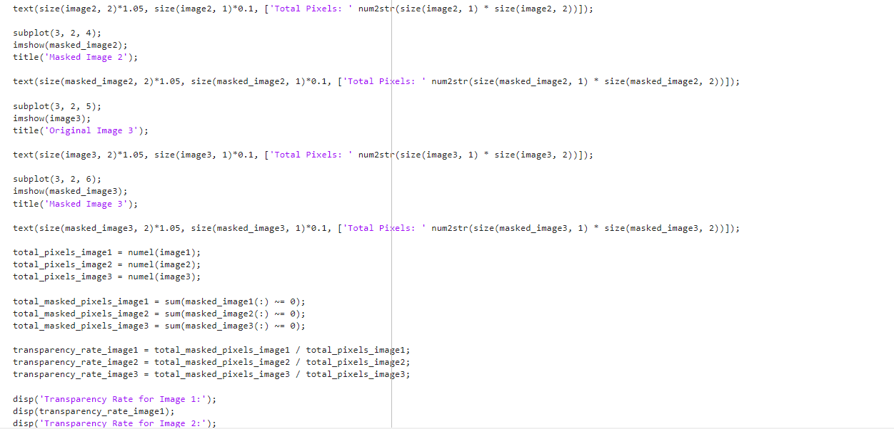

Slide 10
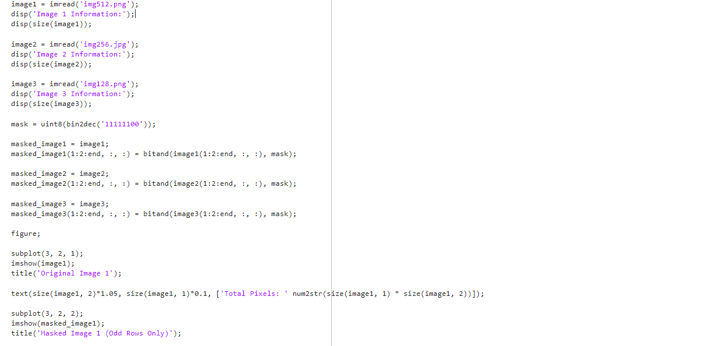
Masking 2 LSB bits in odd-numbered rows:

Slide 11
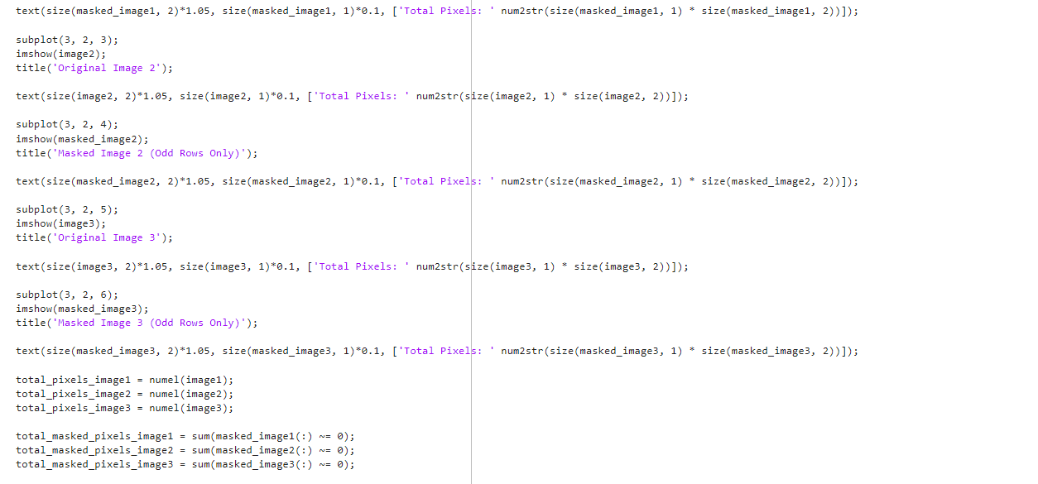

Slide 12
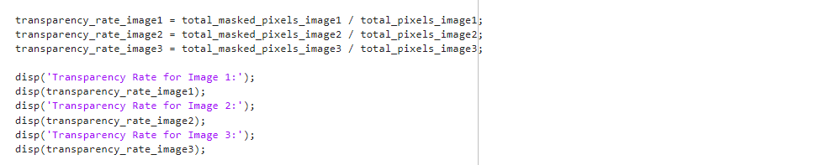

Slide 14
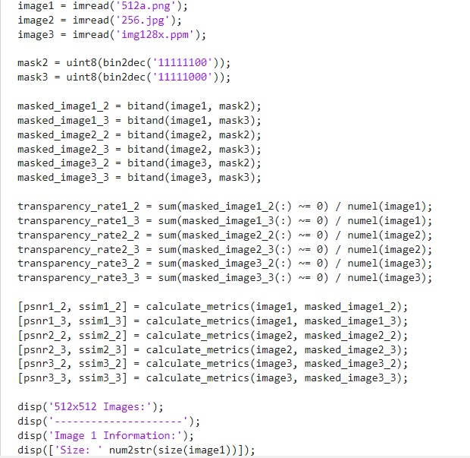

Slide 15
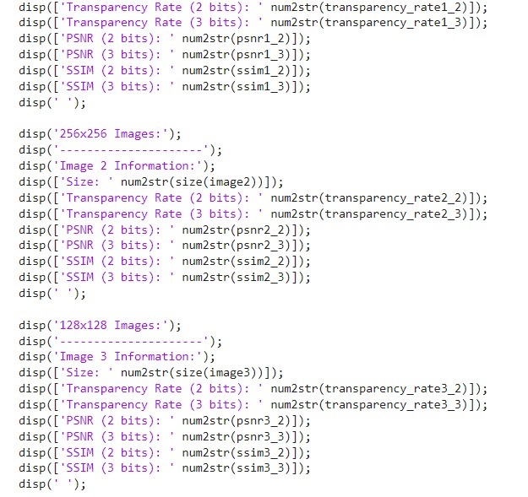

Slide 16
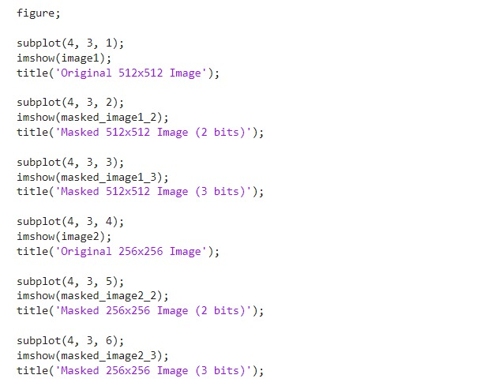

Slide 17
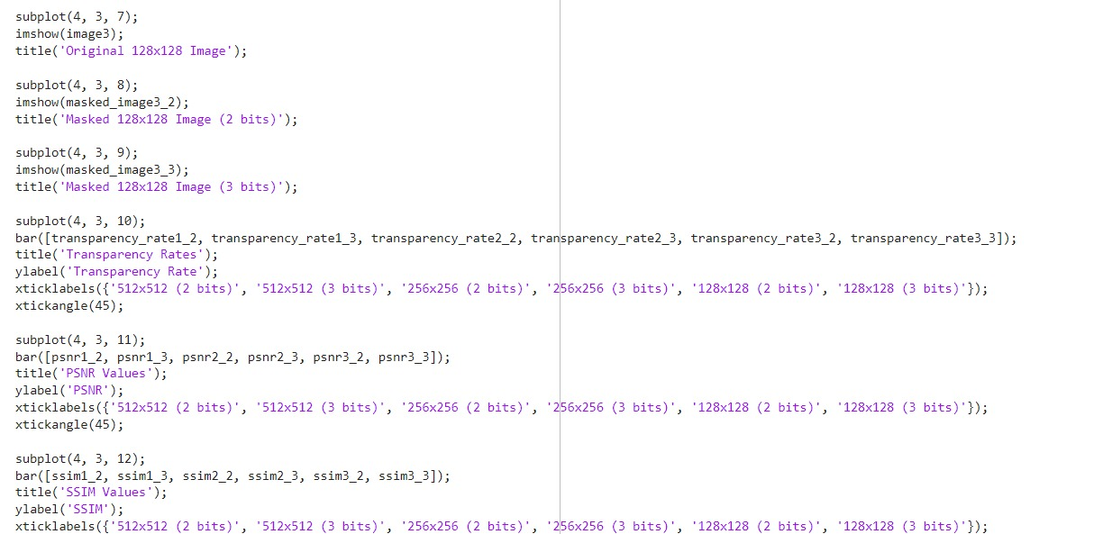

Slide 18

Transparency rate refers to the proportion of pixels in an image that are transparent after applying a specific masking operation.
A high transparency rate means that a large portion of the image becomes transparent, indicating that the masking operation has affected a significant portion of the image.
Conversely, a low transparency rate means that only a small portion of the image becomes transparent, suggesting that the masking operation has had minimal impact on the image's transparency.

Slide 19
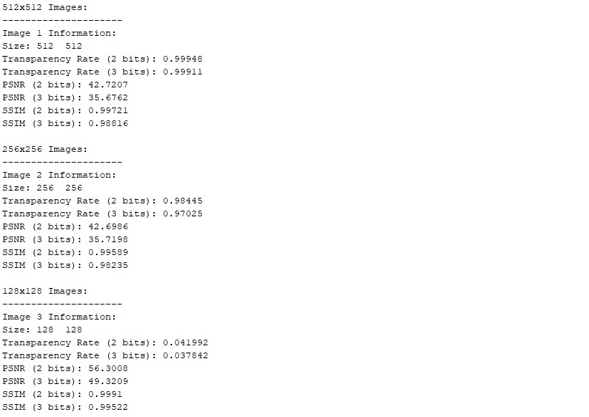

Slide 20
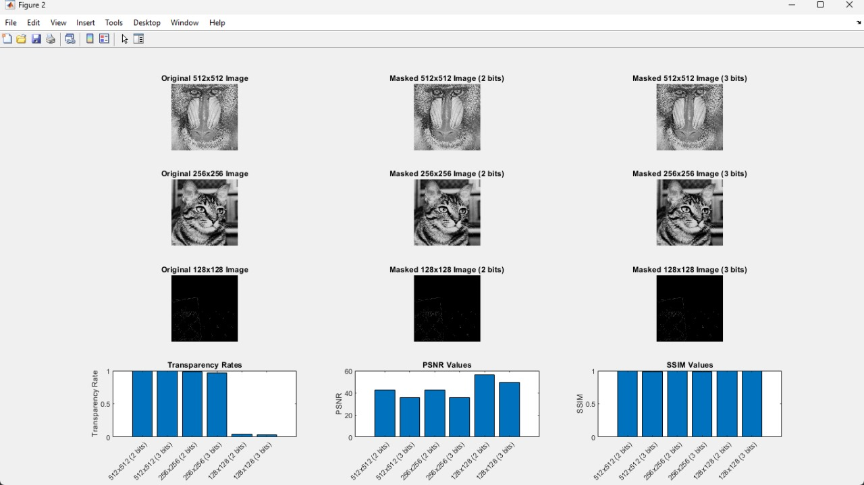

Slide 21
The desired transparency rate depends on the specific application and the intended effect. For some applications, such as image compression or watermarking, a higher transparency rate might be desirable to achieve greater data reduction or embedding of additional information. In other cases, such as preserving image integrity or visual quality, a lower transparency rate might be preferable to minimize data loss or distortion.
Therefore, whether a high or low transparency rate is desirable depends on the context and requirements of the particular image processing task or application.
In the context of image quality assessment, PSNR (Peak Signal-to-Noise Ratio) measures the quality of the reconstruction of a processed image compared to the original image. Higher PSNR values indicate better quality or less distortion.
Therefore, in general:
- A higher PSNR value indicates that the processed image is closer in quality to the original image, implying lower levels of distortion or noise.
- Conversely, a lower PSNR value suggests that the processed image deviates more from the original image, indicating higher levels of distortion or noise.

Slide 22
A higher SSIM value indicates greater similarity between the processed image and the original image, suggesting better preservation of structural information, textures, and details.
Conversely, a lower SSIM value indicates less similarity between the images, suggesting that more structural information, textures, or details have been lost or distorted during processing.
In summary, a higher SSIM value is desirable as it indicates better similarity between the processed and original images. However, as with PSNR, the interpretation of SSIM should consider the specific context and requirements of the image processing task or application.

Slide 23
REFERENCE
A Survey on Steganography using Least Significant bit(LSB) Embedding Approach, Kriti Bansal, Aman Agrawal, Nency Bansal
An Improved Least Significant Bit Image Steganography Method,
Sa'ed Abed,Nora Hamad Al-Huwais,Yousef Ahmad, AtiyahS. Parvin, Amjad Gawanmeh
Identification of LSB image Steganography using Cover Image Comparisons
M. PelosiN. PoudelPratap LamichhaneDevon LamGary C. KesslerJoshua MacMonagle

Slide 24
THANK YOU

