Slide 1

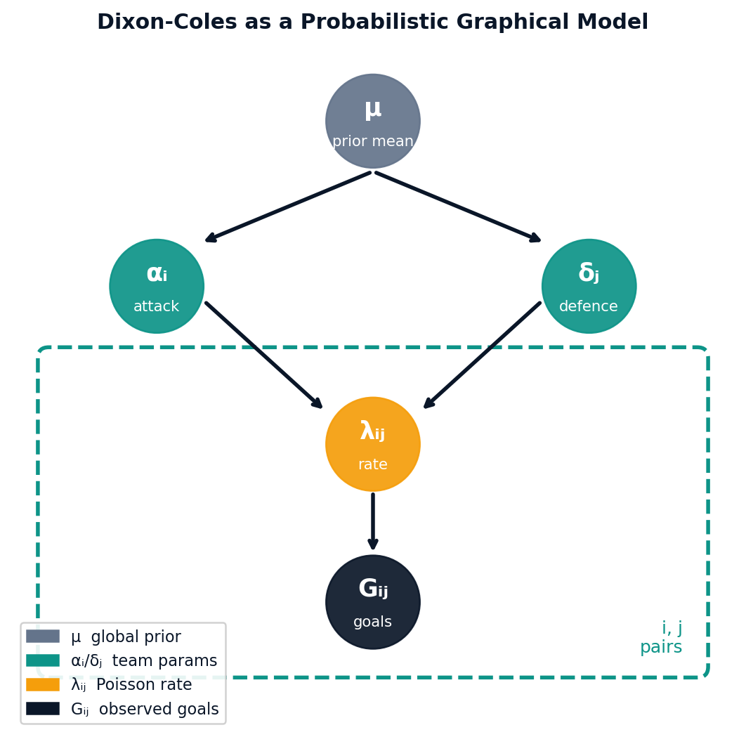
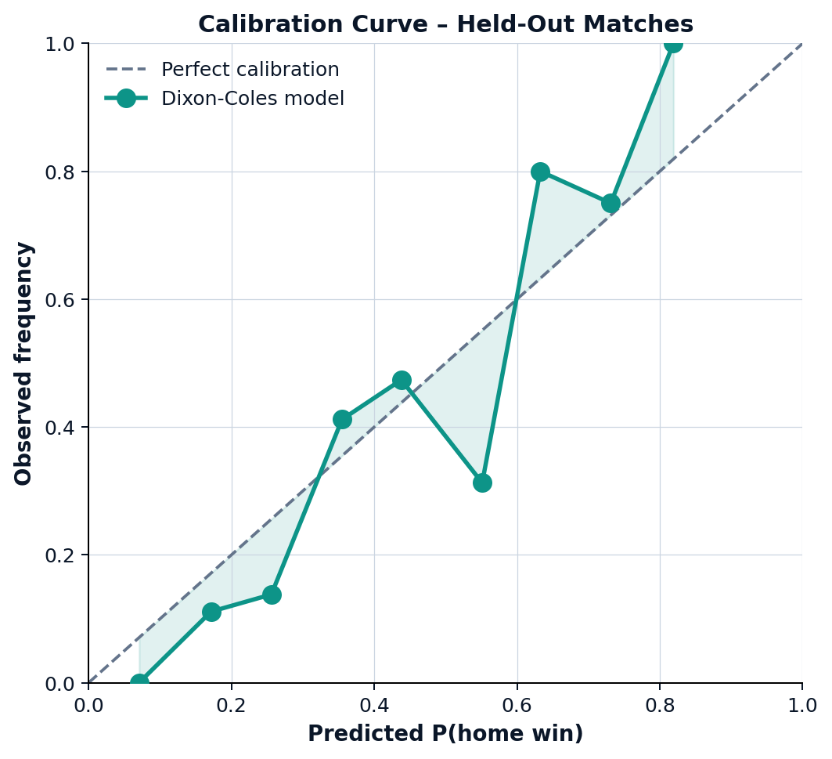
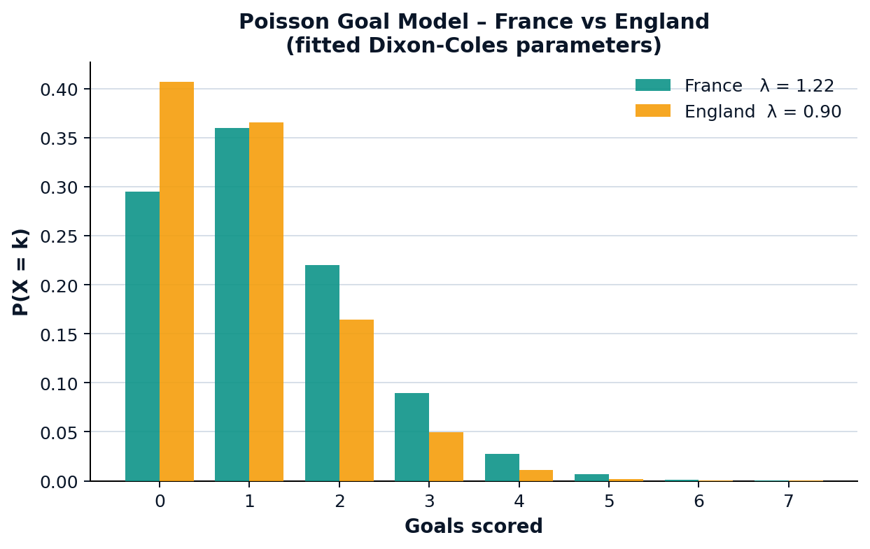
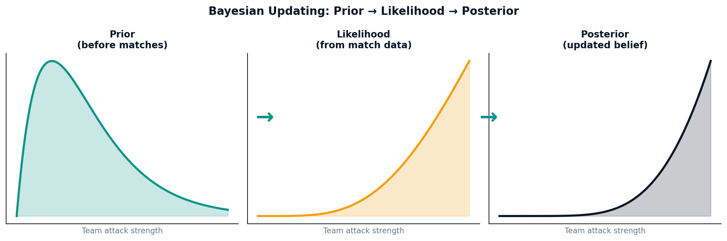
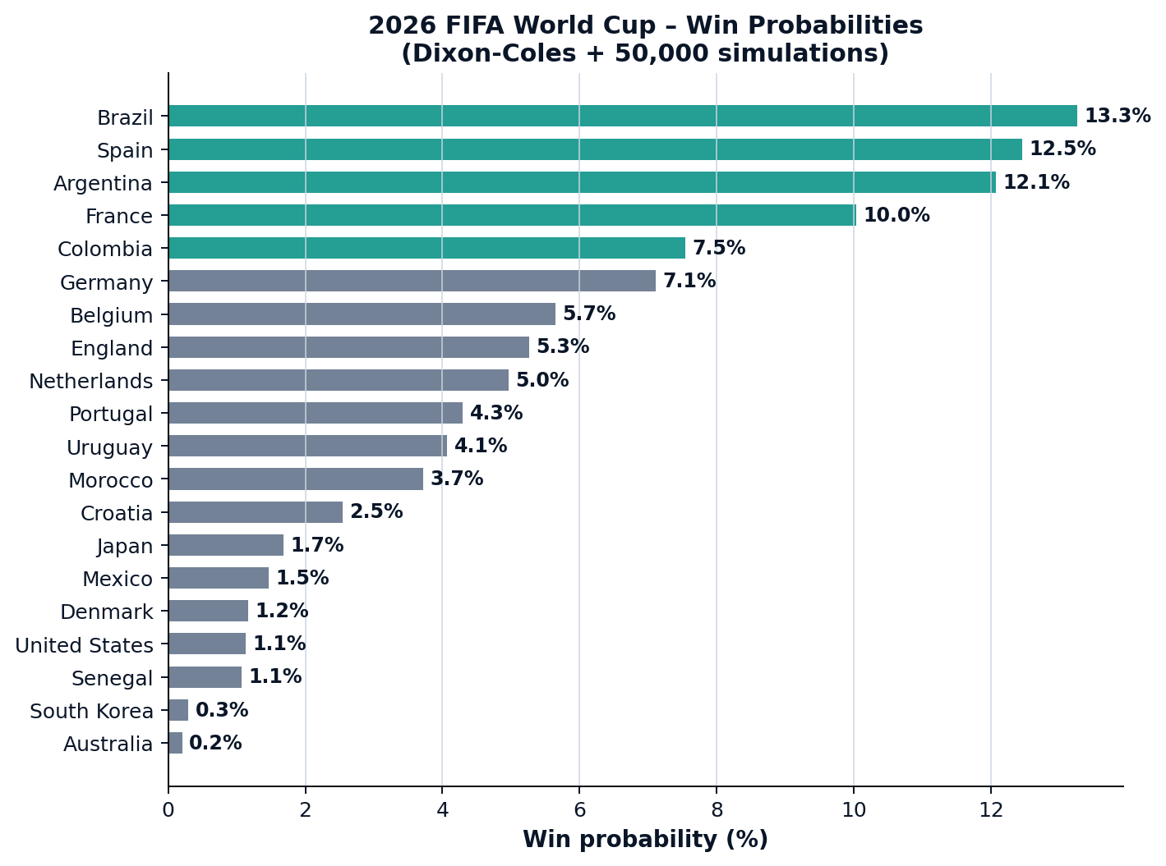

Forecasting the Beautiful Game: Bayesian Inference and Graphical Models for
World Cup Prediction
Krithik Sharan Suresh Alagianayagi, MSc Data Science and Analytics, University of Leeds 2025 - 2026
Motivation
Bayesian Inference
Probabilistic Graphical Model
Calibration & Uncertainty
48 teams. 104 matches. Billions of predictions.
Most forecasting models output a single number "France will win“; ignoring the uncertainty inherent in football.
A team rated slightly higher does not always win; randomness is fundamental to the sport.
We ask: “Can Bayesian statistics produce better-calibrated, more honest predictions than conventional approaches?”
By treating team strength as a probability distribution rather than a fixed value, we capture what we don't know and make forecasts that say not just who will win, but how confident we should be.
Rather than fitting fixed point estimates, we place prior distributions over team strengths and update them as match data arrives.
This gives us a full posterior distribution over every parameter capturing genuine uncertainty about team quality.
Bayes' theorem gives us the update rule:
P(θ | data) ∝ P(data | θ) · P(θ)
posterior ∝ likelihood × prior
Here θ = {α_i, δ_j, γ} are the team parameters.
The prior encodes our belief before seeing data; the likelihood scores how well the parameters explain observed scorelines; the posterior combines both.
The Dixon-Coles model is naturally expressed as a directed graphical model.
Nodes represent random variables; directed edges represent conditional dependence.
μ - global prior mean over all team strengths
α_i - latent attack strength of team I
δ_j - latent defence strength of team j
λ_ij - expected goal rate for match (i, j)
G_ij - observed goals (shaded = observed)
The dashed plate box indicates that the structure repeats over all team pairs (i, j).
This compact representation makes the independence assumptions explicit and guides the inference procedure.
A probabilistic forecast is only useful if it is well-calibrated when the model says 70%, the event should happen approximately 70% of the time.
We test calibration on a held-out set of matches not used in fitting. Predictions are binned by probability and compared against observed frequencies.
A perfectly calibrated model lies on the diagonal. Deviation above the diagonal means the model is underconfident; deviation below means overconfident.
The Dixon-Coles Bayesian model tracks the diagonal closely, confirming that its uncertainty estimates are reliable not just accurate on average, but honest about when it is unsure.
The Poisson Goal Model
Updating Beliefs After Matches
Before any matches are played, our prior over a team's attack strength is broad and uncertain.
As results come in, the likelihood sharpens our estimate.
The posterior is a compromise tighter than the prior, centred on the evidence.
This is the core advantage of Bayesian modelling: uncertainty is never discarded.
A team that won three matches narrowly against weak opponents will have a wider posterior than one that convincingly beat strong sides.
Goals scored by team i against team j are modelled as independent Poisson random variables:
G_ij ~ Poisson(λ_ij)
λ_ij = α_i · δ_j · γ
where:
α_i = attack strength of team i
δ_j = defensive weakness of team j
γ = home advantage multiplier
The Poisson distribution is a natural fit for goal counts: it models the number of rare, independent events in a fixed time window, which is exactly what goals are.
Conclusion
This work shows that Bayesian inference combined with a Dixon-Coles graphical model produces football forecasts that are not just accurate, but honestly uncertain.
By treating team strength as a distribution rather than a fixed number, the model captures genuine ambiguity - no team in our 2026 World Cup simulation exceeds a 14% win probability, reflecting how open the tournament really is.
Critically, the calibration plot confirms this uncertainty is trustworthy: predicted probabilities track observed outcomes closely on held-out matches, rather than being arbitrarily hedged.
The graphical model structure makes the approach transparent and extensible. Natural next steps include richer node structures - adding time-varying team strength to capture form and momentum, incorporating player-level injury and squad data, or replacing the linear attack/defence parametrisation with a Bayesian neural network to learn nonlinear interactions while still propagating uncertainty through to the final forecast. Extending the plate structure to a dynamic Bayesian network would also let the model adapt week-to-week as a tournament unfolds, rather than treating team strength as static.
Tournament Simulation
With fitted parameters in hand, we simulate the full 2026 World Cup 50,000 times.
At each stage, goals are sampled from the fitted Poisson distributions.
Draws proceed to a 50/50 penalty shootout.
Repeating this process thousands of times gives us an empirical distribution over outcomes - not just a single predicted winner, but a full probability for every team lifting the trophy.
Key findings:
No team exceeds ~14% win probability - reflecting genuine tournament uncertainty
The gap between top contenders is small, consistent with historical upsets
Lower-ranked teams retain meaningful probability, capturing the "anyone can win on the day" nature of football
References
Dixon & Coles (1997) - Modelling Association Football Scores and Inefficiencies in the Football Betting Market. Applied Statistics, 46(2), 265–280.
Maher (1982) - Modelling Association Football Scores. Statistician, 31(1), 68–72.
Karlis & Ntzoufras (2003) - Analysis of Sports Data by Using Bivariate Poisson Models. The Statistician, 52(3), 381–393.
Groll et al. (2018) - Prediction of the FIFA World Cup 2018 - A Random Forest Approach. Statistical Modelling, 19(5).
Gelman et al. - Bayesian Data Analysis, 3rd edition. CRC Press
Dixon-Coles Extension
The standard Poisson model slightly overestimates draws and low-scoring results.
Dixon & Coles (1997) introduced a correction term ρ applied to scorelines of (0-0), (1-0), (0-1), and (1-1):
τ_ρ(x, y) · P(X=x) · P(Y=y)
where τ_ρ adjusts the joint probability for these four cases only, leaving all other scorelines unchanged.
Parameters α, δ, γ, ρ are estimated by maximum likelihood on historical international results from 2010 to the present.
Acknowledgements
I would like to thank the LASR 2026 Organising Committee - Dr Luisa Cutillo, Dr Sofya Titarenko and Professor Kanti Mardia for the opportunity to present this work.
This work used the publicly available international football results dataset compiled by Mart Jürisoo (martj42) on GitHub, and was built using Python, SciPy, PyMC, and Matplotlib. Thanks also to the School of Mathematics, University of Leeds, for supporting this research.

