Slide 1
Update progress 2025/05/26 By: Krit Ittisomboon (クリット イティソンブーン) (Hymn) (ヒム)

Slide 2
Progress
Fixing a code to create a Map of Thailand border as CSV.
Taking Data of Echo weather (precipitation in Thailand).
Fix the data loss problem of the last week.

Slide 3
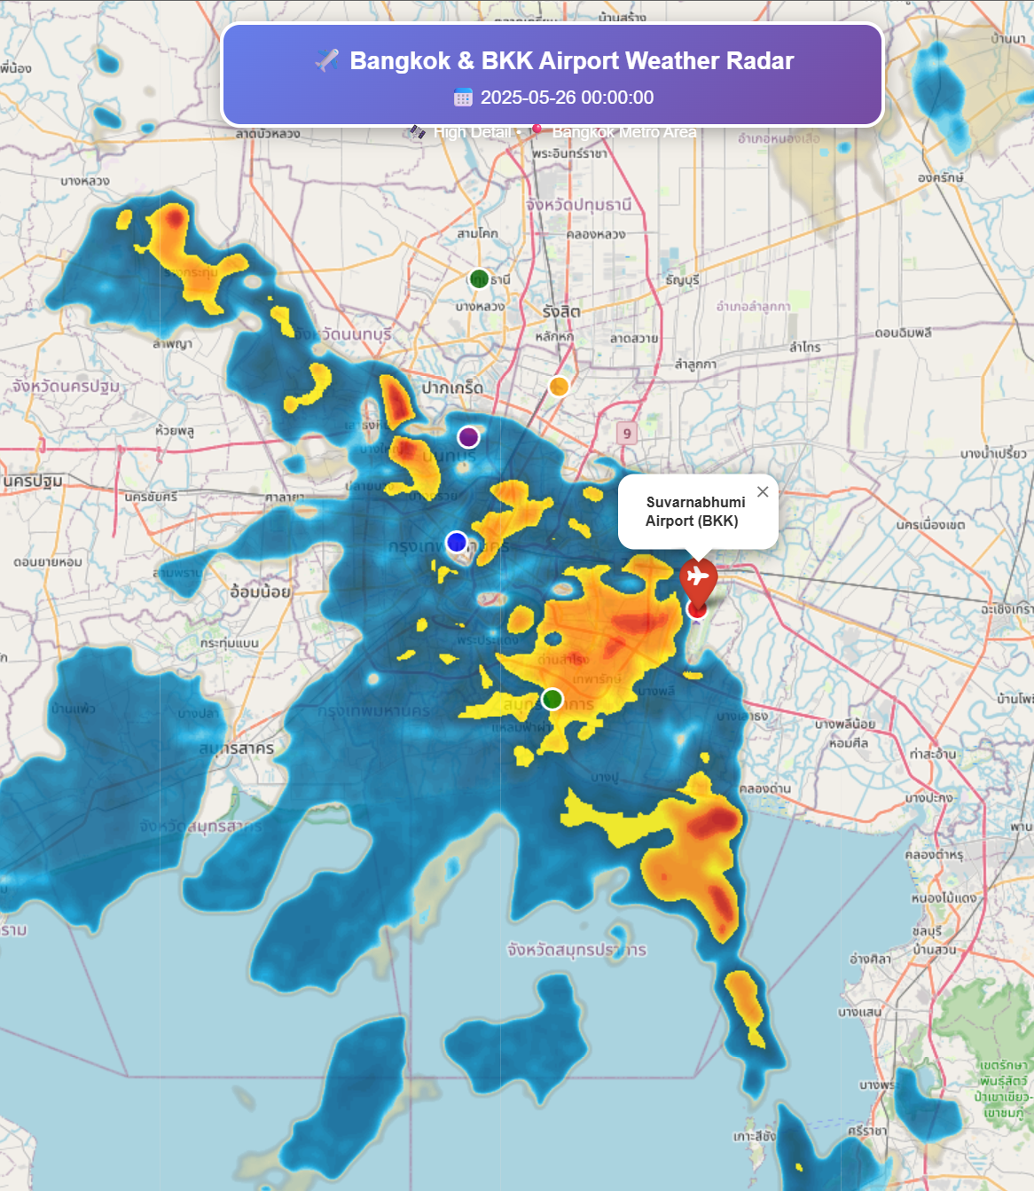
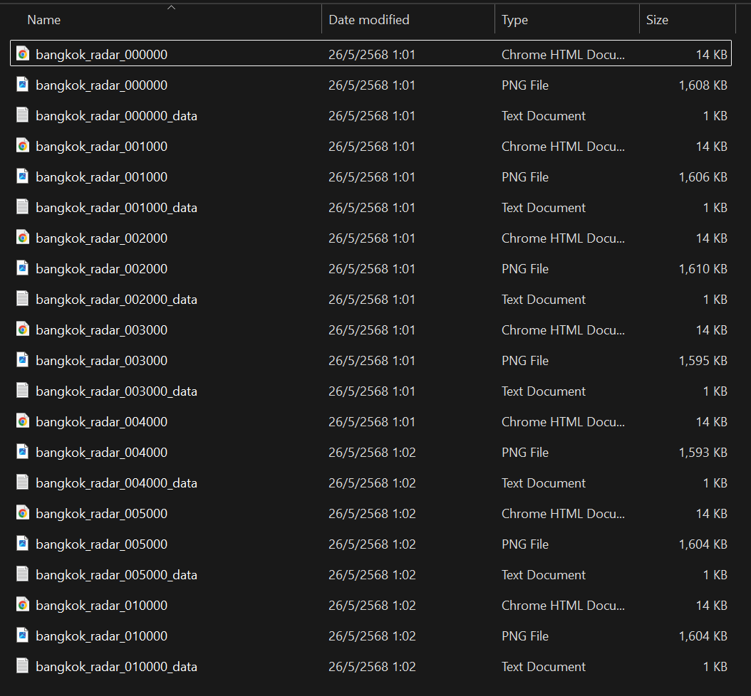
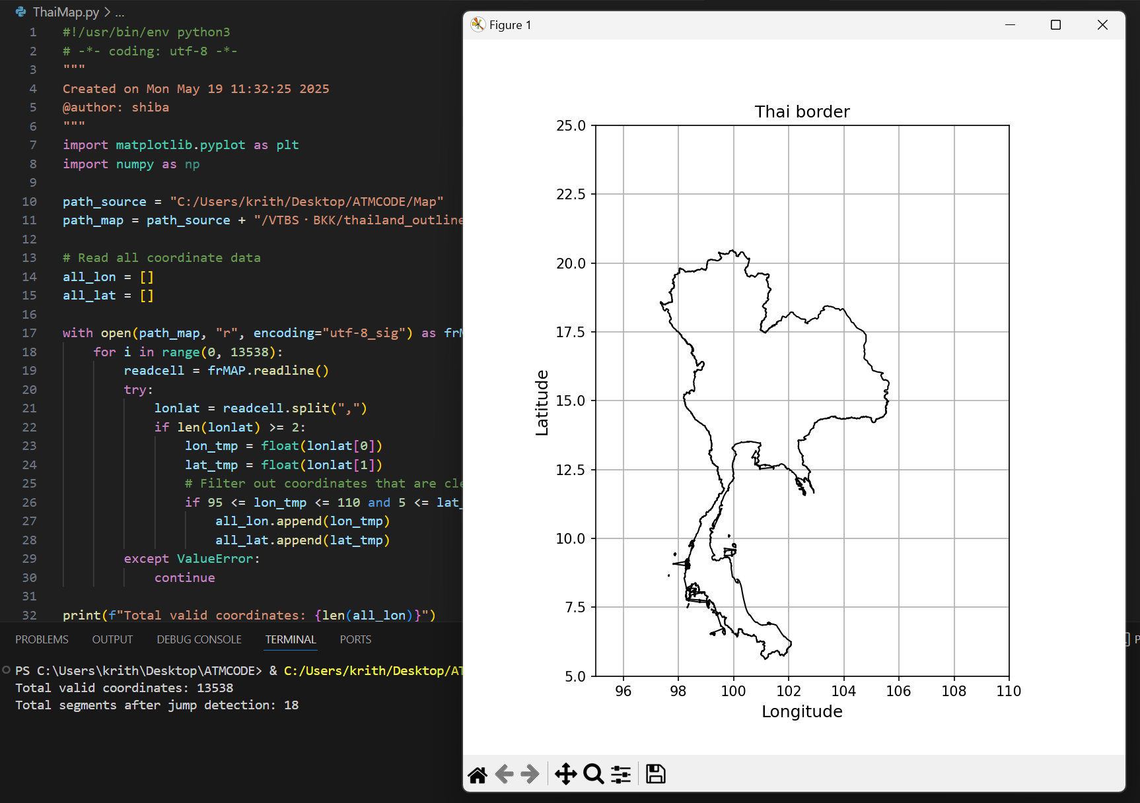
Result
The Map of precipitation we create doesn’t take from live APIs call from Rain-Viewer so when the time past our data lost. But we fix it to use the static map instead like taking screenshot so data still there.
I create a map as html file that can zoom in and out and a simple version of PNG
Map of Thailand Border to work on that later.

Slide 4
Problem
We need to open the computer all the time to collect data because data need to be collect at real-time or only past 2 hours.

Slide 5
Future work
Find how to take echo data all the time without opening computer all day long.
Focus on making code of taking flight data to get more accurate and precise.
Quantify qualitative weather avoidance decisions by pilots and air traffic controllers—such as measuring distance to weather echoes and deviations from flight paths.

