Slide 1
Update progress 2025/06/02 By: Krit Ittisomboon (クリット イティソンブーン) (Hymn) (ヒム)

Slide 2
Progress
Run Code to collect echo data 24/7.
Merging 2 Code of Flight data collection and echo collection.
Creating Map with Flight on it.

Slide 3
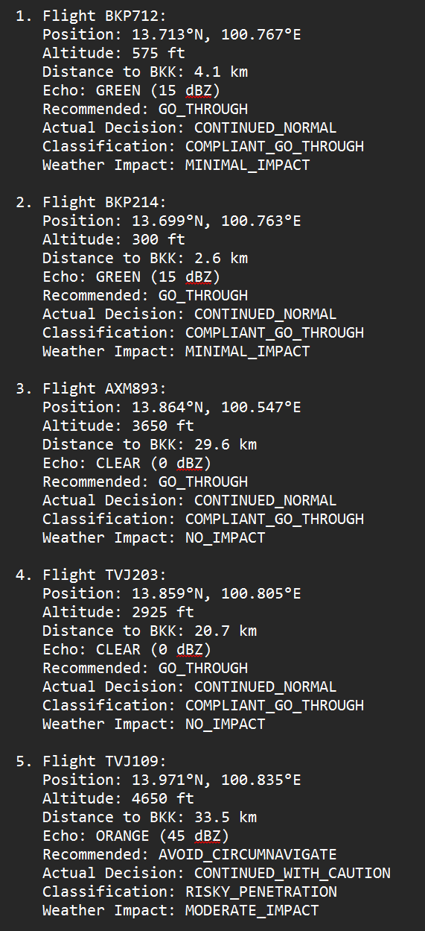
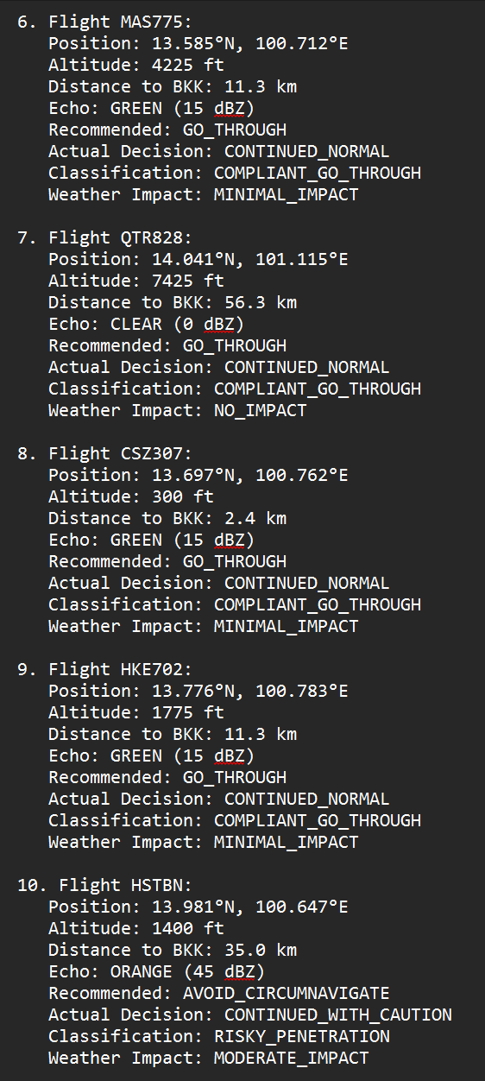
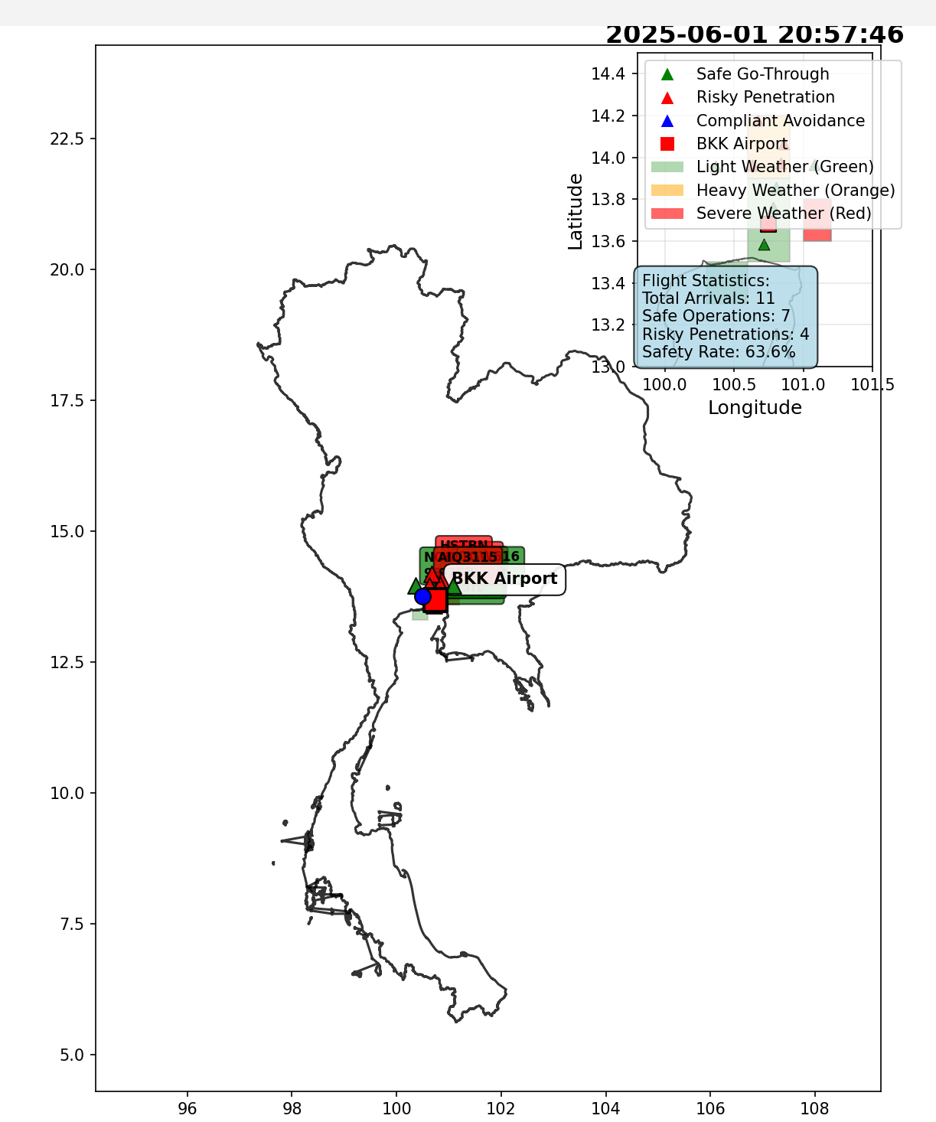
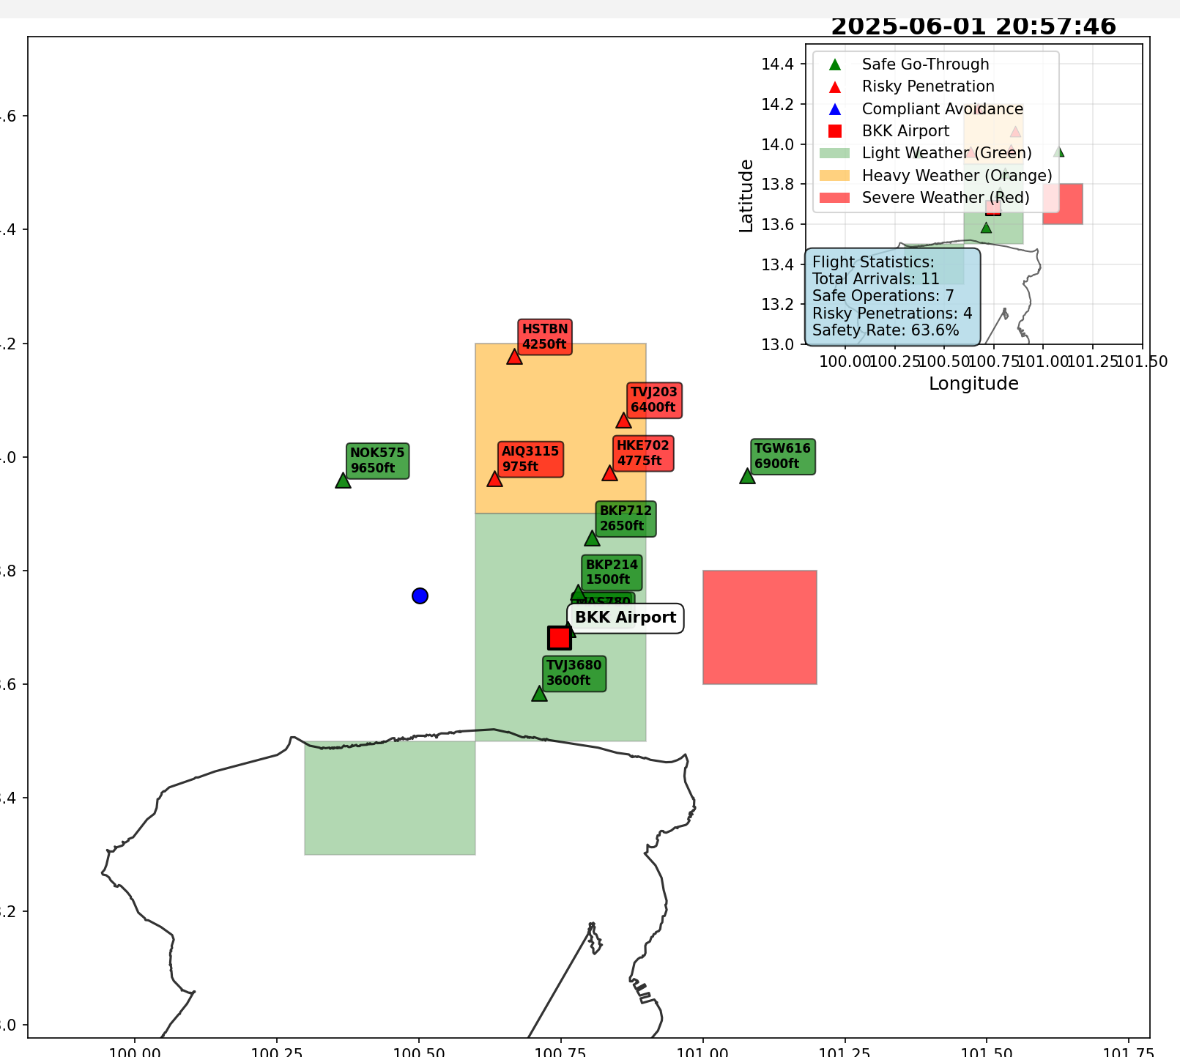
Result
Run the code to collect data all day long.
Merging 2 code of collect echo data and flight data to find data case that planes avoid or go through echo.
Create Map.csv to plot out the flight and echo.

Slide 4
Future work
Fixing Error.
Improve work.
Continue to do and gather data.
Echo Impact Analysis on Bangkok Airspace
ML-Based Route Generation Model.

