Slide 1
Update progress 2025/06/16 By: Krit Ittisomboon (クリット イティソンブーン) (Hymn) (ヒム)

Slide 2
Progress
Find Wind Direction of the flight
Finding altitude of atmosphere

Slide 3
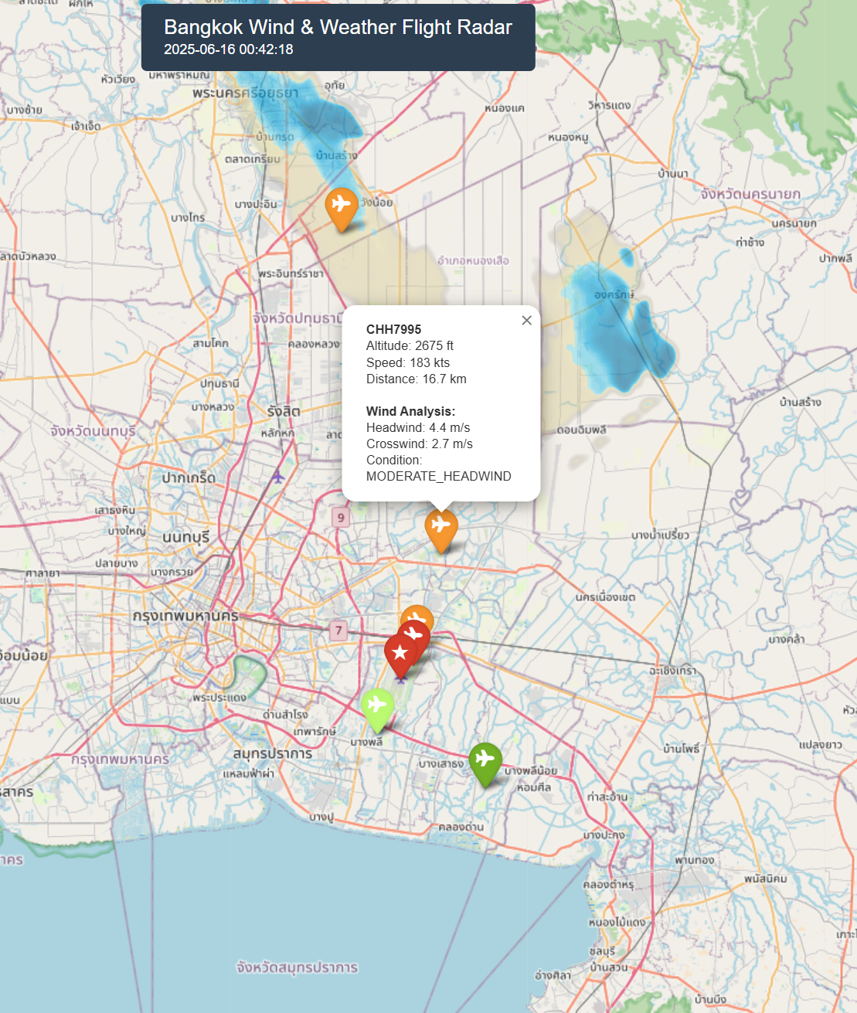
Result
I found the wind direction data and put it in to the map to recognize the flight that are flying with head-wind or tail-wind. Also find the altitude of the flight in that time also.

Slide 4
Problem
I try to merge the wind data code with the echo data code but the errors is too much so I separate it.

Slide 5
Future work
Try to fix the error so can be able to merge 2 code.
Find the METAR_Data
Finding the temperature at certain altitude of flight.

