Slide 2
Title
Introduction
Outline
Background
About current Thai air traffic
Purpose
To know features of Thai air traffic
Data
Where you got flight data and echo data and …
By Friday
Result
The number of data and %
Conclusion
Conclusion and future work
By Monday

Slide 3

Introduction
Thailand is one of Southeast Asia’s major aviation hubs, with Suvarnabhumi Airport (VTBS) in Bangkok serving as the primary international gateway. Each day, VTBS handles hundreds of domestic and international flights.
However, Thailand's tropical climate often causes weather-related disruptions. Thunderstorms and heavy rainfall can significantly impact flight paths and air traffic flow.
This project explores how weather conditions influence flight routes around VTBS using real flight and weather data.

Slide 4
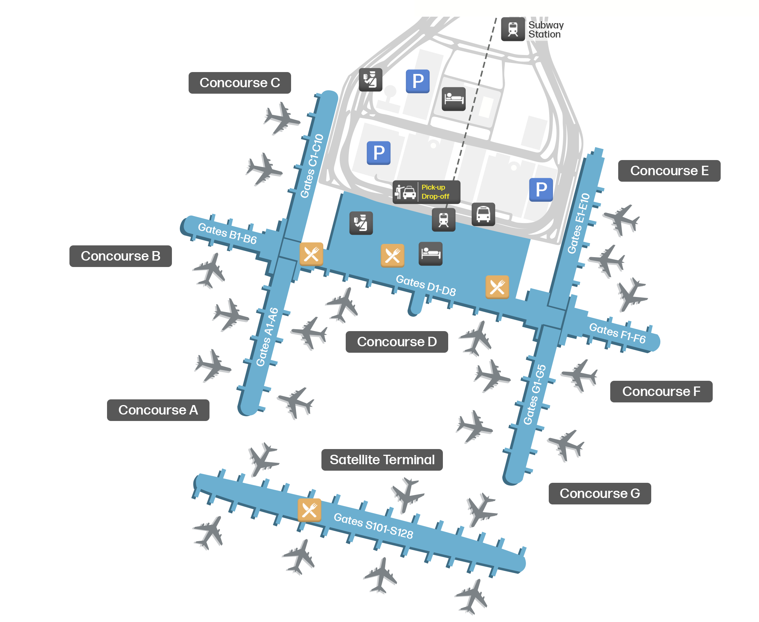
Background
Suvarnabhumi Airport (VTBS) is Thailand’s main international gateway, handling over 800 flights daily, both domestic and international.
As Thailand continues to grow as a tourism and business hub, air traffic congestion has become more common—especially during peak hours.
Weather conditions like storms and heavy rain often lead to route changes, holding patterns, or even delays, making air traffic management more complex.

Slide 5
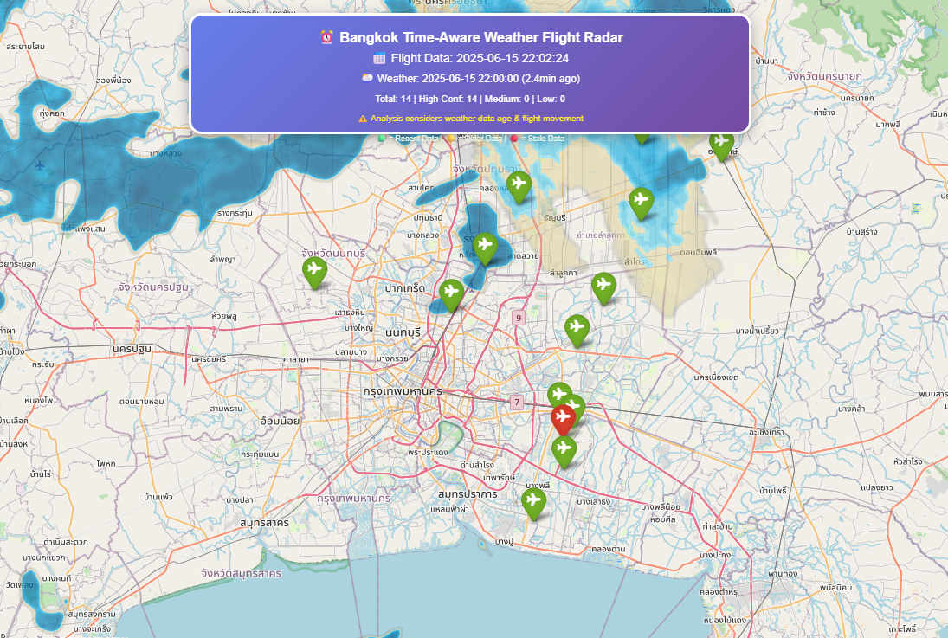
Purpose
By Analyzing the relationship between weather and air traffic around VTBS (Suvarnabhumi Airport).
By collecting real flight data and weather echo data, we aim to:
Understand how flights are rerouted during bad weather
Identify patterns in air traffic affected by storms or heavy rainfall
Explore possibilities for improving air traffic management using data-driven insights

Slide 6
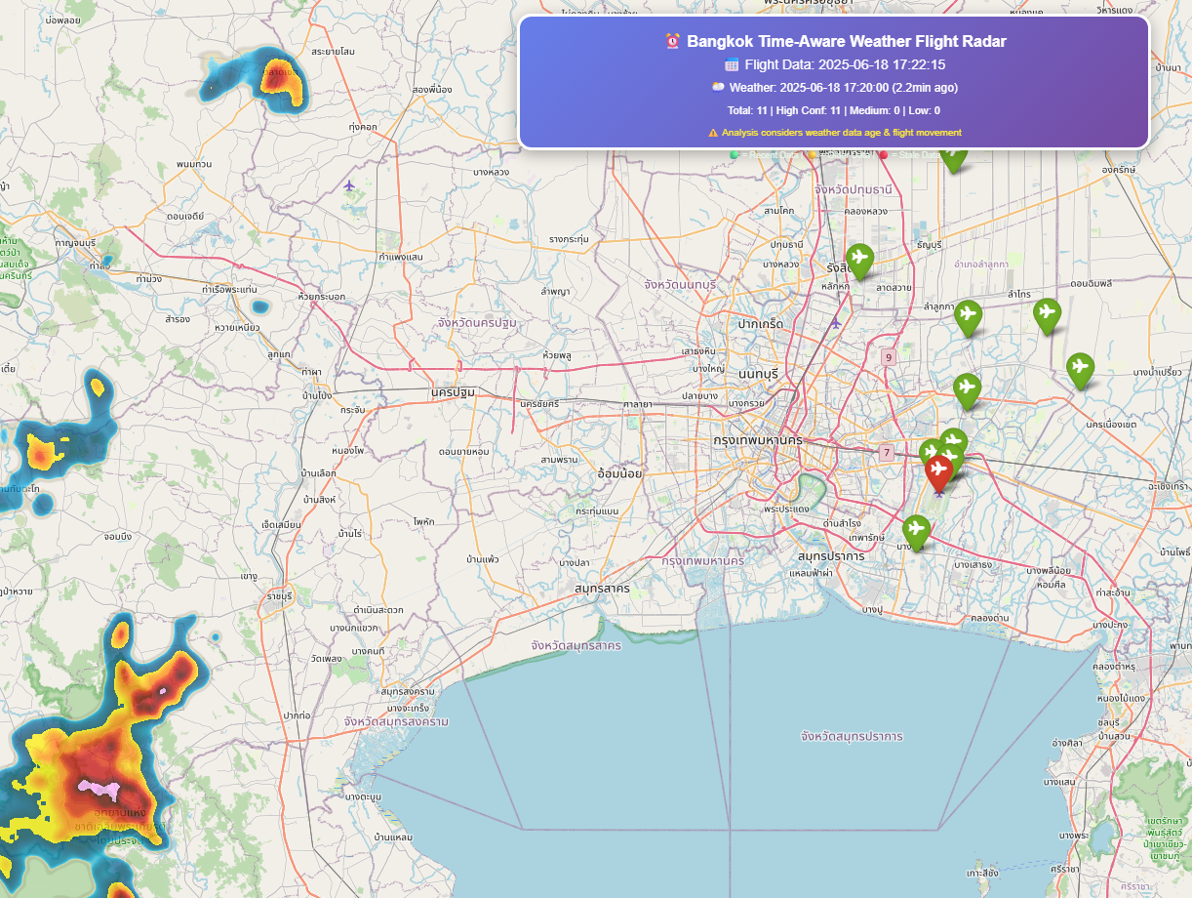
Data
This project uses two main types of data collected around Suvarnabhumi Airport (VTBS):
Flight Data✈️
Source: Flight Data - OpenSky Network API
Data: Real-time positions of aircraft, Callsign, latitude, longitude, altitude, speed, vertical rate
Use: To analyze flight paths, delays, and rerouting near VTBS
Weather Echo Data🌧️
Source: Weather Radar Data - RainViewer API
Data: Weather radar imagery URLs, Timestamps and paths to weather radar tiles
Use: To correlate weather events with flight changes

