Slide 1
Pulmonology Department – Diagnostic Tests
Debjani Mukherjee

Slide 2
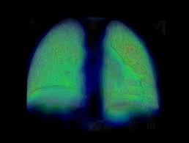
Nuclear Lung Scanning (Ventilation-Perfusion Scan / V/Q Scan)
Definition
Nuclear Lung Scanning, commonly known as a Ventilation-Perfusion (V/Q) Scan, is a nuclear medicine imaging procedure used to evaluate the distribution of air and blood flow within the lungs. The test uses small amounts of radioactive substances (radiotracers) and a gamma camera to create images of lung function.
Objectives
Detect pulmonary embolism (blood clot in the lungs)
Assess regional lung function
Evaluate chronic lung diseases
Determine lung function before lung surgery
Investigate unexplained shortness of breath
Assess congenital and vascular lung disorders

Slide 3
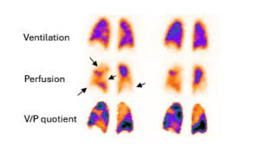
Types of V/Q Scan
A. Ventilation Scan
Evaluates how well air reaches different parts of the lungs.
Procedure:
The patient inhales a radioactive gas or aerosol through a mask or mouthpiece.
The radiotracer spreads throughout the airways.
A gamma camera records images showing airflow distribution.

Slide 4
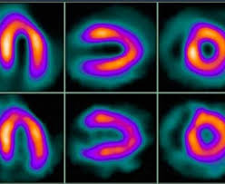
Types of V/Q Scan
B. Perfusion Scan
Evaluates blood flow through the lungs.
Procedure:
A radioactive tracer is injected into a vein.
The tracer travels through the bloodstream and reaches the pulmonary capillaries.
Images are obtained using a gamma camera to assess blood flow patterns.

Slide 5
Indications
Suspected pulmonary embolism
Chronic obstructive pulmonary disease (COPD)
Pulmonary hypertension
Preoperative lung assessment
Congenital heart and lung diseases
Evaluation of lung transplantation candidates

Slide 6
Interpretation of Results
Advantages
Normal Scan: Uniform ventilation and perfusion throughout both lungs.
Matched Defect: Both airflow and blood flow are reduced in the same area, suggesting lung disease.
Mismatched Defect: Normal ventilation but reduced perfusion, indicating pulmonary embolism.
Non-invasive procedure
Low radiation exposure
Highly sensitive for pulmonary embolism
Provides functional assessment of the lungs

Slide 7
Limitations
Risks and Complications
Less specific than CT pulmonary angiography
Results may be affected by pre-existing lung diseases
Limited anatomical detail
Minimal radiation exposure
Rare allergic reaction to radiotracers
Mild discomfort during injection

Slide 8
Pulmonary Artery Angiography (Pulmonary Angiography)

Slide 9
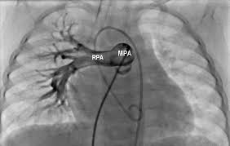
Definition
Pulmonary Artery Angiography is an invasive diagnostic imaging procedure that visualizes the pulmonary arteries by injecting a contrast dye and obtaining X-ray images. It is considered the gold standard for diagnosing pulmonary vascular abnormalities.
Objectives
Diagnose pulmonary embolism
Assess pulmonary artery anatomy
Detect vascular obstructions
Evaluate pulmonary hypertension
Identify congenital vascular abnormalities
Plan interventional procedures

Slide 10
Principle
The procedure involves introducing contrast material directly into the pulmonary arteries through a catheter. The contrast outlines the blood vessels, allowing detailed visualization under fluoroscopy.
Preparation
Patient should fast for 6–8 hours before the procedure.
Blood tests are performed to assess kidney function and clotting status.
Informed consent is obtained.
Allergies to contrast dye should be reported.
Intravenous access is established.

Slide 11
Procedure
Step 1: Catheter Insertion
Local anesthesia is administered.
A catheter is inserted into a large vein, usually the femoral vein (groin) or jugular vein (neck).
Step 2: Catheter Navigation
Under fluoroscopic guidance, the catheter is advanced through the right side of the heart into the pulmonary artery.
Step 3: Contrast Injection
Contrast dye is injected into the pulmonary artery.
The patient may experience a temporary warm sensation.
Step 4: Imaging
Multiple X-ray images are obtained as the contrast flows through the pulmonary arteries.
Areas of blockage, narrowing, or abnormal blood flow are identified.

Slide 12
Indications
Suspected pulmonary embolism when other tests are inconclusive
Pulmonary hypertension evaluation
Pulmonary arteriovenous malformations
Congenital pulmonary vascular disorders
Pulmonary artery stenosis
Pre-surgical vascular assessment

Slide 13
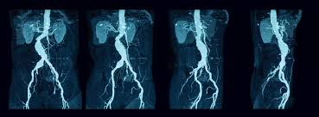
Findings
Normal Result: Smooth and unobstructed flow of contrast through pulmonary arteries.
Abnormal Result: Filling defects indicating emboli
Vessel narrowing or stenosis
Abnormal vascular communications
Pulmonary artery enlargement

Slide 14
Advantages
Provides highly detailed vascular images
Gold standard for pulmonary embolism diagnosis
Allows simultaneous therapeutic interventions
Accurate assessment of pulmonary circulation
Limitations
Invasive procedure
Requires contrast dye
More expensive than non-invasive imaging tests

Slide 15
Risks and Complications
Bleeding at catheter insertion site
Infection
Allergic reaction to contrast dye
Cardiac arrhythmias
Blood vessel injury
Contrast-induced kidney damage
Rare pulmonary artery rupture

