Slide 1
CONSTRUCTION OF PERSONALISED KNOWLEDGE GRAPHS BASED ON EHR DATA
Prof. Holger Fröhlich, Fraunhofer SCAI
Manuel Lentzen, Fraunhofer SCAI
Kriti Amin, University of Bonn

Slide 2
CONTENTS
Motivation
Approach
Results
Challenges
Conclusion and Discussion

Slide 3
MOTIVATION
Better visualisation of patient history
discover hidden relations
Input for graph convolutional networks
predictive tasks
Kriti Amin

Slide 4
TERMINOLOGY
Knowledge graphs
network that captures information about entities and the relations between those entities
Electronic Health Record (EHR)
patient health information stored in a digital format
RxNorm - standardized nomenclature for clinical drugs
RxCui - RxNorm Concept Unique Identifier
International Classification of Diseases (ICD)
assigns unique codes to diagnosis
Unified Medical Language System (UMLS)
ontology of biomedical concepts
Kriti Amin

Slide 5
BASIC WORKFLOW
Resources
source validation
dataset analysis and preprocessing
hypergeometric test
Knowledge graphs
patient data
drug - diagnosis relationships
disease - disease associations
Visualisation
Statistics
Kriti Amin

Slide 6
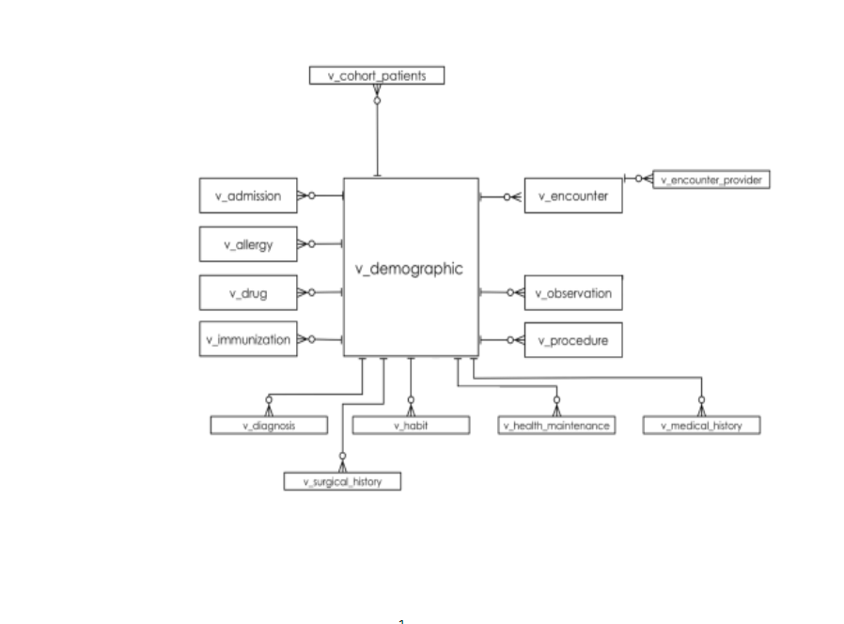
IBM EXPLORYS THERAPEUTIC DATASET
Structured EHR data of deidentified US citizens collected from year 2010 to 2021
Covid patients subset
Total patients = 207,876
Unique drug = 19,864
Unique diagnosis = 42,810
Kriti Amin

Slide 7
DRUG-DIAGNOSIS RELATIONSHIPS
Resources
MEDI , Drug Bank, Drug Central
MEDI
links RxNorm medications with indications mapped to ICD codes
ontology relationships and natural language processing (NLP) techniques used to extract indications from public medication resources
medications - RxNorm concepts (RxCUIs)
indications - ICD codes
Kriti Amin

Slide 8
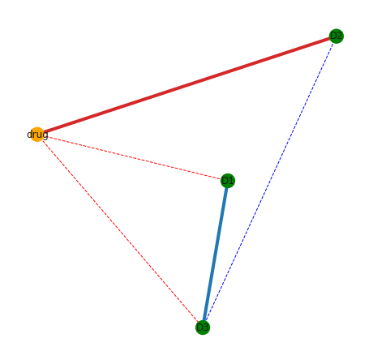
DRUG-DIAGNOSIS RELATIONSHIPS (CONT)
Overlap between IBM and MEDI
Common rxcuis = 1974
Common icd codes = 7025
Unique pairs = 223,153
Edges based on pairs
literature only – dashed
real edges – highlighted (based on data)
Kriti Amin

Slide 9
DIESEASE-DISEASE ASSOCIATIONS
Resources
DisGeNet, CREEDS, MalaCards
DisGeNet
information about disease associated genes and variants from multiple sources
data integration from diverse sources is done using ontologies and controlled vocabularies
associations based on number of shared genes, and shared variants (by source) between pairs of diseases
fraction of shared genes (or variants) is assessed by the Jaccard Index (JI)
Kriti Amin

Slide 10
DIESEASE-DISEASE ASSOCIATIONS (CONT)
Subset
only associations with icd mappings
hypergeometric test
Overlap between IBM and DisGeNet
Common icd codes = 4,998
Total associations = 819,924
Corrected subset = 59,508
Edges based on associations
literature only – dashed
real edges – highlighted (based on data)
Kriti Amin

Slide 11
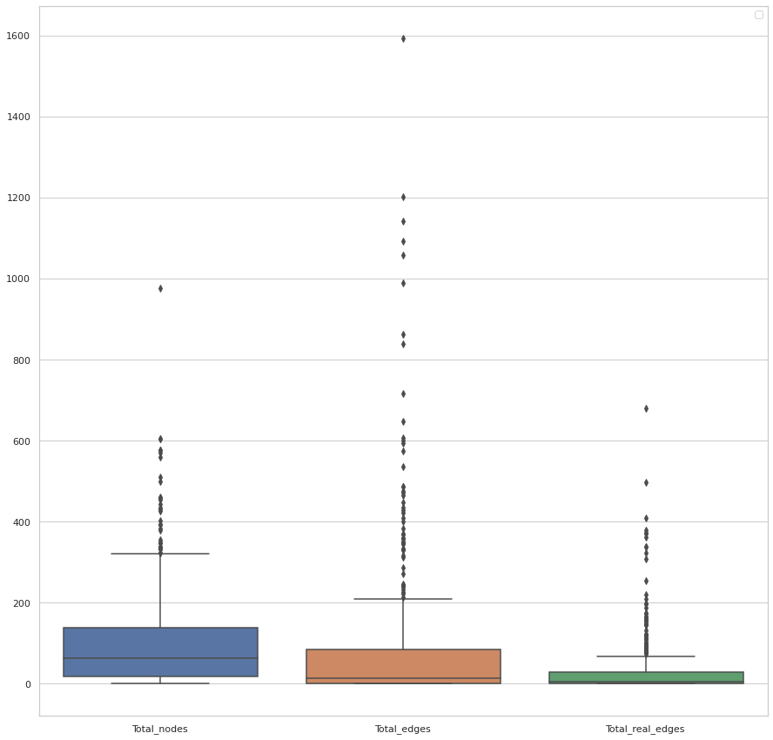
RESULTS
500 knowledge graphs
Average Number of :
nodes ~104
edges ~ 82
found edges ~ 31
Kriti Amin

Slide 12
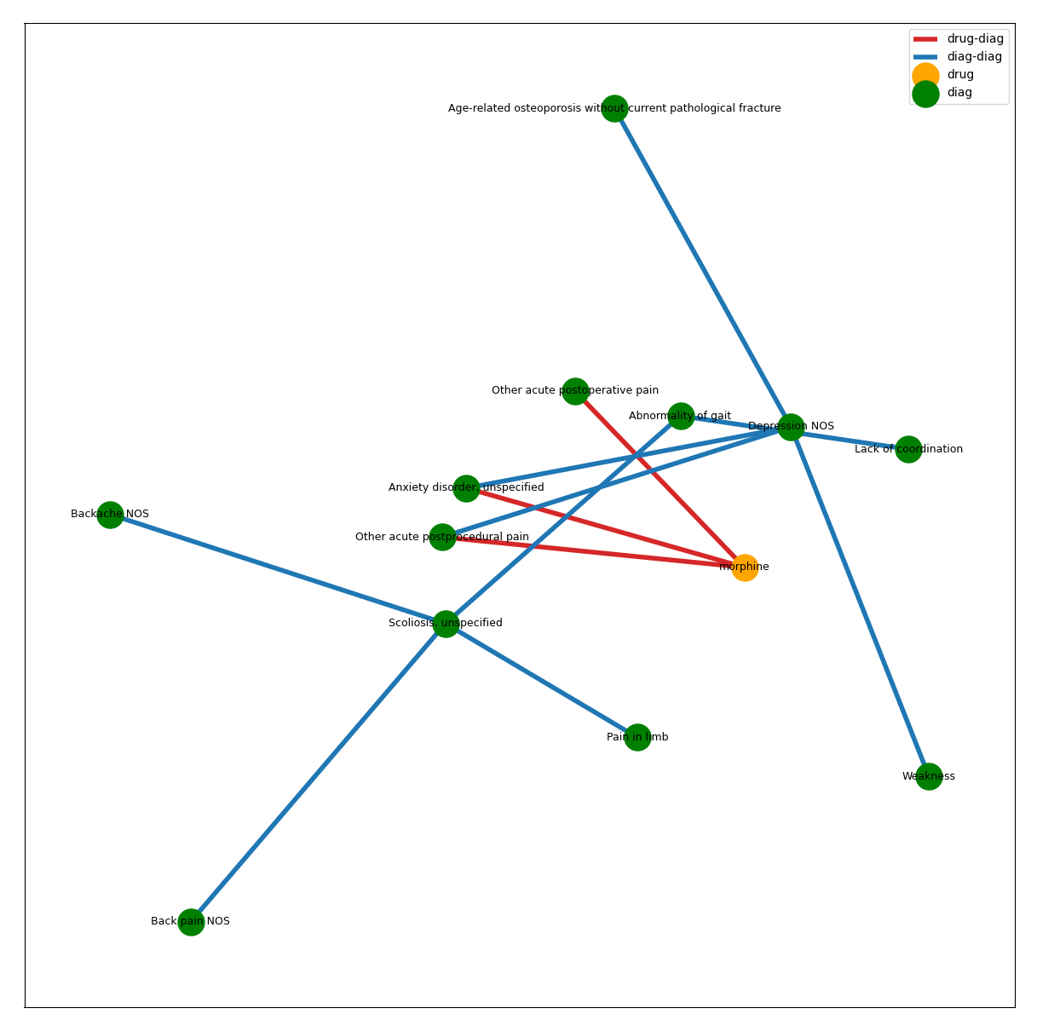
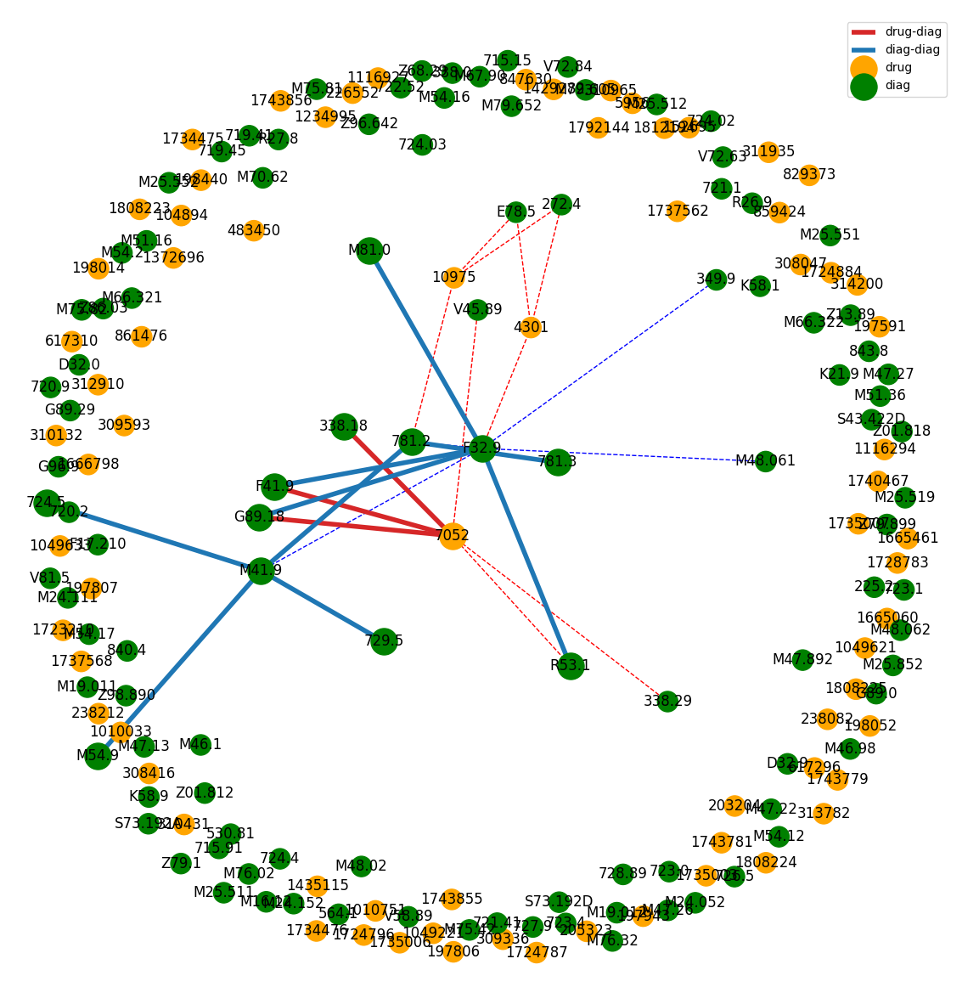
Kriti Amin

Slide 13
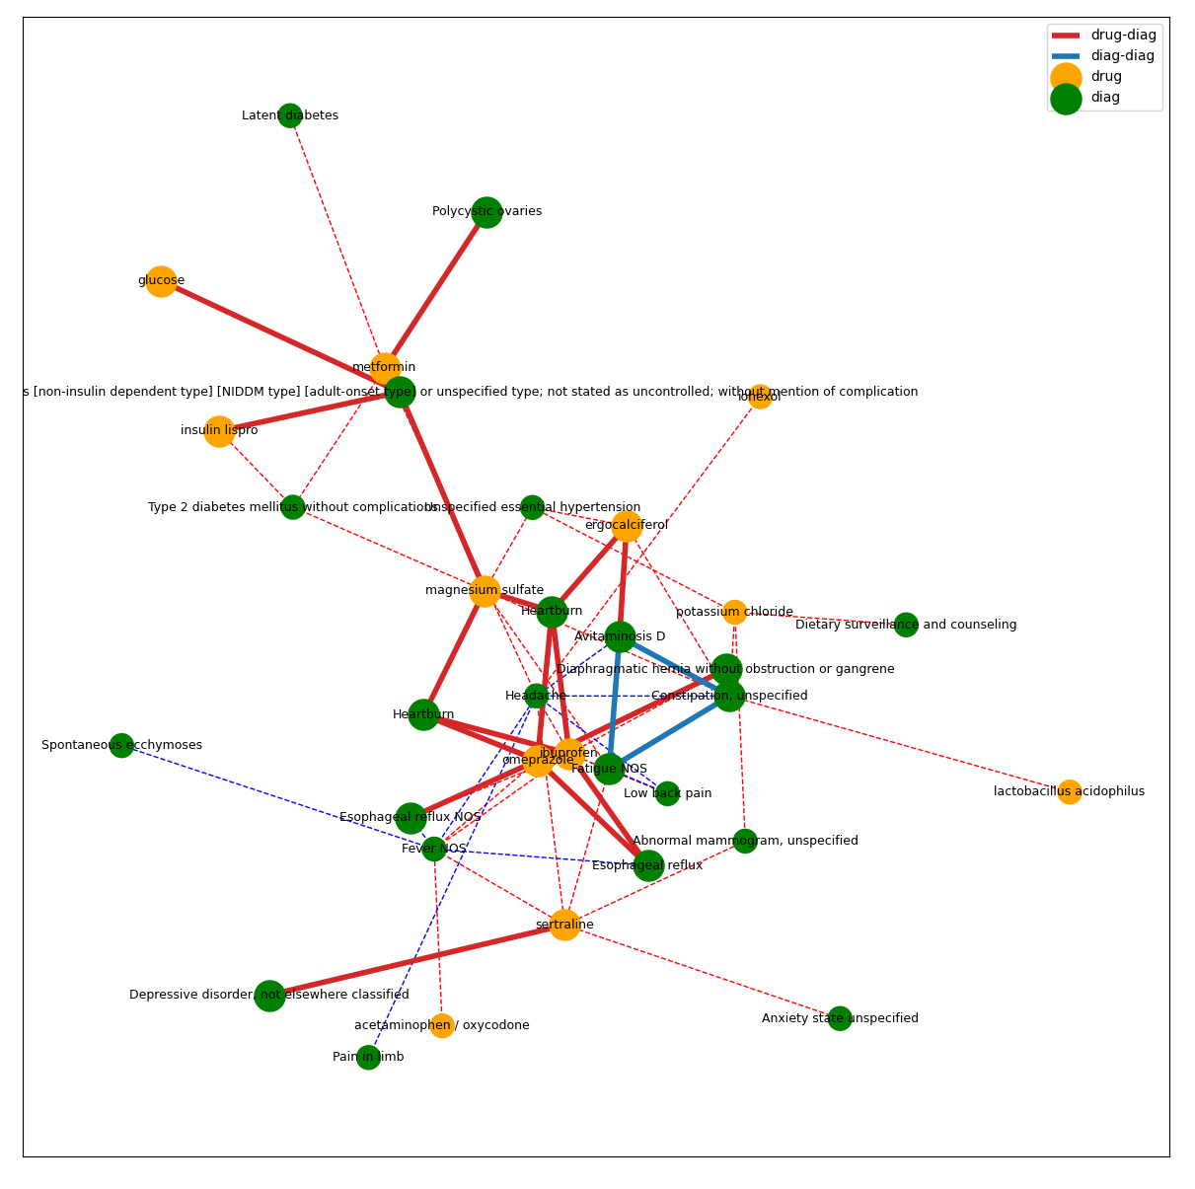
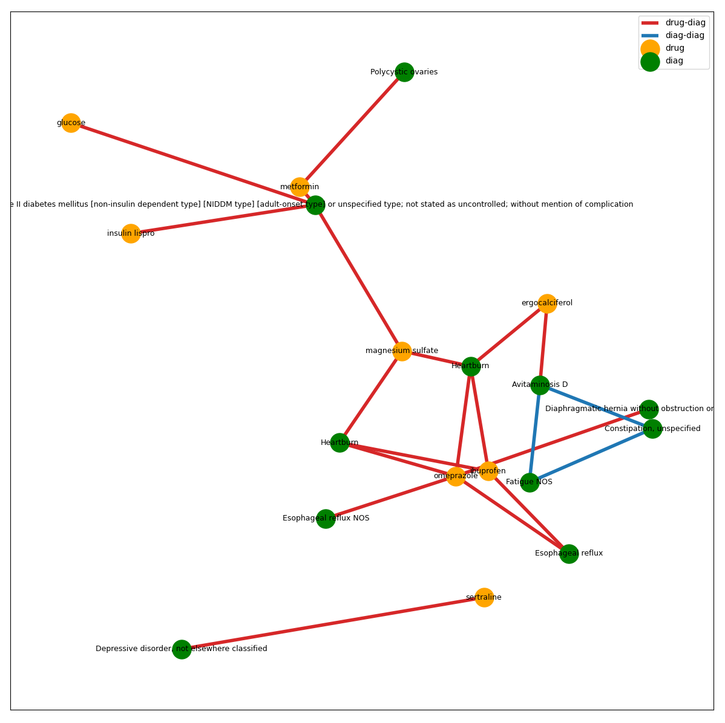
Kriti Amin

Slide 14
CHALLENGES
Low overlap
UMLS identifiers not distinct for one ICD code
Sparse data
Irregular time series
Kriti Amin

Slide 15
CONCLUSION
More insights into patient history
Discover hidden relations
Potential for precision medicine
Kriti Amin

Slide 16
Limitations
Non-distinctive identifiers
Study limited by the scope of MEDI and DisGeNet
Outlook
ICD versions can be harmonized – improve KG
Knowledge graph used as input to graph convolutional networks for predictive tasks
Kriti Amin

Slide 17
REFERENCES
WQ Wei, RM Cronin, H Xu, TA Lasko, L Bastarache, JC Denny, Development and evaluation of an ensemble resource linking medications to their indications, Journal of the American Medical Informatics Association. 2013;20:954-961 doi:10.1136/amiajnl-2012-001431
WQ Wei, JD Mosley et al. Validation and Enhancement of a Computable Medication Indication Resource (MEDI) Using a Large Practice-based Dataset. AMIA Annual Symposium, 2013, Washington DC.
Piñero J, Ramírez-Anguita JM, Saüch-Pitarch J, Ronzano F, Centeno E, Sanz F, Furlong LI. The DisGeNET knowledge platform for disease genomics: 2019 update. Nucleic Acids Res. 2020 Jan 8;48(D1):D845-D855. doi: 10.1093/nar/gkz1021.
Ping P, Watson K, Han J, Bui A. Individualized knowledge graph: a viable informatics path to precision medicine.Circ Res. 2017; 120:1078–1080. doi: 10.1161/CIRCRESAHA.116.310024.
Verma A, Bang L, Miller JE, Zhang Y, Lee MTM, Zhang Y, Byrska-Bishop M, Carey DJ, Ritchie MD, Pendergrass SA, Kim D; DiscovEHR Collaboration. Human-Disease Phenotype Map Derived from PheWAS across 38,682 Individuals. Am J Hum Genet. 2019 Jan 3;104(1):55-64. doi: 10.1016/j.ajhg.2018.11.006. Epub 2018 Dec 29. PMID: 30598166; PMCID: PMC6323551.
Kriti Amin

Slide 18
Thank You for your Attention!!

