Slide 1
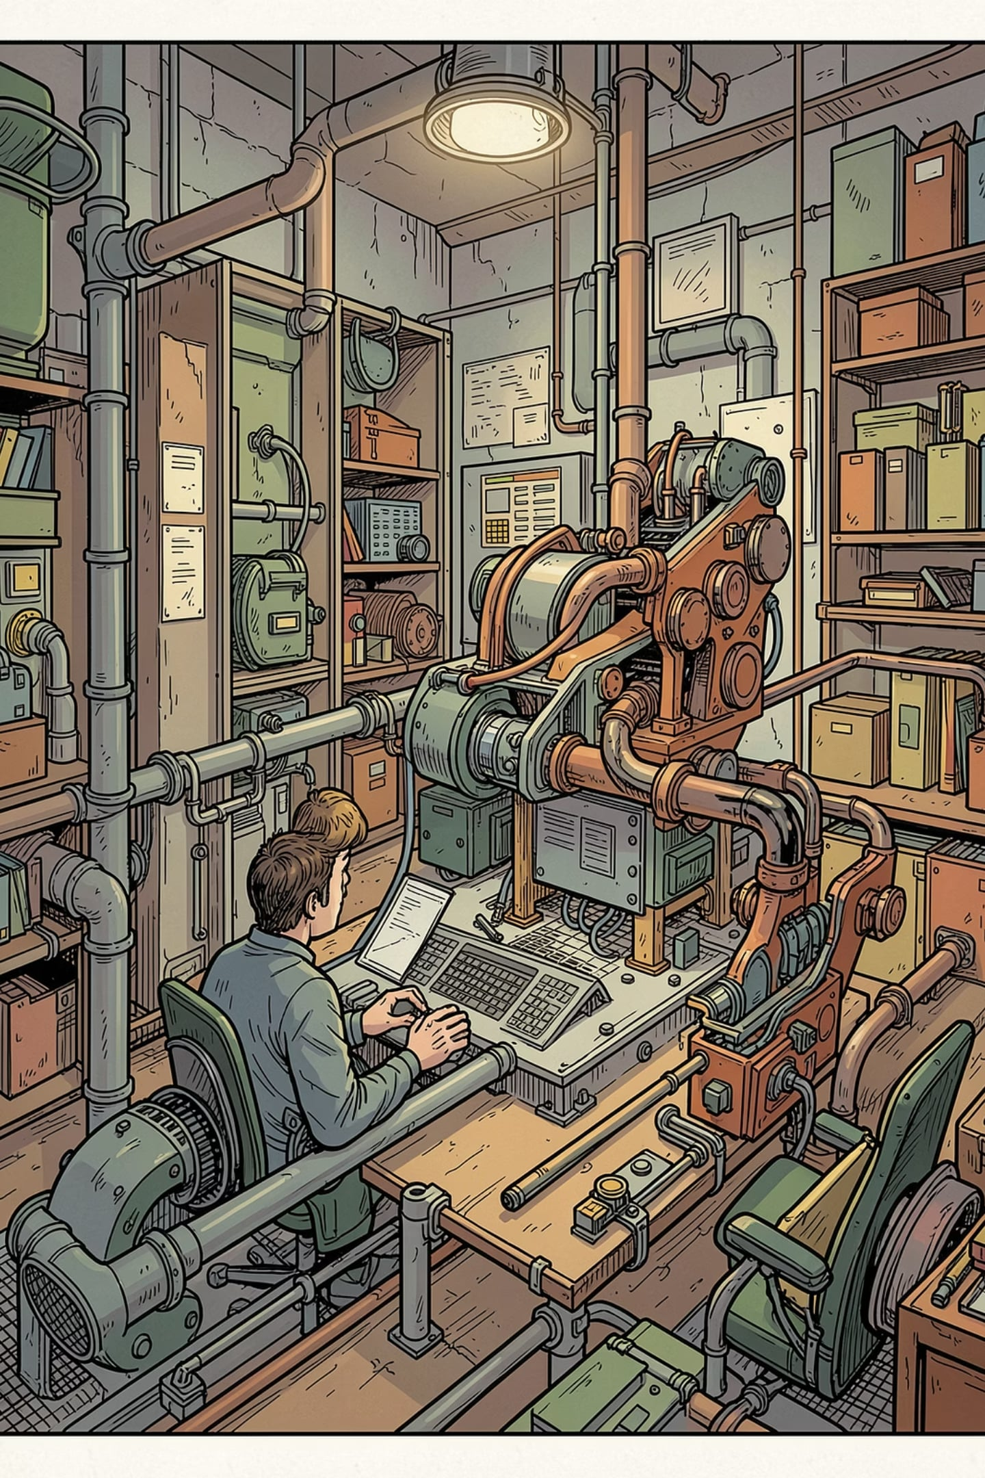
Project 1: CIFAR-10 Image Classification
Kriti Amin
· AI Engineering Bootcamp · Ironhack GmbH

Slide 2
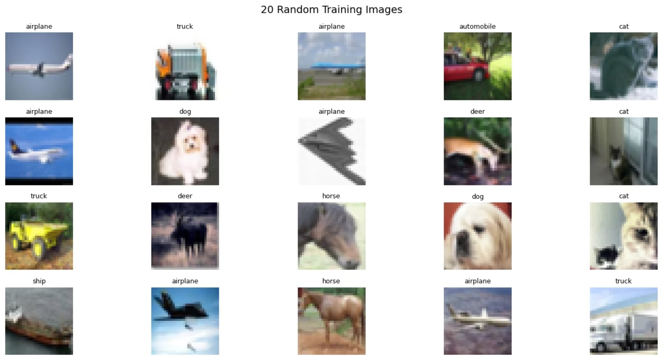
Project Overview
The Dataset
CIFAR-10 — 60,000 color images of 32×32 shape, 10 classes
The Approach
Baseline CNN → progressively deeper architectures → transfer learning with MobileNetV2.
Store and compare training details.
Select 3 models to evaluate on test set.

Slide 3
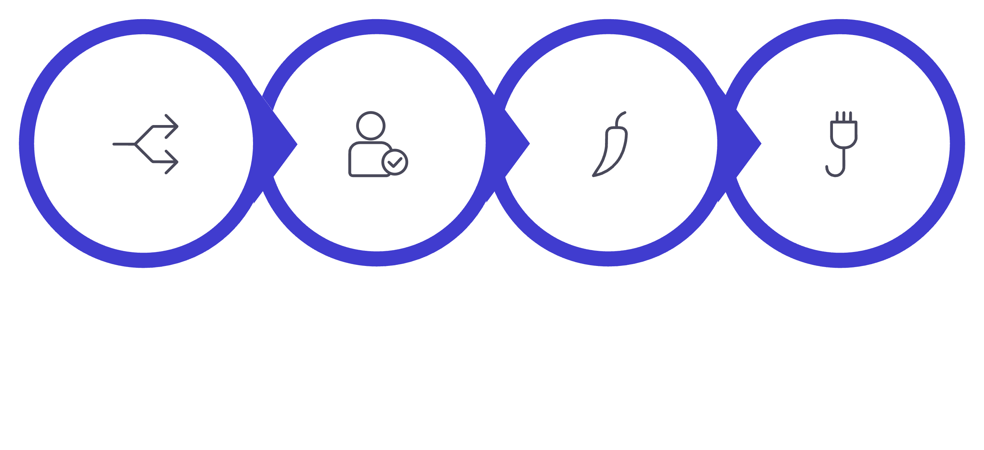

Preparing the Data
Split 66/16/16
One‑Hot Encoding
Feed to Model
Normalize
Resized images to 96×96 pixels to match the transfer learning input size.

Slide 4




From First Draft to Final Model
Baseline CNN
Deeper CNN
MobileNetV2
Single conv layer — fast to train but overfit quickly on CIFAR-10's complexity.
Added BatchNorm & Dropout — better generalization. Augmentation / Resizing showed no improvement and high train time.
Transfer learning — lightweight, fast to fine-tune
Why MobileNetV2? Minimal parameters, strong ImageNet-pretrained features, and efficient fine-tuning.

Slide 5
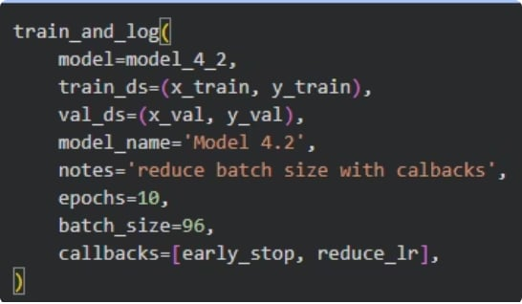

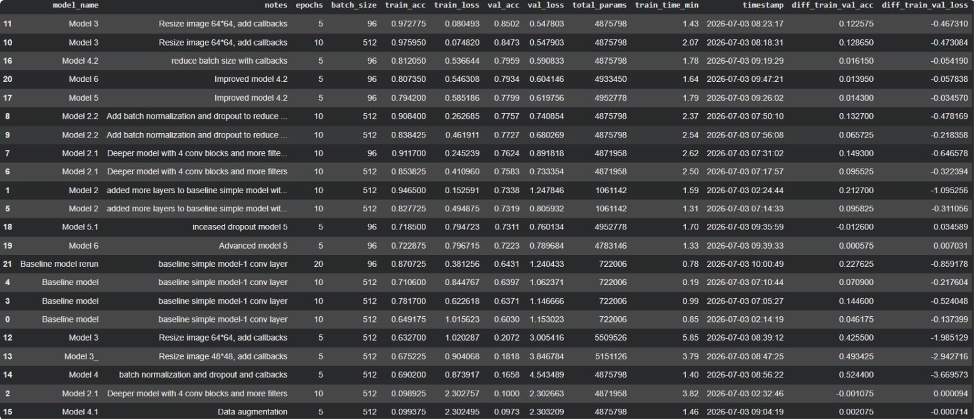
Systematic Model Experimentation
Experiment Framework
Built reusable code blocks for standardized training
Captured: epochs, batch size, metrics, timing
Stored results in single comparison table
Selected 3 models

Slide 6
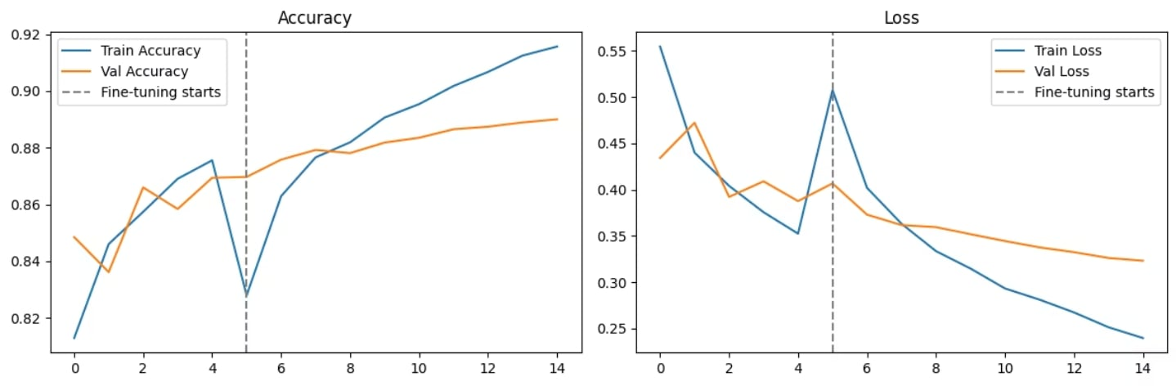
MobileNetV2 Architecture & Results
Final Architecture
Test Set Performance
01
88%
Input: 96×96×3
Test accuracy — MobileNetV2 achieved the highest score with the smallest train-val gap among all three candidates.
02
MobileNetV2 base (ImageNet weights, frozen → fine-tune last 30 layers)
03
Conv2D(64) + BatchNormalization + Dropout(0.3)
04
GlobalAveragePooling → Dense(256) → Dense(10, Softmax)
Optimizer: Adam (lr=0.001) · Loss: Categorical Crossentropy

Slide 7
Results & Model Comparison
Below is a summary of the performance metrics for each model on the test set.
Model
Test Accuracy
Test Loss
Baseline CNN
61%
1.2
Deeper CNN
81%
0.57
MobileNetV2
88%
0.33
MobileNetV2 was selected as the final model because it achieved the highest test accuracy (88%) with the smallest train-validation gap, indicating the best generalization among all candidates.

Slide 8
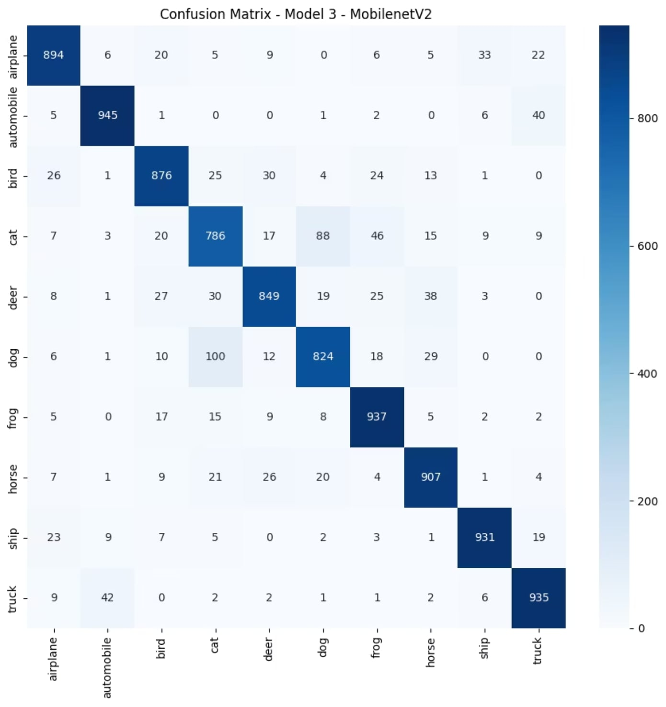
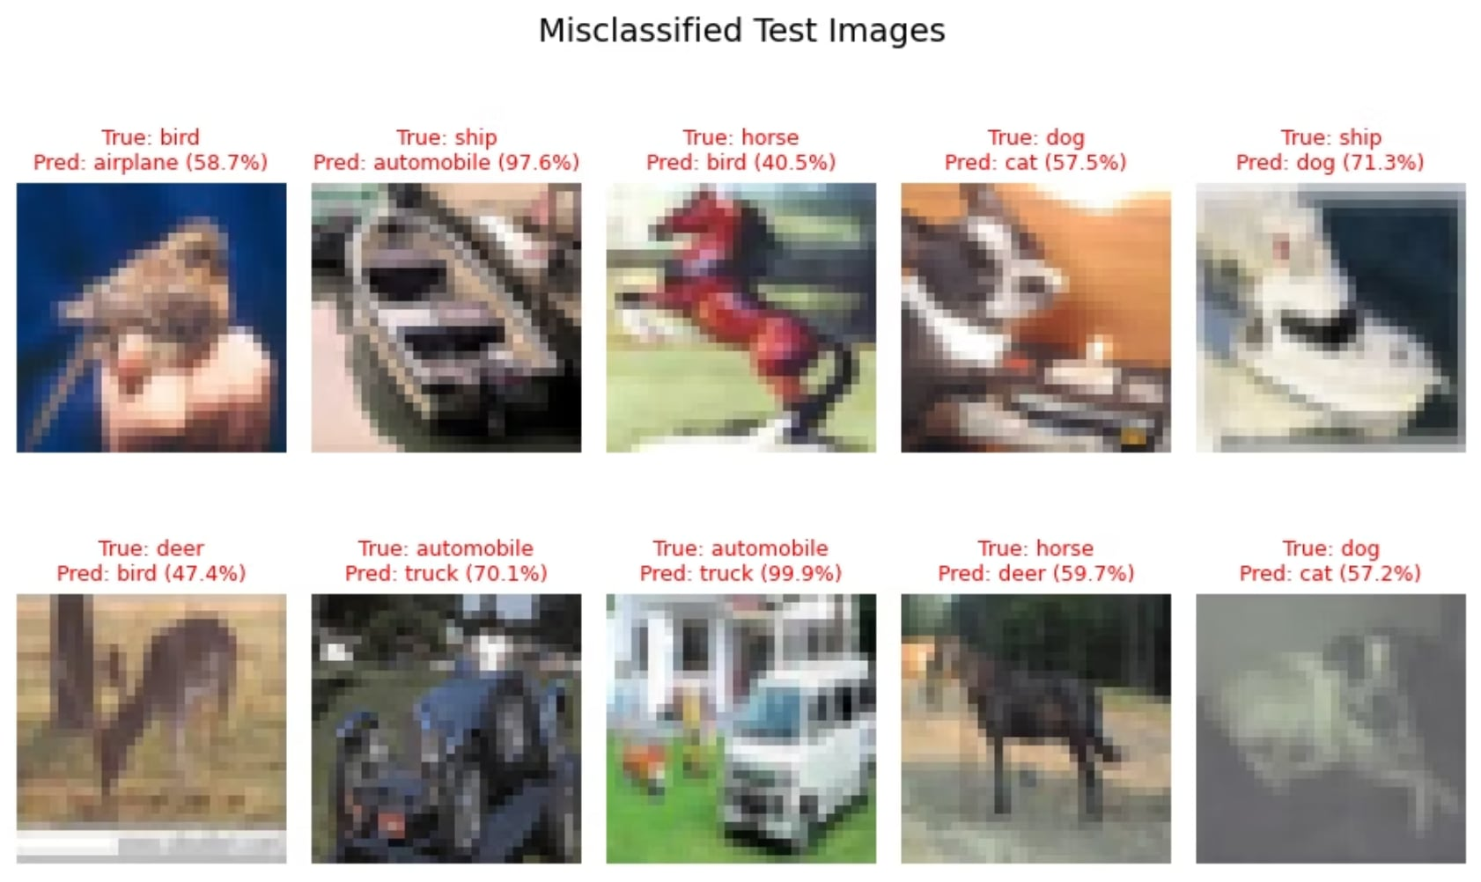
Model Hallucinations
Confusion Patterns
Dogs vs. Cats: Most common confusion (similar features)
Trucks vs. Automobiles: Misclassified due to overlapping shapes

