Slide 1

Fake News Classification with NLP
Detecting fake vs. real news articles using text classification
Kriti | AI Engineering Bootcamp

Slide 2
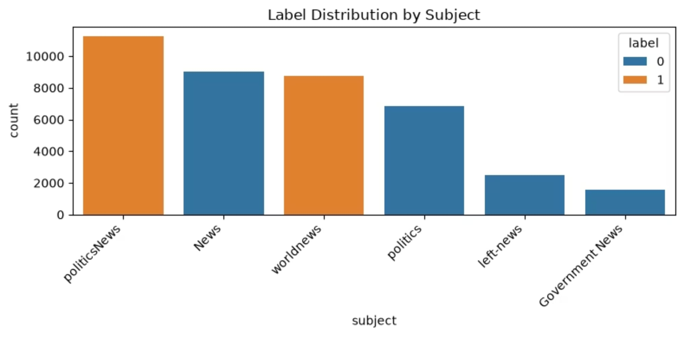
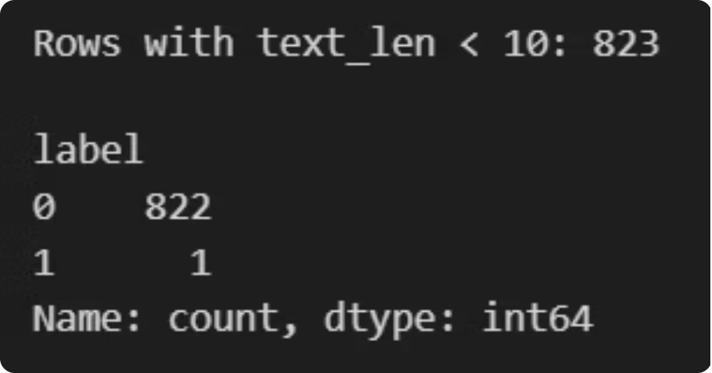
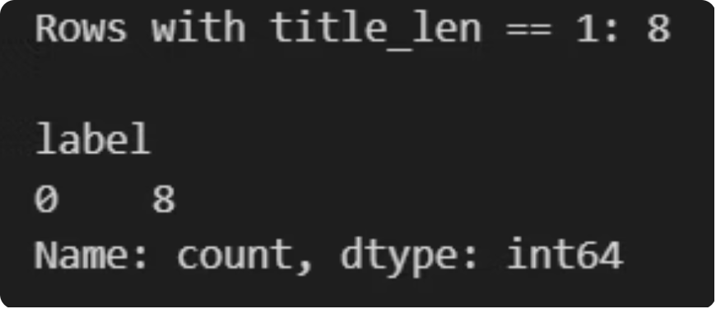
Exploring the Data
Checked label balance, text length distributions, date relevance
Found data leakage: subject column perfectly predict the label → dropped
The subject distribution plot show that the subject field was strongly correlated with the target label. This confirms that the feature introduced leakage and should be excluded to prevent inflated model performance.

Slide 3
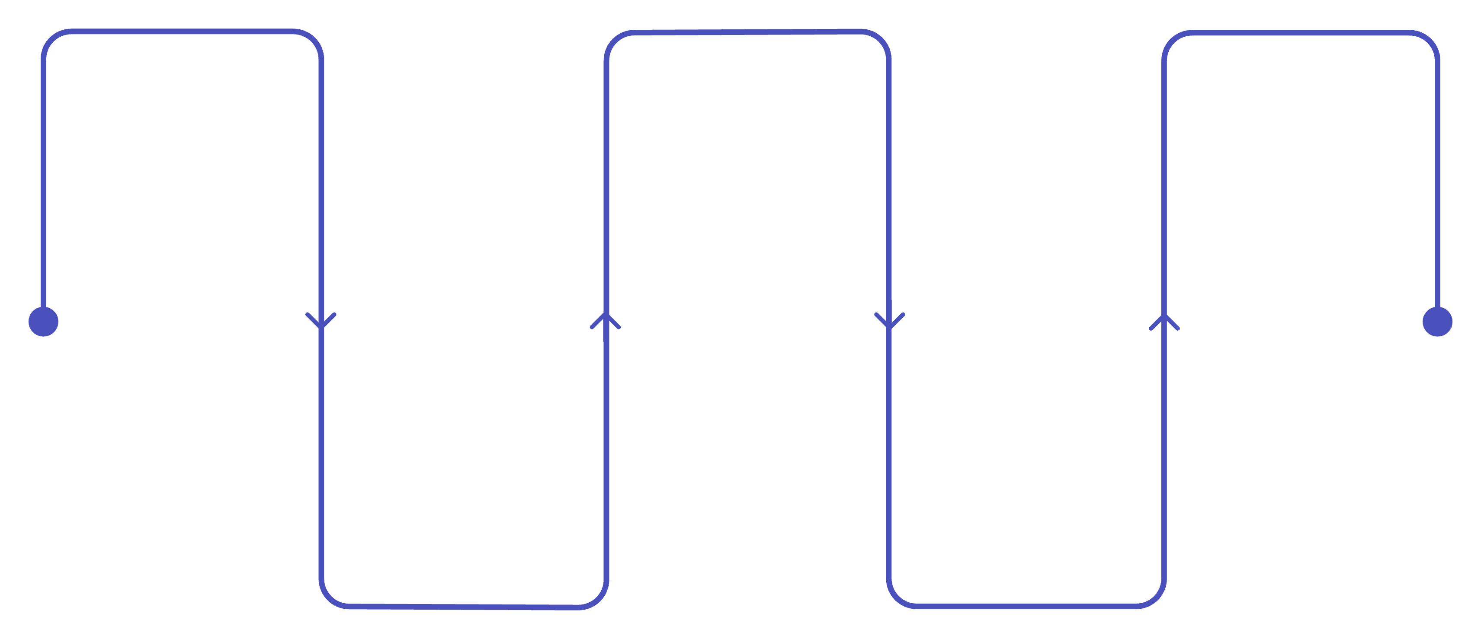
From Raw Text to Features
Methodology:
Text cleaning: remove HTML/URLs/special characters, tokenize, remove stopwords, lemmatize
Preprocess text data: clean title and text column seperately
Feature extraction methods compared: Bag of Words (BoW), TF-IDF, Word2Vec (averaged embeddings)
Models compared: Logistic Regression, Naive Bayes, Random Forest, SVM
Reusable training/evaluation pipeline logs every model × feature-method combination
Raw Text
Cleaning
Model Training
Collect unprocessed text data
Clean text and title columns separately
Train and evaluate classifiers
Feature Extraction
Split Data
BoW, TF‑IDF, Word2Vec embeddings
Train/test partitions
Note: All models were automatically saved and results logged for comparison and reproducibility

Slide 4
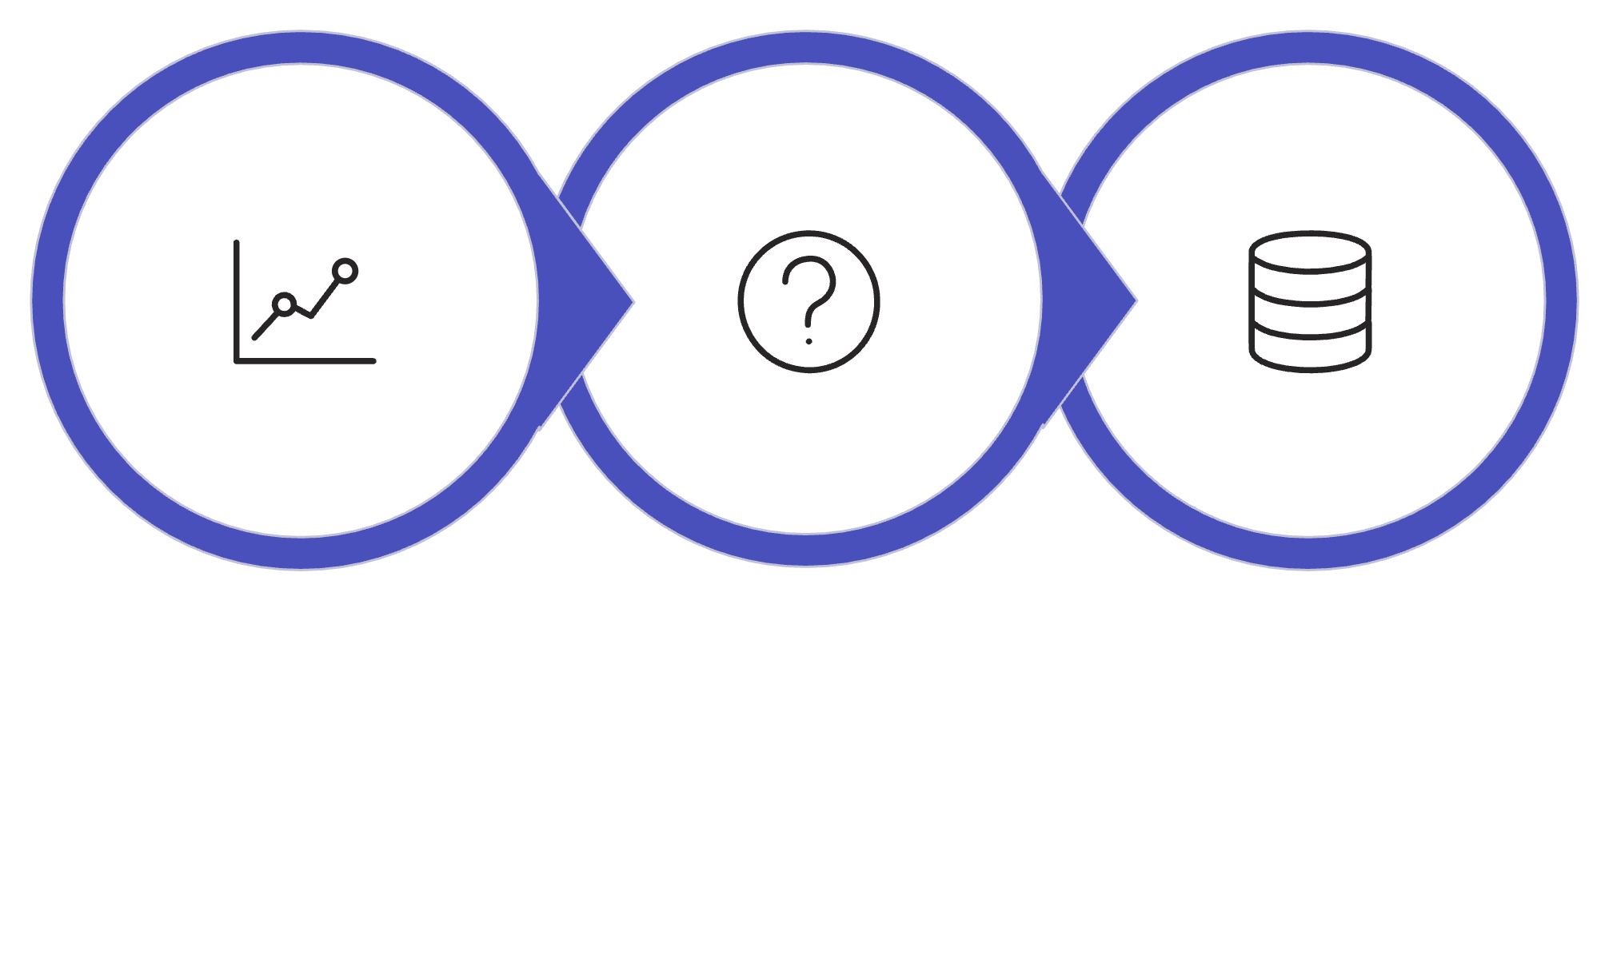

Overfitting Analysis and Dataset Quality Assessment
Overfitting/ Data Leakage
High Metrics
Retrain Raw
This models gave unusually strong results, raised an overfitting/ data leakage concern, and then confirmed that raw data still performed extremely well.
Dataset Quality > Memorization
Small train-test gap = good generalization.

Slide 5
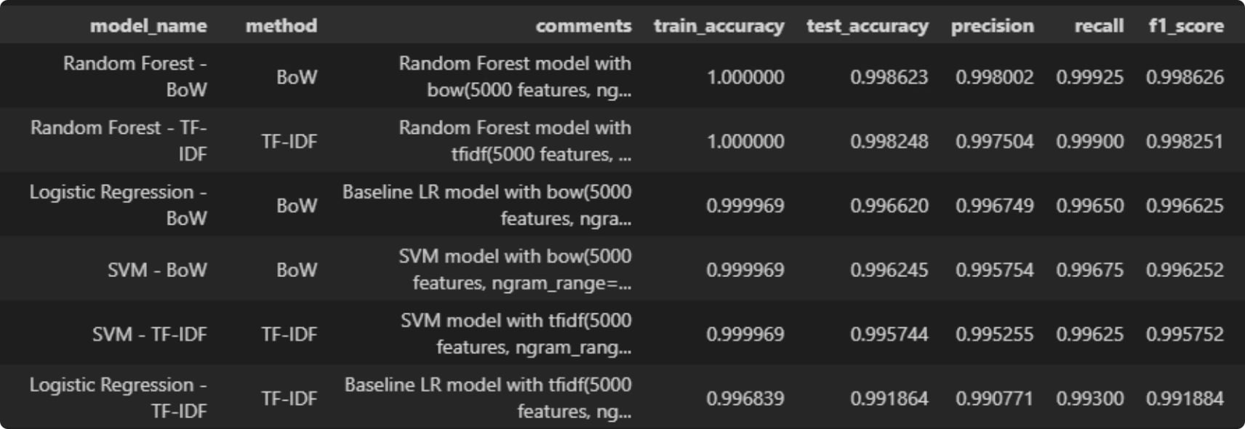
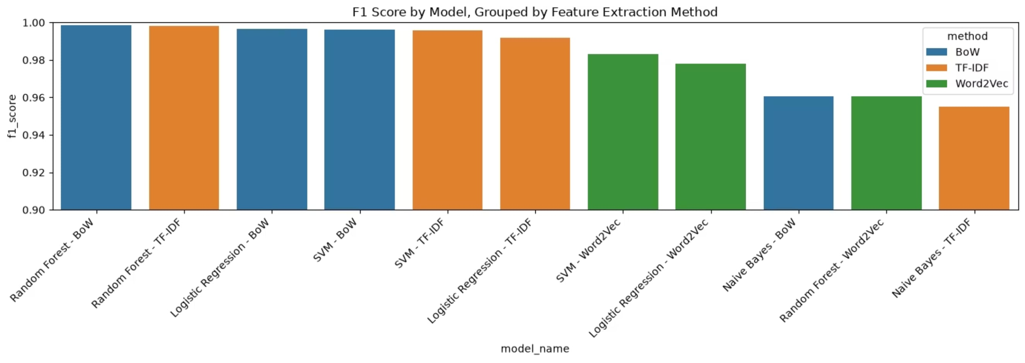
Comparing Models & Feature Methods
Best model: Random Forest + BoW (F1 score ≈ 0.999)
Logistic Regression + BoW strong baseline for comparison
Bag of Words consistently outperformed TF-IDF and Word2Vec across models

Slide 6
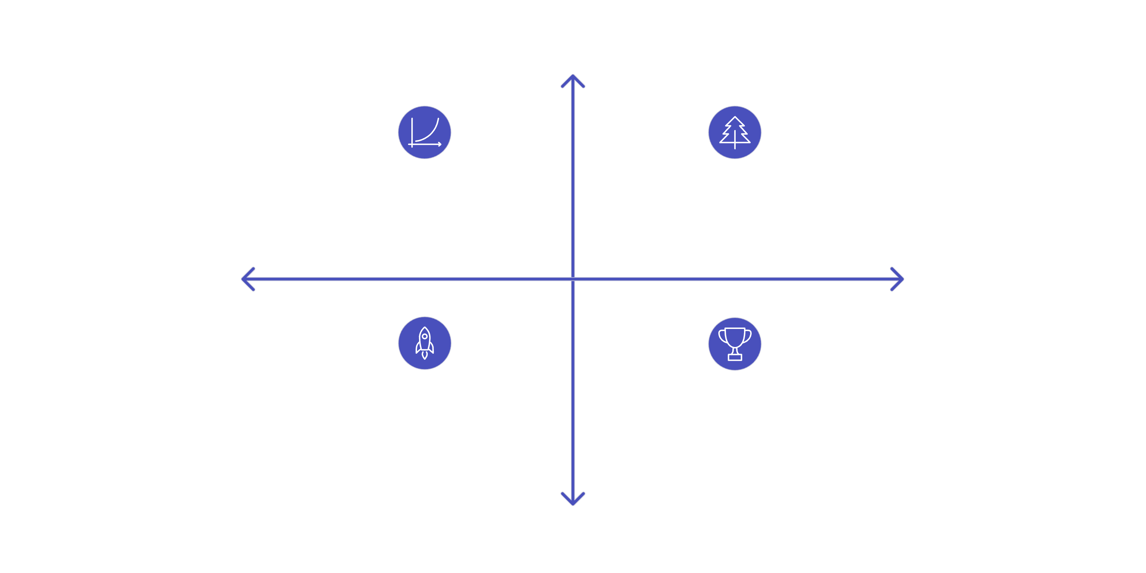
Model Selection and Final Decision
Logistic Regression (BoW) was selected as the final model and winner, achieving an F1 score of 0.9966
High Accuracy
Logistic Regression (BoW) — F1 0.9966
Random Forest (BoW) — F1 0.9986
Low Complexity
High Complexity
Efficient Choice — Selected for speed
Max Performance — Slightly higher F1
Lower Accuracy
Comparing these two models provides a trade-off analysis between speed and simplicity versus maximum predictive performance.

Slide 7





Conclusion & Key Takeaways
Full Text-Classification Pipeline
Feature Extraction Matters
Built and compared a full text-classification pipeline: cleaning → 3 feature methods → 4 models → evaluation
Learning: feature extraction choice mattered more than model choice here (BoW outperformed TF-IDF and Word2Vec across the board)
Beware of Data Leakage
Next Steps
Learning: always check for data leakage (subject/date almost gave away the label) before trusting high accuracy numbers
Next steps: try BERT/transformer embeddings, tune hyperparameters, deploy the app publicly

