Slide 1
VOL. I — CUSTOMER REVIEW INTELLIGENCE
Field Notes
Turning thousands of Amazon reviews into decisions
stakeholders can actually use.
Kriti Amin | Ironhack GmbH

Slide 2

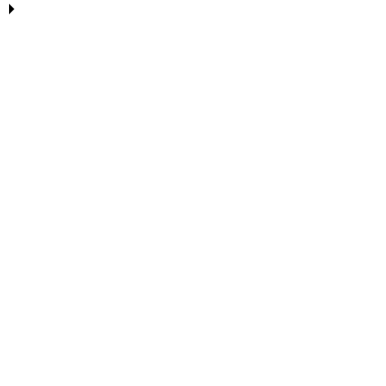



ONE PIPELINE, FOUR STAGES
From raw data to a usable product
Sentiment
Analysis
Product
Clustering
Review
Summarization
Web App
DistilBERT classifies
every review
TF-IDF + KMeans
groups products
OpenAI write
category reports
React + FastAPI
ships it live
30744
60
6
REVIEWS ANALYZED
UNIQUE PRODUCTS
PRODUCT CATEGORIES MAPPED

Slide 3


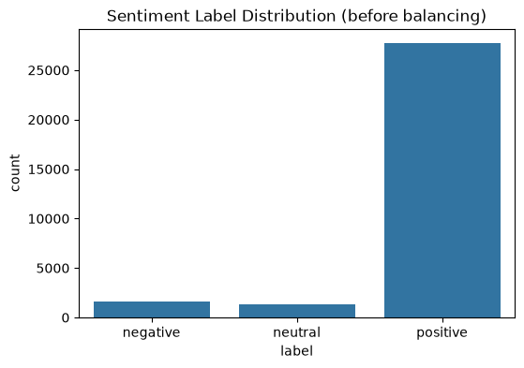


TASK 1
Sentiment Analysis — DistilBERT
Fine-tuned distilbert-base-uncased for 3-class sentiment (negative / neutral / positive), derived from star ratings
Undersampled data and Class-weighted loss handles the natural
Dynamically quantized after training: int8 linear layers cut deployed model size for the live API
TRAINING DATA — LABEL DISTRIBUTION
27762
~90%
Positive reviews
1653
Negative reviews
1329
Neutral reviews

Slide 4
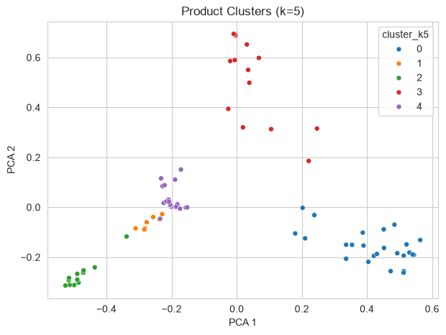

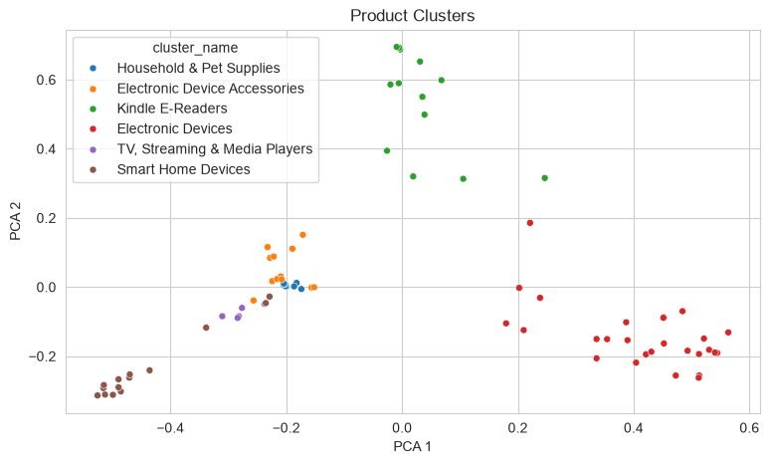
TASK 2
Product Clustering — TF-IDF + KMeans
-Review text is vectorized with TF-IDF and grouped with KMeans into 6 categories, each named by inspecting its top-weighted terms.
-Combined product name and sub-categories to enrich data
27
16,157
4.56 / 5
PRODUCTS
REVIEWS
AVG. RATING
TOP 3 PRODUCTS
1. Fire HD 8 Tablet with Alexa, Tangerine
4.60 / 5
2,441 reviews
2. All-New Fire HD 8 Tablet, Black
4.58 / 5
2,369 reviews
3. Fire Kids Edition Tablet, Pink
4.53 / 5
1,663 reviews

Slide 5

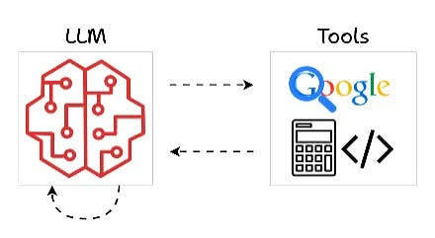
TASK 3
Turning Reviews into Blog-Style Reports
Reviews
Product
Summaries
Category
Article
OpenAI GPT-4o-mini
Noticeably more natural prose; used for the articles shipped in the live app.

Slide 6

TASK 4
From notebooks to a live product
React Frontend
FastAPI Backend
Models & Data
Deployed on Vercel
Deployed on Render
DistilBERT · TF-IDF/KMeans · Articles
Inspect a Review
Category Reports
Paste any review, get an instant sentiment verdict
Browse all 5 categories: article + stats + top/worst product
Field Notes — built to be used, not just demoed.

