Slide 1
MultiDEC: Multi-Modal Clustering of Image-Caption Pairs

Slide 2
What the paper is all about?
Clustering image-caption pairs by simultaneously learning image representations and text representations that are constrained to exhibit similar distributions.

Slide 3
Input and output
Learning DNN parameters θX and θT that map data points X and T to Z and Z’ and a set of centroids µ and µ’ in the latent space Z and Z’

Slide 4
Methodology
Parameter initialization:
Initialize the text and image representations by stacked auto encoders.
Apply K means on this initial embeddings
Clustering:
Update the DNN parameters and centroids
by iterating between computing joint auxiliary target distribution and minimizing the Kullback-Leibler (KL) divergence to the calculated target distribution.

Slide 5
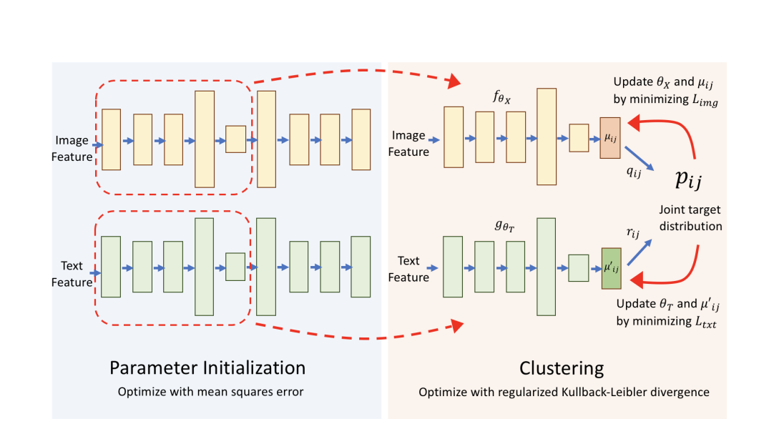

Slide 6
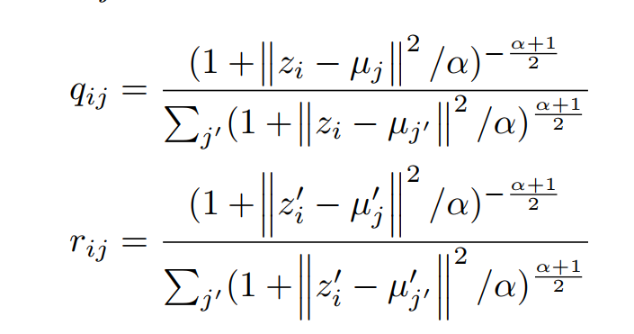
Methodology
Soft assignment:

Slide 7
Aligning Image Clusters and Text Clusters
Create a confusion kxk matrix of the image and text clusters.
where an entry (m; n) represents the number of data points being assigned to m-th image cluster and n-th text cluster.
Use Hungarian algorithm to assign the image clusters to the text clusters.

Slide 8
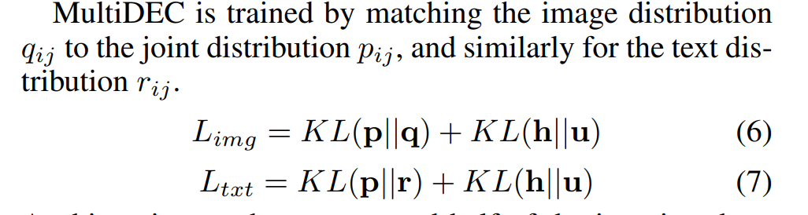
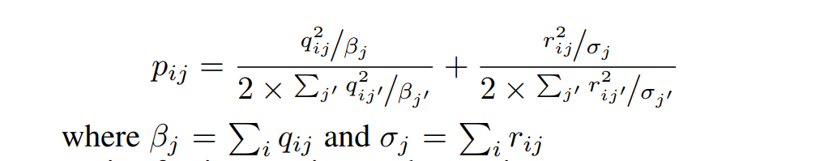
KL divergence
Notes:
Hj is the prior frequency of clusters in joint target distribution

Slide 9
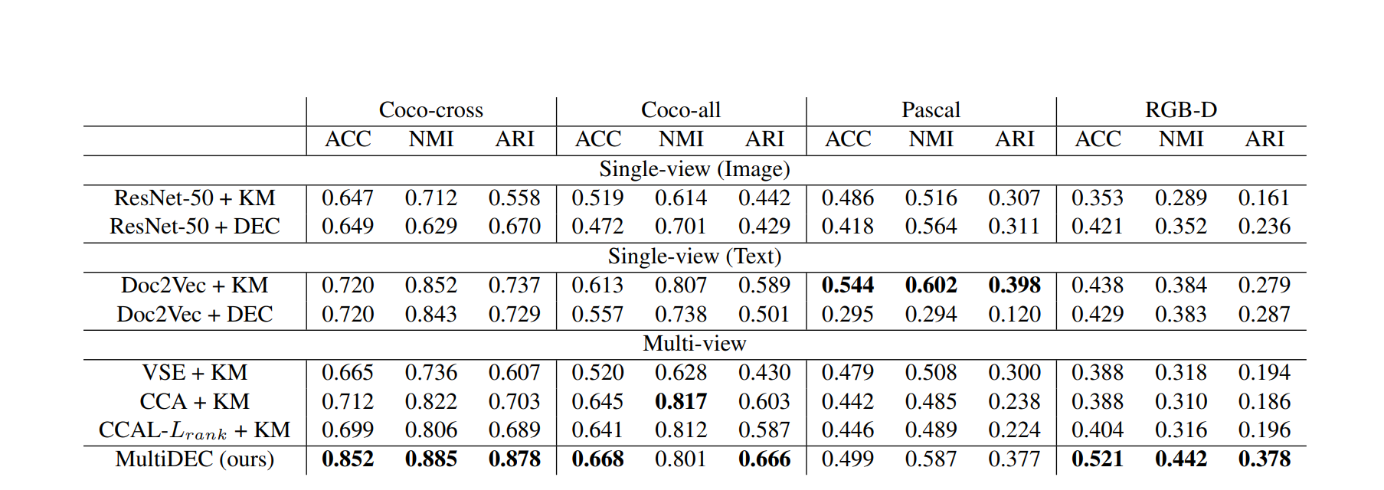
Experiments

Slide 10
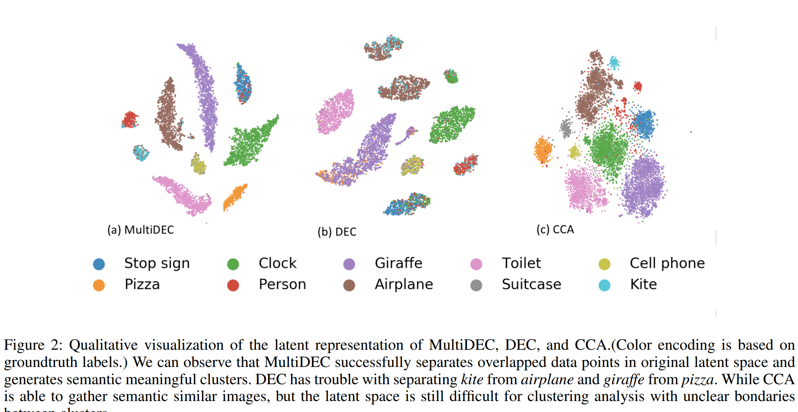
Results

Slide 11
