Slide 1
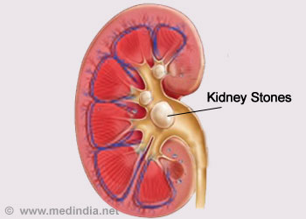
Automated Techniques for Renal Calculus Detection: A Detailed Study
Authors: Pallavi Kaul
Arashdeep Kaur

Slide 2
About The Research:
The paper starts with an introduction to kidney stones and then gives the process of its removal with the help of automated techniques.
Section II deals with the literature review i.e. study of various techniques given by different authors in their paper followed by Section III in which the key process is given that is being followed during the diagnosis of kidney stone.
Section IV and V of the paper throws light upon the parameters that are used during the evaluation process and prepare a comparative analysis based on them.
In the last section of the paper a Conclusion is made based upon the research.

Slide 3
PURPOSE
The research mainly focuses on studying various methods that helps in the diagnosis of kidney stone present inside human bodies with the help of ultrasound images.
Accurate detection of kidney stones is an important and crucial task, hence it should be done very carefully.
Thus making use of automated techniques helps in providing better results as compared to manual techniques resulting in the better treatment of the patient.

Slide 4
Key Process for the process of Kidney Stone
Noise Removal: It involves noise filtering which helps in enhancing the quality of images.
Detection of ROI: It helps in finding out the region of interest that will be helpful during the process of diagnosis.
Dilation and Erosion: These are a part of morphological analysis which produces a smoothening effect on the image.

Slide 5
Parameters used during evaluation process:
SNR: Signal Noise Ratio
MSE: Mean Square Error
MAE: Mean Absolute Error

Slide 6
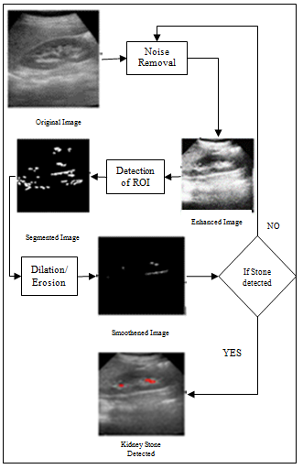

Slide 7
CONCLUSION:
A fundamental study of kidney stone using ultrasound images has been done in this paper.
These ultrasound images usually contain speckle noise which needs to be removed by applying certain techniques in order to increase the accuracy in the detection process.
The comparative study indicates the efficiency of various existing methods.
In future the aim will be to design and implement an efficient technique which can be used during the kidney stone detection process.

Slide 8
THANK YOU

