Slide 1
FAST ALGORITHMS FOR CONVOLUTIONAL NEURAL NETWORKS
BY:
Deeksha Sahu(2019201068)
Aditya Gupta(2019201067)
Kritika Singh(2019201075)

Slide 2
INTRODUCTION
In this presentation, the following points are discussed
Neural Network
Fully Connected Neural Network
Forward and backward pass
Why Not FCN
Why CNN
Flops required in CNN
Reducing Flops in CNN
Timeline Analysis

Slide 3
NEURAL NETWORK
It is a series of algorithms that shows how to recognize underlying relationships in a set of data through a process that mimics the way the human brain operates.
The first artificial neural network was invented in 1958 by psychologist Frank Rosenblatt, Called Perceptron

Slide 4
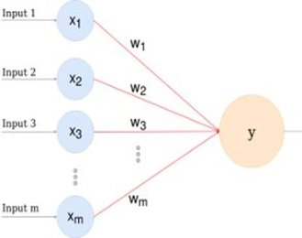
NEURAL NETWORK

Slide 5
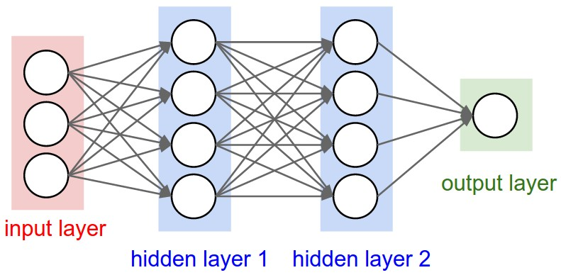
FULLY CONNECTED NEURAL NETWORK

Slide 6
FORWARD PROPOGATION
Forward pass is basically a set of operations which transform network input into the output space.
During the inference stage neural network relies solely on the forward pass.
Except the neurons in the last layers, uses ReLu activation function (the last layer uses softmax).
Activation functions are used to bring non-linearity into the system, which allows learning complex functions.

Slide 7
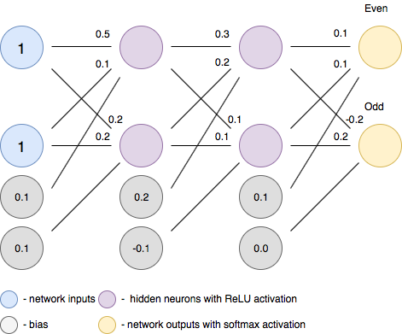
FORWARD PROPOGATION

Slide 8
BACK PROPOGATION
Backpropagation is an algorithm which calculates error gradients with respect to each network variable (neuron weights and biases).
Those gradients are later used in optimization algorithms, such as Gradient Descent, which updates them correspondingly.
The process of weights and biases update is called Backward Pass.
In order to start calculating error gradients, first, we have to calculate the error (in other words — loss) itself.
However, the loss function could be any differentiable mathematical expression.
The standard choice for regression problem would be a Root Mean Square Error (RMSE).

Slide 9
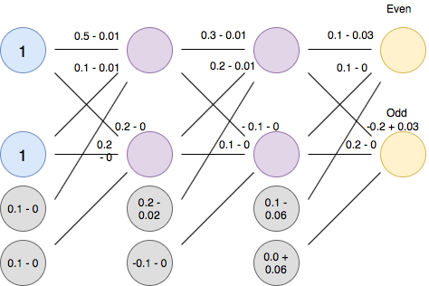
BACK PROPOGATION

Slide 10
WHY NOT FULLY CONNECTED LAYER
Due to large number of parameters that are usually present in these fully connected layers, it is often very computationally expensive.
Lots of features are presents which may lead to lots neurons the input layer
In some cases (AlexNET, etc.) more than half of the total computational costs in terms of parameter count, comes only form these fully connected layers.

Slide 11
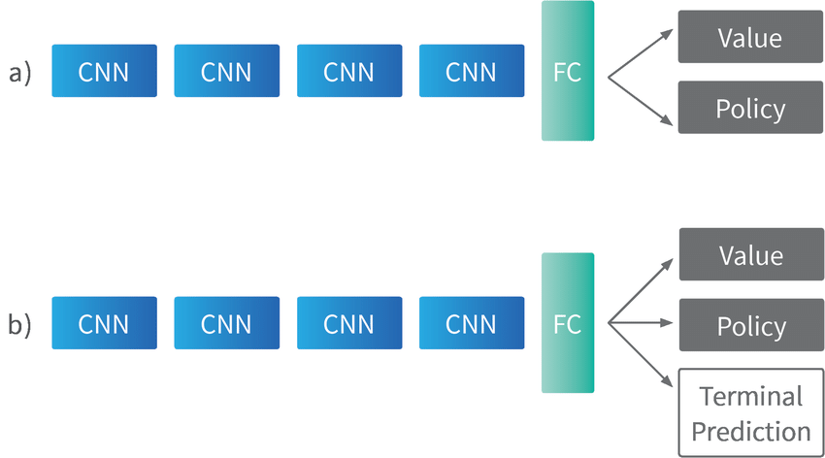
SOLUTION
Convolutional Neural Network -> FC -> GD
CNNs outperform NNs on conventional image recognition tasks and many other tasks.
For a completely new task / problem CNNs are very good feature extractors.
Convolutional Neural Networks are the basis of all modern computer vision models.

Slide 12
CONVOLUTIONAL NEURAL NETWORK
A Convolutional Neural Network (ConvNet/CNN) is a Deep Learning algorithm which can take in an input image, assign importance (learnable weights and biases) to various aspects/objects in the image and be able to differentiate one from the other.
Convolutional neural networks (CNNs) are frequently used for the tasks of image recognition and classification.

Slide 13
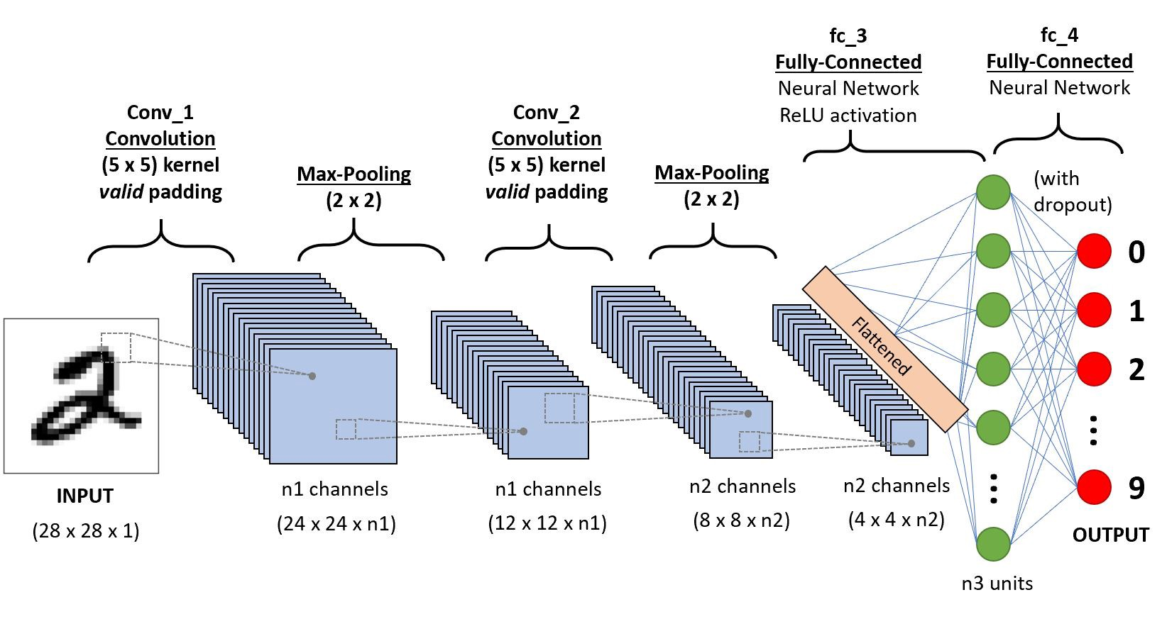
CONVOLUTIONAL NEURAL NETWORK

Slide 14
CONVOLUTIONAL NEURAL NETWORK
ARCHITECTURE:
Convolutional layer “filter” passes over the image, scanning a few pixels at a time and creating a feature map that predicts the class to which each feature belongs.
Pooling layer (downsampling)━reduces the amount of information in each feature obtained in the convolutional layer while maintaining the most important information (there are usually several rounds of convolution and pooling).
Fully connected input layer (flatten)━takes the output of the previous layers, “flattens” them and turns them into a single vector that can be an input for the next stage.
The first fully connected layer━ takes the inputs from the feature analysis and applies weights to predict the correct label.
Fully connected output layer━ gives the final probabilities for each label.

Slide 15
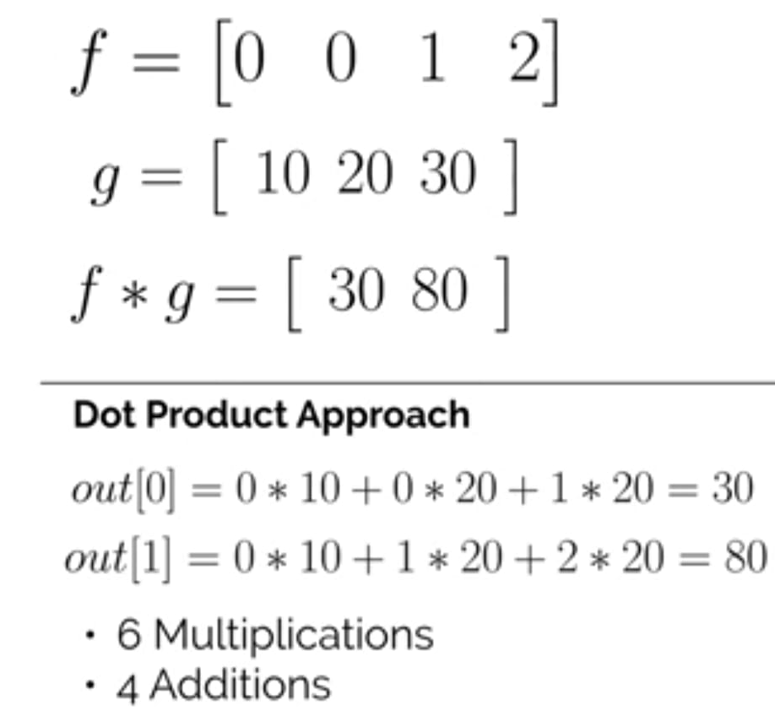
NUMBER OF FLOPS (Floating point operations) IN CONVOLUTIONAL LAYER

Slide 16
REDUCING THE NUMBER OF FLOATING-POINT OPERATIONS
Winograd's fast convolution algorithms transform input and filters into another space where convolution becomes element-wise multiplication.
Winograd minimal algorithms only need 1 real multiplication per input, which is essentially the computational advantage that Winograd convolution.

Slide 17
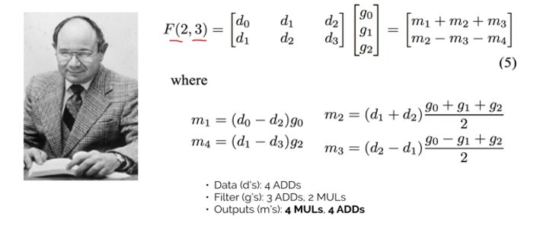
SHMUEL WINOGRAD

Slide 18
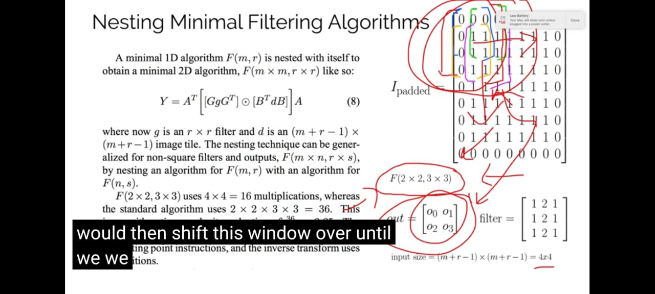
WINOGRAD'S ALGORITHM
A minimal 1D algorithm F(m , r) is nested with itself to obtain a minimal 2D algorithm, F(m x m , r x r ) like so:

Slide 19
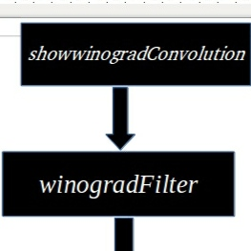
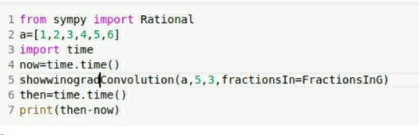
CODE IMPLEMENTATION

Slide 20
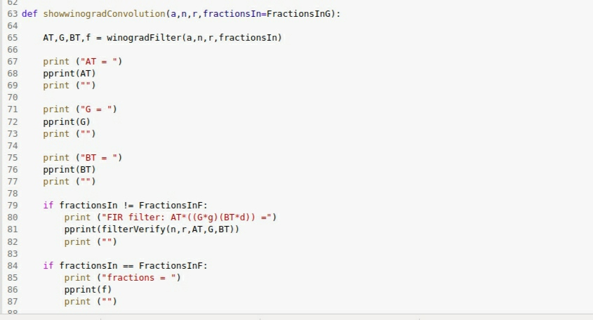

Slide 21
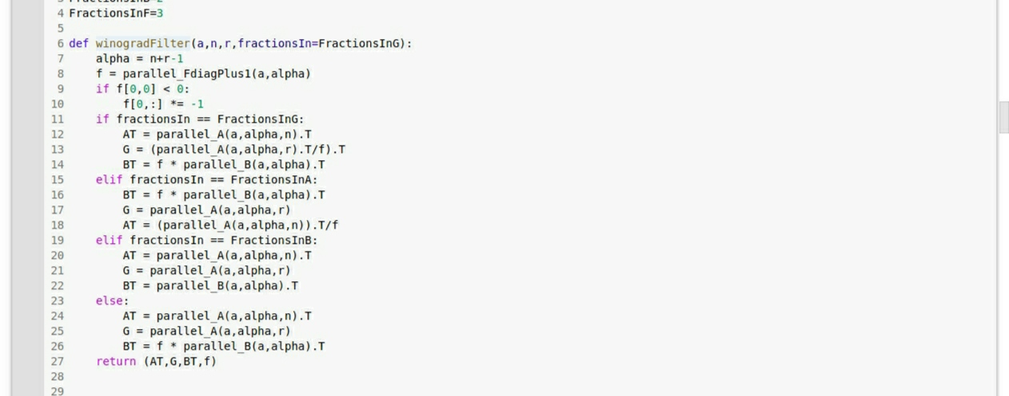
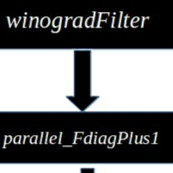

Slide 22
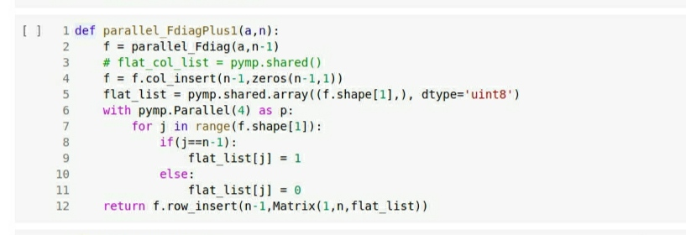
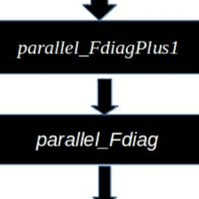

Slide 23
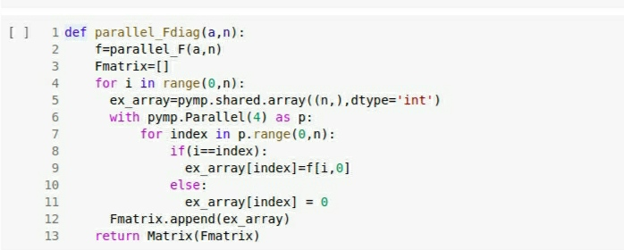
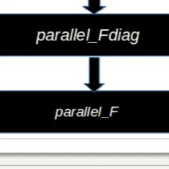

Slide 24
CODE IMPLEMENTATION
FLOWCHART
showwinogradConvolution
WinogradFilter
parallel_FdiagPlus1
parallel_Fdiag
parallel_F

Slide 25
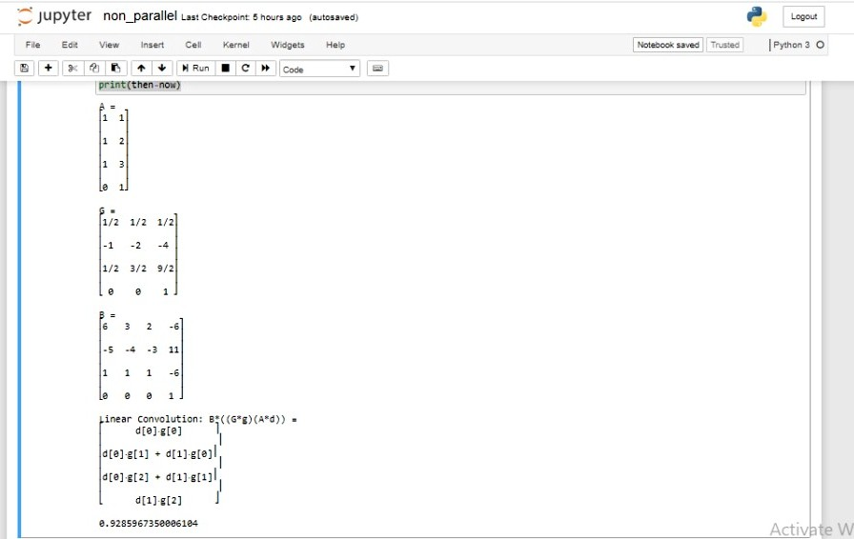
OUTPUT ANALYSIS Non-parallel O/P
0.928539 Sec

Slide 26
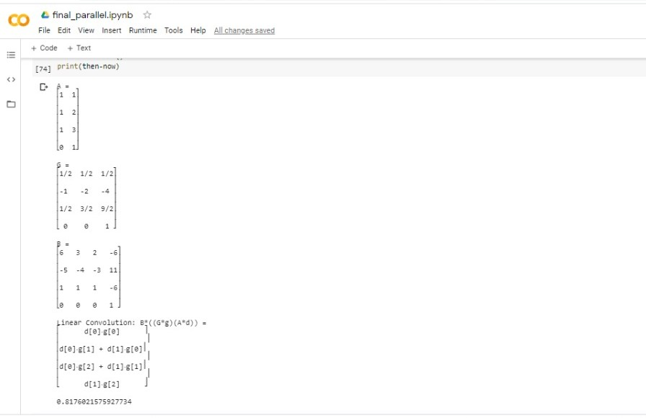
OUTPUT ANALYSIS parallel O/P
0.8175603 Sec

Slide 27
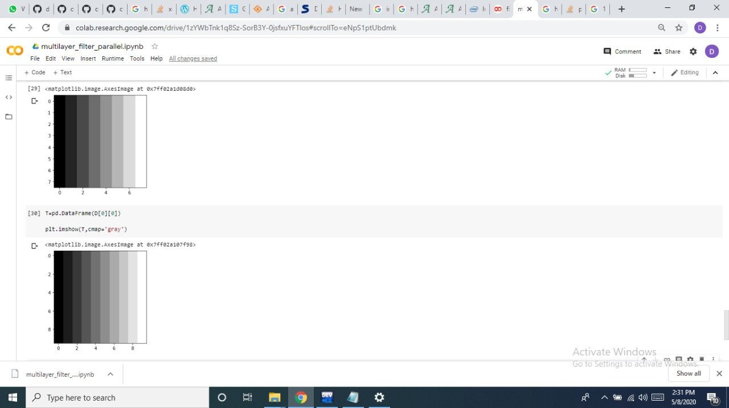
OUTPUT ANALYSIS Conv layer O/P

Slide 28
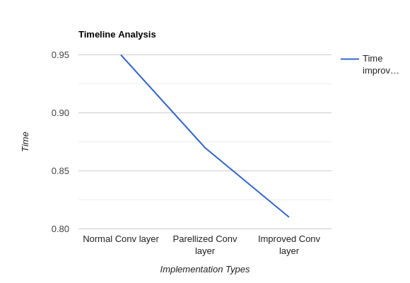
TIMELINE ANALYSIS
Graph Representing Time variations

Slide 29
SIDE-EFFECTS
Memory - Transforms are intermediate results in Winograd, which often require significant memory. As more convolutions using Winograd are added to the topology, this memory could grow significantly.
Accuracy - In some cases Winograd can be significantly less accurate than direct as demonstrated in Winograd paper

Slide 30
CONCLUSION
Implementing convolution using the Winograd algorithm often gives a significant performance boost compared with the Normal algorithm.

Slide 31
REFERENCES
https://machinelearningmastery.com/ tutorial-first-neural-network-python-keras/
https://machinelearningmastery.com/convolutional-layers-for-deep-learning-neural-networks/
http://openaccess.thecvf.com/content_cvpr_2016/papers/Lavin_Fast_Algorithms_for_CVPR_2016_paper.pdf

Slide 32
THANK YOU

