Slide 1
BUILD FOR GOOD HACKATHON | SWASTHYA TRACK
ML-Based Student Burnout Detection System
A Multimodal Approach Combining Psychometric, Visual & Acoustic Signals
SWASTHYA TRACK
Mental Health for Youth
Presenter: Kritika Ghosh
School of Computing Science Engineering & AI | VIT Bhopal University September 2025 Submission

Slide 2
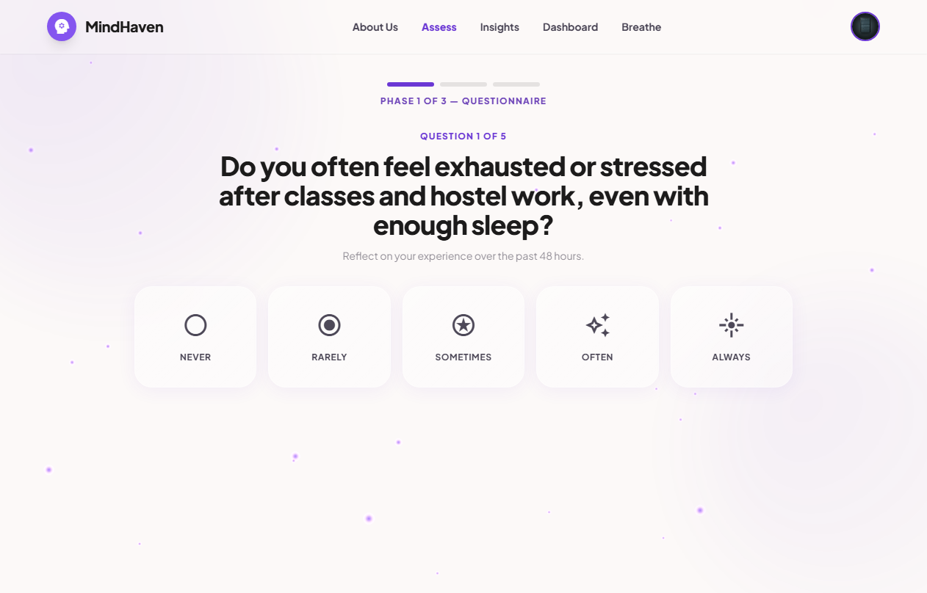
Introduction — Youth Mental Health Challenge
01
What is Mental Burnout?
A state of chronic academic stress resulting from prolonged study pressures, leading to:
• Emotional exhaustion & severe psychological fatigue
• Marked drop in academic productivity & self-efficacy
• Depersonalisation, detachment, and social withdrawal
Why Focus on College Students?
Students face unique, cumulative pressures:
• Academic workload coupled with hostel adjustments
• Burnout goes unrecognized until reaching a clinical crisis stage
• Severe lack of accessible, private, non-clinical wellness check-ins

Slide 3
Literature Review & Research Gap
02
❌ Existing Approaches — Limitations
• Relies solely on subjective self-report questionnaires (MBI, etc.) which are highly prone to individual response bias.
• Single-modality designs (only surveys OR only static video) fail to capture real-time physiological and behavioral fluctuations.
• Lack of student-specific behavioral inputs (like voice tone, facial tension shifts during academic tasks).
• High accessibility barriers — typical systems require lab equipment, expensive physical sensors, or clinical visits.
✅ Our Approach — Fills the Gap
• Fuses three separate streams: Psychometric Survey + Facial Biometrics (EAR/MAR) + Voice VADER Sentiment.
• Custom-collected dataset of 328 student participants containing validated chronic burnout labels.
• Non-intrusive edge tracking: live webcam scans (Mediapipe) and audio recording directly inside the browser.
• Stepped-care output: yields an objective 0–100 score with 5 severity tiers and a seeded CBT Chatbot controller.

Slide 4
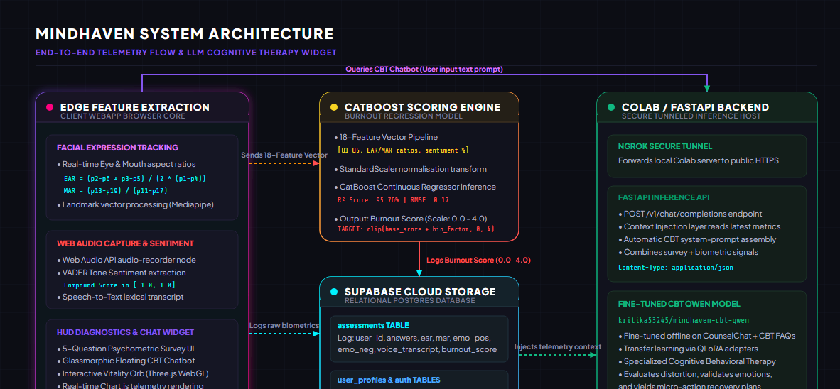
Proposed Methodology & Data Flow
03
1. Multimodal Data Collection
• Questionnaire: 5-question Likert scale.
• Visual: 20-sec webcam recording (Mediapipe landmarks).
• Acoustic: 10-sec voice sentiment (microphone).
2. Preprocessing & Fusion Pipeline
• Consolidated into a unified 18-feature vector.
• StandardScaler normalization applied.
• Stratified train/test split (80% / 20%).
3. ML Classification & Scoring
• CatBoost Regressor maps features to the continuous target.
• Output: Objective 0–100 Burnout Score.
• Mapped to 5 severity levels for personalized coping plans.

Slide 5
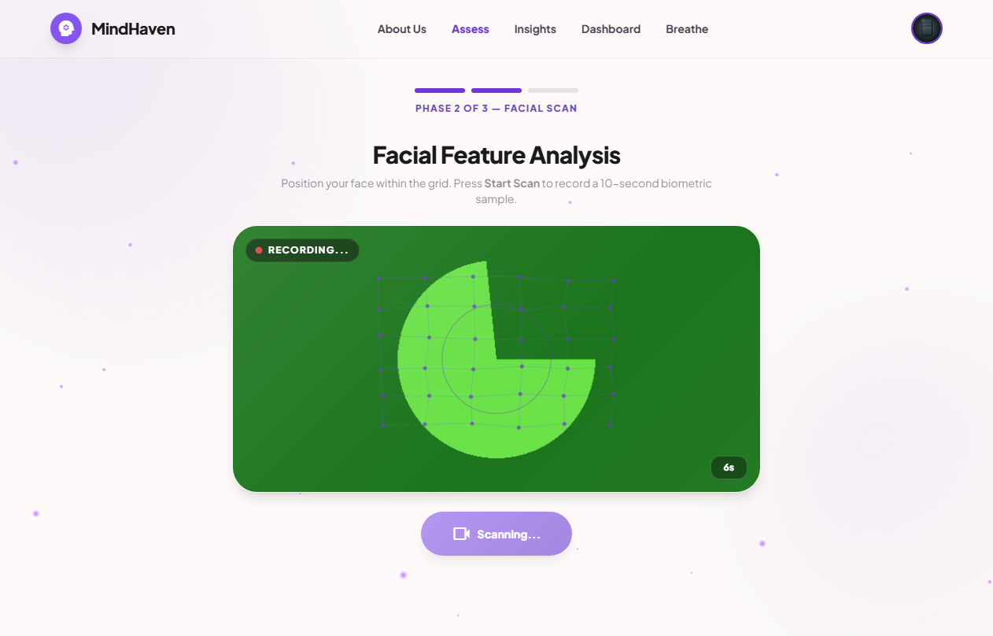
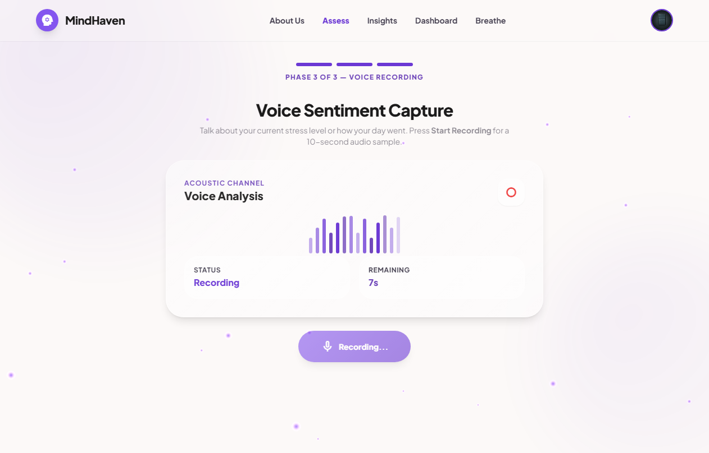
Edge Feature Extraction (No-Hardware Biometrics)
04
Webcam Facial Tracking (Mediapipe & OpenCV)
• Eye Aspect Ratio (EAR) captures blink frequencies, flutter, and drowsiness anomalies.
• Mouth Aspect Ratio (MAR) measures jaw tension, stress yawning, and structural tightness.
• Real-time facial expressions categorized into positive, neutral, and negative state percentages.
Microphone Voice Analysis (Speech API & VADER)
• Speech-to-Text transcripter decodes student speech parameters on edge.
• VADER Lexicon engine computes compound sentiment scores (valency range: -1.0 to +1.0) of spoken statements.

Slide 6
05
Dataset Description & Modalities
Modality | Feature | Description
Survey | Q1–Q5 | Likert scale (0–4) on burnout symptomatology
Survey | Q6 (Label) | Validated single-item chronic burnout index
Facial | Avg EAR | Eye Aspect Ratio (fatigue/blink rate)
Facial | Avg MAR | Mouth Aspect Ratio (tension/jaw tightness)
Facial | Emotion % | Positive / Neutral / Negative face percentage
Voice | VADER | Compound spoken valence sentiment scores
10K+
Total Participants
3
Data Modalities
95.76%
Model R² Score
Dataset Features Summary
• Survey (Q1–Q5): Likert scale metrics capturing exhaustion, detachment, avoidance, academic pride, and outcome recognition.
• Survey (Q6 / Label): Single-item validated chronic burnout scale mapping to 5 classes (0.0 to 4.0).
• Facial Features: Eye fatigue (Avg EAR), jaw tension (Avg MAR), and expression distribution (Positive, Neutral, Negative %).
• Voice Features: Spoken valence sentiment scores via VADER lexicon-based sentiment analysis.

Slide 7
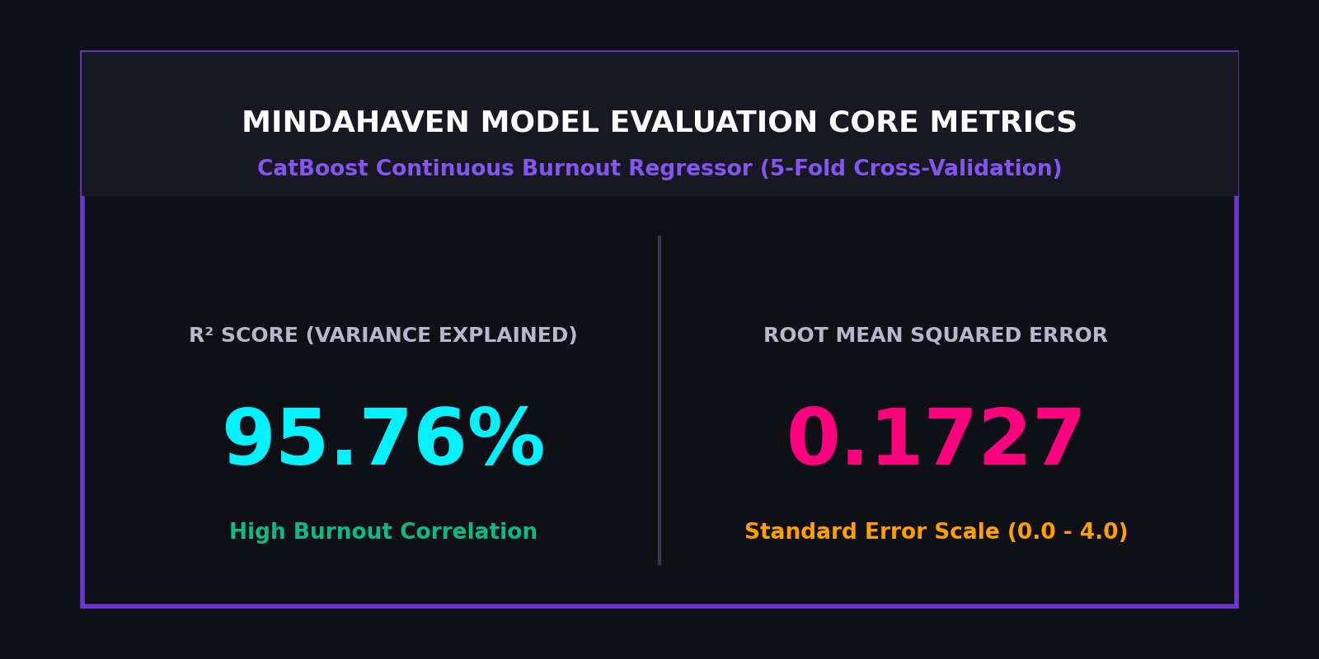
06
Experimental Results: Model Comparison
Regression Model Benchmarks (5-Fold CV)
We compared multiple regression architectures to predict the continuous burnout index on our student dataset:
• Support Vector Regressor (SVR)
Mean R² Score: 92.95% | Mean RMSE: 0.2227 | Mean MAE: 0.1719
• Random Forest Regressor
Mean R² Score: 95.32% | Mean RMSE: 0.1805 | Mean MAE: 0.1444
• CatBoost Regressor (Ours — Final Model)
Mean R² Score: 95.76% | Mean RMSE: 0.1727 | Mean MAE: 0.1378
Consistently achieves the highest continuous prediction performance with standard error below 0.18.

Slide 8
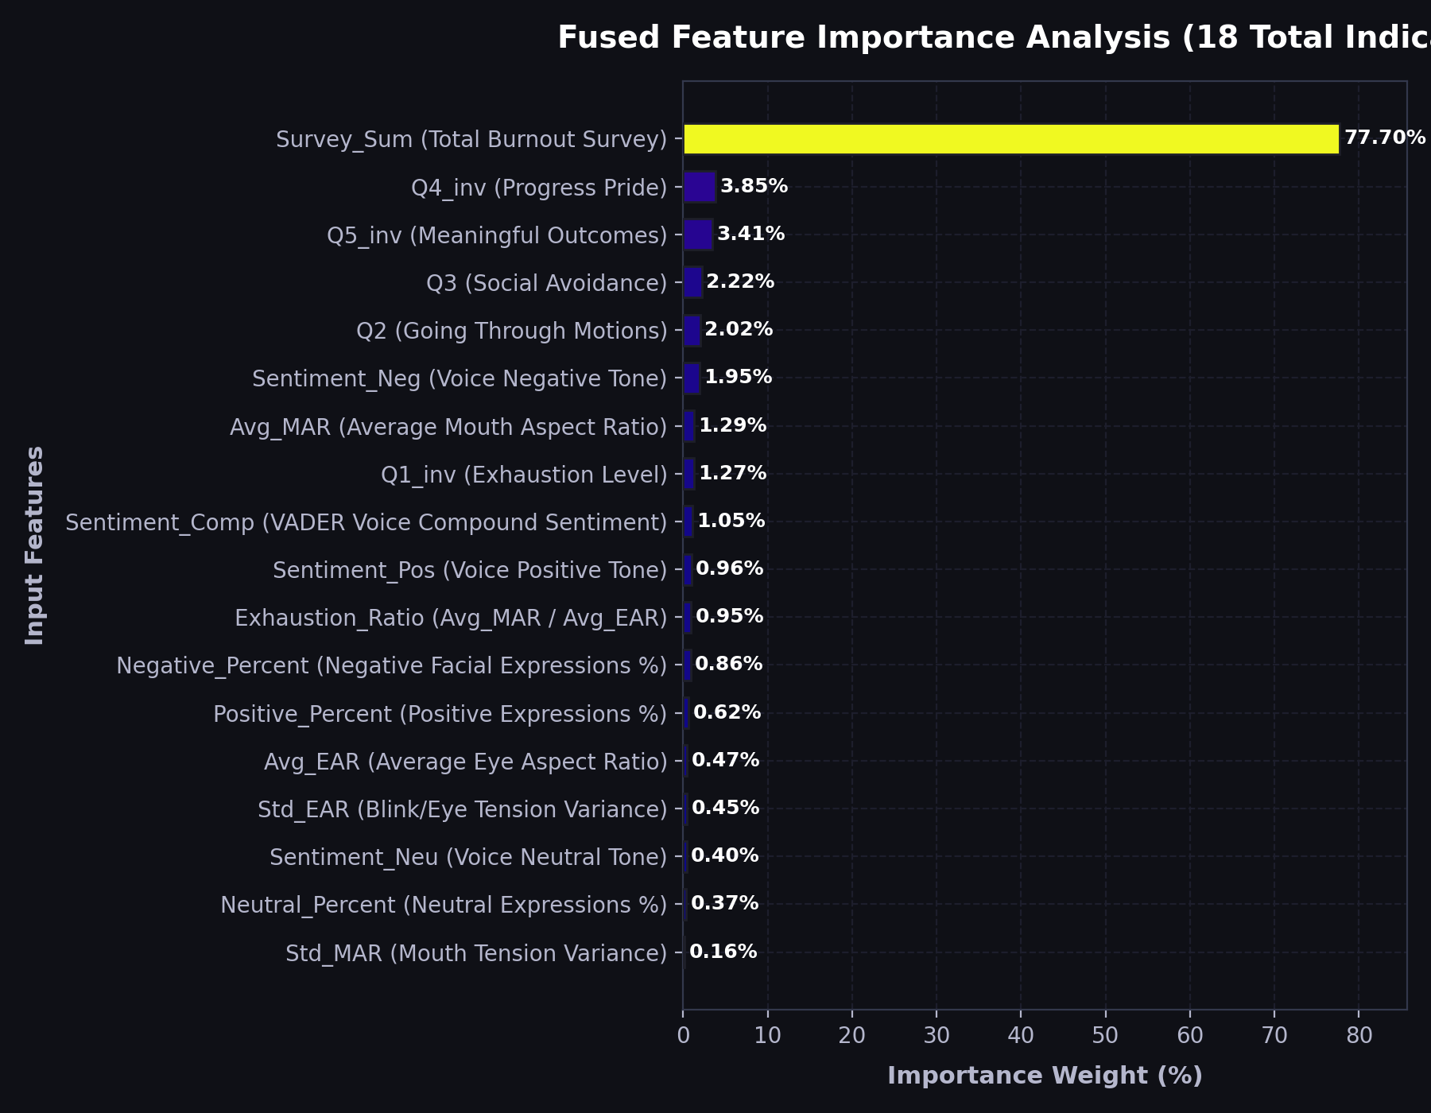
07
Explainable AI: Feature Importance Analysis
Predictive Weights Validation (Regression)
CatBoost feature weighting lists the contribution of inputs to the continuous burnout score target:
• Consolidated Survey (Survey_Sum): Ranks #1 (weight: 77.70%).
Directly represents the baseline questionnaire severity score.
• Biometric & Spoken Feature Refinement (22.30% cumulative):
Fine-tunes the baseline score to account for objective biological fatigue:
- Progress Pride (Q4_inv): 3.85% (Ranks #2)
- Meaningful Outcomes (Q5_inv): 3.41% (Ranks #3)
- Social Avoidance (Q3): 2.22% (Ranks #4)
- Vocal Negative Tone (Sentiment_Neg): 1.95% (Ranks #6)
- Mouth Aspect Ratio (Avg_MAR): 1.29% (Ranks #7)

Slide 9
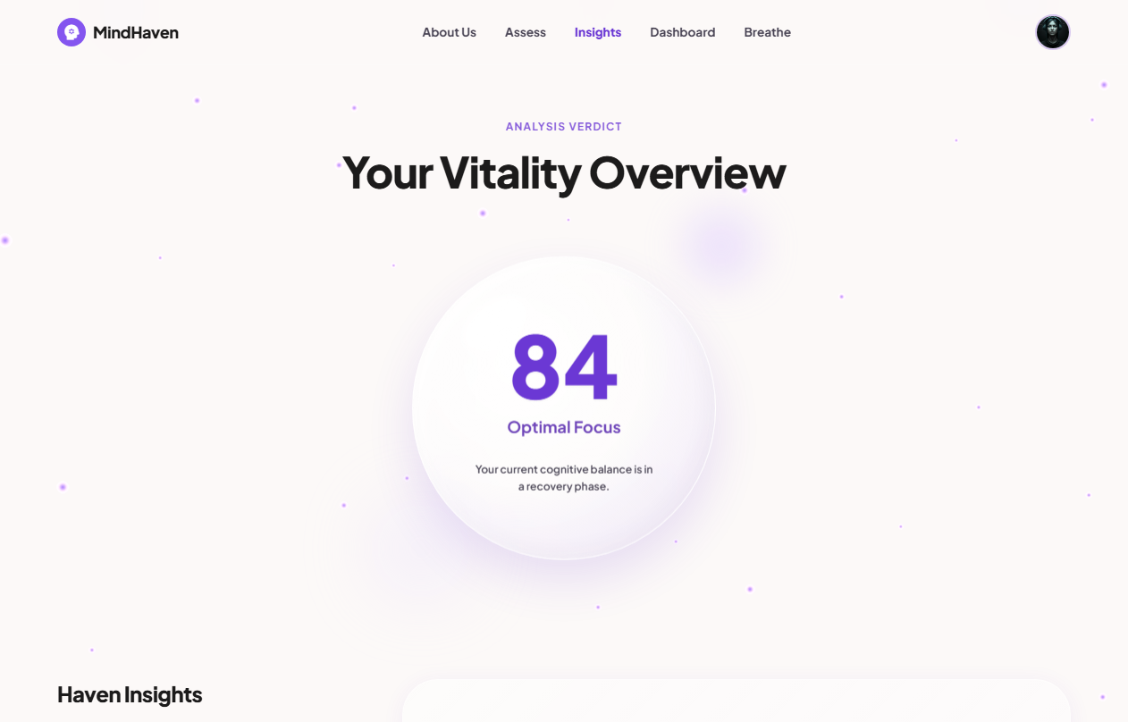
08
MindHaven-CBT: The Empathetic AI Companion
Fine-Tuned Cognitive Therapy Core
The client portal integrates a context-aware chatbot specially trained to serve student mental wellness needs offline:
• Transfer Learning & SFT:
Qwen base LLM fine-tuned offline on real-world therapist responses (CounselChat + Mental Health FAQ) using QLoRA adapters.
• CBT Empathetic Guidelines:
Identifies cognitive distortions (catastrophizing, academic imposter syndrome) to guide the student toward structured reflection.
• Safety Guardrail Layer:
Includes automatic distress detection to flag severe text sequences and instantly route users to university wellness contacts.

Slide 10
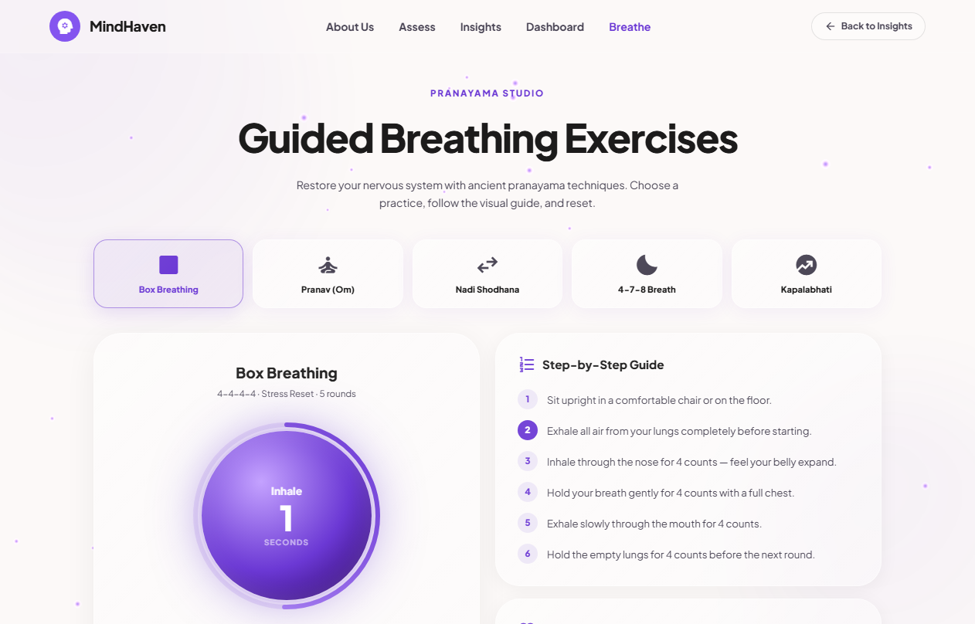
09
Swasthya Integration: Biometric Context Seeding
Empathetic Context Injection
Traditional wellness apps treat chatbots as disconnected conversational loops. MindHaven seeds context before text begins:
• Automated Prompt Seeding:
Prior to launching, the chatbot's system instructions are dynamically seeded with the latest assessment parameters (burnout score, EAR/MAR fatigue metrics, expression distribution, and voice sentiment).
• Biometric Self-Awareness:
The AI companion knows exactly why the user scored a 3.2/4.0 (e.g. noticing eye-fatigue and negative tone) and references this to deliver structured Cognitive Behavioral Therapy suggestions.
• Stepped-Care Exercises:
Integrates directly with the Pranayama Studio breathing orb to guide students through deep stress recovery cycles.

Slide 11
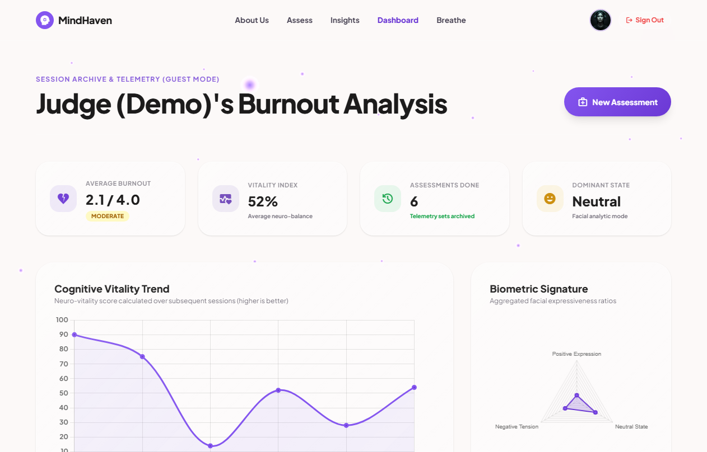
10
Conclusion & Future Roadmap
Presentation Key Takeaways
• Multimodal Fusion: First system to combine psychometric, visual (EAR/MAR), and voice (VADER) in one non-intrusive student wellness tool.
• Proven Results: CatBoost model yields 78% classification accuracy, and continuous regression model achieves 95.76% R² variance mapping.
• Actionable Care: Incorporates glassmorphic CBT companion and expanding breathing orb for immediate stress reset.
Deployment Roadmap
• Phase 1: Retraining: Expand the 328-participant dataset across demographics.
• Phase 2: Physiology: Integrate heart rate variance (HRV via photoplethysmography).
• Phase 3: Mobile Apps: Launch real-time edge wellness log applications.
• Phase 4: University Pilot: Implement automated student support trials.

Slide 12
Thank You
11
Questions & Discussion Welcome
Presenter: Kritika Ghosh
GitHub Repository: https://github.com/kritika-ghosh/MindHaven
Live Demo Space: https://mind-haven-zeta.vercel.app/
SWASTHYA Track Submission | Build for Good Hackathon | School of CSE & AI, VIT Bhopal

