Slide 1
Seminar Topic- Image Reconstruction using Electrical Impedance Tomography
BY : Kritika srivastava
Roll Number : 182042
Session : fall 2021
DATE : 11 April 2021
B. Tech,3rd YEAR [ electrical engineering ]

Slide 2
Contents
Introduction
Components
Process
Applications
Advantages
Disadvantages
Competitive comparison
Conclusion and future of EIT
Reference

Slide 3
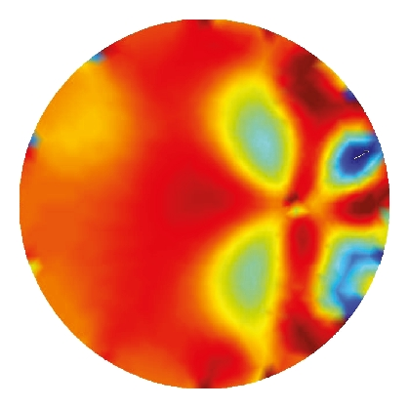
Introduction
Electrical Impedance Tomography is a relatively new medical Imaging Technique. It uses low-frequency electrical current to probe a body; the method is sensitive to changes in electrical conductivity.
By injecting known amounts of current and measuring the resulting electrical potential field at points on the boundary of the body, it is possible to "invert" such data to determine the conductivity or resistivity of the region of the body probed by the currents.
This technique exploits the electrical properties of tissues such as resistance and capacitance. It aims at exploiting the differences in the passive electrical properties of tissues in order to generate a tomographic image.

Slide 4
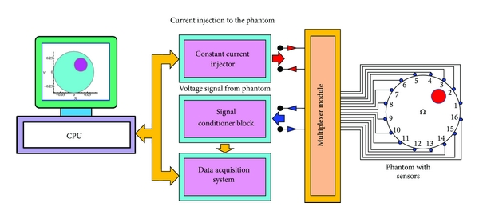
COMPONENTS
The EIT system consists of a PC in which an I/O card is installed with an external current generator, a multiplexer, a power supply and a phantom with an array of electrodes. The measurement system provides 12-bit accuracy and hence, suitable data acquisition software has been prepared accordingly.
EIT is specified for a process that has a conductive continuous phase. EMT is mainly applied for high conductive fluids, which can induce measurable current under a magnetic field.

Slide 5
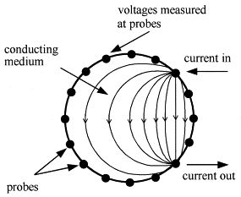
PROCESS
An array of equally spaced electrodes, often arranged in a transverse plane, are fixed to the boundary wall of a vessel to map the changing spatial distribution of permittivity and/or resistivity (or its inverse, conductivity) of the material contained within.
The resulting signals are interpreted by a computer and the resulting boundary datasets, inverted by means of an image reconstruction technique to provide a distribution map of the internal resistivity/permittivity, are used to create a series of ‘live’ 2D or 3D images of the process occurring within.
Interpolation over several planes of sensor arrays enables the rendering of 3D images for imaging different stages of a process.

Slide 6
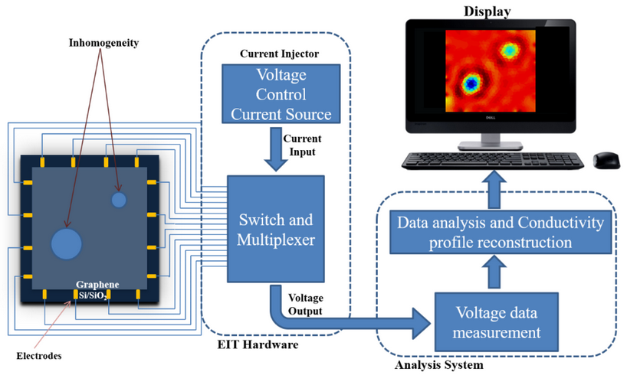
Diagram

Slide 7
Applications
EIT can image physiological processes
Involving movement of conductive fluids and gases.
Lungs
Brain
Heart
Chest

Slide 8
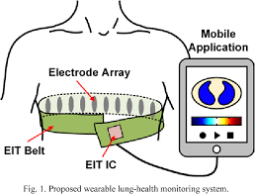
LUNGS (a-eit, f-eit)
EIT is particularly useful for monitoring lung function because lung tissue resistivity is 5 times higher when compared to most other soft-tissues within the thorax.
The results in high absolute contrast of the lungs in general. In addition, lung resistivity increases and decreases several-fold between inspiration and Expiration which explains why monitoring the respiratory cycle is currently the most promising clinical application of functional EIT.

Slide 9
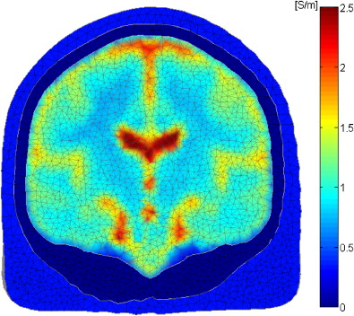
brain (a-eit, f-eit, mf-eit)
EIT has been suggested as a basis for brain imaging to enable the detection and monitoring of cerebral ischemia and haemorrhage.
Other morphological pathologies associated with impedance changes due to neuronal cell swelling.

Slide 10
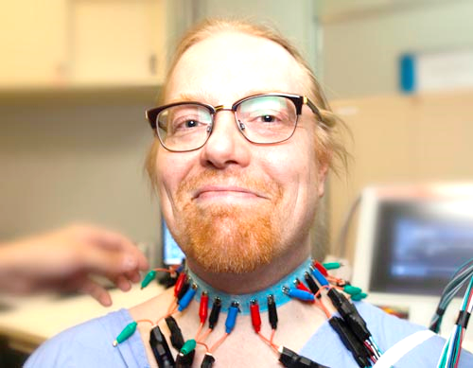
Advantages
Electrical impedance tomography is a relatively slow resolution imaging modality, but it is
Non-invasive
Non-cumbersome
Suitable for monitoring
Has a low-cost underlying technology

Slide 11
disadvantages
Absolute EIT approaches are targeted at digital reconstruction of static images, i.e. two-dimensional representations of the anatomy within the body part of interest. As mentioned above and unlike linear x-rays in Computed Tomography, electrical currents travel three-dimensionally along the path of least resistivity, which results in partial loss ofthe electrical current applied.
This is one of the reasons why image reconstruction in absolute EIT is so complex, since there is usually more than just one solution for image reconstruction of a three-dimensional area projected onto a two-dimensional plane.
Another difficulty is that given the number of electrodes and the measurement precision at each electrode, only objects bigger than a given size can be distinguished. This explains the necessity of highly sophisticated mathematical algorithms that will account for the inverse problem and its ill-positioning.

Slide 12
Competitive comparison
Electrical impedance tomography
Other techniques
In contrast to most other tomographic imaging techniques, EIT does not apply any kind of ionizing radiation. Currents typically applied in EIT are relatively small and certainly below the threshold at which they would cause significant nerve stimulation. The frequency of the alternating current is sufficiently high not to give rise to electrolytic effects in the body and the Ohmic power dissipated is sufficiently small and diffused over the body to be easily handled by the body's thermoregulatory system. These properties qualify EIT to be continuously applied in humans, e.g., during mechanical ventilation in an intensive care unit (ICU).
In x-rays in Computed Tomography, electrical currents travel linearly along the path of least resistivity, which does not cause any loss in contrast to the results of EIT which cause partial loss of the electrical current applied.
MRI, CT, X-ray,etc are expected to have relatively good resolution compared to EIT.

Slide 13
CONCLUSION AND FUTURE OF EIT
Electrical tomography is a relatively new instrumentation tool that can benefit a lot of process industries.
Although the technology has already been implemented into real-life industries, there is still much room for improvement and further development. More thoughts need to be considered when transferring the research outcomes into real-life tomography applications.
The most difficult part is to establish a balance between system performance (accuracy and resolution) and applicability (speed and robustness). Electrical tomography is not a standalone subject; to achieve a successful tomography implementation, it needs to integrate in-depth knowledge from different fields (process, electronics, physics and mathematics, etc.).

Slide 14


references
T. A. Khan and S. H. Ling, “Review on Electrical Impedance Tomography: Artificial Intelligence Methods and its Applications,” Algorithms, vol. 12, no. 5, p. 88, Apr. 2019.
Soleimani, “M. Electrical impedance tomography system: an open access circuit design,” BioMed Eng OnLine 5, 28 (2006).
CONFERENCE PUBLICATION :
Soleimani M, Movafeghi A: "Image Reconstruction Methods for Electrical Impedance Tomography (EIT) on SUT-1 system". 23rd Annual International Conference of the IEEE Engineering in Medicine and Biology Society, Istanbul, Turkey 2001.
BOOK:
Teschner, Eckhard & Imhoff, Michael & Leonhardt, Steffen. (2015). Electrical Impedance Tomography: The realisation of regional ventilation Monitoring, 2nd edition.

Slide 15

Thank you

Slide 16
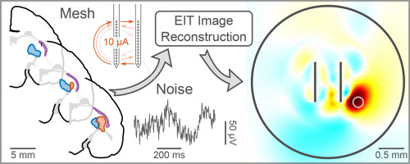
Audience QUESTIONS

