Slide 1
ANALYSIS OF THE KMP ALGORITHM
KRITIKA RAJ (180123024)
PRAGATI MAHAMUNE (180123032)

Slide 2
Objectives:
Pattern- matching Problem
State of Art of KMP
Limitations of KMP
Proposition of L-I-KMP
Conclusion

Slide 3
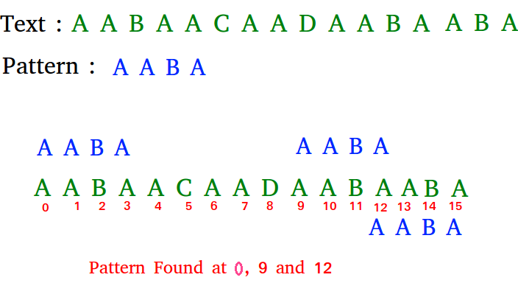
Pattern-Matching Problem
Consider a string T and a smaller string P then a pattern-matching algorithm wants to find the starting index m in string T[ ] that matches the search string P[ ].

Slide 4
Original kmp algorithm
The Knuth-Morris-Pratt (KMP) algorithm has been considered as the first linear time string-matching algorithm with a serial cost of O(m+n) and a preprocessing time of O(m).
The KMP algorithm traverses the given pattern string from head to tail, trying to find the longest common elements between the prefix and the suffix of each substring of the pattern, and take down the length of the common part in a “Failure Table”, and the table being the same length of the pattern.

Slide 5
How does kmp work?
Start comparing the letters of T from the first letter of P.
Let N1 denotes the number of matched characters and updates with the comparison process.
Represent “the corresponding number in the Failure Table of the last matched character” as N2.
If the not-match situation starts from one letter of P then the digits that P needs to move towards the right are: (N1-N2).

Slide 6
Pseudo code for KMP
algorithm kmp_search: input: an array of characters, T(the text to be searched) an array of characters, P(the pattern sought) output: an array of integers, A (positions in T at which P is found) an integer, nP (number of positions) define variables: an integer, j ← 0 (the position of the current character in T) an integer, k ← 0 (the position of the current character in S) an array of integers, FT (the table, computed elsewhere) // the "failure table" let nP ← 0 while j < length(T) do if P[k] = T[j] then let j ← j + 1 let k ← k + 1 if k = length(P) then (occurrence found, if only first occurrence is needed, m ← j - k may be returned here) let A[nP] ← j - k, nP ← nP + 1 let k ← FT[k] (FT[length(P)] can't be -1) else let k ← FT[k] if k < 0 then let j ← j + 1 let k ← k + 1

Slide 7
Pseudo code for KMP (contd.)
algorithm kmp_table: input: an array of characters, P (the pattern to be analyzed) output: an array of integers, I (the table to be filled) define variables: an integer, pos ← 1 (the current position we are computing in FT) an integer, cnd ← 0 (the zero-based index in P of the next character of the current candidate substring) let FT[0] ← -1 while pos < length(P) do if P[pos] = P[cnd] then let FT[pos] ← FT[cnd] else let FT[pos] ← cnd let cnd ← FT[cnd] (to increase performance) while cnd ≥ 0 and P[pos] <> P[cnd] do let cnd ← FT[cnd] let pos ← pos + 1, cnd ← cnd + 1 let FT[pos] ← cnd (only need when all word occurrences searched)

Slide 8
An example to illustrate kmp
0 | 1 | 2 | 3 | 4 | 5 | 6 | 7 | 8 | 9 | ...
a | b | c | a | b | c | a | b | d
a | b | c | a | b | d
 |  |  | a | b | c | a | b | d
The symbols at positions 0, ..., 4 have matched. Comparison c-d at position 5 yields a mismatch. The pattern can be shifted by 3 positions, and comparisons are resumed at position 5.
The shift distance is determined by the widest border of the matching prefix of p. In this example, the matching prefix is abcab, its length is j = 5. Its widest border is ab of width b = 2. The shift distance is j – b = 5 – 2 = 3.

Slide 9
An example to illustrate kmp(contd.)
0 | 1 | 2 | 3 | 4 | 5 | 6 | 7 | 8 | 9 | ...
a | b | a | b | b | a | b | a | a
a | b | a | b | a | c
 |  | a | b | a | b | a | c
 |  |  |  | a | b | a | b | a | c
 |  |  |  |  | a | b | a | b | a | c
 |  |  |  |  |  |  | a | b | a | b | a | c

Slide 10
Complexity analysis
The time complexity of suffix generation is O(m) where m is the length of pattern.
Time complexity of finding pattern is O(n) where n is the length of the pattern.
Since m<=n the overall complexity of the Knuth-Morris-Pratt algorithm is in O(n).
Total time complexity is O(n) for average as well as worst case.

Slide 11
Limitation of kmp
Although this algorithm is relatively outstanding, it still has a considerable margin of improvement.
As the pattern slides forward, there are still many matches that are not necessary.
In addition, when the pattern first appears in the second part of the text, more comparisons will be needed.

Slide 12
Work Focused l-I-kmp algorithm
This algorithm is based on a data structure ‘Last-Identical array’.
For preprocessing part of this algorithm, one is required to make a letter table as shown below:
Text: abacdfgeacbmaacabb
Pattern: acabb
01234
b | 3 | 4
a | 0 | 2
c | 1

Slide 13
L-I-kmp algorithm(contd.)
In the last-identical array, the character in the pattern not only corresponds to its position number but also points to the previous position of the same letter.
If this letter appears the first time from left to right, then it points NULL. In figure below, given the pattern “acabb” and its position array in order is “01234”, its last-identical array is to be “NULL NULL 0 NULL 3”.
0 | 1 | 2 | 3 | 4
a | c | a | b | b
NULL | NULL | 0 | NULL | 3

Slide 14
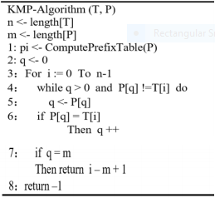
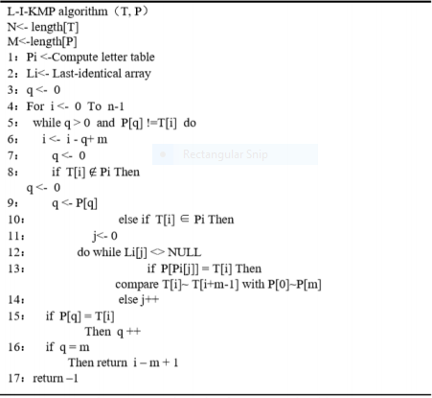
Performance Comparison of Algorithms

Slide 15
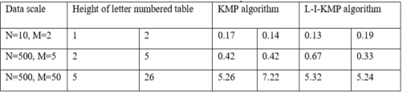
Performance Comparison of Algorithms
The two essential elements to analyze the capability of the matching algorithm are times of attempt and the amount of letter’s matched during the whole matching procedure.
Table below shows that L-I-KMP algorithm performs well in practice when the same letters are apart and there are few types of letters in the pattern. If the pattern is not so long, it can achieve a good speed similar to the original KMP algorithm. Therefore, this is an appropriate algorithm.

Slide 16
Conclusion
The efficiency of KMP and L-I-KMP algorithms are almost equal, assuming that the amount of data is small.
However for large data set, and relatively big number of types of the pattern , or small but unevenly distributed number, the L-I-KMP algorithm is superior to the KMP algorithm.
The new algorithm can be improved in many aspects by optimizing the last-identical array or completing the comparing process with the letter numbered table.

Slide 17
References:
The Analysis of KMP Algorithm and its Optimization, Article by Xiangyu Lu 2019 J. Phys: Conf. Ser. 1345 042005. https://www.researchgate.net/publication/337595769_The_Analysis_of_KMP_Algorithm_and_its_Optimization
Knuth-Morris-Pratt Algorithm: An Analysis, Conference Paper : August 1989 by Mireille Regnier
https://www.researchgate.net/publication/220975322_Knuth-Morris-Pratt_Algorithm_An_Analysis
Introduction To Algorithms, Thomas H. Cormen, Charles E. Leiserson, Ronald L. Rivest, Clifford Stein.
Illustration is from:
https://www.iti.fh-flensburg.de/lang/algorithmen/pattern/kmpen.htm

Slide 18
THANK YOU

