Slide 1
AJAX
What is AJAX ?
AJAX Stands for Asynchronous JavaScript and XML
It is one of the most widely used concepts today
Update small section of a page without reloading the entire page
Ex: Search Box on Many websites and Mobile Applications
It will send a request to the server without changing the page
The server will receive the request , process it and send the response back
The Client browser will receive the response and update section
This is how the entire logic works

Slide 2
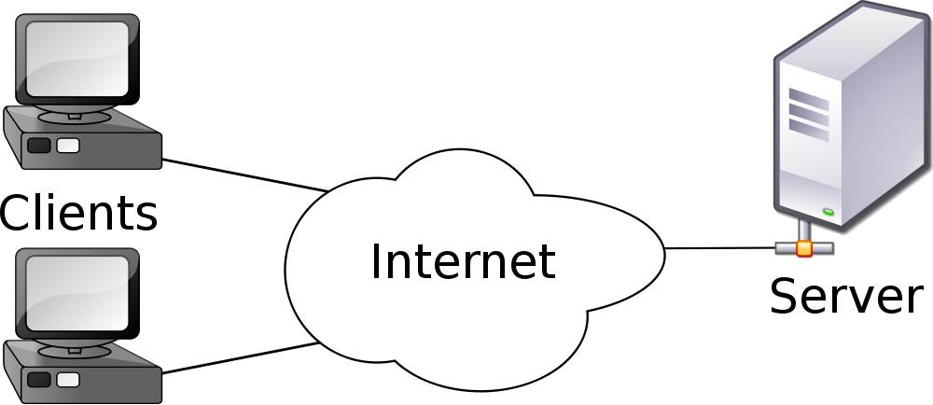
AJAX
How does AJAX work ?
Step 1 : the client loads a web page
Step 2 : You want to update / change a section of
the page and so make a request to server
Step 3 : The server will receive the request,
process it and return the response.
Step 4 : The client will receive the response and
update the necessary section

Slide 3
AJAX
Installing Server on Local Machine
We need a Server to Make AJAX Call to
We Will Install Something called as XAMPP
XAMPP will install Apache Server , MySQL DB and PHP
One Installer Installs several Module
Its available for Windows, Mac and Linux
Lets see how to get XAMPP

Slide 4
AJAX
GET vs POST Request
GET carries data inside URL Whereas POST carries data as message
Server Page URL : http://localhost/server_page.php
GET Ex. http://localhost/server_page.php?searchterm=olympics
POST Ex. http://localhost/server_page.php and message with content searchterm=Olympics
GET less secure as compared to POST
GET has limitation on size of data that can be sent in request
GET request are easier to bookmark
GET and POST both has their Advantages and Disadvantages

Slide 5
AJAX
AJAX In Javascript
STEP 1:
The first step is client loads a web page
In order to let a client load a web page, lets first create a regular html page
STEP 2 , 3 and 4:
Making a request to Server
Receiving response from server
Updating the Web Page

Slide 6
AJAX
AJAX In Javascript
We will use object XMLHttpRequest to interact with server
Properties and method of XMLHttpRequest :
readyState : it is used to determine the current status of the request
0: request not initialized by client yet 1: connection is established with the server 2: request is received by the server 3: server is processing request 4: response is ready and received at client end
2) status : it specifies if request was successful or not
200: OK i.e. request was successful
404: page was not found
3) Onreadystatechange : it holds a function which runs everytime the value of readyState changes
4) open( method , server url , asynchronous )
5) send() for GET Method or send( data ) for POST method

Slide 7
AJAX
AJAX In Javascript
We use object XMLHttpRequest to receive response from server as well
Properties and method of XMLHttpRequest :
responseText: This contains the response from server as text
responseXML : This receives the response from server as XML

Slide 8
AJAX
Request to Server , Receiving Response and Updating the Page
We will use object XMLHttpRequest to interact with server
var http = new XMLHttpRequest();
http.onreadystatechange = function(){
if( http.readyState == 4 && http.status == 200 ) {
// Write some code to change / update the web page
}
};
http.open( "GET" , “some_server_url" , true );
http.send();

Slide 9
AJAX
AJAX In Jquery
Jquery is JS Library which is very convenient and has lot of functionality
In order to use jquery, you know you need to include jquery library
$.get is used for making use of GET method for request
$.post is used for making use of POST method for request
Syntax :
$.get( server_url , request_data , function ( response_data , status , XMLHttpRequest ) , dataType )
$.post( server_url , request_data , function ( response_data , status , XMLHttpRequest ) , dataType )
function will be executed only when status is a success or else not
datatype is to be set to the type of data you are expecting to get in response.
possible values of datatype are html , text , xml , json , etc.

Slide 10
AJAX
AJAX In Jquery
What if you want to run a function if there is an error ?
$.get and $.post are both great at doing AJAX but provides very less control
over the execution of AJAX
$.ajax provides a lot more functionality as compared to $.get and $.post
You can perform both GET and POST AJAX using $.ajax
Syntax :
$.ajax({
paraName1 : paraValue1 ,
paraName2 : paraValue2
})

Slide 11
AJAX
AJAX In Jquery
Lets look at some of the parameters of $.ajax
URL : It indicates the URL where request should be sent
data : data to be sent to the server
dataType : type of data to be expected in response from server
type : method type. GET or POST
beforeSend( http ) : function to run before sending of data begins
success( response_data , status , http ) : function to run on success
error( http , status , error ) : function to run when request fails
complete( http , status ) : function to run when ajax completes
Lots of parameters available to set with $.ajax for fine tuning

