Slide 1

DG INTERNS HUB | WEEK 3
Network Security Assessment
Nmap, Wireshark, vulnerability assessment and hardening on an authorized lab
Kritika Rai | DG/SEPTEMBER/CYBER/112 | Cybersecurity Intern | 21 September 2026
Notes:
Opening: this is a discover, analyze, assess, harden, verify loop on my own lab.

Slide 2
Project Objective
Find it, prove it, rate it, fix it, verify it
Discover
Investigate
Fix and prove
Find live hosts and exposed services with Nmap (-sn, -sV, -O, -sS, -sU).
Capture packets with Wireshark and match them to scan results. Look for unusual patterns.
Rate findings by risk, harden the target, then re-scan to show real improvement.
Week 3 Network Security Assessment | 2

Slide 3
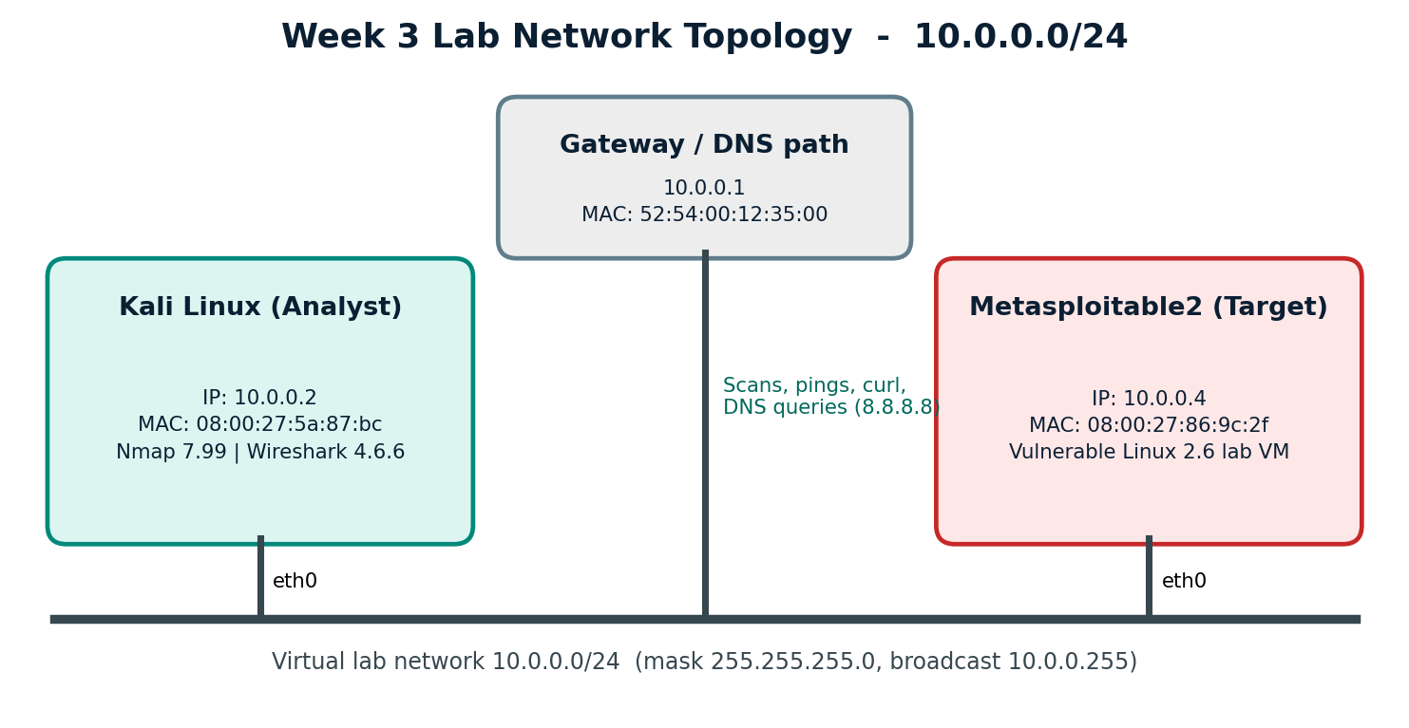
Lab Architecture
Isolated lab network 10.0.0.0/24 (authorized systems only)
Kali Linux 10.0.0.2
Metasploitable2 10.0.0.4
Gateway 10.0.0.1
DNS 8.8.8.8
Mask 255.255.255.0
Week 3 Network Security Assessment | 3

Slide 4
Tools Used
Nmap 7.99
Wireshark 4.6.6
Host discovery, port and version scans, OS detection, NSE vulnerability scripts.
Packet capture and display filters: dns, arp, icmp, tcp.flags.*
Kali + Metasploitable2
GitHub + topology diagram
Analyst VM and an authorized vulnerable target in VirtualBox.
Repo: cybersecurity-week-3-network-security. Diagram drawn with Python (matplotlib).
Week 3 Network Security Assessment | 4

Slide 5
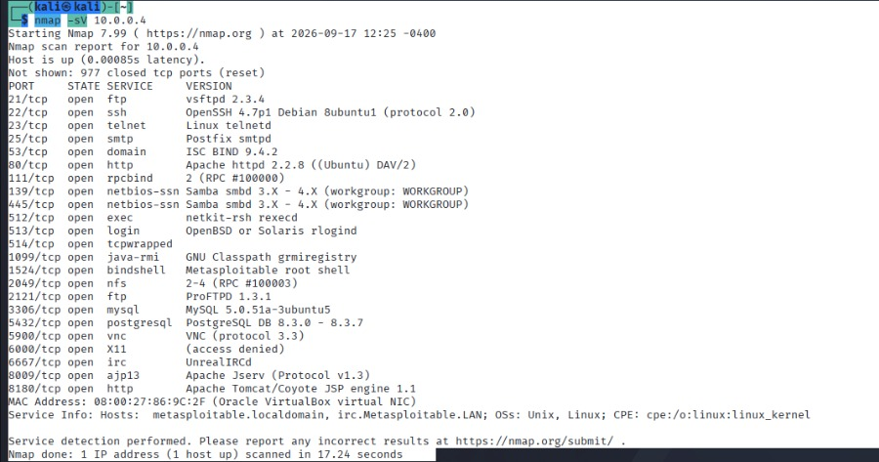
Nmap Assessment
Target 10.0.0.4 (Metasploitable2)
23
open TCP ports
(977 closed)
3 hosts up (-sn, 4.74 s)
OS: Linux 2.6.9 - 2.6.33
UDP: 53 and 137 open
vsftpd 2.3.4, UnrealIRCd, RMI, root bind shell
Week 3 Network Security Assessment | 5

Slide 6
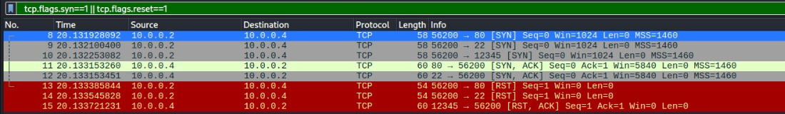
Wireshark Analysis
What an Nmap SYN scan looks like on the wire
Open port: SYN, SYN/ACK, then RST (pkts 8, 11, 13)
Closed port: SYN, then RST/ACK (pkts 10, 15)
One source port (56200), window 1024, all within about 0.3 ms
Also captured: DNS to 8.8.8.8, ICMP, ARP, HTTP handshake
Week 3 Network Security Assessment | 6

Slide 7
Security Findings
11 findings from Nmap, NSE and packet evidence
# | Finding | Evidence | Risk
1 | vsftpd 2.3.4 backdoor (21) | NSE VULNERABLE, id returned uid=0 | Critical
2 | Root bind shell (1524) | -sV: Metasploitable root shell | Critical
3 | UnrealIRCd (6667) | -sV; version not confirmed | High
4 | Java RMI registry (1099) | NSE rmi-vuln-classloader | High
5 | Telnet + r-services (23, 512-514) | Open, clear text | High
6 | Default login + old web apps (80) | msfadmin/msfadmin, DVWA, phpMyAdmin | High
7 | MySQL / PostgreSQL exposed | 3306, 5432, very old versions | High
8-10 | POODLE, SMB/NFS, VNC/X11/old SSH+BIND | NSE and -sV output | Medium
Week 3 Network Security Assessment | 7

Slide 8
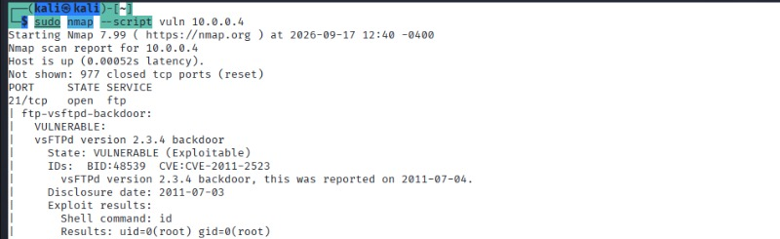
Vulnerability and Risk Assessment
Severity is explained in the report, never assigned without reasoning
Nmap --script vuln: vsftpd 2.3.4 backdoor, command id returned uid=0 (root)
Critical: remote root access, no login needed
High: confirmed or very likely compromise
Medium: needs extra conditions
Low: uncertain state, small impact (tftp)
Week 3 Network Security Assessment | 8

Slide 9
Hardening Performed
6 changes on the target (3 required)
inetd services off
vsftpd disabled
ProFTPD stopped
telnet, shell, login, exec, ingreslock commented out.
xinetd disable = yes, port 21 gone.
Second FTP server (2121) stopped.
Samba stopped
RMI killed
UnrealIRCd killed
nmbd and smbd off (139, 445).
rmiregistry process stopped (1099). Not persistent.
Process stopped (6667). Not persistent.
Week 3 Network Security Assessment | 9

Slide 10
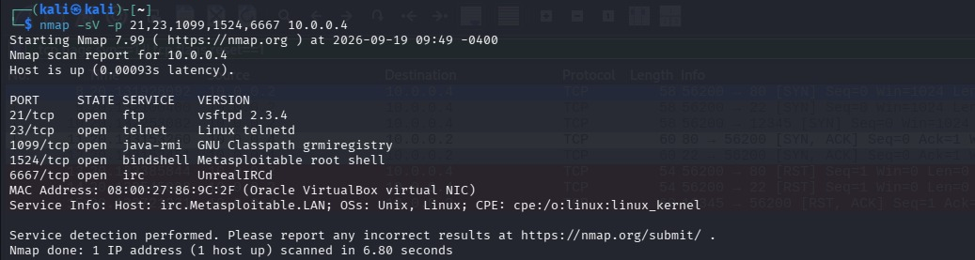
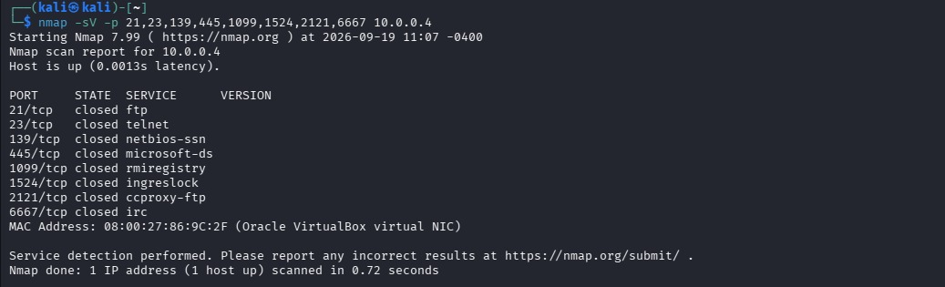
Before vs After
Same scan, run before and after hardening
BEFORE (09:49): ports open
AFTER (11:07): all closed
8 ports confirmed closed: 21, 23, 139, 445, 1099, 1524, 2121, 6667 (about 35% fewer). 512-514 disabled but not re-scanned.
Week 3 Network Security Assessment | 10

Slide 11
Recommendations
1
Retire or patch old systems (15-year-old software)
2
Remove unneeded services; bind databases to localhost
3
Default-deny firewall (ufw or iptables), allow only needed ports
4
Use SSH, SFTP and HTTPS; change default credentials
5
Make fixes permanent (disable at boot), re-scan, alert on SYN bursts
Week 3 Network Security Assessment | 11

Slide 12
Conclusion
23 exposed ports and 2 Critical flaws found
Wireshark confirmed exactly what Nmap did
6 fixes applied, 8 ports verified closed
Next: full re-scan, permanent service removal, firewall
Find it. Prove it. Fix it. Verify it.

