Slide 1
Web Security & Vulnerability Testing
VAPT Basics: hands-on with DVWA, Burp Suite and OWASP ZAP
Kritika Rai | Week 6 Assignment | 14 October 2026

Slide 2
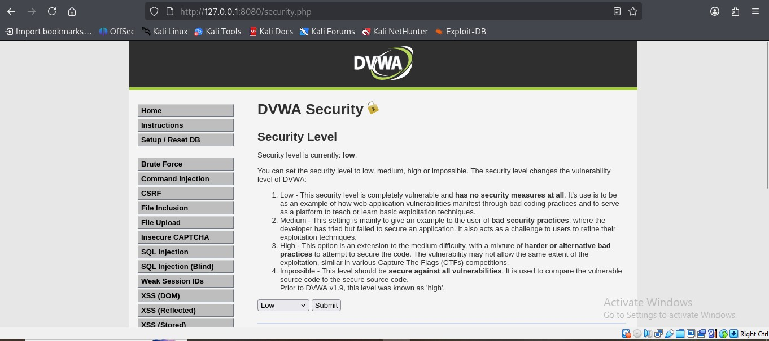
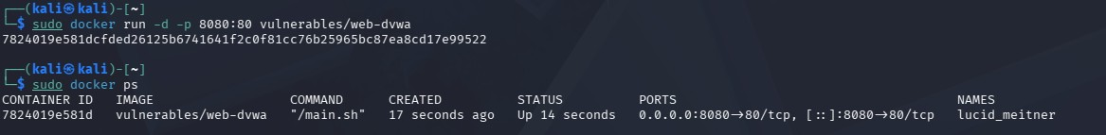
What is VAPT?
VA
PT
Assessment
Pen Testing
Scan and list known weaknesses.
Actually exploit them to see the real impact.
DVWA security level set to Low
Lab setup
DVWA in Docker on my own machine
Port 8080, login admin / password
Security level set to Low
No live or real sites were tested
DVWA container running (docker ps)

Slide 3
Tools used
Burp Suite
OWASP ZAP
Proxy between browser and site. Used to capture and read raw requests and responses.
Automated scanner. Found 9 alerts on DVWA, mostly header and cookie issues.
DVWA
Docker
Deliberately weak web app. A safe and legal target for practice.
Runs DVWA with PHP and MySQL ready. Setup in minutes, no XAMPP.

Slide 4
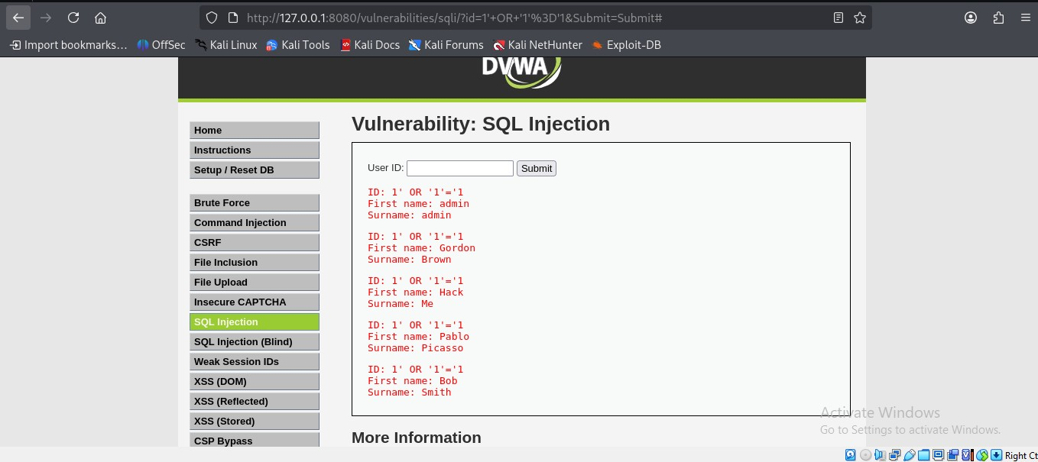
SQL Injection
Payload typed in User ID
1' OR '1'='1
Normal input returned 1 user. The payload returned every user in the table.
Cause: input goes straight into the SQL query.
Risk: High
All users returned (admin, Gordon Brown, Hack Me, Pablo Picasso, Bob Smith)

Slide 5
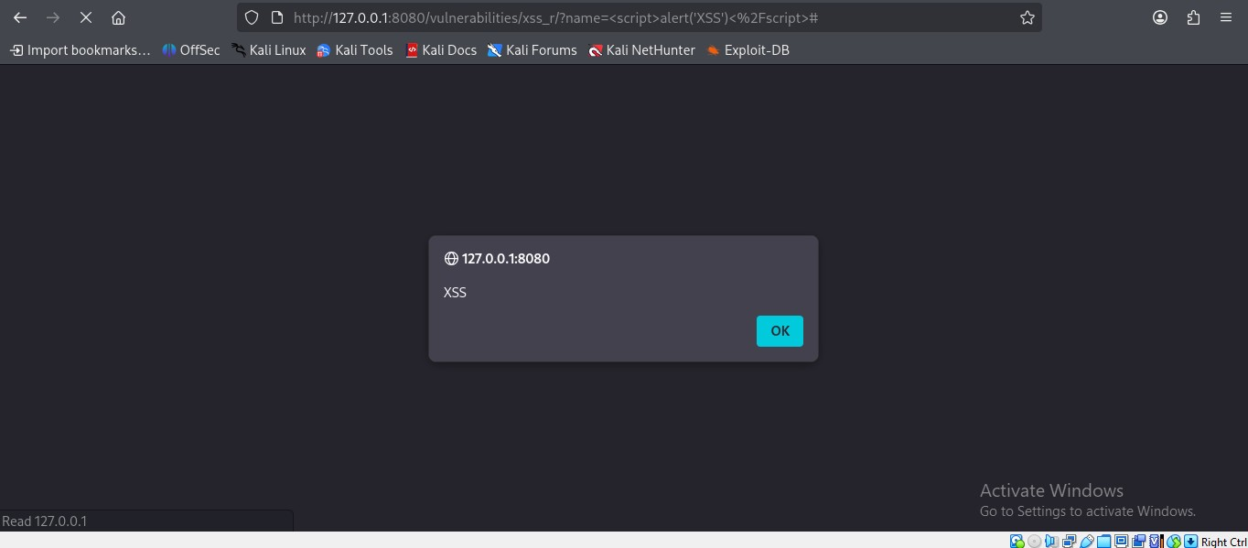
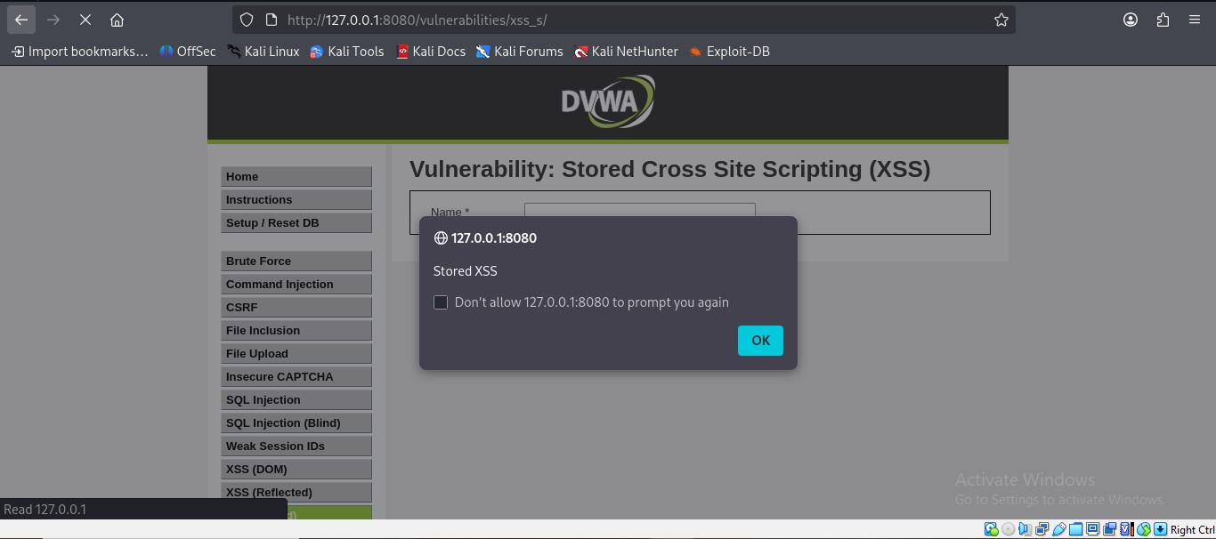
Cross-Site Scripting (XSS)
<script>alert('XSS')</script>
Reflected: popup runs from the input box. Risk: Medium
Stored: popup returns after page reload. Saved in the database. Risk: High
Stored XSS hits every visitor, not only the attacker.

Slide 6
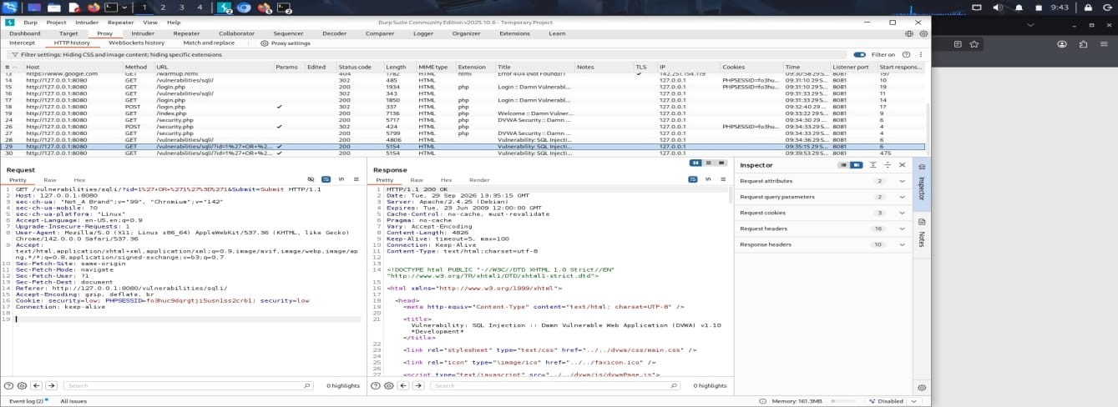
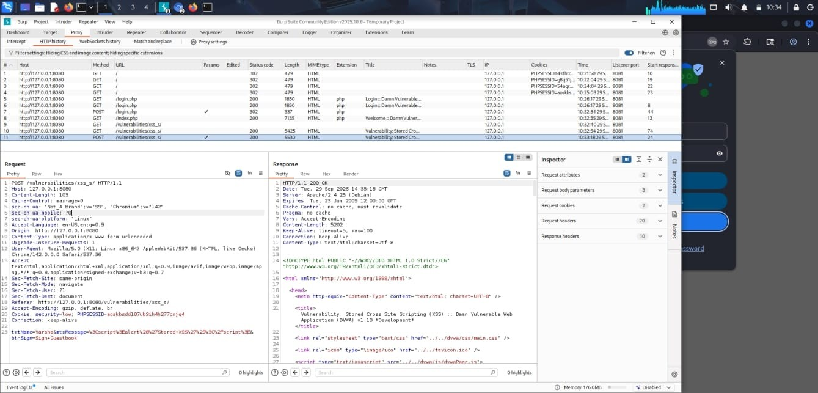
Requests captured in Burp Suite
SQLi: GET request with encoded payload in the id parameter
Stored XSS: POST request carrying the script in the message field
Burp shows exactly what the app receives. The server never filtered the payload, and it sent a normal 200 OK back.

Slide 7
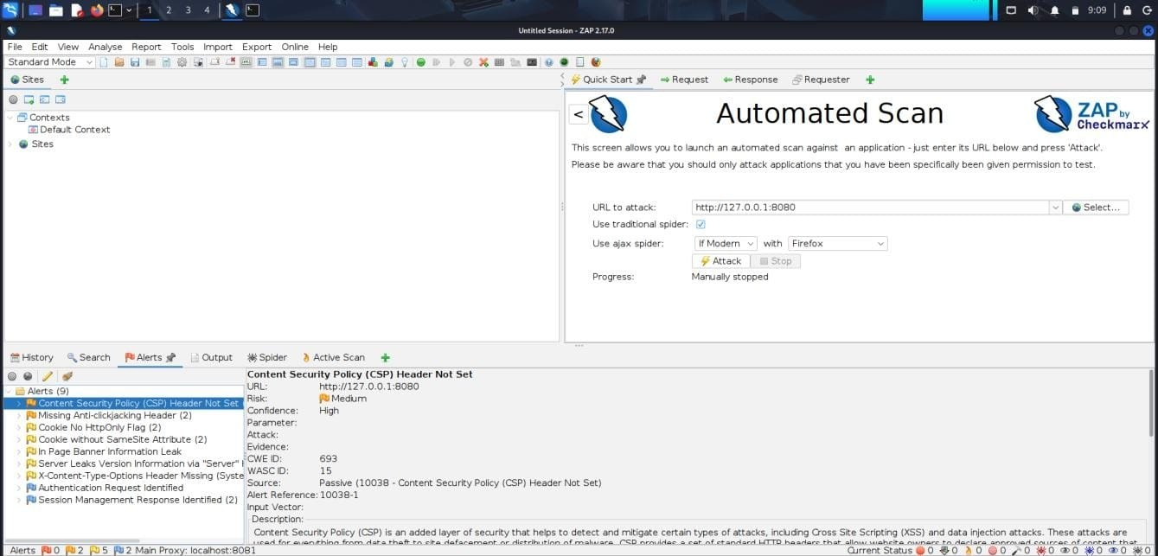
OWASP ZAP scan
0
High
2
Medium
5
Low
2
Info
9 alerts: missing CSP and anti-clickjacking header, cookie flags, server version leak.

Slide 8
Findings and risk levels
Finding | Where | Risk
SQL Injection | User ID field | High
Stored XSS | Guestbook message | High
Reflected XSS | name parameter | Medium
CSP header missing | All pages | Medium
No anti-clickjacking header | All pages | Medium
Cookie without HttpOnly / SameSite | PHPSESSID | Low
Server version leak | Server header | Low

Slide 9
How to prevent these
SQL Injection
XSS
Prepared statements. Server-side validation. Least-privilege DB account.
Encode output. Add a CSP header. Set HttpOnly cookies.
Broken Auth
Misconfiguration
Strong passwords, lockout, MFA, new session ID after login.
Add security headers. Hide versions. Patch often. Rescan regularly.
Main lesson: never trust user input.

