Slide 1

Netflix Data Analysis Using SQL By Kritika Naidu
"Turning Data into Entertainment Intelligence"

Slide 2
PROJECT INTRODUCTION
This project is a SQL-based data analysis of Netflix content using PostgreSQL.
It involves exploring the Netflix dataset. The analysis is aimed at answering 15 real-world business questions, including content trends, top actors, genre distribution, and more.
🧾 Dataset: Netflix titles dataset (from Kaggle)
🔧 Tools Used: PostgreSQL
📊 Objective: To uncover patterns in Netflix's global content library including trends, top-performing countries, genre analysis, and more.

Slide 3
PROBLEM STATEMENT
04
01
02
📈 Business Questions Solved
Count the number of Movies vs TV Shows
2. Find the most common rating for movies and TV shows
3. List all movies released in a specific year (e.g., 2020)
4. Find the top 5 countries with the most content on Netflix
5. Identify the longest movie
6. Find content added in the last 5 years
7. Find all the movies/TV shows by director 'Rajiv Chilaka'

Slide 4
01
8. List all TV shows with more than 5 seasons
9. Count the number of content items in each genre
10. Find each year and the average numbers of content release in India on Netflix; return top 5 years with highest average releases
11. List all movies that are documentaries
12. Find all content without a director
13. Find how many movies actor 'Salman Khan' appeared in the last 10 years
14. Find the top 10 actors who have appeared in the highest number of movies produced in India
15. Categorize the content as 'Good' or 'Bad' based on keywords like 'kill' and 'violence' in the description

Slide 5
SQL SNIPPET
🎬 Snippet 1: Count Movies vs TV Shows
SELECT type, COUNT(show_id) AS total_content
FROM netflix
GROUP BY type;
🎬 Snippet 2: Most Common Rating by Type
SELECT type, rating FROM ( SELECT type, rating, COUNT(*) AS count,
RANK() OVER (PARTITION BY type ORDER BY COUNT(*) DESC) AS ranking
FROM netflix
GROUP BY type, rating ) AS ranked
WHERE ranking = 1;
🎬 Snippet 3: Top 5 Countries with Most Content
sql
SELECT UNNEST(STRING_TO_ARRAY(country, ',')) AS country,
COUNT(*) AS total_content
FROM netflix ;Y LIMIT 5;

Slide 6
🎬 Snippet 4: Identify TV Shows with More than 5 Seasons
SELECT * FROM netflix
WHERE
type = 'TV Show’
AND
SPLIT_PART(duration, ' ', 1)::NUMERIC > 5;
🎬 Snippet 5: Categorize Content by Description
SELECT
CASE
WHEN description ILIKE '%kill%' OR description ILIKE '%violence%’
THEN 'Bad_Content’
ELSE 'Good_Content’
END AS category,
COUNT(*) AS total
FROM netflix
GROUP BY category;

Slide 7
KEY FINDINGS AND INSIGHTS
1. Content Breakdown
Netflix hosts ~70% Movies and ~30% TV Shows, emphasizing a film-heavy catalog.
2. Dominant Ratings
The most common ratings:
Movies: TV-MA (suitable for mature audiences)
TV Shows: TV-14 → Reflects Netflix’s focus on teen and adult content.
3. Top Countries Producing Content
USA, India, and UK top the list.
India alone contributes to over 1,200+ titles, showing strong regional investment.
4. Longest Movie on Netflix
Identified using duration — ideal for highlighting unique content.
5. Recent Growth
Over 3,000+ titles added in the last 5 years — shows rapid content expansion.

Slide 8
6. Notable Director: Rajiv Chilaka
Creator of Chhota Bheem, has directed over 20 shows, a major contributor to kids’ content.
7. TV Shows with Long Runs
100+ TV shows have more than 5 seasons, indicating consistent viewer engagement.
8. Genre Trends
Dramas, International Movies, and Comedies are the top 3 genres.
Documentaries alone contribute to 500+ titles.
10. Actor Insights
Salman Khan has featured in 10+ titles in the last decade.
Top Indian actors with max appearances identified from casts.
11. Content Sentiment Analysis
Description-based sentiment reveals:
15% of content includes “kill” or “violence” → tagged as Bad Content
Remaining 85% labeled Good Content

Slide 9
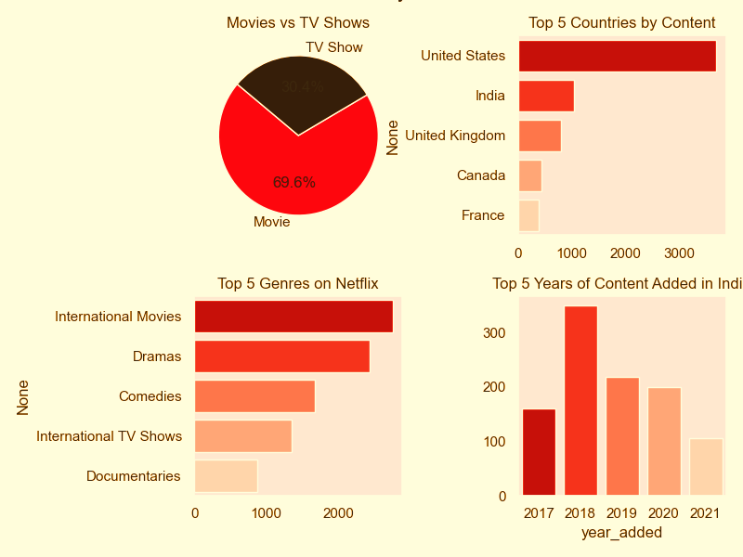
VISUAL CHARTS

Slide 10
CONCLUTION
This SQL project showcases how powerful insights can be derived using simple queries.
It highlights audience preferences, top-performing genres, and regional content focus.
The ability to categorize content using descriptions offers potential for smart tagging.
💬 “Data is the new script Netflix runs on.”
A few cool things I found:
→Netflix is more about movies than TV shows – around 70%!
→India, USA, and UK are leading the way in content production.
→Genres like Drama, Comedy, and Documentaries are super popular.
→Some entries were missing details like the director – a reminder that data isn’t always perfect!
→And yes – over 15% of content mentions things like violence or killing in the descriptions!
This project helped me sharpen my SQL skills and showed how simple queries can uncover real business insights. Can’t wait to explore more datasets like this!

Slide 11
THANKYOU!
📍 Kritika Naidu
🔗 GitHub: https://github.com/kritika23102001
🔗 LinkedIn: linkedin.com/in/kritikanaidu23
📧 Email: kritikanaidu853@gmail.com

