Slide 1
## Project: Heart Diseases Prediction Model
KRITIKA GUPTA (TEAM BUG BYTE)

Slide 2
## Project objective
The goal of this project is to build a model that can predict the probability of heart disease occurrence, based on a combination of features that describes the disease. In order to achieve the goal, we used data sets that was collected by Cleveland Clinic Foundation in Switzerland.
The dataset used in this project is part of a database contains 14 features from Cleveland Clinic Foundation for heart disease. The dataset shows different levels of heart disease presence from 1 to 4 and 0 for the absence of the disease. We have 303 rows of people data with 13 continuous observation of different symptoms.
In this study, we look into different classic machine learning models, and their discoveries in diseases risks. We have developed two algorithms using linear regression and decision trees, on Cleveland dataset.

Slide 3
## Problem Statement
A set of disease-predicting parameters {Ak} k=1,2..n is decided upon based on observed correlation with disease diagnosis (heart diseases in our case), where n is the number of such parameters.
We also have a set of N patients {xi} that have been diagnosed with heart disease or not, and the dataset consists of the {Ak(xi)} parameter readings. where {wk}k=1,2..n is a set of weights for each of the n disease-predicting parameters (to be determined by fitting the dataset to the model).
The models are aiming to predict the probability that a given patient x will be diagnosed as heart disease, and predict the weights of the features on finding the probability. When our data was a small data sets, then we hope that the model will fit the data without the risk of overfitting.

Slide 4
##Dataset Description
The dataset used in this project is part of a database contains 14 features from Cleveland Clinic Foundation for heart disease [1]. The dataset shows different levels of heart disease presence from 1 to 4 and 0 for the absence of the disease. Experiments with the Cleveland database have concentrated on simply attempting to distinguish presence (values 1, 2, 3, 4) from absence (value 0). We have 303 rows of people data with 13 continuous observation of different symptoms.

Slide 5
##Features Description
Feature | Detail
Age | Age in years
Sex | 1 for male; 0 for female
Chest pain type | Value1: typical angina. Value2: atypical angina. Value3: non-anginal pain. Vlaue4: asymptomatic
Resting blood pressure | In mm hg on admission to the hospital
Serum cholesterol | In mg/dI
Fasting blood sugar > 120 mg/dI | 1 for true; 0 for false
Resting electrocardiographic results | Value0: normal. Value1: having ST-T wave abnormality (T-wave inversions and/or ST elevation or depression of > 0.05 mV). Value2: showing probable or definite left ventricular hypertrophy by Estes’s criteria
Maximum heart rate achieved | centered
Exercise-induced angina | 1 for yes; 0 for no
ST depression induced by exercise relative to rest | In mm Hg on admission to the hospital
Number of major vessels | (0-3) colored by fluoroscopy
The slope of the peak exercise ST segment | Value1: upsloping. Value2: flat. Value3: downsloping
Thallium heart scan | 3 for normal; 6 for fixed defect; 7 for reversible defect
Diagnosis heart disease (angiographic disease) | Value0: no disease. Value1: heart disease

Slide 6
## Data Exploration
Preprocess the data, to change the missing data into mean value, using simple mean imputation methods
Heart disease types discovering (0 - no disease 1,2,3,4 - types of disease by severity in ascending)
Find similarity between the types of diseases.(OUTPUT- The mild forms of disease are more similar than 4 type of heart disease and others)
Find the ranges of each feature by disease type (sex, chest_pain,blood pressure, serum_cholestoral, fasting_blood_sugar, electrocardiographic results, max_heart_rate, induced_angina, ST_depression, etc.

Slide 7
##Solution
We can consider that the person with
age > 38, Gender= man
with chest pain = 4, blood pressure > 112, serum_cholestoral > 166, fasting_blood_sugar = 0, electrocardiographic = 2, max_heart_rate > 114, ST_depression about 2, slope >=2, vessels about 1.6, thal more than 6, is the most likely have 4 type of the heart disease.

Slide 8
##Method
map dependent variable y = "diagnosis" into binary label
normalize the data
Constructing the sample set
Attribute sets decomposing
Exploratory Visualization
correlation search
Build training set and estimate the LSS parameters (Model 1)
Model Evaluation
Performance Metrics
Probability for test data calculation
Features coefficients printing
Model 2: Decision tree
Return probabilities for each feature X_s
Develop a module to combine all the above modules in a sequential manner

Slide 9
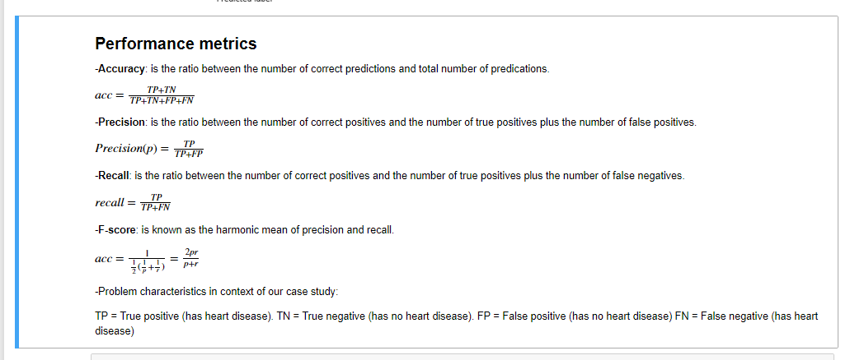
##Performance Metrics

