Slide 1
HOW TO THINK WHILE CREATING APPS IN REACT-TYPESCRIPT.

Slide 2

KRITIKA SRIVASTAVA,
FRONTEND DEVELOPER @GLOBALLOGIC

Slide 3

ABOUT ME
FRONTEND DEVELOPER (REACTJS).
HAVE A TECH BLOG ON DEV ON dev.to/kritika27.
DOG LOVER.
I LIKE TO PAINT,SKETCH,WRITE,DO PHOTOGRAPHY. I LIKE TO PICK UP NEW HOBBIES.
YOU WILL OFTEN FIND ME SENDING MEMES TO FRIENDS.

Slide 4
BEST FRIENDS…

Slide 5
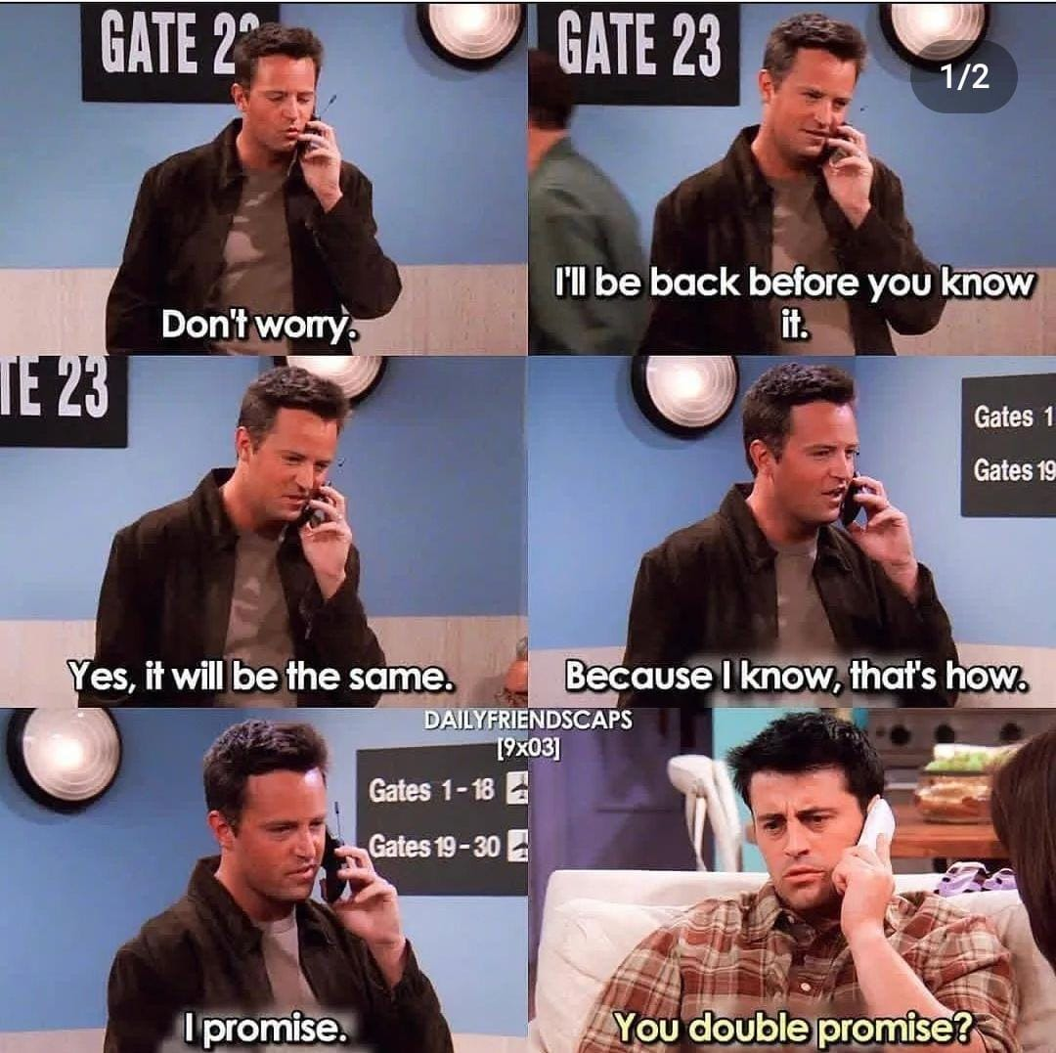

Slide 6
PETER TINGLE…

Slide 7


Slide 8
TYPESCRIPT

Slide 9
TYPESCRIPT IS A SUPERSET OF JAVASCRIPT DEVELOPED AND MAINTAINED BY MICROSOFT.
IT IS DESIGNED FOR DEVELOPING LARGE APPLICATIONS AND TRANSCOMPILES TO JAVASCRIPT.
TYPESCRIPT GIVES YOU TYPE SAFETY.
IT CAN BE USED TO DEVELOP JAVASCRIPT APPLICATIONS FOR BOTH CLIENT-SIDE AND SERVER-SIDE.

Slide 10
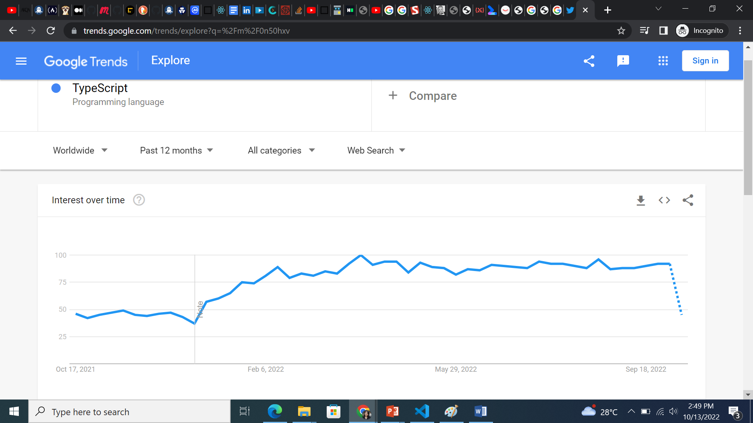

Slide 11
WHY TYPESCRIPT?

Slide 12
TYPESCRIPT IS EASY TO INTEGRATE WITH OTHER FRAMEWORKS LIKE REACTJS,NEXTJS,ETC.
IT IS A BETTER OPTION IF WE ARE WORKING IN A BIG TEAM SO THAT WE CAN AVOID ERRORS.
IT IS USED IN LARGE COMPLEX APPLICATIONS.
JS,JAVA,C# DEVELOPERS CAN LEARN IT EASILY.

Slide 13
HOW TO THINK WHILE CREATING APPS IN REACT-TYPESCRIPT.

Slide 14
ABOUT THIS TALK

Slide 15
THIS IS A BEGINNER FRIENDLY TALK AND IS FOR ALL THOSE WHO ARE INTO JAVASCRIPT, REACT, TYPESCRIPT, FRONTEND,PROGRAMMING.
THIS IS A SHORT TALK AND NOT A DETAILED ONE.
IT TALKS ABOUT THE BEST PRACTICES AND THE APPROACH WE CAN TAKE BASED ON WHAT I HAVE LEARNED FROM THE WORLD AND MY EXPERIENCE.

Slide 16
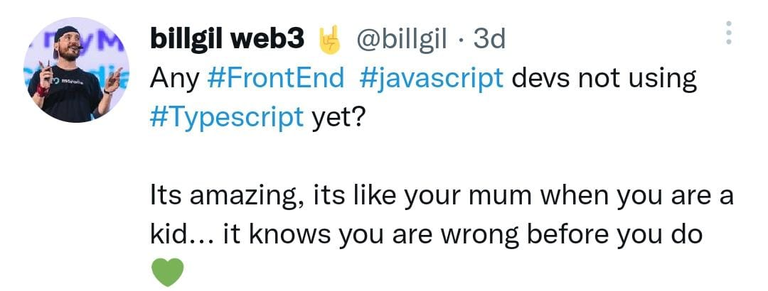

Slide 17
NEXT STEPS…

Slide 18
CREATE REACT APP USING TYPESCRIPT TEMPLATE.
npx create-react-app my-app --template typescript.
ADD REACT.FC TO YOUR FUNCTION COMPONENTS.DECLARE INTERFACE,TYPES,ADD TYPES TO YOUR DECLARED STATE,EVENTS,PROPS.

Slide 19
COMMON BEST PRACTICES

Slide 20
REACT-TYPESCRIPT BEST PRACTICES

Slide 21
WE CAN USE ‘?’ IF WE KNOW THAT WE HAVE NULL VALUE IN OUR ARRAY SO THAT IT DOES NOT GIVE ERROR LATER.

Slide 22
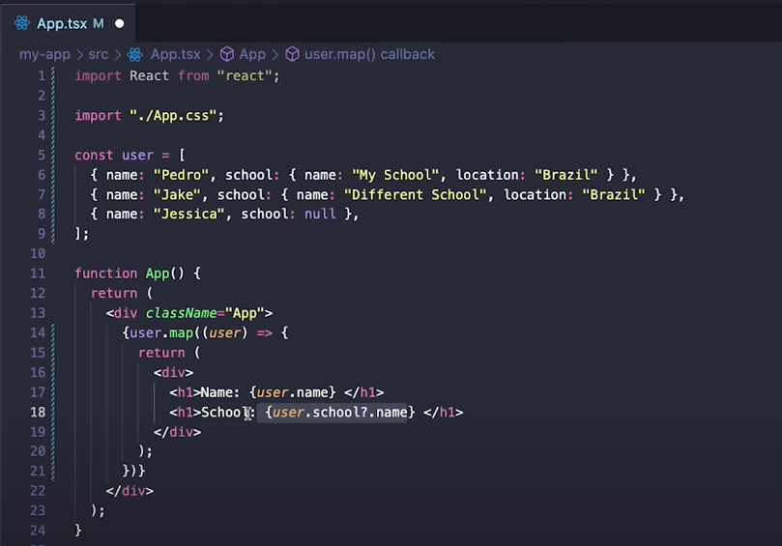

Slide 23
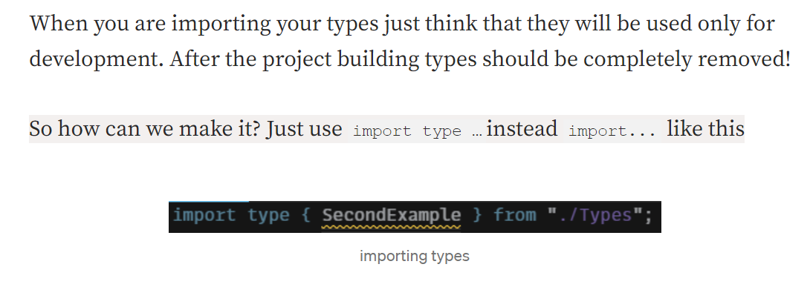

Slide 24
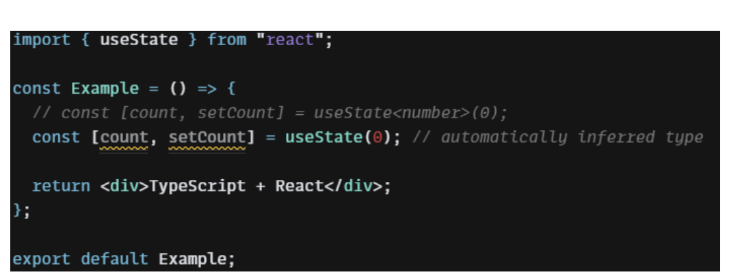
INFERRED TYPES

Slide 25
REUSE THE TYPES INSTEAD OF DECLARING IT AGAIN AND AGAIN TO AVOID CODE REPETITION.

Slide 26
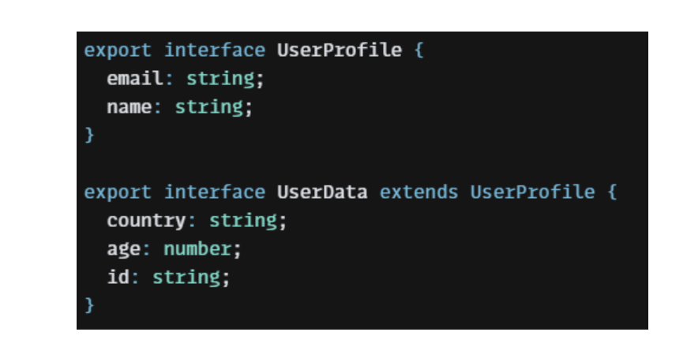

Slide 27
STILL EXPLORING..

Slide 28
ENUMERATION OR ENUM IS TYPESCRIPT DATA
THAT ALLOWS US TO DETERMINE A SET OF NAMED
CONSTANTS. USING ENUMS CAN MAKE IT EASIER TO
DOCUMENT INTENT OR CREATE A SET OF DISTINCT CASES.
GENERICS.
DECORATORS.
ADVANCED TYPES.

Slide 29
REFERENCES
https://www.freecodecamp.org/news/best-practices-for-react/
https://blog.bitsrc.io/5-strong-reasons-to-use-typescript-with-react-bc987da5d90n7
https://medium.com/codex/mastering-react-good-practices-when-using-typescript-7240cbaf4fc6
https://aglowiditsolutions.com/blog/typescript-vs-javascript/
https://www.youtube.com/watch?v=3rKyewl7wzo

Slide 30

THANK YOU
Blog dev.to/kritika27
Twitter
@kritikasri27
Email kritikasri27@gmail.com
Github kritika27

Slide 31
WOULD YOU PREFER TO IMPLEMENT TYPESCRIPT IN YOUR PROJECT?
WHY? AND WHY NOT?

