Slide 1
Adult Census Income Prediction

Slide 2
Objective
The application goal is to predict whether a person has an income of more than 50K a year or not. This is basically a binary classification problem where a person is classified into the >50K group or <=50K group.
Benefits
This project will be able to predict income of a user with almost 85% accuracy based on various factors like age, gender, occupation, education, race, work class, maritial status and hours-per-week.

Slide 3
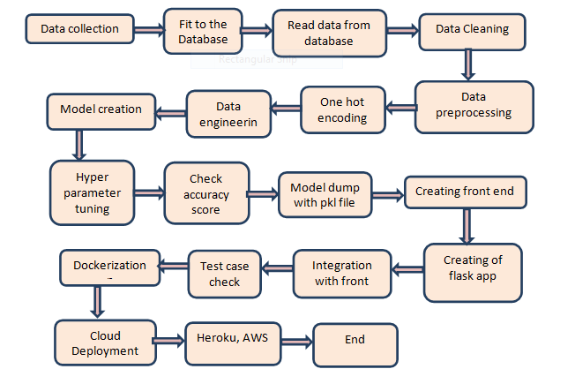
Architecture

Slide 4
Duration : It took 2 months to make this project.
Team : 3 people together made this project
Dataset : https://www.kaggle.com/overload10/adult-census-dataset

Slide 5
Approach
Data Collection
I have dataset of 32562 rows which includes all the parameters required to predict the income. The data is available in a CSV file format and it’s collected from the link as per provided in the project description
Data Insertion into Database
a. Database Creation and connection - Create a database with Cassandra cloud version and connect to the database.
b. Insert the user input in data base and store it database is work as a hidden API in entire project.
Export Data from Database
Take the user input and store in Cassandra database.
Data Cleaning
In order to fit the data to the model I need to identify incomplete, incorrect, inaccurate or irrelevant parts of the data and then replacing, modifying, or deleting the dirty or coarse data

Slide 6
Feature Engineering
In this section I try to take care of validating or replacing values with other values in the dataset. Additionally, I also take care of converting the categorical columns to numerical columns by one hot encoding and apply label encoding on label data.
Sampling
Here dataset is unbalanced so I try random oversampling to balance the data.
Model Building
After the completion of the above process I split the dataset into test and train. I use various classification algorithm like Decision trees, Random Forest, K-NN, Bagging, XgBoost, ExtraTree classifier and validate the accuracy. Finally I select the best algorithm and check the accuracy on train and test data. I used the metrics which validates the variance from model prediction to ground truth.

Slide 7
Hyperparameter Tuning
Here I have used Randomized Search CV for selection of the best parameters to reduce overfitting criteria. Along with this I have used k fold cross validation technique for training of the model and finally got 84% accuracy.
Model Dump with pkl file
I have saved the model using pickle.
Creation of front end
As per the required parameters for the user to predict the income I have created the front end in order to link with the Flask App. Here the styling and formatting of the html page is taken care with the CSS file.
Flask Web App
I have created a Flask Web App where I read the contents from the pickle file and made sure it linked to the html file to predict the income.

Slide 8
Dockerize
I have used dockerize technique here which helps the application to run within a docker container. It is useful to take care of the environmental variables and helps the app to run in all the platforms.
Deployment
I have deployed the app on Heroku platform but I have prepared a docker container to help user in order to deploy on other platforms as well.
Technology Used : Python, Amazon EC2, Cassandra, Flask, Html, CSS, Docker, Vscode

Slide 9
Q & A
Q1) What is the source of data?
The dataset is in csv format and there are 32562 rows and 15 columns.
Q 2) What was the type of data?
The data was the combination of numerical and Categorical values.
Q 3) What’s the complete flow you followed in this Project?
The complete flow is written in above approach section.
Q 4) How logs are managed?
Loggers are implemented in each and every module and function. All logs are being captured and recorded in a separate log file.

Slide 10
Q 5) What techniques were you using for data pre-processing?
Removing unwanted attributes
Visualizing relation of independent variables with each other and output variables
Checking and changing Distribution of continuous values
Removing outliers
Cleaning data and imputing if null values are present.
Converting categorical data into numeric values.
Scaling the data
Q 6) How training was done or what models were used?
First we split the data into train set and test set then we apply classification algorithms like SVM, KNN, Decision tree, Random forest, XgBoost and Extratree Classifier and apply hyperparameter tuning on this algorithm.
Q 7) What are the different stages of deployment?
The web app will get deployed in :
AWS
Heroku

Slide 11

THANK YOU

