Slide 1
REVENUE SCIENCE — PROOF OF CONCEPT
Revenue Quality & Leakage
Recovery Engine
Detecting revenue leakage, prioritizing which accounts to act on, and forecasting the recovery — an end-to-end analytical approach to revenue quality.
Prepared by Kritika · mahnakritika3@gmail.com · August 2026
Independent analysis, not affiliated with or endorsed by FedEx. Built entirely on public information — no proprietary, confidential, or internal FedEx data was used.

Slide 2






WHAT THIS DECK COVERS
From a business signal to a working POC
1. The opportunity
2. Root-cause analysis
Why revenue quality in low-density, e-commerce-driven shipments is a live, urgent problem — grounded in public earnings calls and industry signals.
5W framing, a 5-Whys chain, and a fishbone diagram tracing the leakage back to its structural causes.
3. The POC
4. Results & business case
A working Python pipeline — Detect → Target → Forecast — built on an illustrative, publicly-grounded synthetic dataset.
What the model finds, who it flags, and what recovery looks like over the next two quarters.
5. From POC to production
6. Key takeaways
A realistic 4-phase path to putting this on real shipment and billing data.
A summary of the problem, the approach, and the recommended path forward.
Revenue Quality & Leakage Recovery Engine — Proof of Concept
2

Slide 3



THE OPPORTUNITY
The signal: what's happening in FedEx's business right now
Four public data points point at the same underlying problem — revenue quality in low-density, e-commerce-driven shipments.
DIM-weight rules tightened
Competitors moved in lockstep
Aug 18, 2025: FedEx began rounding every fractional inch UP on all three dimensions — a direct lever to capture more revenue from light, bulky e-commerce packages.
UPS rolled out a nearly identical dimensional-rounding change around the same time — this is an industry-wide revenue-quality tactic, not a FedEx-only move.
Shipping trade press (ShipperHQ, PARCEL Industry, 3PL Center)
Shipping trade press (ShipperHQ, PARCEL Industry, 3PL Center)
“Revenue quality” is the watchword
Ground Economy volume declining
Q4 FY26 package yield was reported up 11% year over year, with company commentary attributing the large majority of that gain to base price increases rather than fuel or volume.
Ground Economy volume was reported down roughly 5% in the quarter, described as a deliberate trade of low-margin volume for margin quality.
FedEx Q4 FY26 earnings coverage (multiple financial outlets)
FedEx Q4 FY26 earnings coverage (multiple financial outlets)
Revenue Quality & Leakage Recovery Engine — Proof of Concept
3

Slide 4
ROOT-CAUSE ANALYSIS, PART 1
Framing the problem: the 5W
What
Who
When
Where
Why
Revenue leakage & yield erosion: shipments — especially low-density, “light & bulky” e-commerce packages — are billed below true cost-to-serve and target margin.
Revenue Science, Pricing, and Sales teams own the fix; Finance feels the margin impact; SME and e-commerce accounts are most exposed.
A structural, ongoing issue — acute since the e-commerce boom, now urgent given the Aug 2025 DIM rule change and the CY2026 Ground Economy volume decline.
Concentrated in the FedEx Ground / Ground Economy network, in low-density product categories (apparel, home goods) and SME/e-commerce accounts.
Static rate cards and periodic reviews can't track fast-moving package-density mix — so pricing lags reality instead of correcting it continuously.
Revenue Quality & Leakage Recovery Engine — Proof of Concept
4

Slide 5
ROOT-CAUSE ANALYSIS, PART 2
The 5 Whys: tracing leakage to its root
Why 1: Why is revenue quality eroding in e-commerce / Ground Economy?
Because many shipments are billed below their true, correctly-measured cost-to-serve.
Why 2: Why are they billed below true cost?
Because billable weight is set by static, negotiated rate terms — not continuously reconciled against actual package density.
Why 3: Why aren't rates reconciled continuously?
Because there's no scalable analytics process that monitors account-level density and margin drift and triggers action.
Why 4: Why is there no such process?
Because pricing analytics today is largely retrospective — quarterly GRIs and periodic contract reviews — not a standing statistical monitoring system.
Why 5: Why is it retrospective, not continuous?
Because closing that gap requires building exactly this capability: a revenue science function that combines shipment-level modeling, elasticity analysis, and forecasting into a repeatable, proactive process.
Revenue Quality & Leakage Recovery Engine — Proof of Concept
5

Slide 6
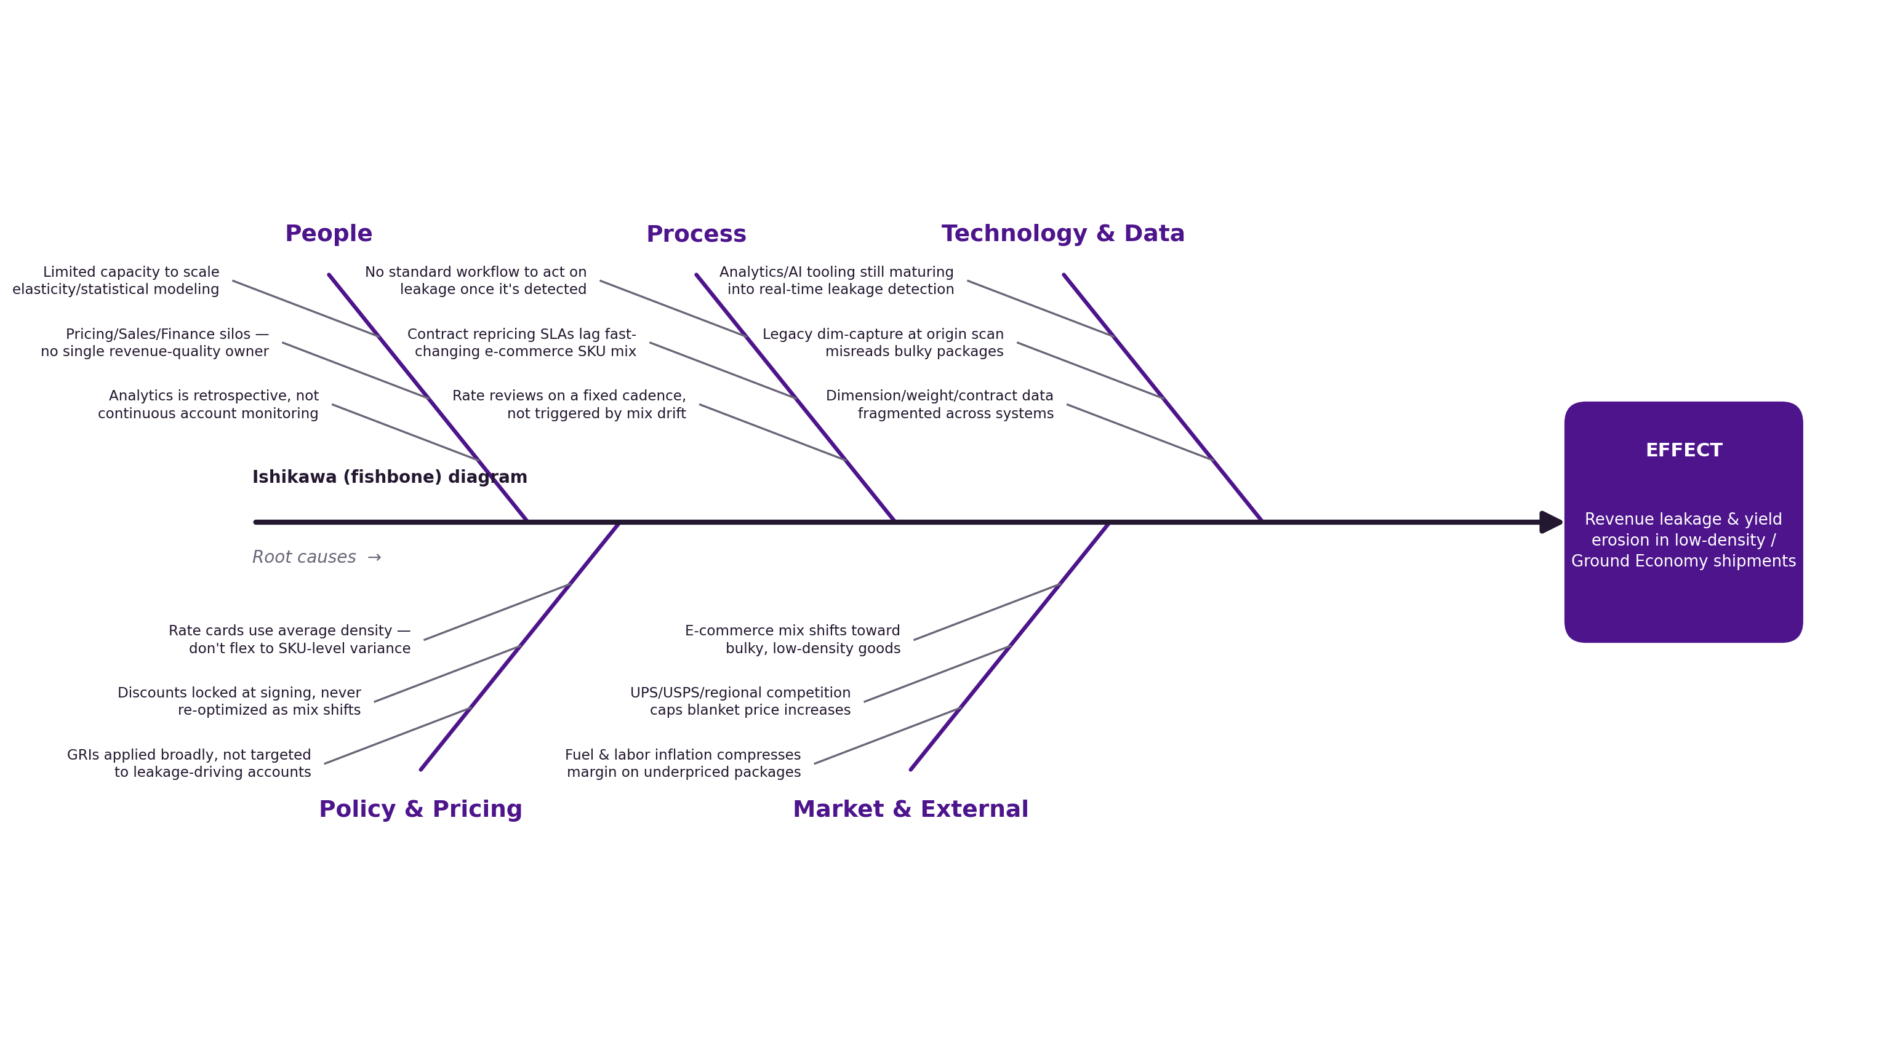
ROOT-CAUSE ANALYSIS, PART 3
Fishbone (Ishikawa) diagram
Five contributing categories, all converging on the same effect — none of them fixable by a one-time rate change alone.
Revenue Quality & Leakage Recovery Engine — Proof of Concept
6

Slide 7

THE POC, PART 1
How the POC works: Detect → Target → Forecast
A Python pipeline (pandas, scikit-learn) built on a synthetic, publicly-grounded shipment dataset — 60,000 shipments across 900 accounts, 13 months.
1. DETECT
2. TARGET
3. FORECAST
Recompute correct dimensional-weight revenue per shipment from length/width/height, and compare to what was actually billed.
Roll up to the account level; score every account on margin gap + leakage share, and size two levers: a no-risk billing fix and a capped, elasticity-aware repricing ask.
Project the leakage trend forward, and model the revenue-quality recovery curve as the fix ramps in over 6 months.
Applies FedEx's published 139 in³/lb DIM divisor
Composite risk score ranks 900 accounts
Linear trend baseline vs. intervention scenario
Models both the legacy and Aug-2025 rounding rules
Segment-level price elasticity (SME/Mid/Enterprise)
Ramped rollout curve (15% → 80% capture)
Flags the $ gap, shipment by shipment
Price increases capped 2–9%, net of modeled volume loss
Output an analyst worklist, not just a chart
Revenue Quality & Leakage Recovery Engine — Proof of Concept
7

Slide 8
RESULTS & BUSINESS CASE, PART 1
What the model finds
$72.1K
+46.2%
135
$69.6K
Leakage identified in sample
Leak $ / shipment since DIM rule change
Tier-1 “act now” accounts
Annualized recovery potential
5.4% of sample revenue
vs. prior rounding rule
35.7% of total leakage $
Levers A + B, sample scale
Monthly revenue leakage ($)
Dashed marker: Aug 18, 2025 DIM-rounding rule change
Revenue Quality & Leakage Recovery Engine — Proof of Concept
8

Slide 9
RESULTS & BUSINESS CASE, PART 2
Where it's concentrated, and who to act on first
Leakage by product category
Accounts by priority tier
Concentrated in low-density goods — as a DIM-weight billing gap would predict.
Composite risk score (margin gap + leakage share) — the top 15% of accounts carry 36% of the leakage.
Revenue Quality & Leakage Recovery Engine — Proof of Concept
9

Slide 10
RESULTS & BUSINESS CASE, PART 3
The output is a worklist, not just a chart
Top accounts by recommended recovery — this is what an analyst or account manager would actually work from.
Account | Segment | Category | Revenue | Leakage $ | Sugg. Price Δ | Recovery $
A100172 | SME | Home & Bulky | $3.3K | $1.0K | +2.7% | $1.0K
A100620 | Mid-Market | Home & Bulky | $3.7K | $914 | +4.5% | $1.0K
A100469 | SME | Home & Bulky | $3.5K | $921 | +2.5% | $957
A100809 | Enterprise | Home & Bulky | $2.9K | $800 | +6.3% | $934
A100802 | Mid-Market | Home & Bulky | $3.1K | $836 | +3.1% | $883
A100380 | SME | Home & Bulky | $4.4K | $794 | +2.6% | $842
Read this row: account A100172 (SME, Home & Bulky) is under-billed by ~$1.0K in the sample window. A capped 2.7% price move — sized to this account's own price elasticity — plus the DIM billing correction recovers essentially all of it, net of modeled volume risk.
Revenue Quality & Leakage Recovery Engine — Proof of Concept
10

Slide 11
RESULTS & BUSINESS CASE, PART 4
6-month forecast: do nothing vs. recommended action
$12.6K
cumulative recovery, 6 months (sample scale)
At FedEx's real shipment volumes — many millions of packages a day — this sample is a rounding error. That's the point: the POC's job is to prove the method (detect → target → forecast) on a small, transparent dataset, not to size FedEx's real opportunity.
The right next step is validating this pipeline on real shipment and billing data, where the same logic would surface the actual dollar opportunity.
Revenue Quality & Leakage Recovery Engine — Proof of Concept
11

Slide 12



FROM POC TO PRODUCTION
A realistic path onto real data
Phase 1 · Days 0–30
Phase 2 · Days 30–90
Phase 3 · Days 90–180
Phase 4 · Ongoing
Validate
Integrate
Pilot
Scale
Replace synthetic data with a sampled extract of real shipment/billing records; recalibrate cost & elasticity assumptions with Finance and Pricing.
Connect to the actual rating/billing systems (e.g., Teradata/Oracle); stand up account scorecards refreshed on a rolling basis, not quarterly.
Automate Lever A (billing correction) end-to-end; pilot Lever B (targeted repricing) with a Sales-approved account cohort, tracking churn vs. forecast.
Expand to additional segments/products; document the method fully so it can be run and extended by others, not just re-run as a one-off.
→
→
→
Revenue Quality & Leakage Recovery Engine — Proof of Concept
12

Slide 13
CLOSING
Key takeaways
The problem is structural, not seasonal
Static rate cards and periodic reviews can't track fast-moving package-density mix, so low-density shipments are billed below true cost-to-serve — and it compounds every rate change.
The method: Detect → Target → Forecast
A full Python pipeline (pandas, scikit-learn) — shipment-level leakage detection, composite account risk scoring, and a fitted trend forecast with a modeled intervention ramp.
The output is a worklist, not just a chart
A ranked, account-level list with two concrete levers and a capped, elasticity-aware price recommendation per account — something a team can act on directly.
It's built to be cross-functional
The fishbone analysis spans people, process, technology, policy, and market causes — the fix touches Pricing, Sales, Finance, and Ops together, not one team alone.
The next step is validation on real data
The POC's job is to prove the method on a small, transparent dataset. The path to real impact is a phased rollout — validate, integrate, pilot, scale.
Revenue Quality & Leakage Recovery Engine — Proof of Concept
13

Slide 14

Thank you
This POC is a starting point, not a finished product — the real opportunity is validating this method on actual shipment and billing data, working alongside Pricing, Sales, and Finance.
mahnakritika3@gmail.com
Full working code, synthetic dataset, and an interactive dashboard are included as supporting attachments.
Revenue Quality & Leakage Recovery Engine — Proof of Concept
14

