Slide 1
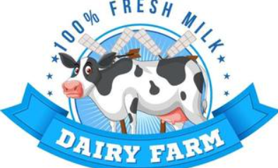
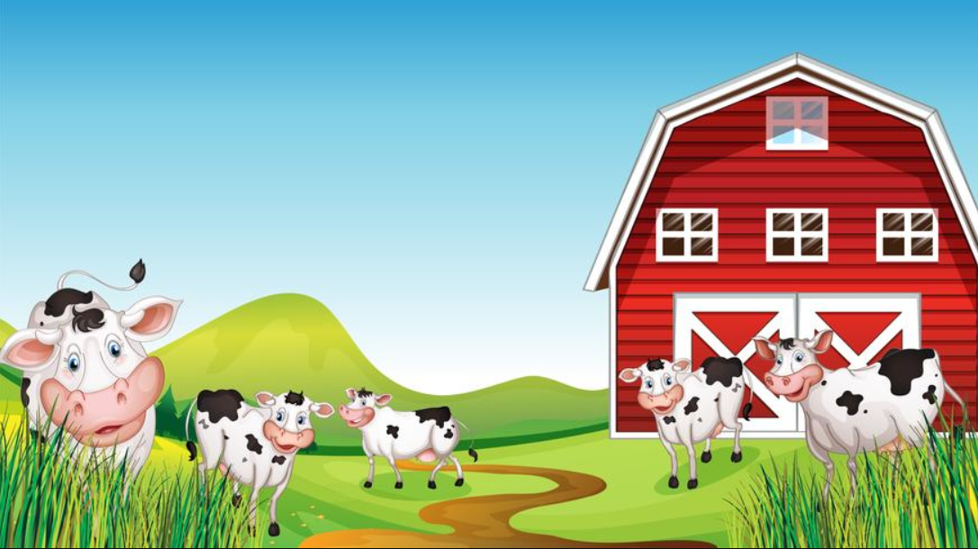
🐄 DAIRY FaRM PROJECT
.

Slide 2
📌 Project Overview
- This project is an Interactive Dairy Farm SQL Reporting System designed to analyze sales, revenue, inventory, and customer purchasing behavior using SQL queries and interactive dashboards.
- This project use data to demonstrate how SQL can be used to analyze data, answer real-world questions.
- The project focuses on transforming raw dairy farm business data into meaningful insights that help improve operational and business decision-making.

Slide 3
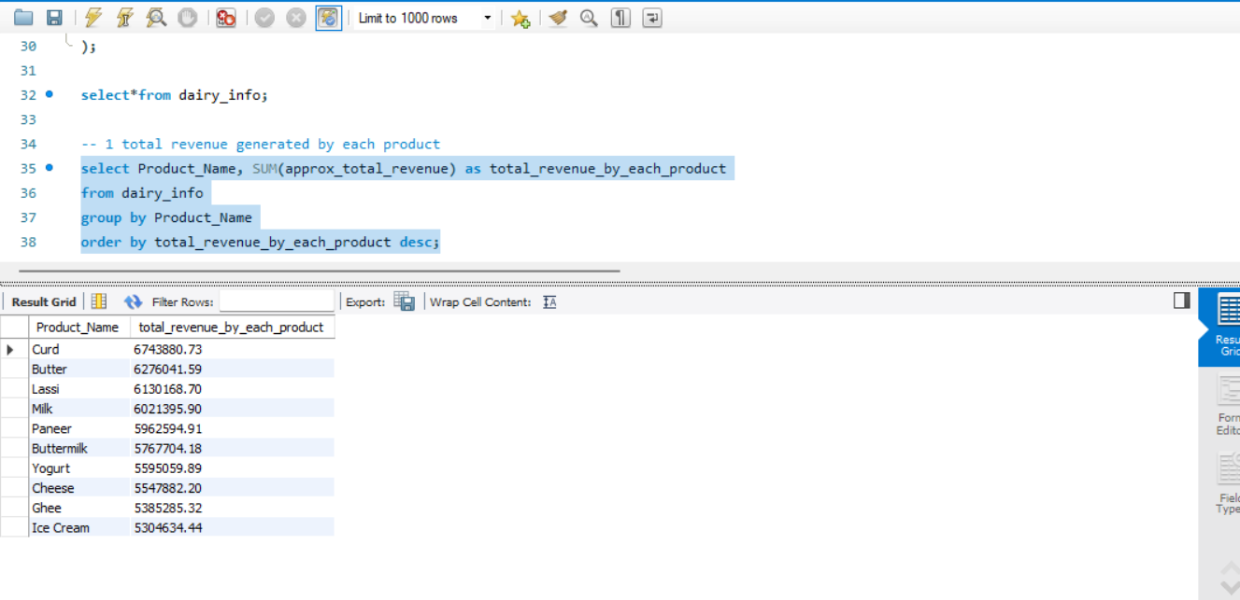
1 Total revenue generated by each product

Slide 4
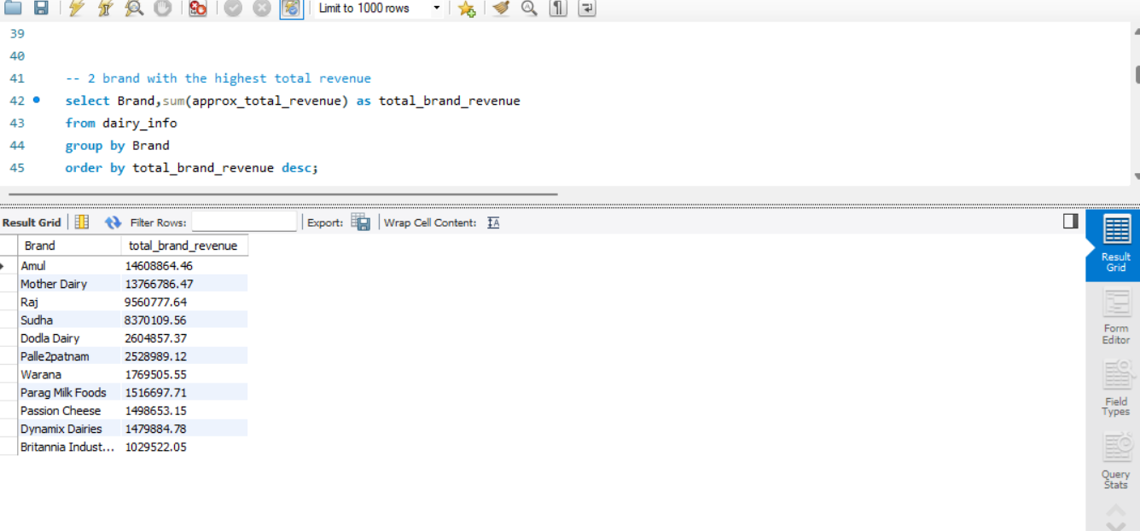
2 Brand with the highest total revenue

Slide 5
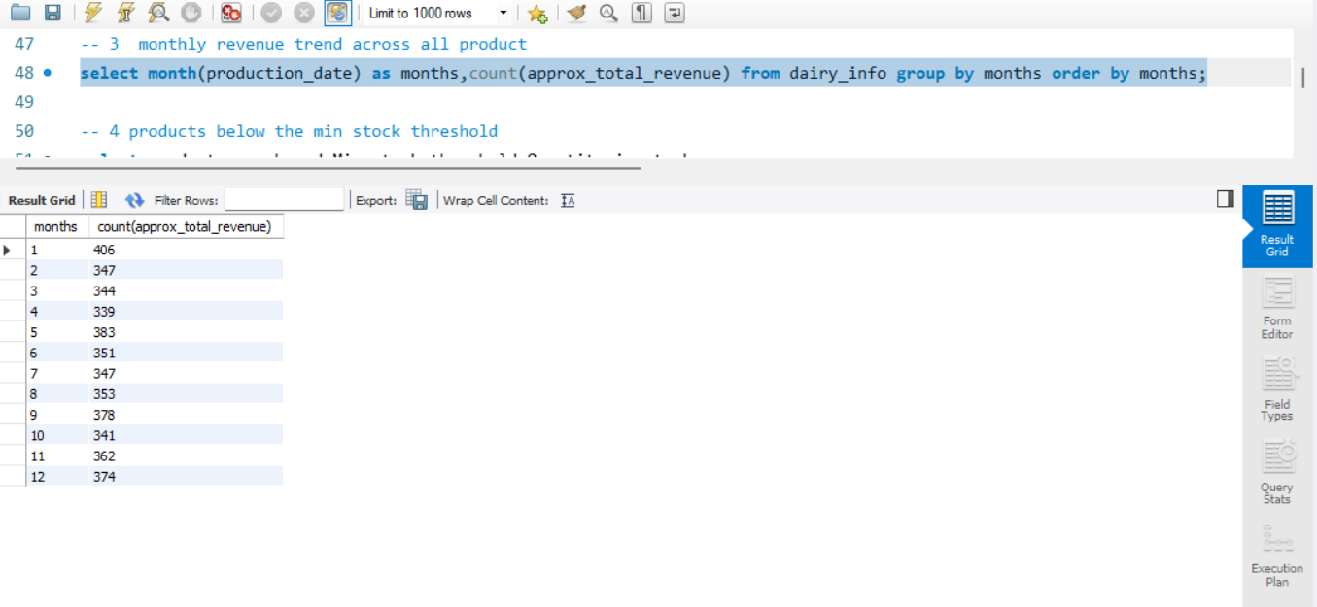
3 Monthly revenue trend across all product
1 = JANUARY
2 = FEBRUARY
3 = MARCH
4 = APRIL
5 = MAY
6 = JUNE
7 = JULY
8 = AUGUST
9 = SEPTEMBER
10 = OCTOBER
11 = NOVEMBER
12 = DECEMBER

Slide 6
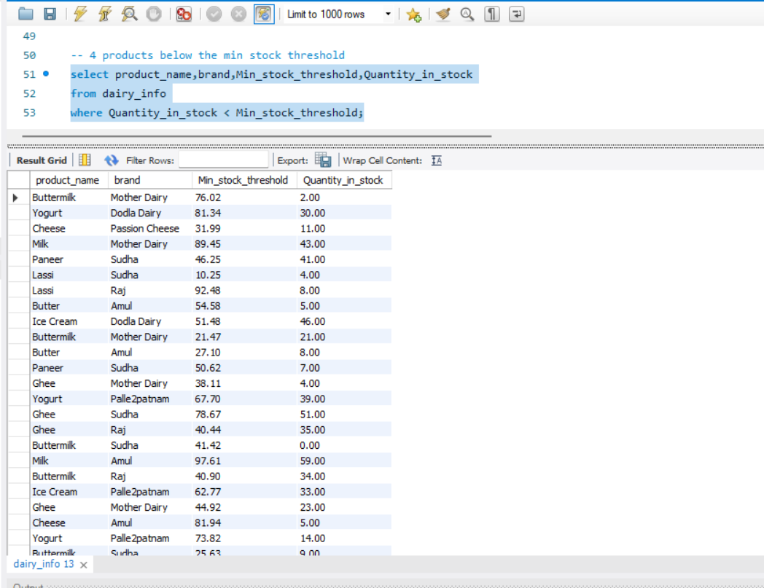
4 Products below the min stock threshold

Slide 7
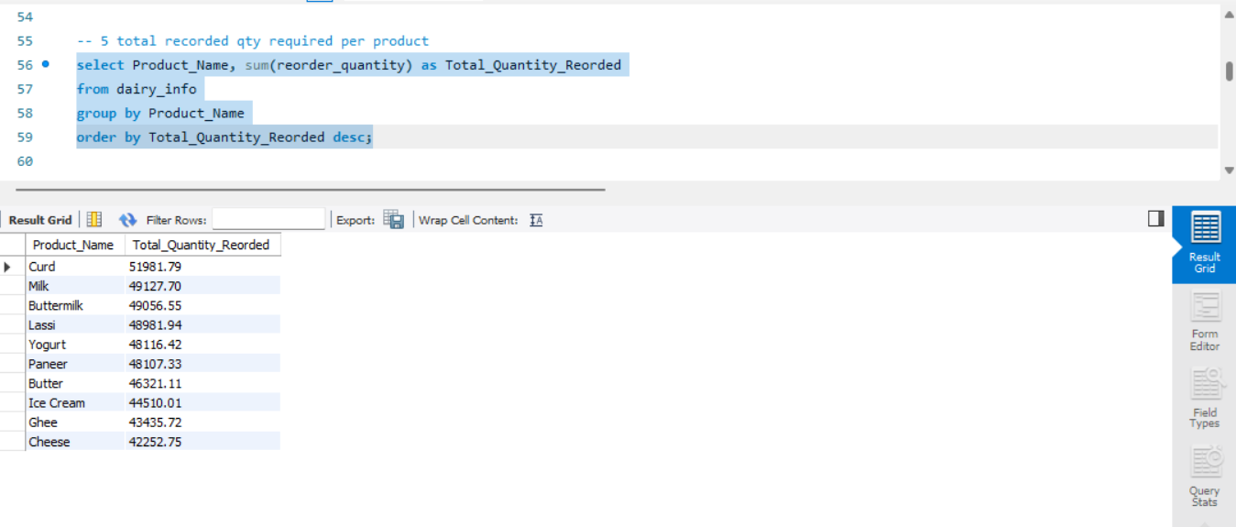
5 Total reorder qty required per product

Slide 8
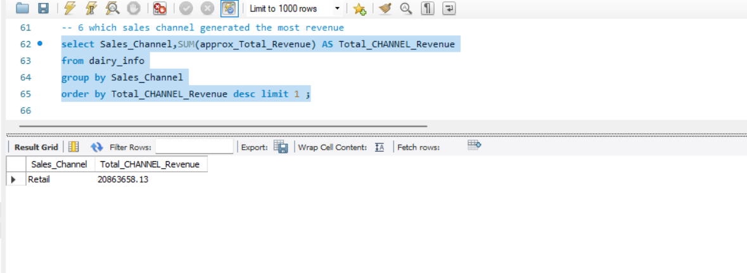
6. Which sales channel generated the most revenue

Slide 9
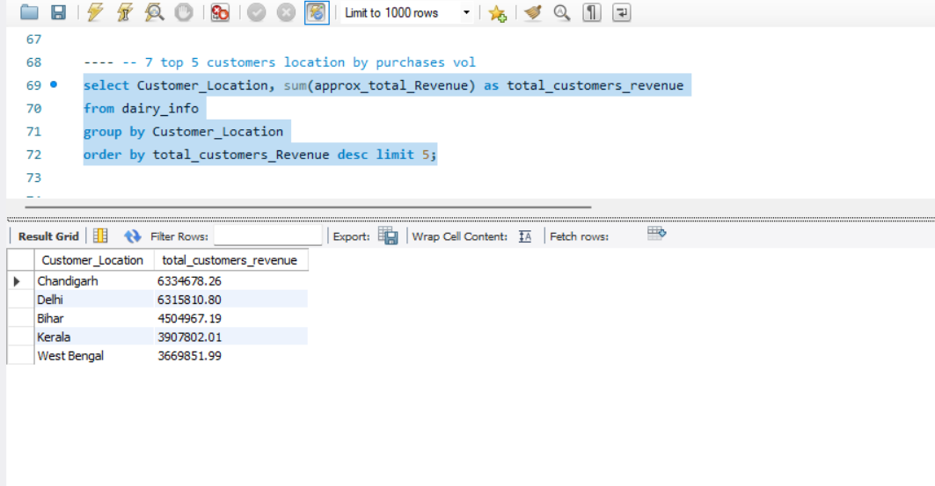
7. Top 5 customers location by purchases vol

Slide 10
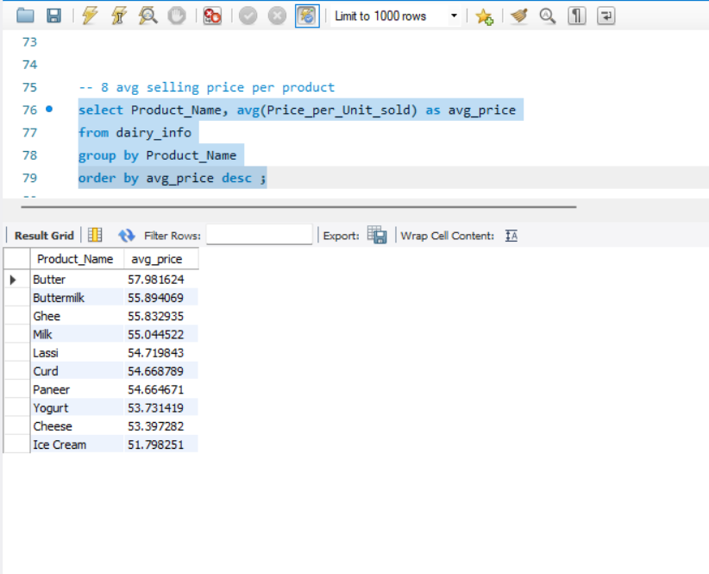
8. Avg selling price per product

Slide 11
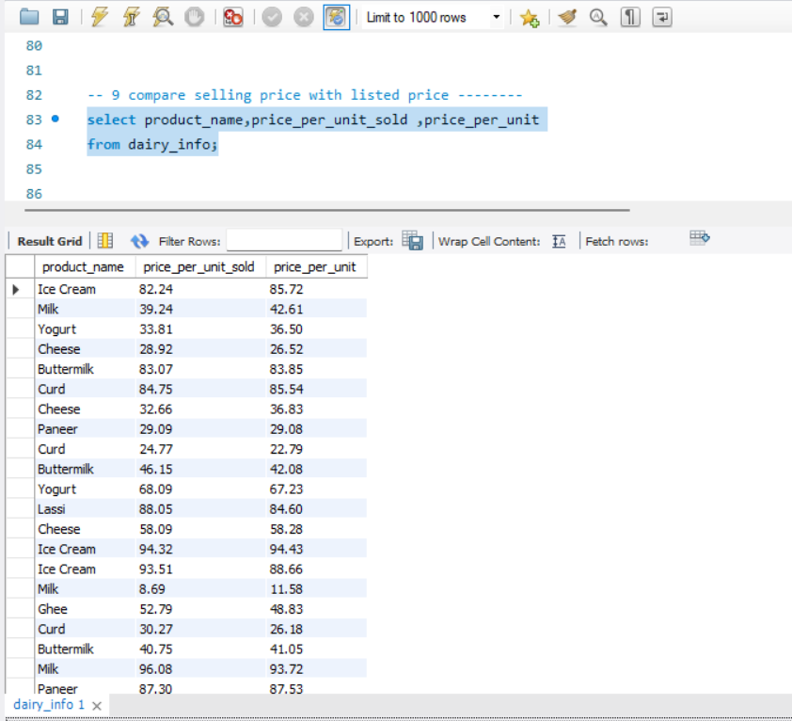
9. Compare selling price with listed price

Slide 12
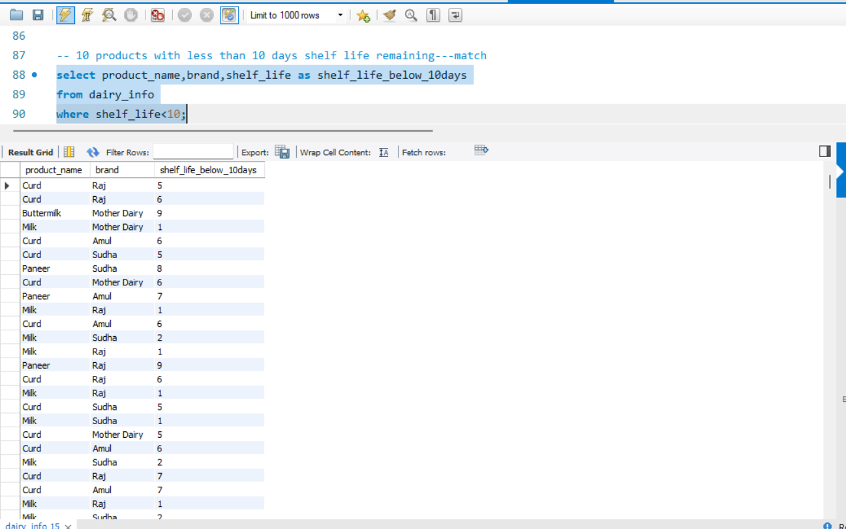
10. Products with less than 10 days shelf life remaining

Slide 13
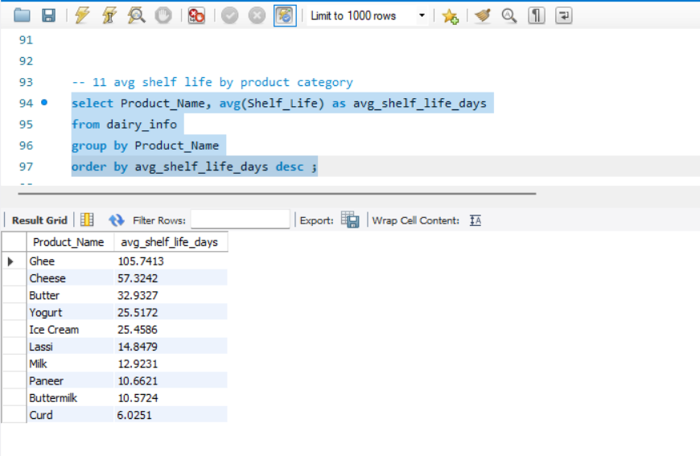
11. Avg shelf life by product category

Slide 14
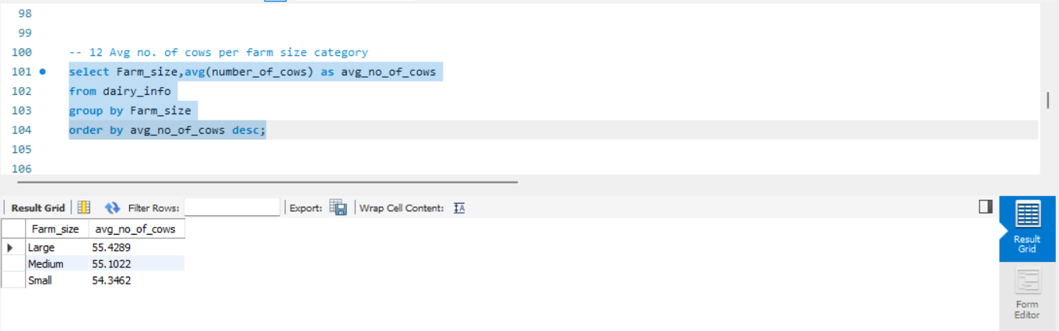
12. Avg no. of cows per farm size category

Slide 15
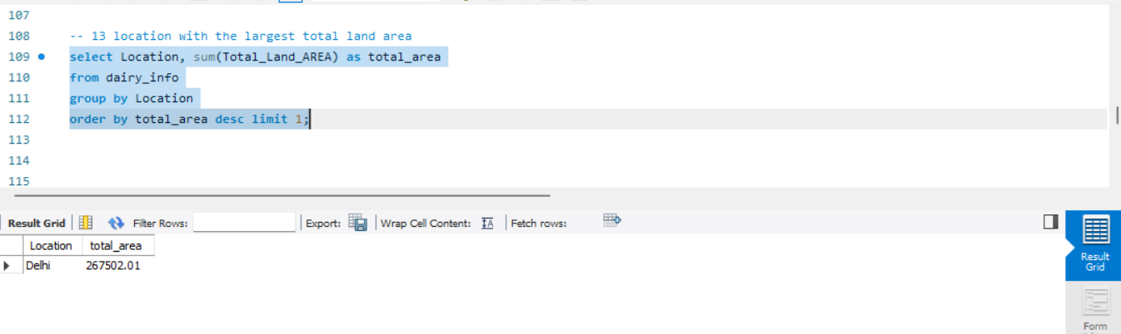
13. Location with the largest total land area

Slide 16
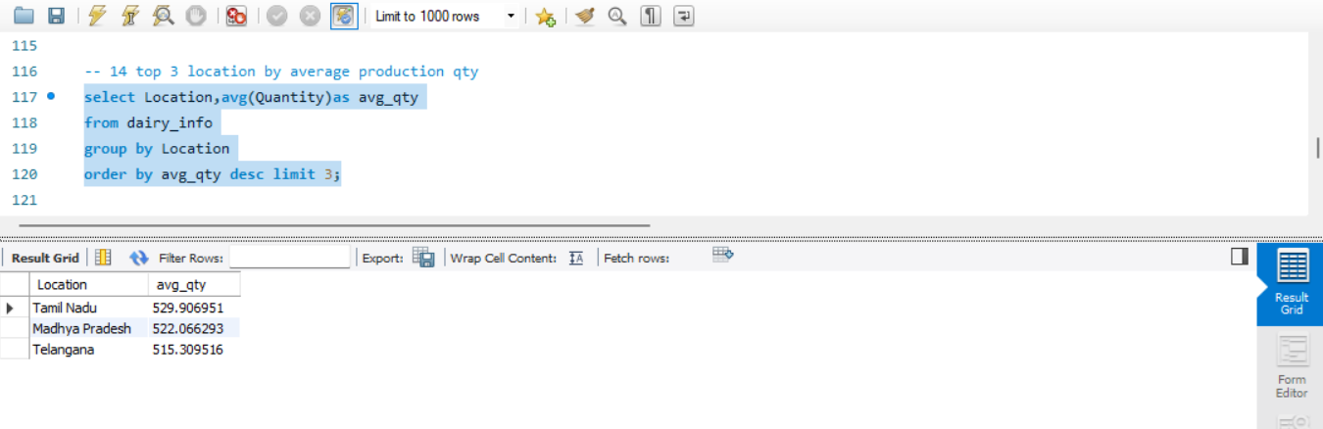
14. Top 3 location by average production qty

Slide 17
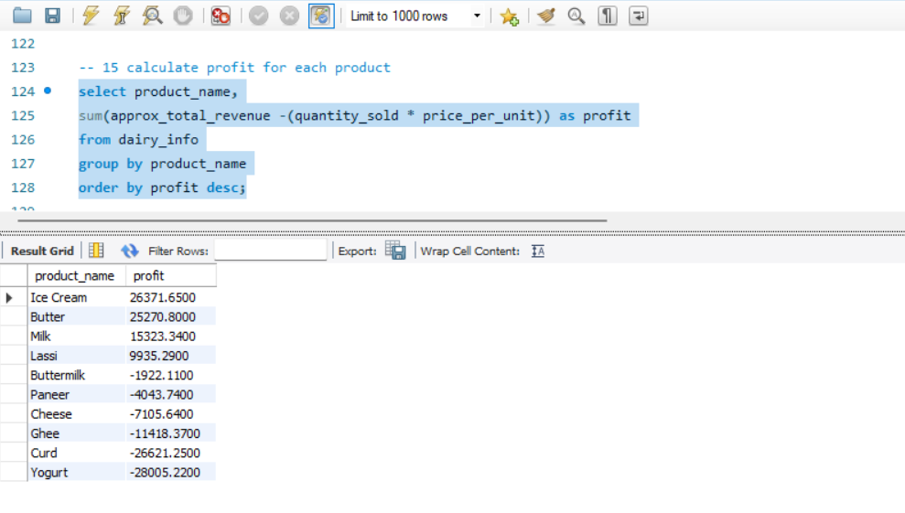
15. Calculate profit for each product

Slide 18
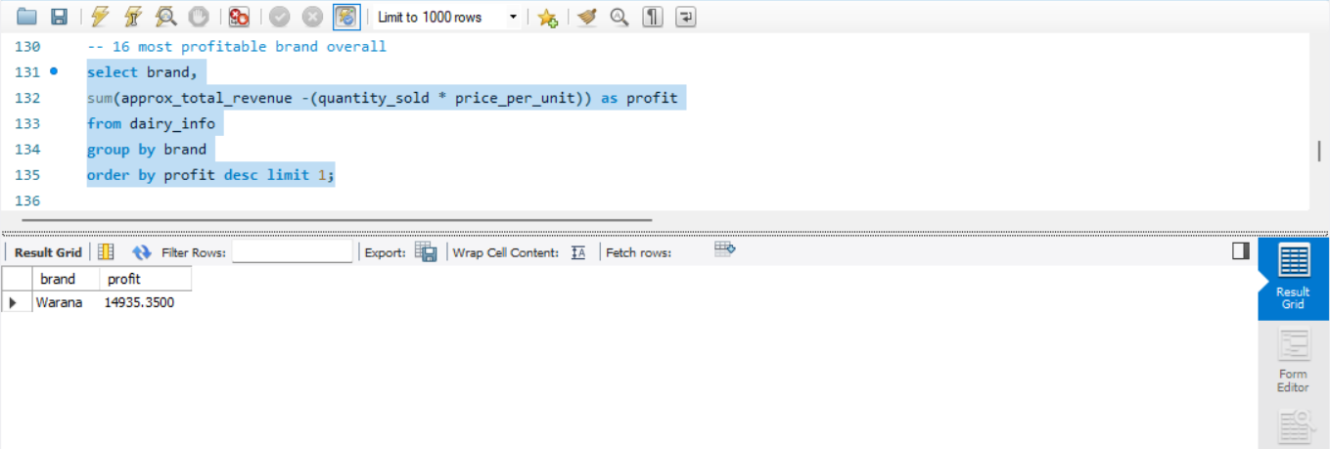
16. Most profitable brand overall

Slide 19
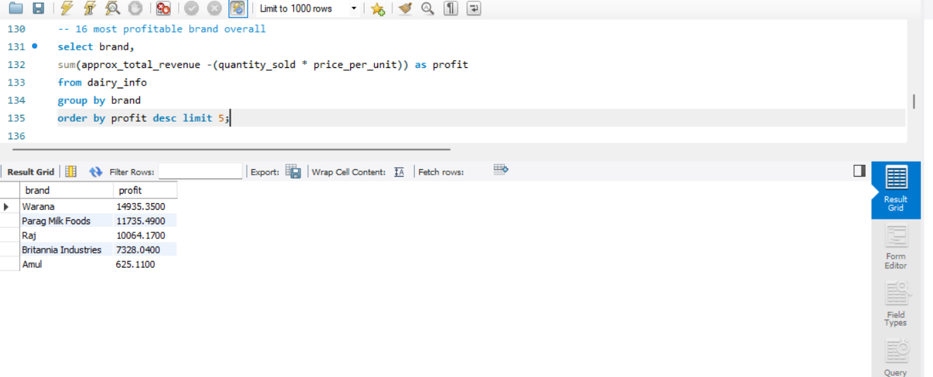
PROFITABILITY BRAND
TOP 5
TOP 1

Slide 20
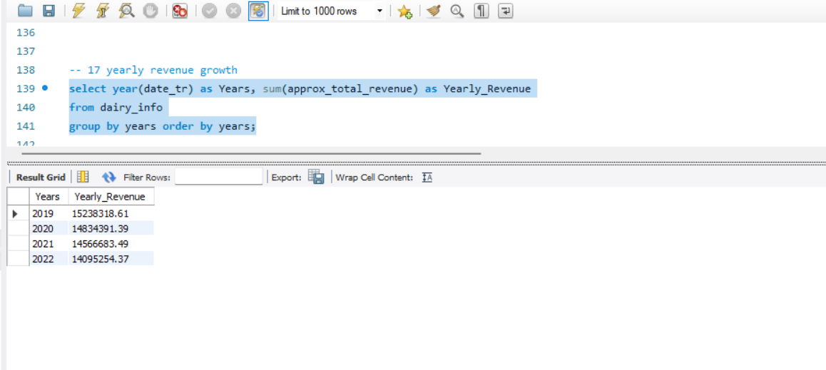
17. Yearly revenue growth

Slide 21
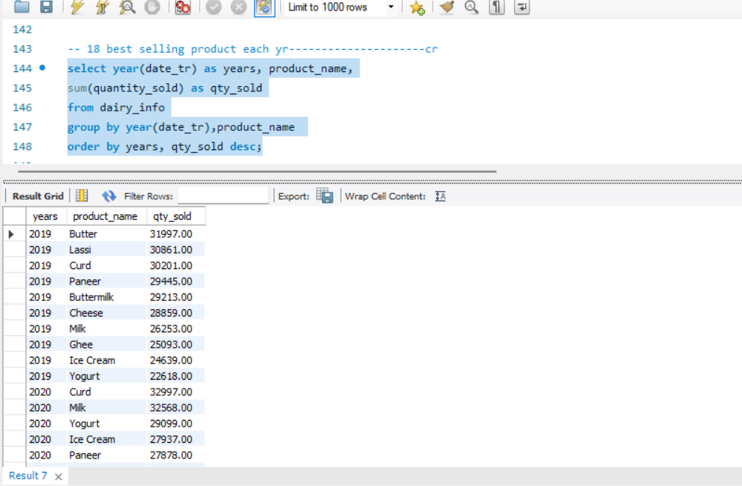
18. Best selling product each yr

Slide 22
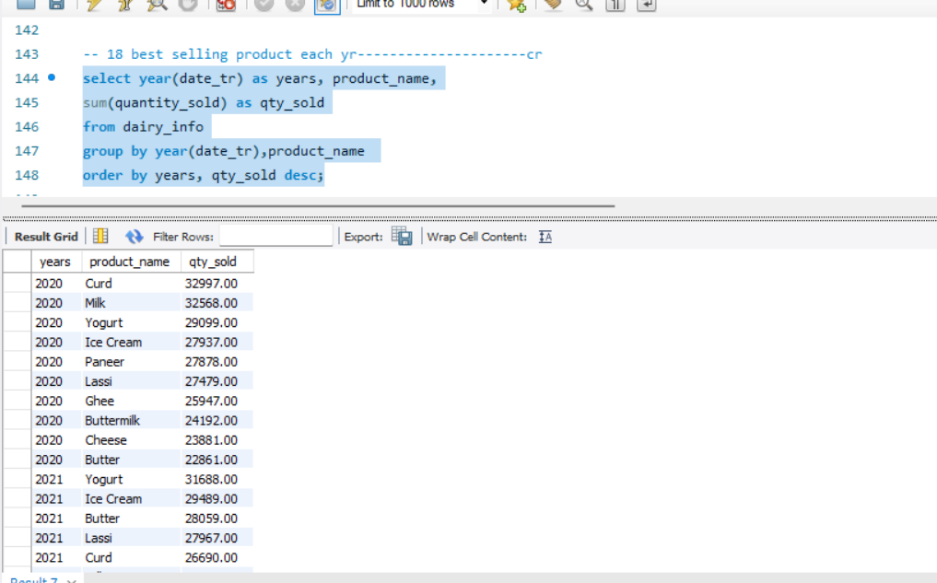
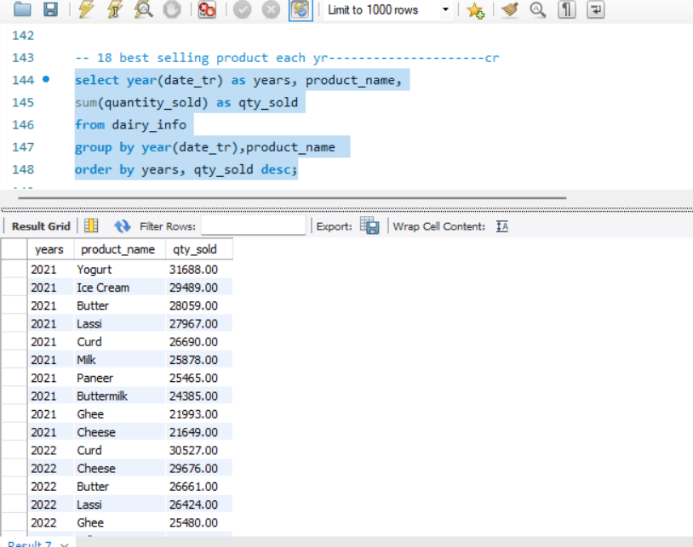
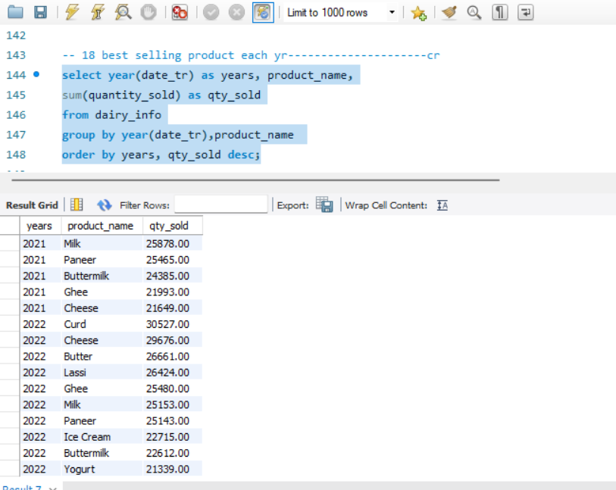
18. Best selling product each yr
IN YEAR 2019 (Butter)
IN YEAR 2020 (CURD)
IN YEAR 2021(YOGURT)
IN YEAR 2022 (CURD)

Slide 23
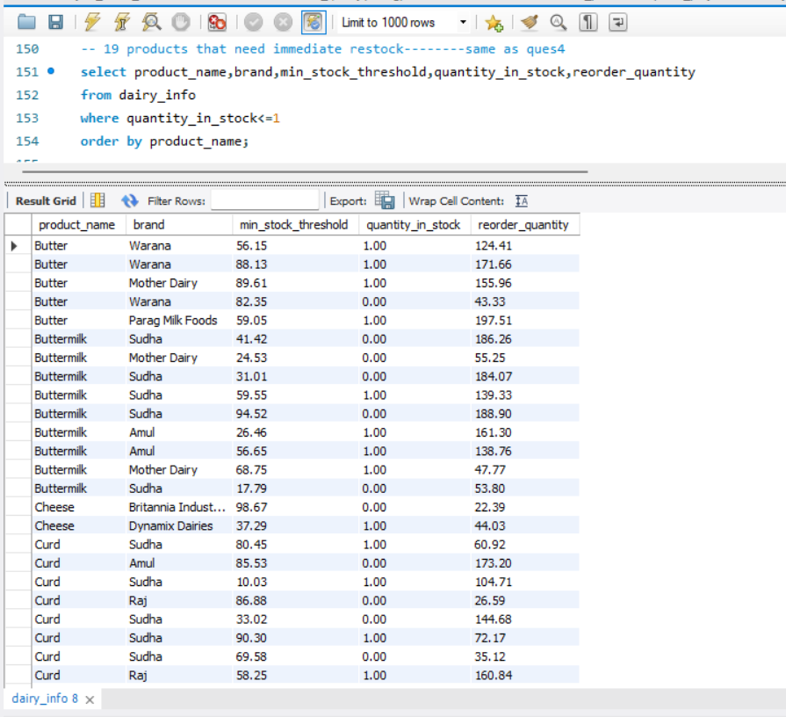
19. Products that need immediate restock

Slide 24
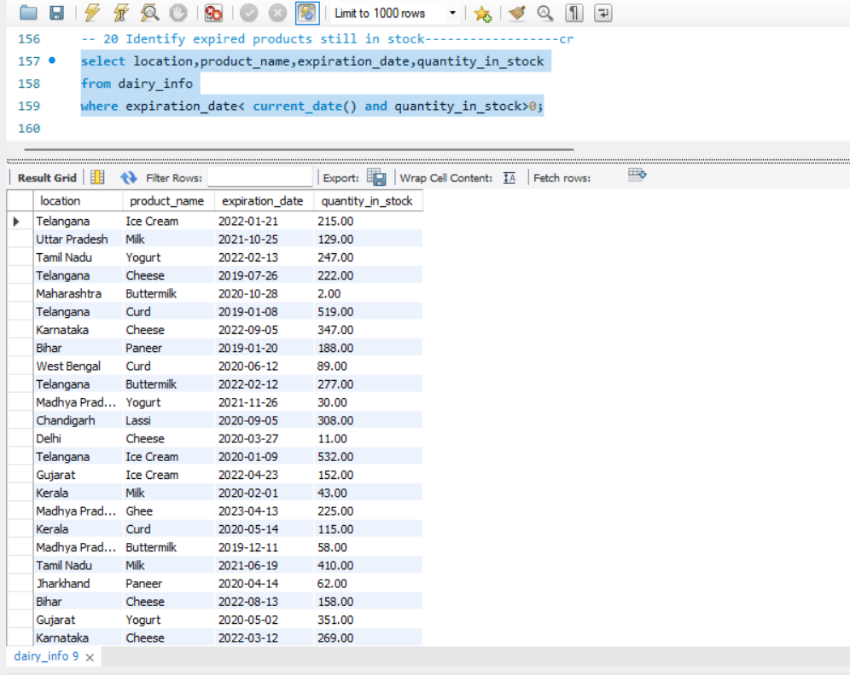
20.Identify expired products still in stock

Slide 25
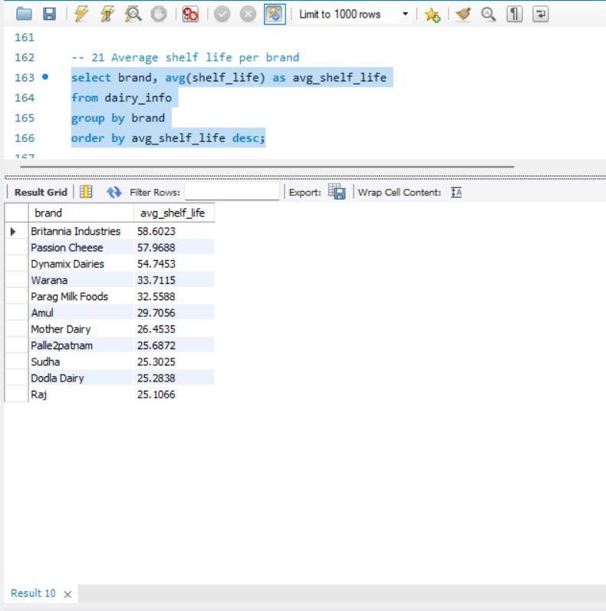
21. Average shelf life per brand

Slide 26
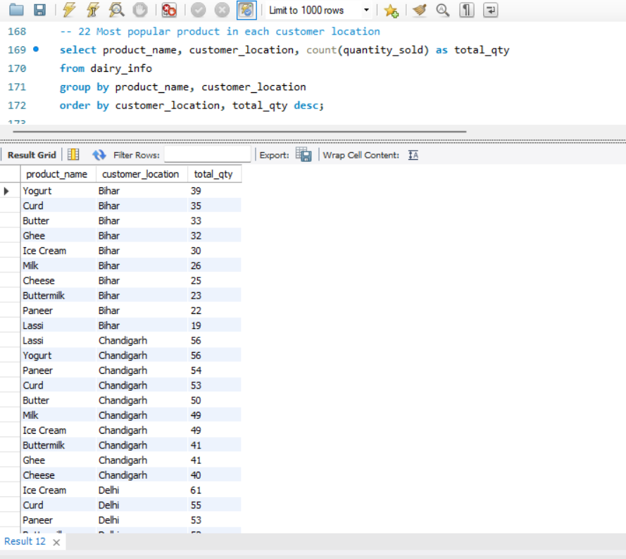
22. Most popular product in each customer location

Slide 27
🎯 Analysis
The product with the highest revenue is Curd.
The brand with the highest revenue is Amul.
The highest revenue was generated in January.
The yearly revenue analysis from 2019 to 2022 shows that 2019 recorded the highest revenue.
The sales channel that generated the most revenue is Retail.
The location with the highest total land area is Delhi, with a total land area of 267,502.01.
The top 3 locations by average quantity sold are:
Tamil Nadu
Madhya Pradesh
Telangana
The Top 5 products with the highest profit are:
Ice Cream
Butter
Milk
Lassi
Buttermilk
The most profitable brand is Warana.

Slide 28
⭐ THANKU

